Slide 1

Major Project Review - V
Project Title: “Revolutionizing Network Security – Blockchain Based Zero Trust Network Access”
Submitted By:
Kola Madhu Latha Reddy - 22B01A0589
Kollu Hruthika Manojhna - 22B01A0591
Malavathu Sowjanyya - 22B01A05A9
Nalluri Harshita - 22B01A05C7
Namburi Akhila - 22B01A05C8
Project Batch No.: 12
Guide:
Name: Dr. A.Seenu
Designation: Professor
Department of Computer Science and Engineering
Shri Vishnu Engineering College for Women (A), Bhimavarm.
Academic Year: 2025 – 2026

Slide 2
Consolidated table showing the modifications
suggested and done from the Review-IV
S.No | Modification suggested (Review-II) | Action Taken/Modification Implemented
1. | What is the outcome? | Outcomes clearly defined as improved security, decentralized access control, tamper-proof logging, and automated policy enforcement.
2. | How much data can a user store and how many users can access the system? | Clarified that only hashed identity credentials and transaction references are stored on-chain. Application scalability depends on blockchain network capacity and backend infrastructure.
3. | Is Ethereum free? Clarify deployment cost. | Specified use of Ethereum test network (Remix environment) for development. Explained gas cost implications for real-world mainnet deployment.

Slide 3
Abstract
This project proposes a Blockchain-Based Zero Trust Network Access (ZTNA) System aimed at eliminating centralized control points and enhancing secure access to network resources in modern distributed environments. Traditional ZTNA architectures rely heavily on centralized identity providers, policy engines, and logging systems, which introduce vulnerabilities such as single points of failure, insider threats, and tampered audit logs.
User and device identities are validated through a distributed ledger, while access policies are enforced automatically using smart contracts without human intervention. The system also supports continuous trust evaluation based on contextual parameters such as device health, behavior, and location.
By decentralizing verification and logging mechanisms, the proposed solution ensures transparency, resilience, and tamper-proof access control, making it suitable for secure, scalable, and cloud-native enterprise environments.

Slide 4
Literature Survey
Author & Year | Area / Technique | Key Contribution | Limitations Identified
NIST (2020) | Zero Trust Architecture (SP 800-207) | Defined core Zero Trust principles and continuous verification model | Relies on centralized policy and identity systems
Rose et al. (2022) | Enterprise Zero Trust | Discussed dynamic authorization and identity validation | Centralized logging remains a risk
Buterin (2023) | Blockchain & Smart Contracts | Introduced decentralized, trustless execution using Ethereum | High latency for real-time enterprise access
Makhdoom et al. (2021) | Blockchain for Cybersecurity | Highlighted immutable logging and decentralized identity | Limited focus on access control
Kong et al. (2024) | Continuous Authentication | Blockchain-enabled continuous trust model | Not fully integrated with ZTNA

Slide 5
Problem Statement
Existing Zero Trust Network Access (ZTNA) mechanisms rely heavily on centralized identity providers, policy engines, and logging databases, making them vulnerable to single points of failure, insider manipulation, and limited audit transparency. In distributed and multi-cloud environments, these centralized components can be compromised, leading to unauthorized access and unreliable access decisions.
Moreover, traditional ZTNA solutions lack trustless verification and tamper-proof audit trails, as access logs can be altered or deleted by privileged insiders. Continuous trust evaluation is often partially implemented and still depends on centralized decision-making entities.
Therefore, there is a critical need for a decentralized, transparent, and verifiable access control system that enforces Zero Trust principles through blockchain-based identity verification, smart contract–driven policy enforcement, and immutable audit logging, without relying on a single controlling authority.

Slide 6
Research Objectives
To design a Blockchain-based Zero Trust Network Access (ZTNA) system for secure data access.
To implement smart contracts using Solidity for decentralized and automated access control.
To ensure tamper-proof storage of user activities and access logs using Ethereum blockchain.
To apply Attribute-Based Access Control (ABAC) for fine-grained and context-aware authorization.
To protect sensitive data using AES encryption before storage and transmission.
To develop and integrate a Django-based backend for secure interaction between users and the blockchain.

Slide 7
Proposed Solution (Finalized)
The system redesigns Zero Trust access by shifting verification and decision-making from centralized servers to a distributed control model. Instead of relying on a single authority, access validation is executed through a decentralized framework that ensures transparency and integrity.
The design emphasizes:
Separation of trust validation from traditional identity servers
Cryptographic assurance of access integrity
Autonomous rule execution without manual oversight
Transparent verification of access activities
High availability through distributed architecture

Slide 8
Methodology
The development process followed a structured research and implementation pipeline:
1. Analyzed structural limitations of existing Zero Trust models.
2. Designed a distributed security architecture based on decentralized validation.
3. Modeled system components and interaction layers.
4. Implemented programmable governance logic within a blockchain environment.
5. Integrated adaptive risk assessment for dynamic authorization.
6. Conducted testing and validation to evaluate reliability and security.

Slide 9
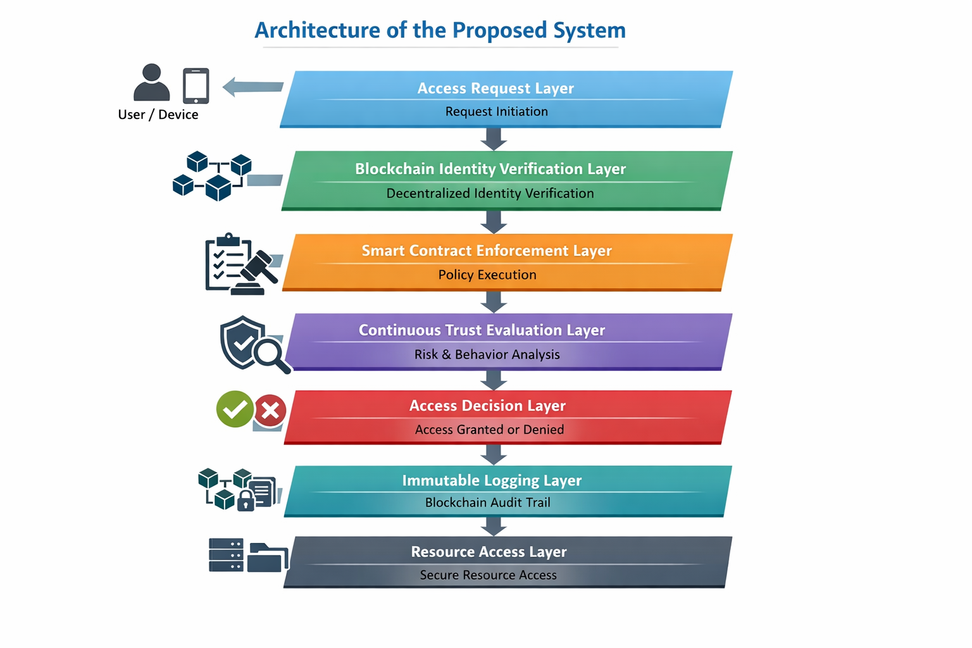
Architecture of the Proposed System
The proposed Blockchain-Based ZTNA System is designed as a layered architecture to enforce Zero Trust principles with decentralized verification and immutable auditing.

Slide 10
System Modules
The system is structured into independent but interconnected functional layers:
Credential Registration & Verification Layer
- Manages secure onboarding and validation of user and device credentials.
2. Policy Governance Engine
- Encodes and evaluates authorization rules in a programmable environment.
3. Contextual Risk Assessment Unit
- Computes dynamic trust levels using behavioral and environmental inputs.
4. Authorization Controller
- Determines final access outcome based on validation and risk metrics.
5. Distributed Activity Recorder
- Maintains verifiable and tamper-resistant access event records.
6. Secure Access Gateway
- Acts as the enforcement interface between users and protected resources.

Slide 11
System Design of the Proposed Solution
The system design of the Blockchain-Based Zero Trust Network Access (ZTNA) System defines how the proposed components interact to deliver secure, decentralized, and continuous access control. The design translates the architectural layers into implementable modules and workflows using UML diagrams for clarity.
UML diagrams are used to visually represent:
User interaction with the ZTNA system.
Access request processing flow.
Decision-making based on identity, policy, and trust score.

Slide 12
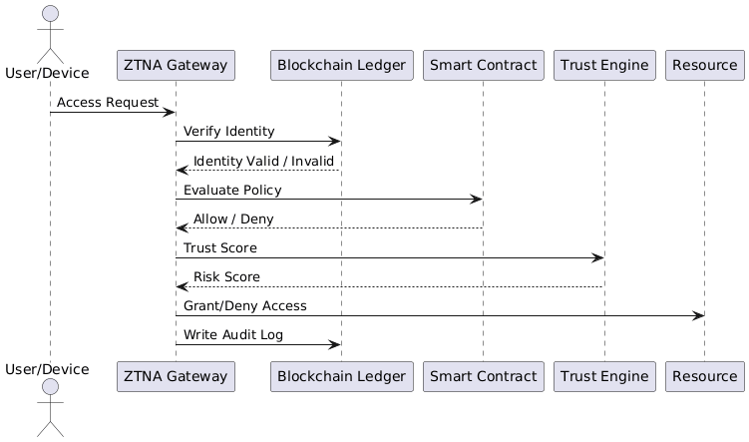
System Design of the Proposed Solution

Slide 13
Implementation of the Proposed Work
The proposed Blockchain-Based Zero Trust Network Access (ZTNA) System is implemented to provide decentralized identity verification, smart contract–based policy enforcement, continuous trust evaluation, and immutable audit logging.
Tools & Tech :
Blockchain: Ethereum
Smart Contracts: Solidity
Backend/API: Python Django
Testing: Remix

Slide 14
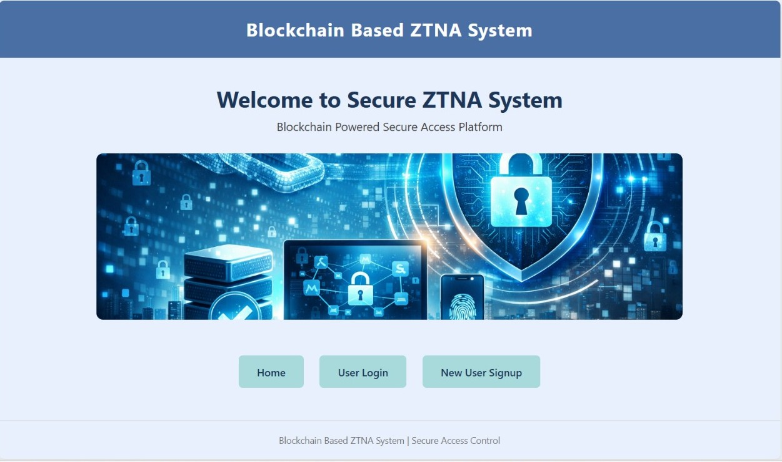
Implementation of the Proposed Work

Slide 15
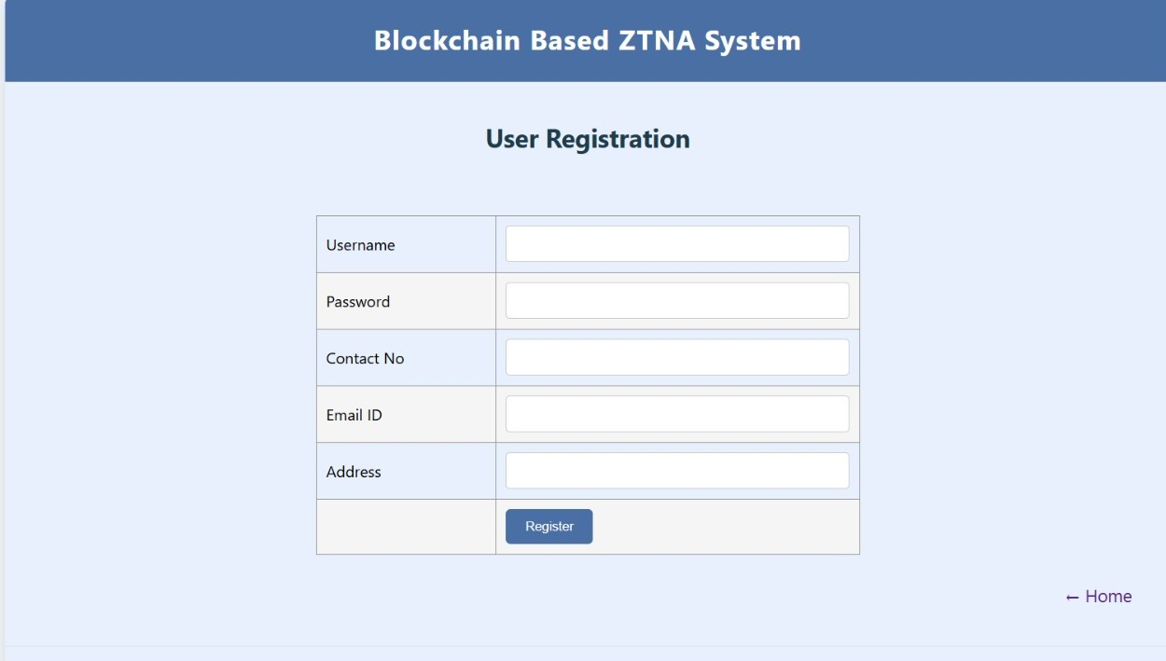
Implementation of the Proposed Work

Slide 16
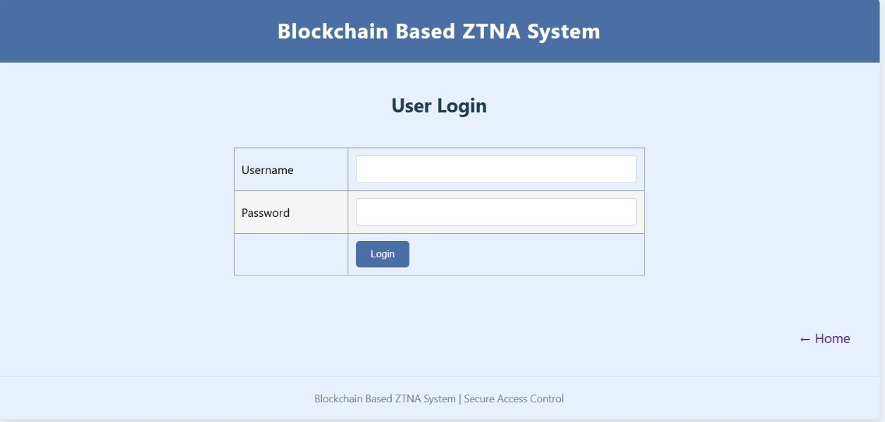
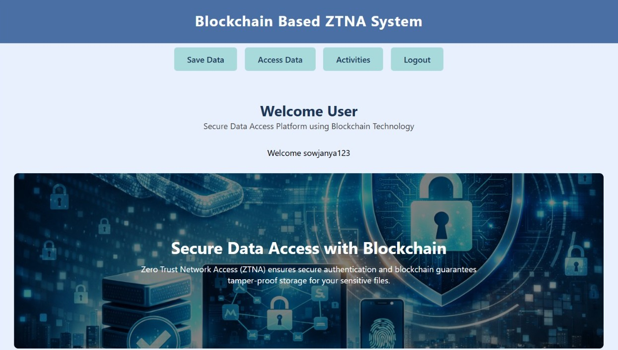
Implementation of the Proposed Work

Slide 17
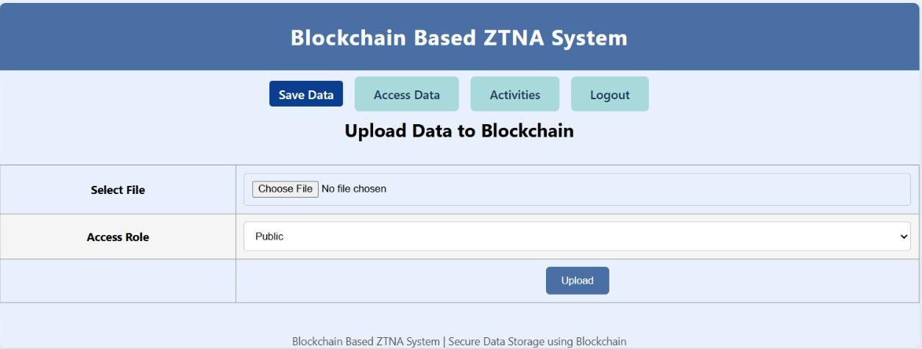
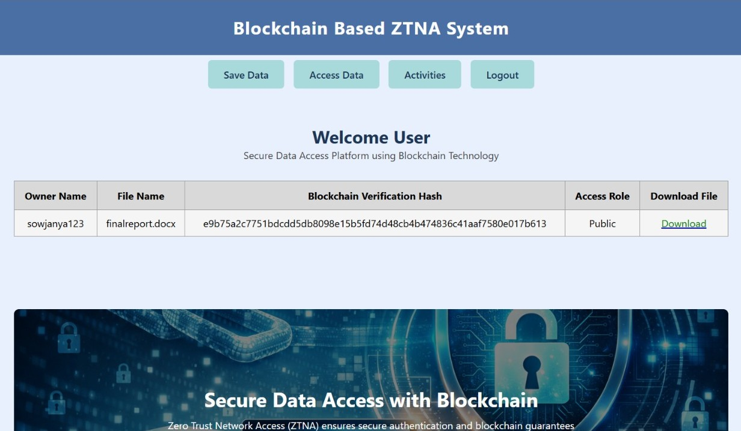
Implementation of the Proposed Work

Slide 18
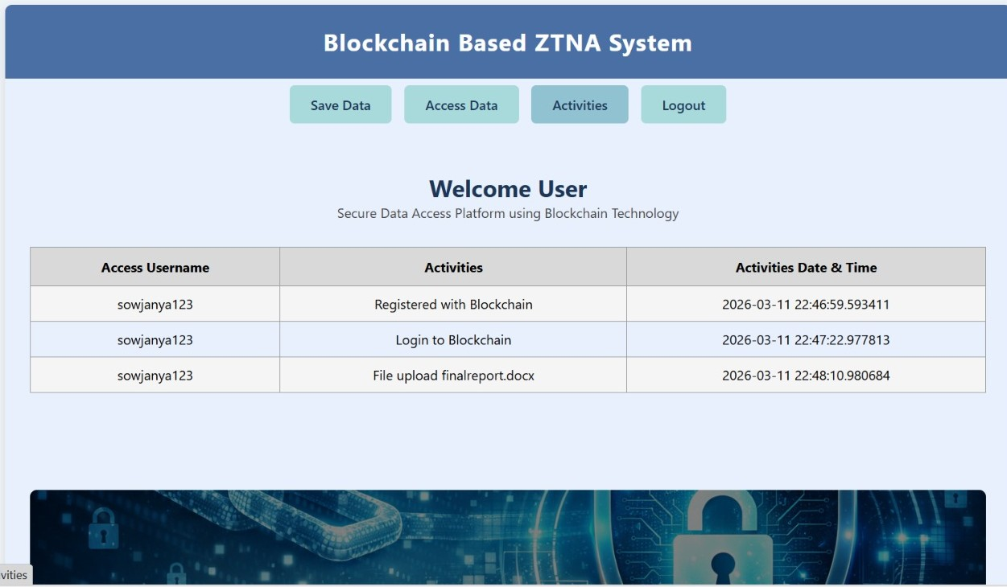
Implementation of the Proposed Work

Slide 19
Existing vs Proposed Solution
Existing ZTNA | Proposed Blockchain-Based ZTNA
Centralized identity and policy control | Distributed validation mechanism
Prone to single point of failure | No dependency on single authority
Limited transparency in decisions | Verifiable and tamper-resistant access control
Suitable for traditional enterprise setups | Designed for distributed and cloud environments

Slide 20
References
National Institute of Standards and Technology. (2020). Zero trust architecture (NIST SP 800-207). U.S. Department of Commerce. https://doi.org/10.6028/NIST.SP.800-207
Rose, S., Borchert, O., Mitchell, S., & Connelly, S. (2022). Zero trust principles for enterprise security. Journal of Cybersecurity and Digital Trust, 6(2), 45–59.
Kindervag, J. (2021). The evolution of zero trust security frameworks. Cyber Defense Review, 9(1), 33–47.
Buterin, V. (2014). Ethereum: A next-generation smart contract and decentralized application platform. Ethereum Foundation. https://ethereum.org
Makhdoom, I., Zhou, I., Abolhasan, M., Lipman, J., & Ni, W. (2021). Blockchain for cybersecurity and the Internet of Things: Challenges, opportunities, and solutions. IEEE Communications Surveys & Tutorials, 23(2), 1382–1408. https://doi.org/10.1109/COMST.2021.3054841
Christidis, K., & Devetsikiotis, M. (2016). Blockchains and smart contracts for the Internet of Things. IEEE Access, 4, 2292–2303. https://doi.org/10.1109/ACCESS.2016.2566339
Ouaddah, A., Elkalam, A. A., & Ouahman, A. A. (2022). FairAccess: A blockchain-based access control framework for IoT. Future Generation Computer Systems, 120, 62–77. https://doi.org/10.1016/j.future.2021.12.004
Singh, A., Sharma, P., & Gupta, N. (2023). Enhancing Zero Trust Network Access using blockchain-based identity verification. International Journal of Information Security Research, 13(4), 214–223.
Kong, L., Qin, Z., & Li, F. (2024). A blockchain-enabled continuous authentication model for zero trust architectures. IEEE Transactions on Dependable and Secure Computing, 21(1), 89–102. https://doi.org/10.1109/TDSC.2023.3264920
Khan, M., Rehman, S., & Iqbal, Z. (2023). Immutable audit trails using blockchain for enterprise access control. Computers & Security, 128, 103201. https://doi.org/10.1016/j.cose.2023.103201

