Slide 1

Design of 4x4 bit Content-Addressable Memory (CAM)
Presented by,
Suryatej Datla
Manas Shah
Swati Sajee Kumar

Slide 2
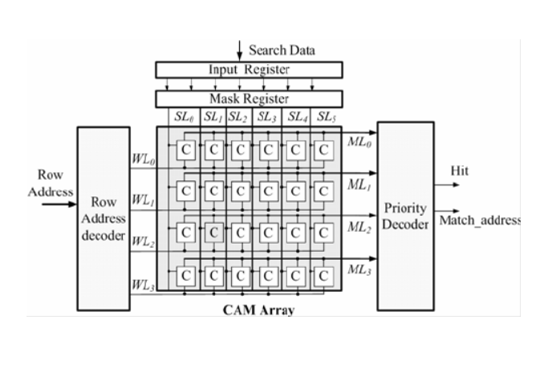
What is a Content Addressable Memory?
CAMs => SRAM + A Comparison Circuitry (in a single clock cycle)
It is an address lookup function
It can be of two types Binary CAM or Ternary CAM
Figure 1: Block diagram od CAM

Slide 3
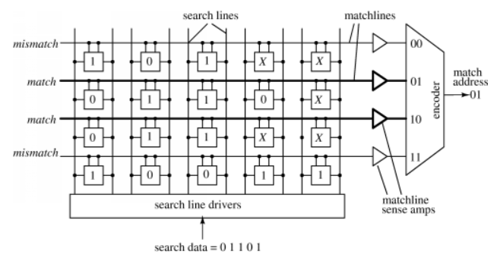
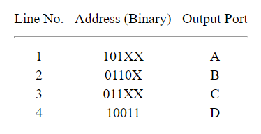
What is a TCAM ?
Figure 2 : 5x4 TCAM

Slide 4
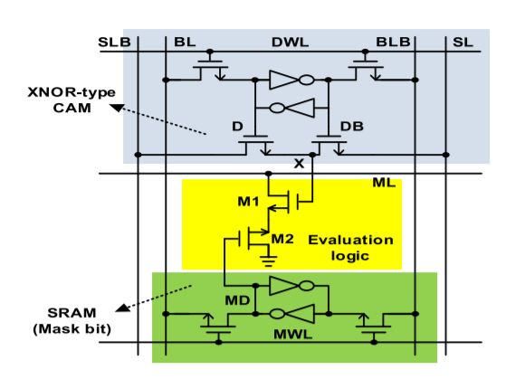
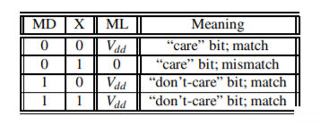
Working of a TCAM Cell
0
1
1
0
1
0
1
1
0
0
PRECHARGE
High
0
1
0
0
1
1
1

Slide 5
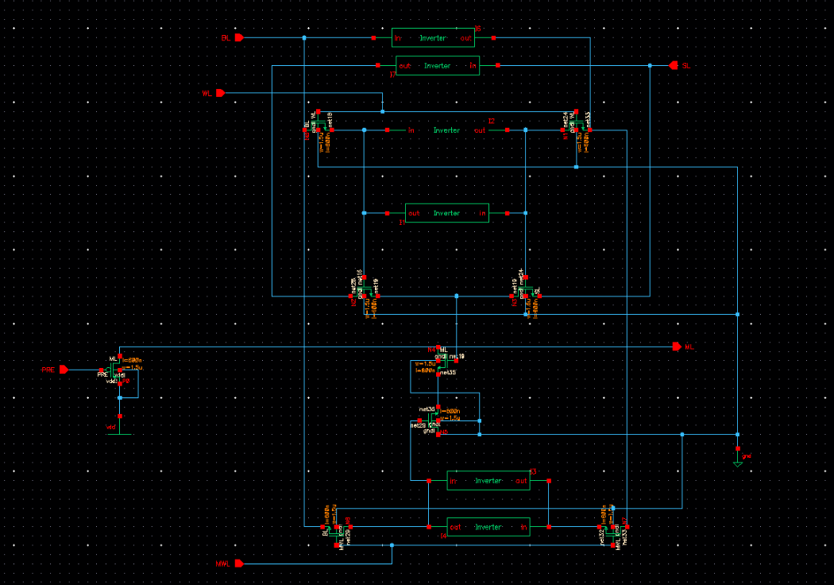
Schematic View Of a Single Bit TCAM Cell

Slide 6
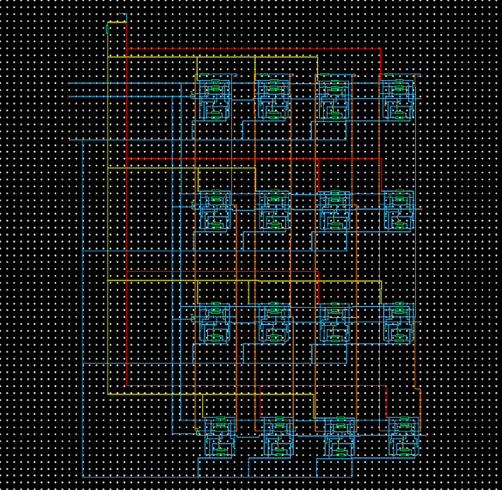
Schematic View of 4x4 bit TCAM
SEARCH DATA →
1 1 0 0
DATA STORED
1 1 1 0
ML_1
ML_2
1 1 0 0
ML_3
1 1 0 1
ML_4
1 0 1 0

Slide 7
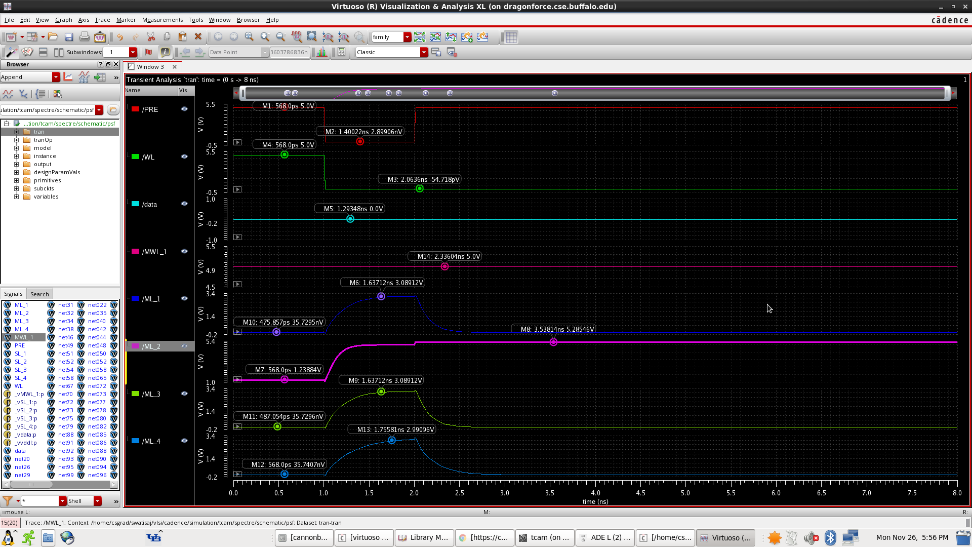
Simulation Results of 4x4 bit TCAM

Slide 8
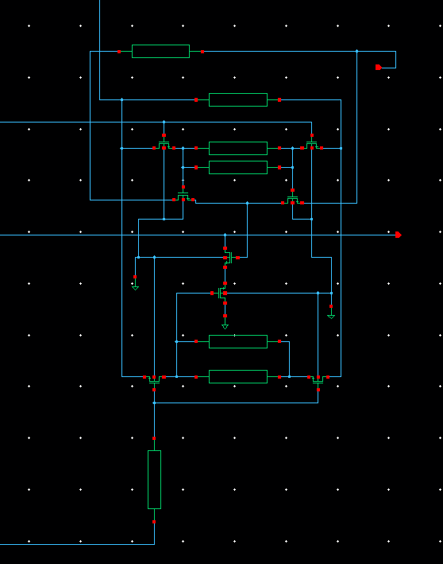
Schematic for masked 4x4 bit TCAM
DATA STORED
1 1 1 0
ML_1
1 1 X X
ML_2
1 1 X 0
ML_3
MWL=0
1 0 1 0
ML_4
SEARCH DATA →
1 1 0 0

Slide 9
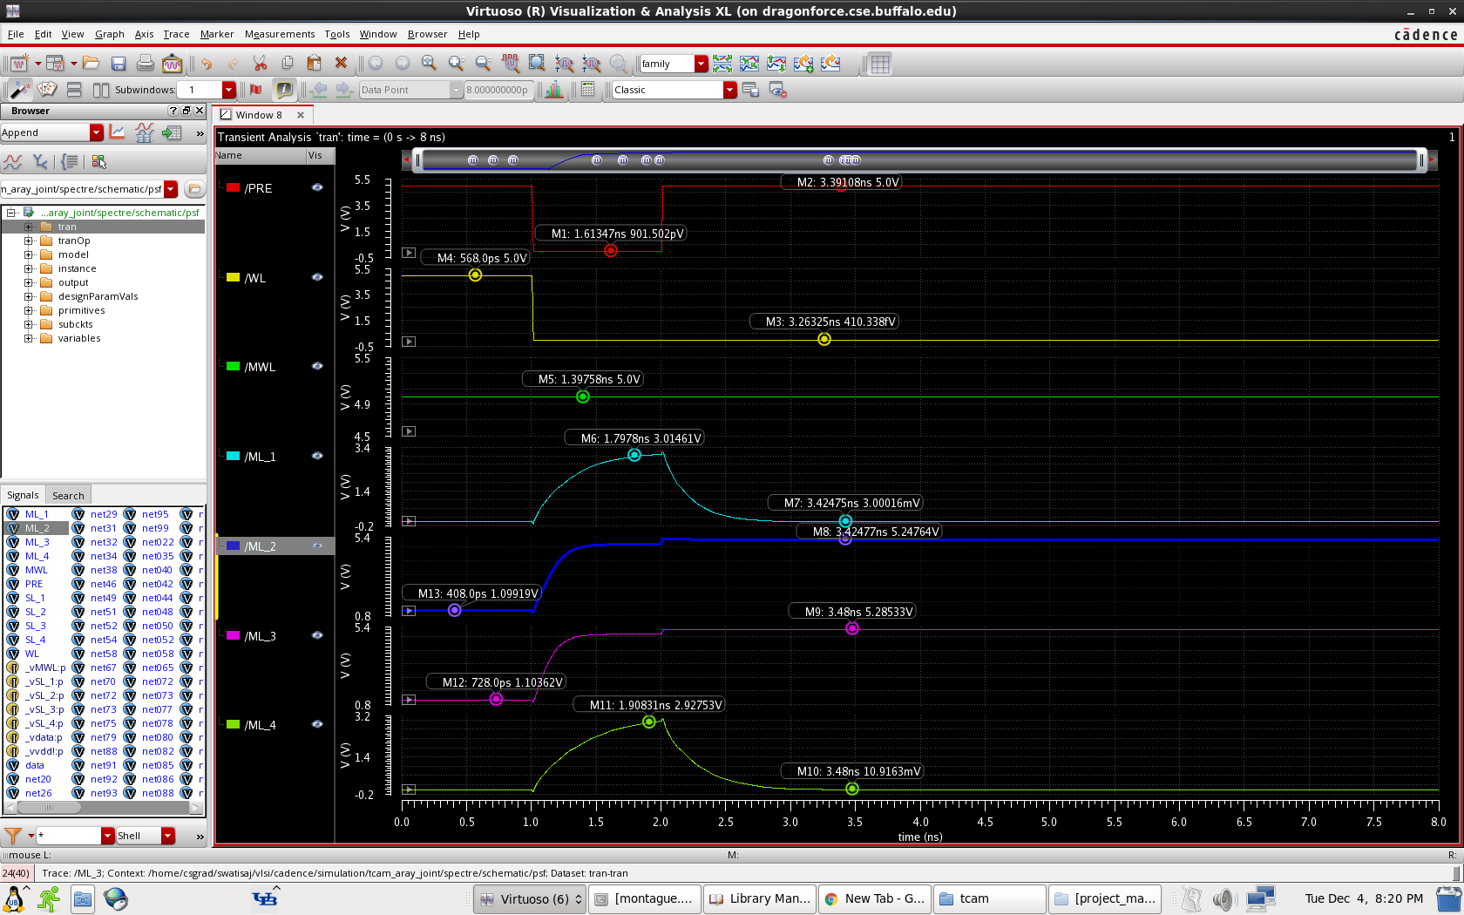
Simulation Results for masked 4x4 bit TCAM

Slide 10
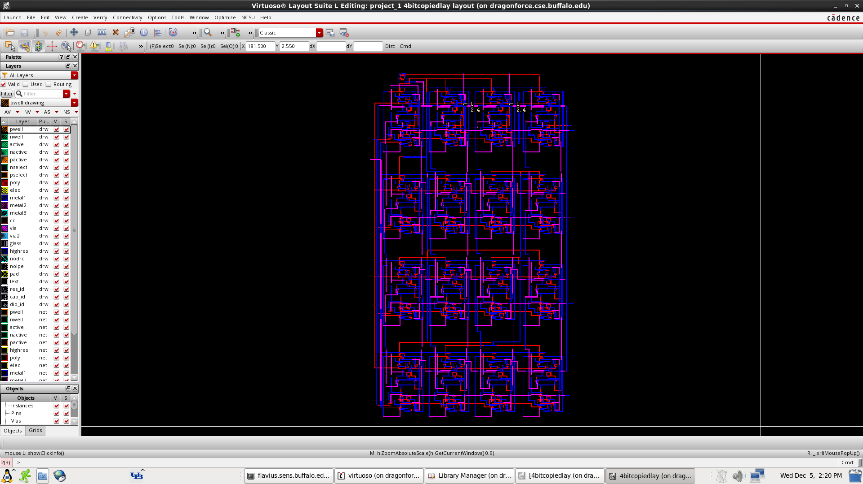
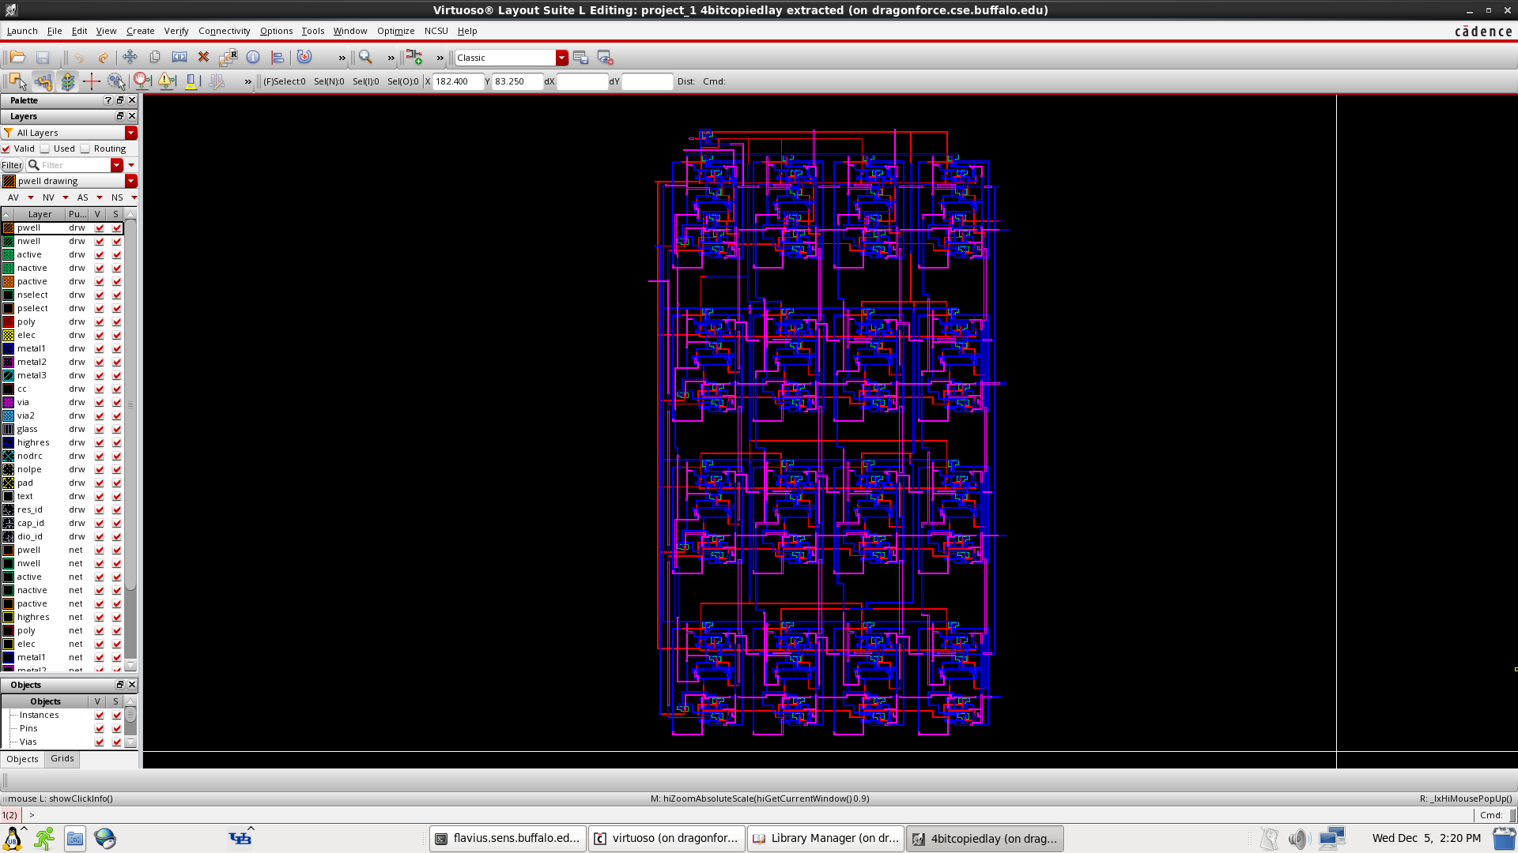
Layout and Extracted View for 4x4 bit TCAM

Slide 11
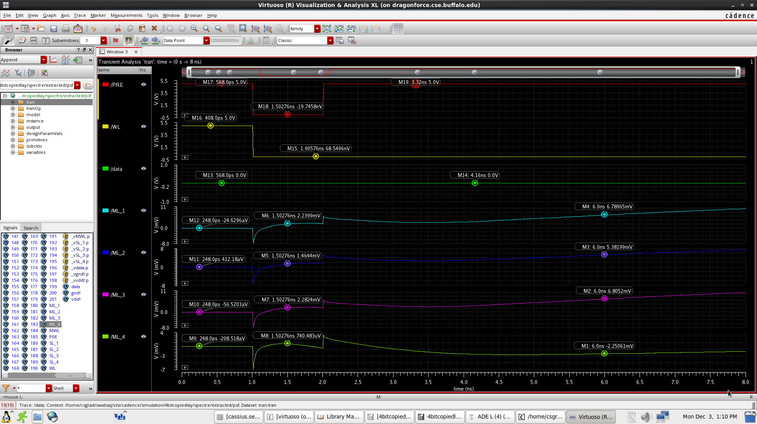
Simulation Results for the Extracted View
UNDESIRED!

Slide 12
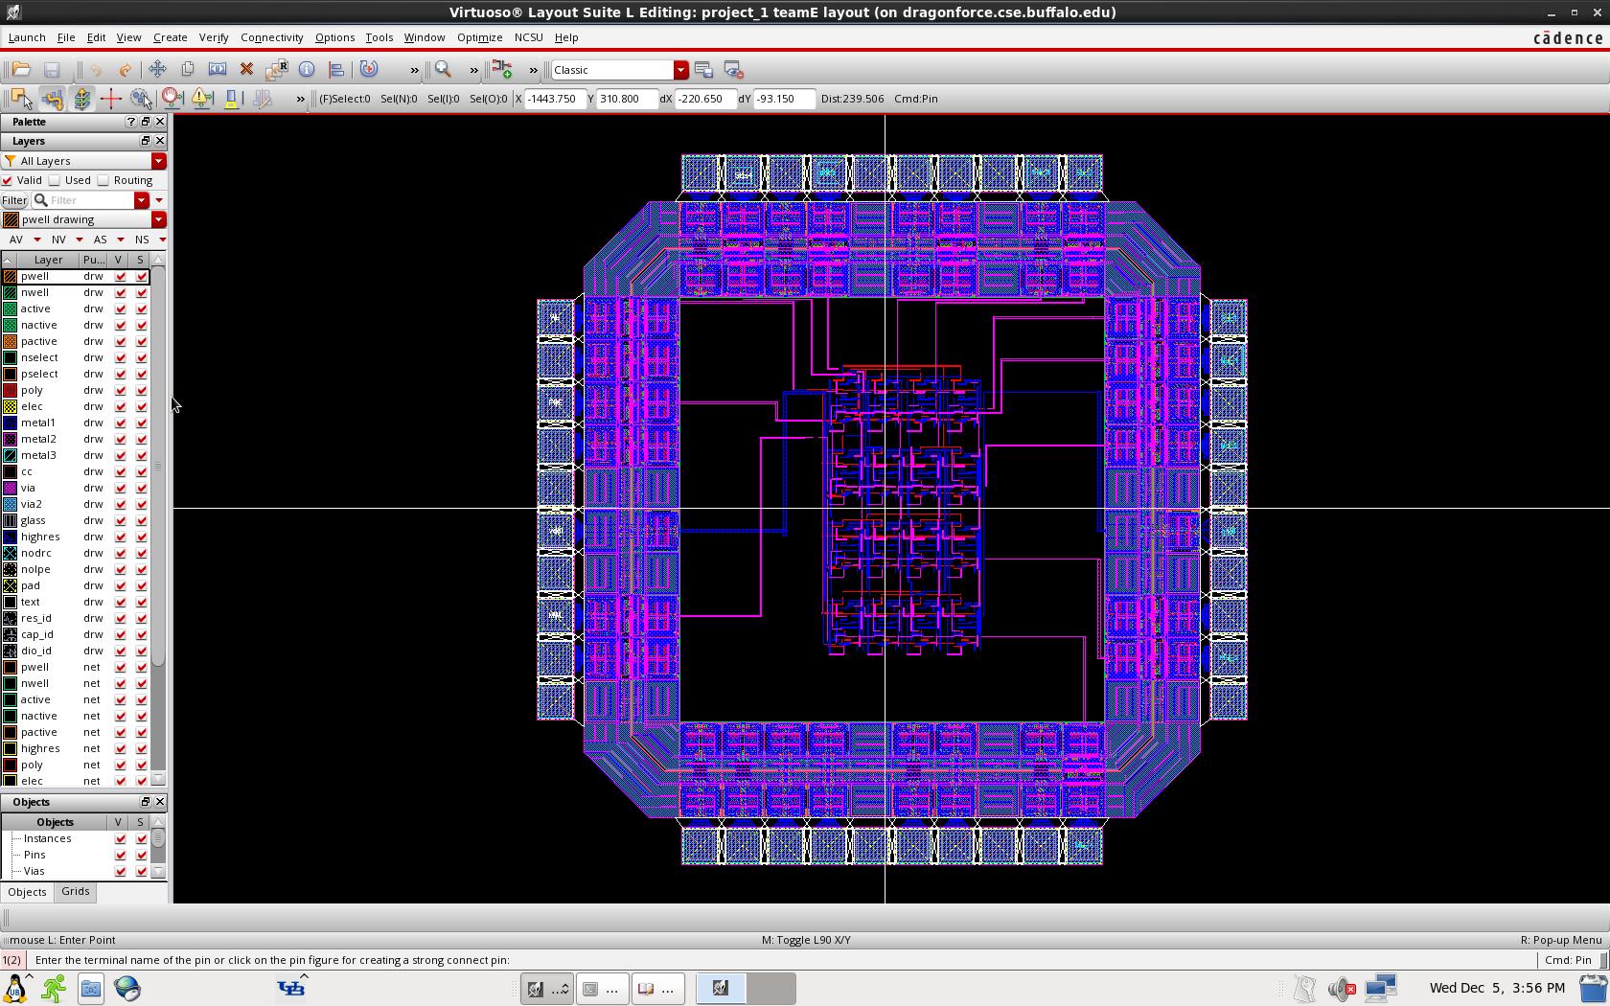
4x4 bit TCAM in Pad Frame

Slide 13
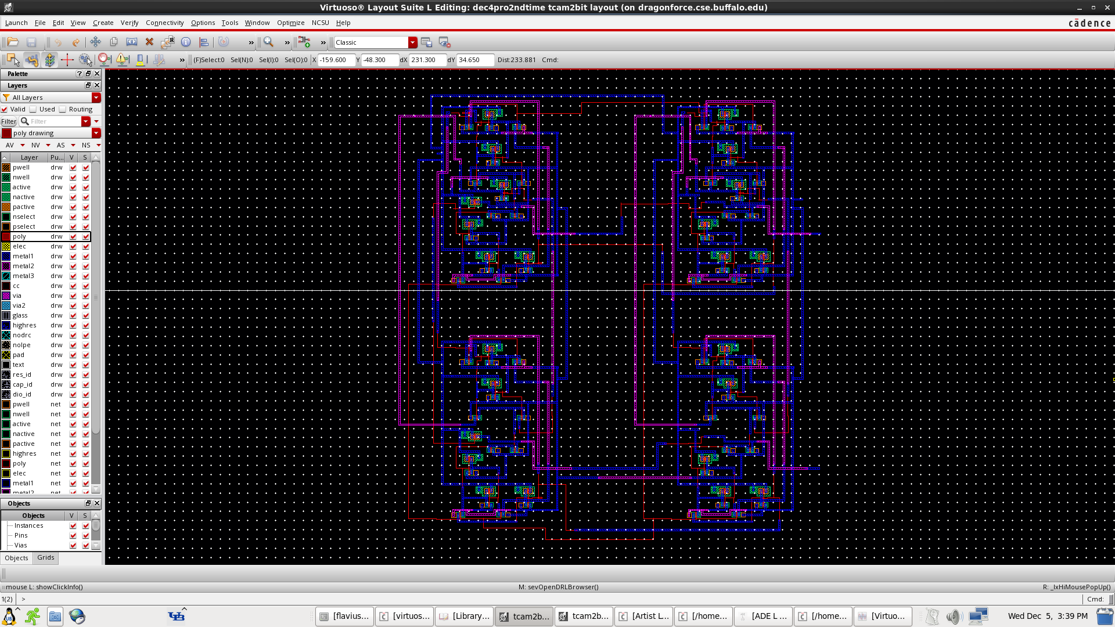
Layout for 2x2 bit TCAM
DATA
M_1
HIGH!
0 0
M_2
1 1
SEARCH DATA → 0 0

Slide 14
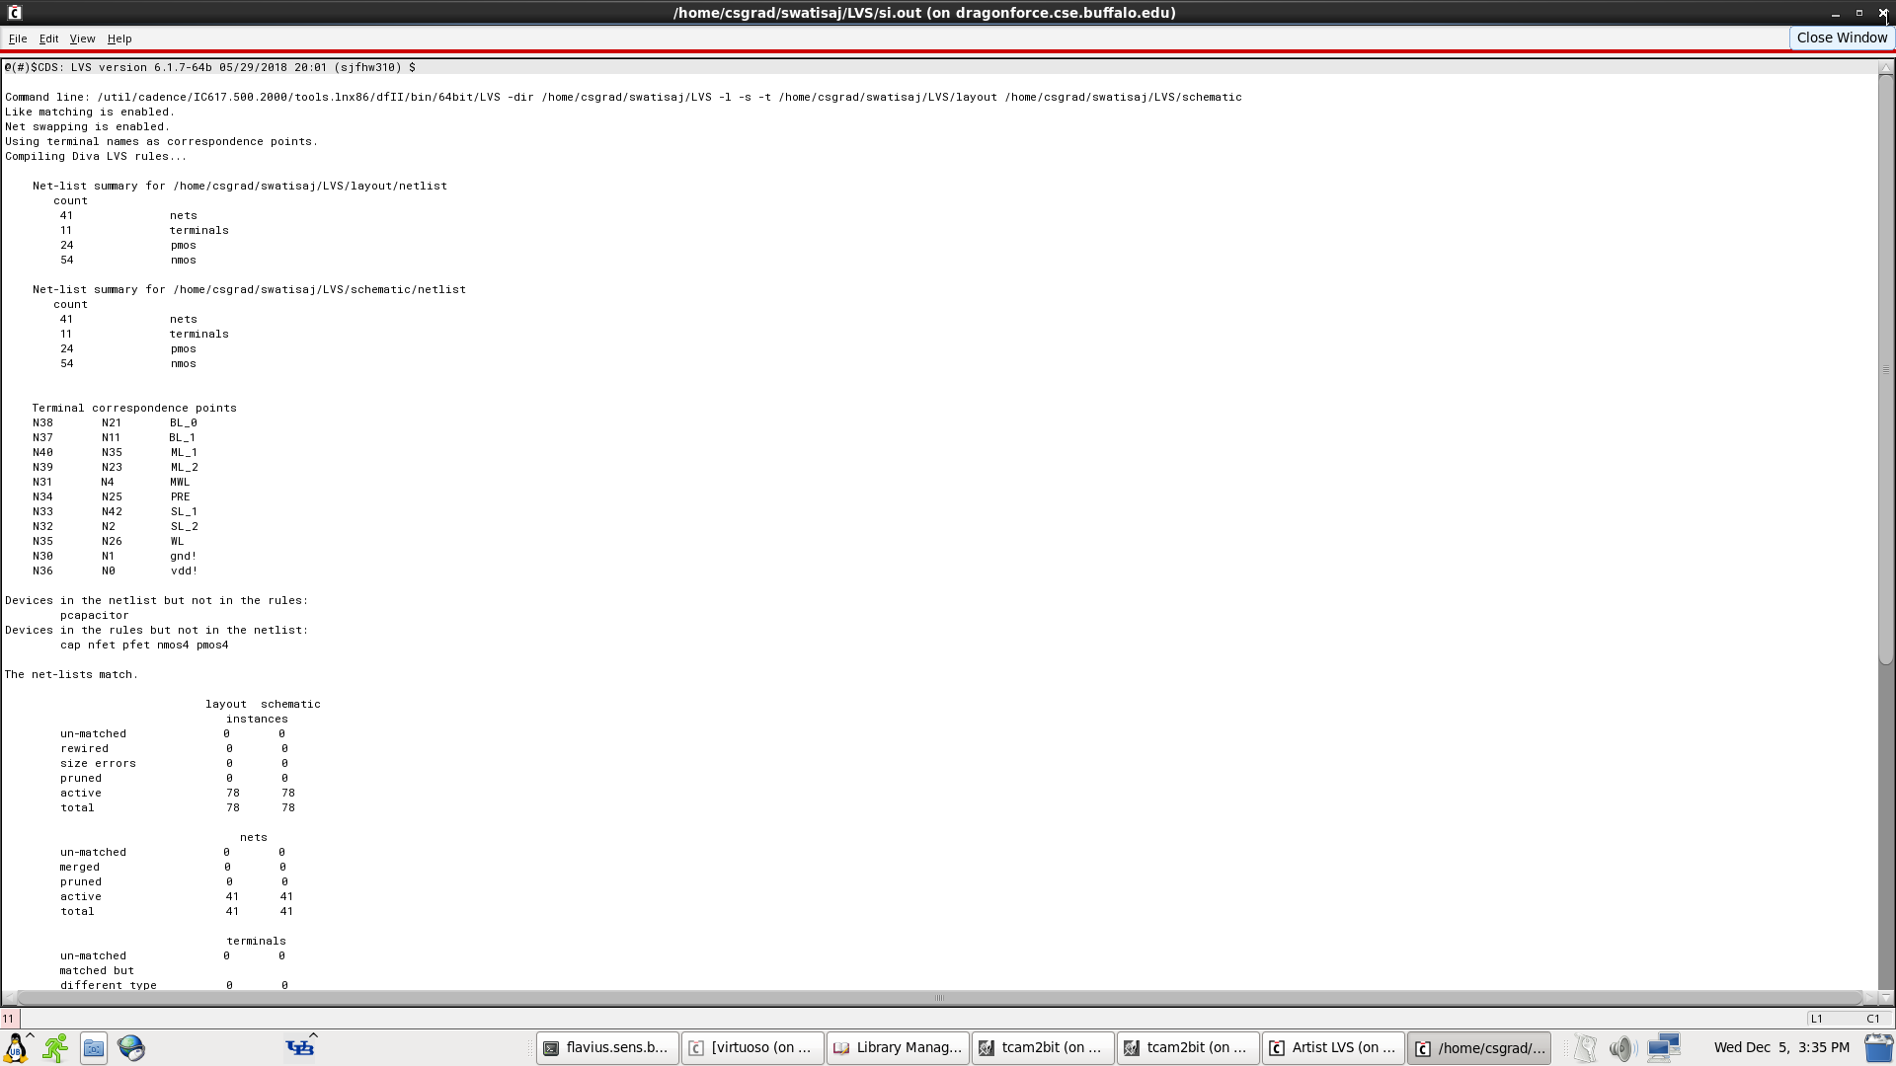
LVS MATCHED!

Slide 15
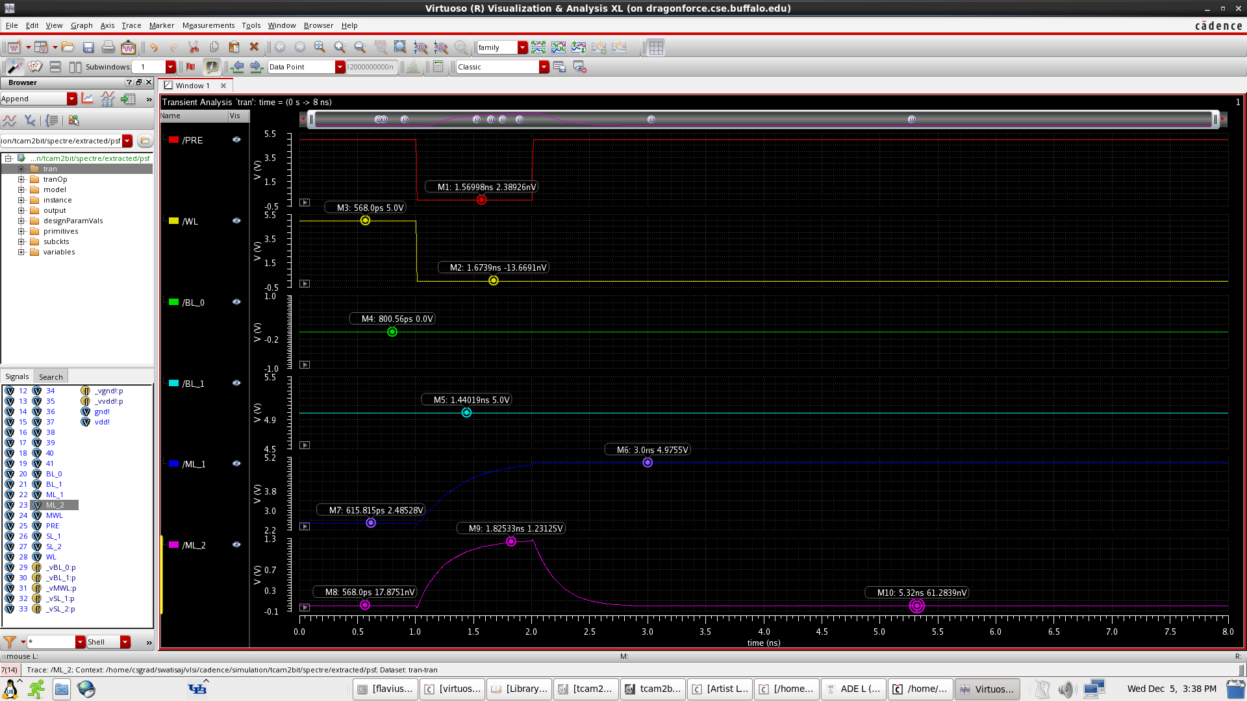
SIMULATION OUTPUT FOR EXTRACTED VIEW OF 2X2 BIT TCAM
SEARCH DATA → 0 0
0 0
1 1

Slide 16
Advantages of TCAM over Software based approaches
Software based approaches eg: Binary Search
Drawbacks: Look up table must be ordered
Complexity : O(log n) where n is number of total bits
CAM can be of two types Binary CAM and TCAM
The max complexity is : O(l) where l is the length of word line
TCAM has an evaluation circuit reducing the search time.

Slide 17
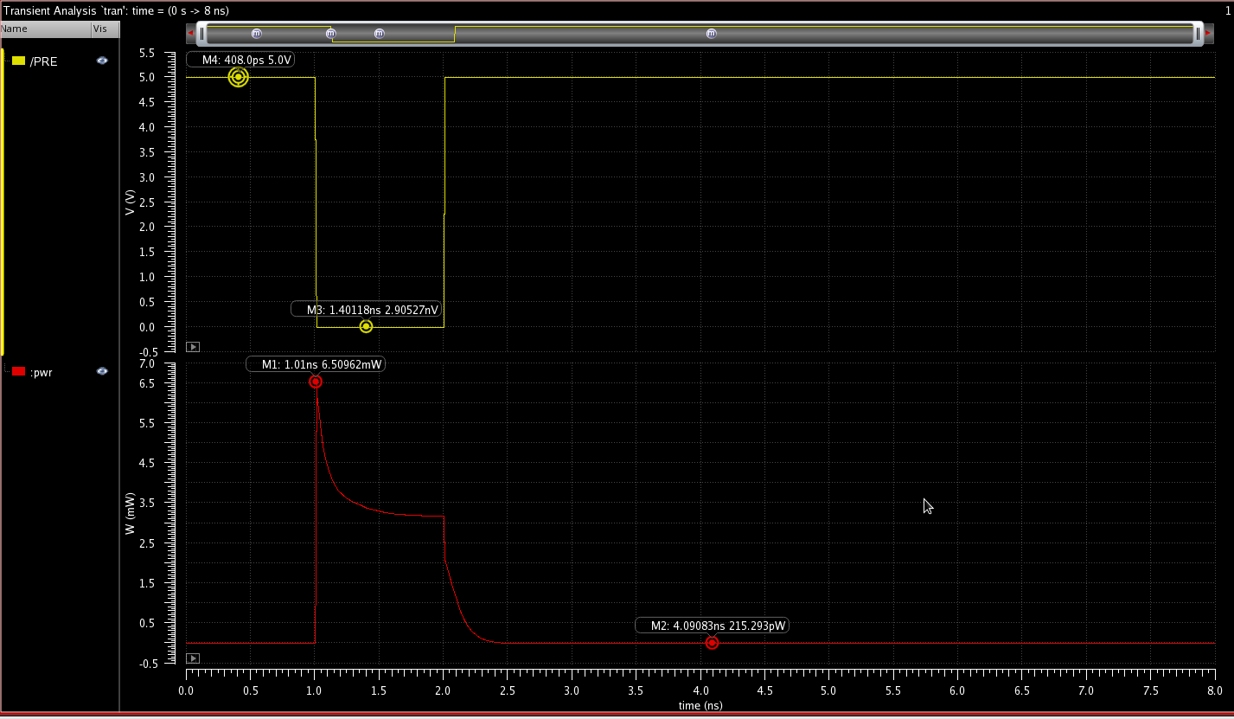
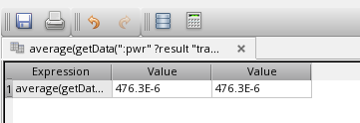
Drawback of TCAM
The fully parallel nature of search operation cause high power consumption ! compared to RAM
6.50962mW
Fig: Graph showing total power consumption

Slide 18
Conclusion and Future Scope Of TCAM
TCAM can highly be used in industries where speed is the major concern. For example in routers, switches, and IOT devices
In order to reduce the power consumption of TCAM for its profound use in hardware:
Selective pre-charging of match line
By minimizing the signal swing in the match line either by reducing the pre-charge and discharge levels
Implementing various architectures such as Butterfly TCAM , Ripple pre-charge TCAM to decrease the power consumption

Slide 19
REFRENCES
[1] A. Agarwal, D. Blaauw, S. Sundareswaran, V. Zolotov, M. Zhou,K. Gala, and R. Panda. Path-based statistical timing analysis considering inter and intra-die correlations. In Workshop on Timing Issues in the Specification and Synthesis of Digital Systems (TAU), June 2002.
[2] D. Brooks, P. Bose, V. Srinivasan, M. Gschwind, P. G. Emma, and M. G. Rosenfield. New methodology for early-stage, micro architecturelevel power-performance analysis of microprocessors. IBM Journal of Research and Development, 47(5/6), 2003.
[3] D. Brooks, V. Tiwari, and M. Martonosi. Wattch: A framework for architectural-level power analysis and optimizations. In 27th Annual International Symposium on Computer Architecture, June 2000.
[4] J. A. Butts and G. S. Sohi. A static power model for architects. In 33rd IEEE/ACM International Symposium on Microarchitecture, Dec. 2000.
[5] M. Q. Do, M. Drazdziulis, P. Larsson-Edefors, and L. Bengtsson. Parameterizable architecture-level SRAM power model using circuitsimulation backend for leakage calibration. In International Symposium on Quality Electronic Design, Mar. 2006

Slide 20
Thank You !

Slide 21
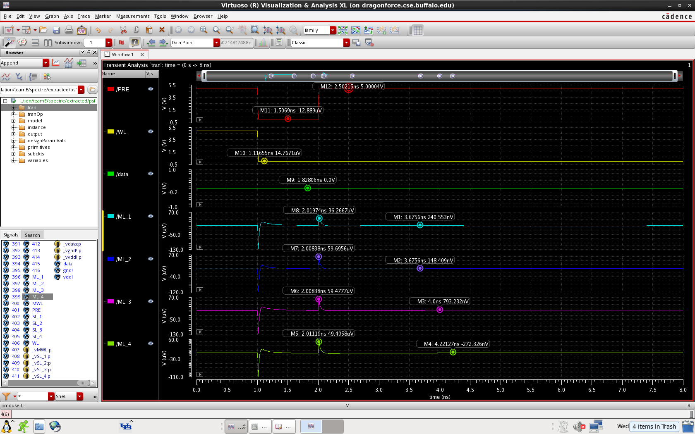
Pad Frame Output

