Slide 1
Hashing
Dashiell Fryer
CS 157B
Dr. Lee

Slide 2
Contents
Static Hashing
  File Organization
  Properties of the Hash Function
  Bucket Overflow
  Indices
Dynamic Hashing
  Underlying Data Structure
  Querying and Updating
Comparisons
  Other types of hashing
  Ordered Indexing vs. Hashing

Slide 3
Static Hashing
Hashing provides a means for accessing data without the use of an index structure.
Data is addressed on disk by computing a function on a search key instead.

Slide 4
Organization
A bucket in a hash file is unit of storage (typically a disk block) that can hold one or more records.
The hash function, h, is a function from the set of all search-keys, K, to the set of all bucket addresses, B.
Insertion, deletion, and lookup are done in constant time.

Slide 5
Querying and Updates
To insert a record into the structure compute the hash value h(K_{i}), and place the record in the bucket address returned.
For lookup operations, compute the hash value as above and search each record in the bucket for the specific record.
To delete simply lookup and remove.

Slide 6
Properties of the Hash Function
The distribution should be uniform.
  An ideal hash function should assign the same number of records in each bucket.
The distribution should be random.
  Regardless of the actual search-keys, the each bucket has the same number of records on average
  Hash values should not depend on any ordering or the search-keys

Slide 7
Bucket Overflow
How does bucket overflow occur?
  Not enough buckets to handle data
  A few buckets have considerably more records then others. This is referred to as skew.
    Multiple records have the same hash value
    Non-uniform hash function distribution.

Slide 8
Solutions
Provide more buckets then are needed.
Overflow chaining
  If a bucket is full, link another bucket to it. Repeat as necessary.
  The system must then check overflow buckets for querying and updates. This is known as closed hashing.

Slide 9
Alternatives
Open hashing
  The number of buckets is fixed
  Overflow is handled by using the next bucket in cyclic order that has space.
    This is known as linear probing.
Compute more hash functions.
Note: Closed hashing is preferred in database systems.

Slide 10
Indices
A hash index organizes the search keys, with their pointers, into a hash file.
Hash indices never primary even though they provide direct access.

Slide 11
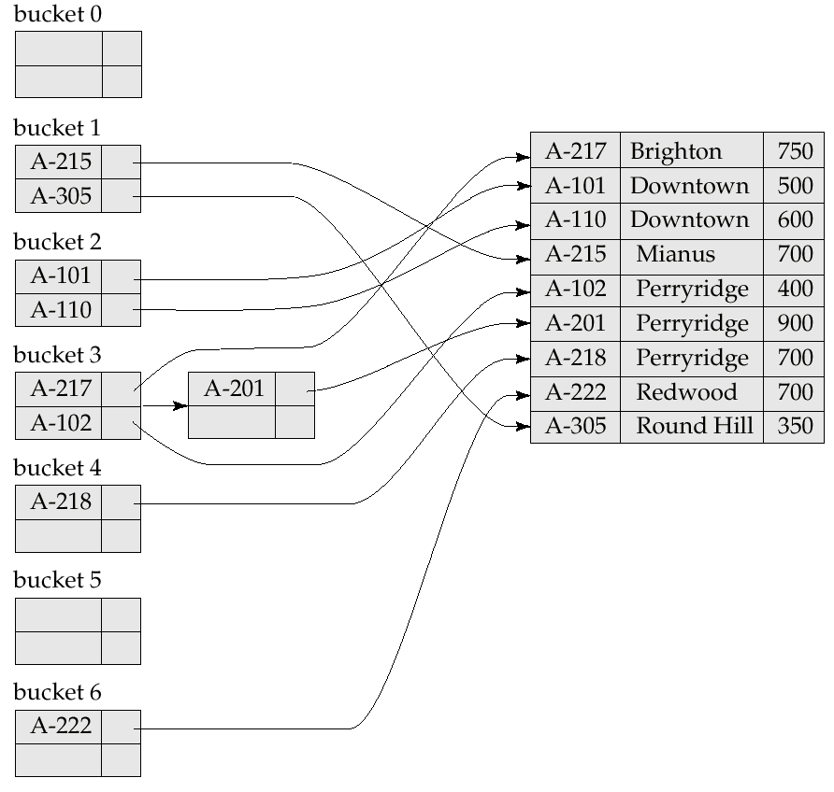
Example of Hash Index

Slide 12
Dynamic Hashing
More effective then static hashing when the database grows or shrinks
Extendable hashing splits and coalesces buckets appropriately with the database size.
  i.e. buckets are added and deleted on demand.

Slide 13
The Hash Function
Typically produces a large number of values, uniformly and randomly.
Only part of the value is used depending on the size of the database.

Slide 14
Data Structure
Hash indices are typically a prefix of the entire hash value.
More then one consecutive index can point to the same bucket.
  The indices have the same hash prefix which can be shorter then the length of the index.

Slide 15
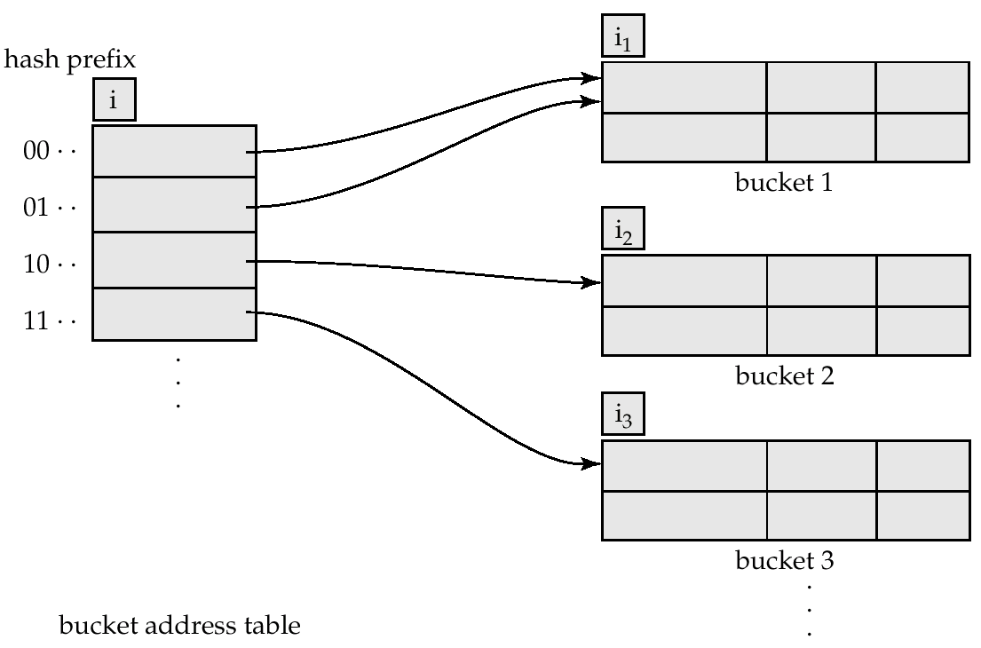
General Extendable Hash Structure
In this structure, i₂ = i₃ = i, whereas i₁ = i – 1

Slide 16
Queries and Updates
Lookup
  Take the first i bits of the hash value.
  Following the corresponding entry in the bucket address table.
  Look in the bucket.

Slide 17
Queries and Updates (Cont’d)
Insertion
  Follow lookup procedure
  If the bucket has space, add the record.
  If not…

Slide 18
Insertion (Cont’d)
Case 1: i = i_{j}
  Use an additional bit in the hash value
    This doubles the size of the bucket address table.
    Makes two entries in the table point to the full bucket.
  Allocate a new bucket, z.
    Set i_{j} and i_{z} to i
    Point the second entry to the new bucket
    Rehash the old bucket
  Repeat insertion attempt

Slide 19
Insertion (Cont’d)
Case 2: i > i_{j}
  Allocate a new bucket, z
  Add 1 to i_{j}, set i_{j} and i_{z} to this new value
  Put half of the entries in the first bucket and half in the other
  Rehash records in bucket j
  Reattempt insertion

Slide 20
Insertion (Finally)
If all the records in the bucket have the same search value, simply use overflow buckets as seen in static hashing.

Slide 21
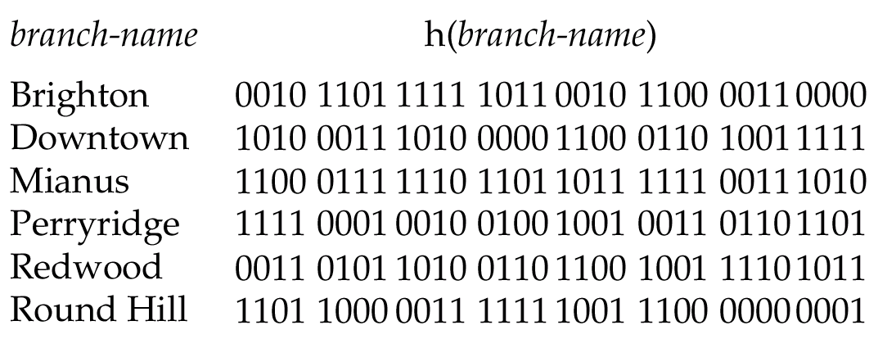
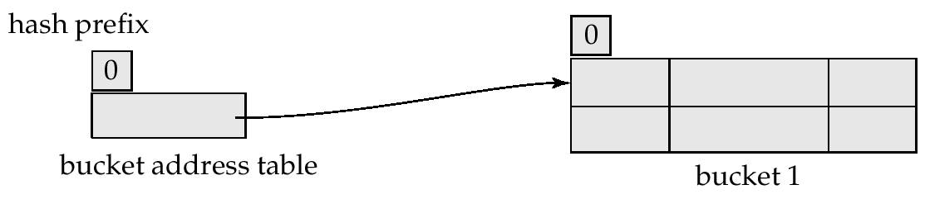
Use of Extendable Hash Structure: Example
Initial Hash structure, bucket size = 2

Slide 22
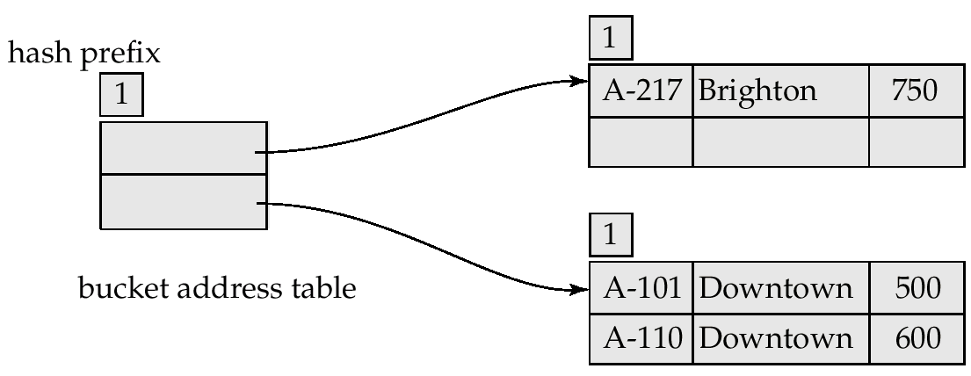
Example (Cont.)
Hash structure after insertion of one Brighton and two Downtown records

Slide 23
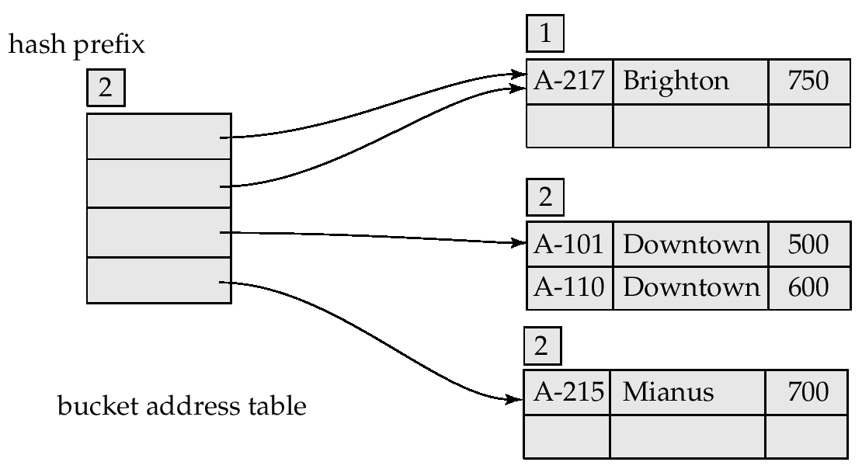
Example (Cont.)
Hash structure after insertion of Mianus record

Slide 24
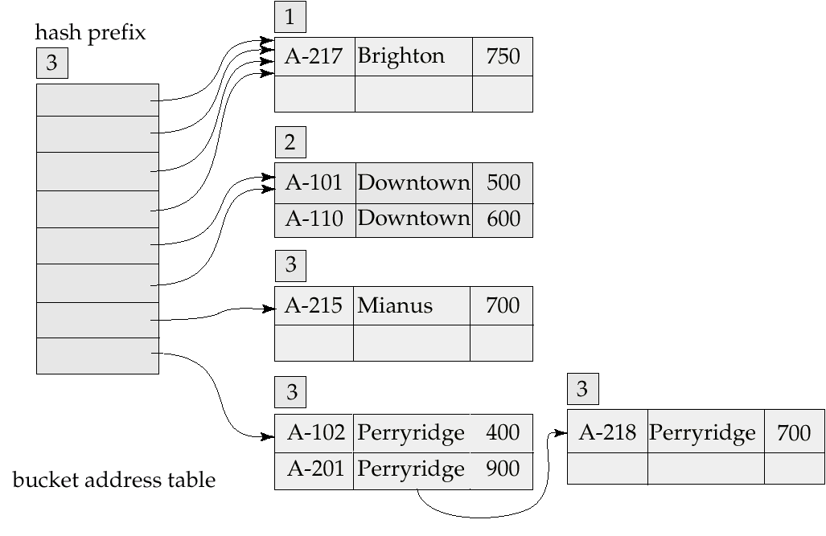
Example (Cont.)
Hash structure after insertion of three Perryridge records

Slide 25
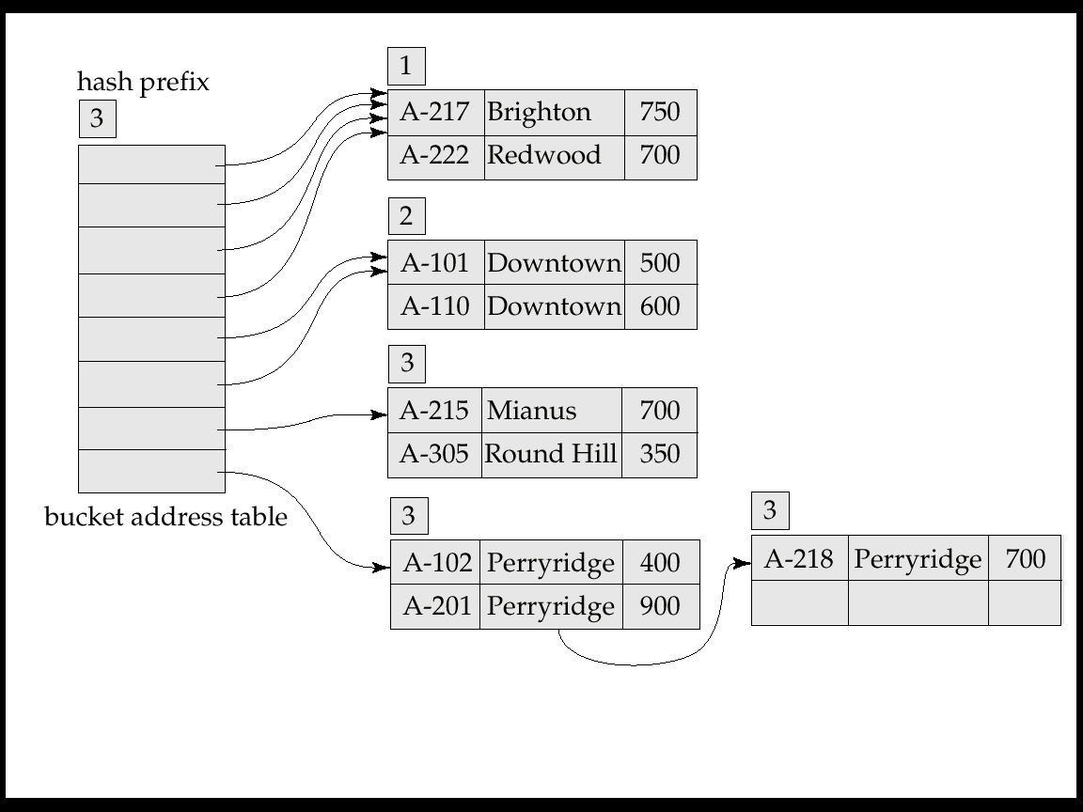
Example (Cont.)
Hash structure after insertion of Redwood and Round Hill records

Slide 26
Comparison to Other Hashing Methods
Advantage: performance does not decrease as the database size increases
  Space is conserved by adding and removing as necessary
Disadvantage: additional level of indirection for operations
  Complex implementation

Slide 27
Ordered Indexing vs. Hashing
Hashing is less efficient if queries to the database include ranges as opposed to specific values.
In cases where ranges are infrequent hashing provides faster insertion, deletion, and lookup then ordered indexing.

