Slide 1
SORTING

Slide 2
Sequential Search
Example
44, 55, 12, 42, 94, 18, 06, 67

Slide 3
* (P.320)
# define MAX-SIZE 1000/* maximum size of list plus one */ typedef struct { int key;
/* other fields */
} element; element list[MAX_SIZE];

Slide 4
*Program 7.1:Sequential search (p.321) int seqsearch( int list[ ], int searchnum, int n )
{
/*search an array, list, that has n numbers. Return i, if list[i]=searchnum. Return -1, if searchnum is not in the list */ int i; list[n]=searchnum; sentinel for (i=0; list[i] != searchnum; i++)
; return (( i<n) ? i : -1);
}

Slide 5
Recursive Linear Search
int RLinearSearch( int A[], int n, int key) {
if(n==0)
return -1;
if (A[n-1]==key)
return n;
return RLinearSearch(A,n-1,key);
}

Slide 6
*Program 7.2: Binary search (p.322) int binsearch(element list[ ], int searchnum, int n)
{
/* search list [0], ..., list[n-1]*/ int left = 0, right = n-1, middle; while (left <= right) { middle = (left+ right)/2; switch (COMPARE(list[middle].key, searchnum)) { case -1: left = middle +1; break; case 0: return middle; case 1:right = middle - 1;
}
} return -1;
}
O(log₂n)

Slide 7
Recursive Binary Search
void binary_search(int list[], int lo, int hi, int key)
{
int mid;
if (lo > hi){
  cout<<"Key not found\n“;
  Return -1;
}
mid = (lo + hi) / 2;
if (list[mid] == key)
return mid;
if (list[mid] > key)
return binary_search(list, lo, mid - 1, key);
if (list[mid] < key)
return binary_search(list, mid + 1, hi, key);
}

Slide 8
Sorting Problem
Definition
  given (R₀, R₁, …, R_{n-1}), where R_{i} = key + data find a permutation σ, such that K_{σ(i-1)} ≤ K_{σ(i)}, 0<i<n-1
sorted
  K_{σ(i-1)} ≤ K_{σ(i)}, 0<i<n-1

Slide 9
Quick Sort (C.A.R. Hoare)
Quick sort is developed by C. A. R. Hoare. The quick sort scheme has the best average behavior among the sorting methods.
In Quick sort the pivot key K_{i} is placed at the correct spot with respect to the whole list.
If key K_{i} is placed in position s(i), then K_{j} ≤ K_{s(i)} for j < s(i) and K_{j} ≥ s(i) for j > s(i).
Therefore, the sublist to the left of S(i) and to the right of s(i) can be sorted independently.

Slide 10
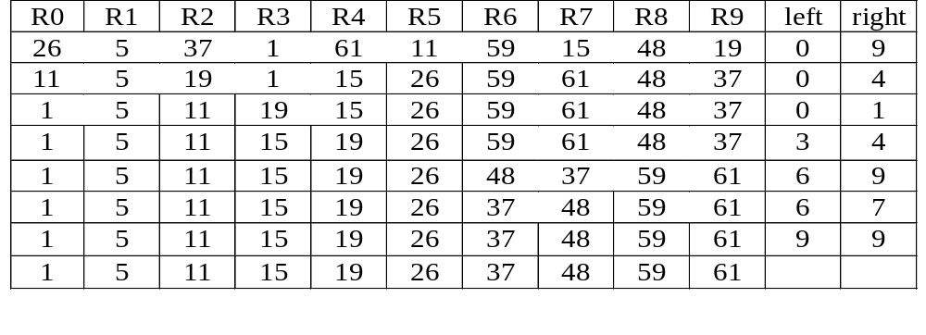
Example for Quick Sort
{
}
{
}
{
}
{
}
{
}
{
}
{
}
{
}
{
}
{
}

Slide 11
Quick Sort
void quicksort(element list[], int left, int right)
{
int pivot, i, j;
element temp;
if (left < right) {
i = left; j = right+1;
pivot = list[left].key;
do {
do i++; while (list[i].key < pivot);
do j--; while (list[j].key > pivot);
if (i < j) SWAP(list[i], list[j], temp);
} while (i < j);
SWAP(list[left], list[j], temp);
quicksort(list, left, j-1);
quicksort(list, j+1, right);
}
}
CHAPTER 7

Slide 12
Analysis for Quick Sort
  The worst case O(n²)
Assume that each time a record is positioned, the list is divided roughly of same size, each of size n/2. Positioning within the list with n element needs O(n)
  Assume T(n) is the time taken to sort a list of size n:
T(n)<=cn+2T(n/2) for some c
<=cn+2(cn/2+2T(n/4))
...
<=cnlog n+nT(1)
=O(nlog n)

Slide 13
Analysis of Quick Sort
Quick sort needs stack space to implement the recursion.
If the lists split evenly, the maximum recursion depth would be log n and the stack space is of O(log n).
The worst case is when the lists split into a left sublist of size n – 1 and a right sublist of size 0 at each level of recursion. In this case, the recursion depth is n, the stack space of O(n).

Slide 14
Time and Space for Quick Sort
Space complexity:
  Average case and best case: O(log n)
  Worst case: O(n)
Time complexity:
  Average case and best case: O(n log n)
  Worst case: O(n )
2

Slide 15
Merge Sort
Given two sorted lists
(A, m)
(B, n)
generate a single sorted list
(C, m+n)

Slide 16
Merge Sort
The process of merging of two sorted lists into a single sorted list is called simple merge.

Slide 17
Example
10 | 20 | 40 | 50 | 15 | 25 | 30 | 10
10 | 20 | 40 | 50 | 15 | 25 | 30 | 10 | 15
10 | 20 | 40 | 50 | 15 | 25 | 30 | 10 | 15 | 20
10 | 20 | 40 | 50 | 15 | 25 | 30 | 10 | 15 | 20 | 25
10 | 20 | 40 | 50 | 15 | 25 | 30 | 10 | 15 | 20 | 25 | 30
10 | 20 | 40 | 50 | 15 | 25 | 30 | 10 | 15 | 20 | 25 | 30 | 40 | 50
10 | 20 | 40 | 50 | 15 | 25 | 30

Slide 18
Merge Sort
void simplemerge(int A[], int B[], int m, int n, int c[]){
int i,j,k;
i=j=k=0;
while (i<m && j<n) {
if (A[i]<B[j])
C[k++]= A[i++];
else
C[k++]= B[j++];
}
while (i<m) C[k++]= A[i++];
while(j<n) C[k++] = B[j++];
}
CHAPTER 7

Slide 19
SimpleMerge(a, low, mid, high)
//Merge 2 arrays with first array starting from low to mid and other array starting from mid+1 to high
void SimpleMerge(int A[], int low, int mid, int high)
{ int c[100];
  i = low, j=mid+1,k=low;
  m = mid+1, n = high+1;
  while (i<m && j<n) {
  if (A[i]<A[j])
  C[k++]= A[i++];
  else
  C[k++]= A[j++];
  }
  while (i<m) C[k++]= A[i++];
  while(j<n) C[k++] = A[j++];
  for i= low to high
      A[i] = c[i];
  }

Slide 20
Recursive Merge Sort
Recursive merge sort divides the list to be sorted into two roughly equal parts:
  the left sublist [left : (left+right)/2]
  the right sublist [(left+right)/2 +1 : right]
These sublists are sorted recursively, and the sorted sublists are merged.
Merge sort needs additional storage space proportional to the number of records in the file being sorted, while its computing time is O(n log n)

Slide 21
Recursive Merge Sort
General Procedure to sort the items using Merge Sort:
Assume low and high are lower and upper limits in an array.
  If (low< high)
    Divide the array into equal parts
    Sort the left part of the array
    Sort the right part of the array
    Merge the left and right part

Slide 22
Recursive Merge Sort
upper
void MergeSort(element list[], int low, int high)
{
int middle;
if (low < high) {
mid = (low+high)/2;
MergeSort(list,low,mid);
MergeSort(list,mid+1,high),
SimpleMerge(list, low, mid, high);
}
}
lower
middle
upper

Slide 23
Sublist Partitioning For Recursive Merge Sort
26
5
77
1
61
11
59
15
48
19
5 26
11 59
19 48
5 26 77
1 61
11 15 59
19 48
1 5 26 61 77
11 15 19 48 59
1 5 11 15 19 26 48 59 61 77

Slide 24
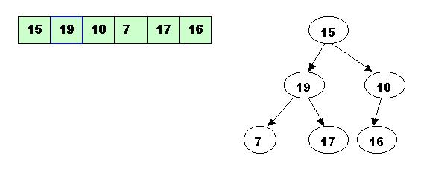
Heap Sort

Slide 25
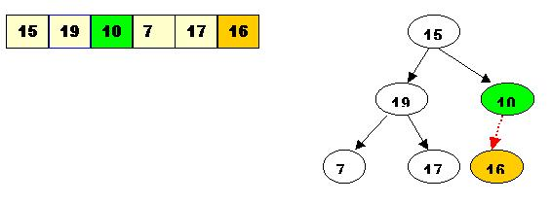
Heap Sort
Start with the rightmost node at height 1 - the node at position 3 = Size/2.
It has one greater child and has to be percolated down:

Slide 26
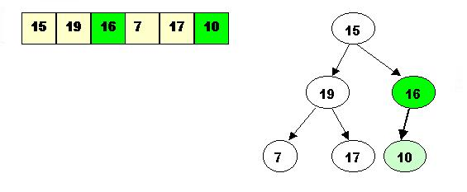
Heap Sort
After processing array[3] the situation is:

Slide 27
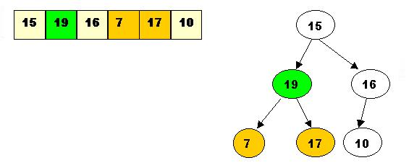
Heap Sort
Next comes array[2]. Its children are smaller, so no percolation is needed.

Slide 28
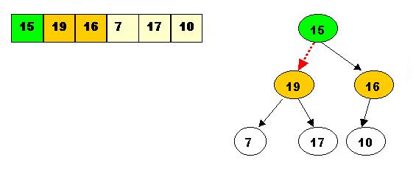
Heap Sort
The last node to be processed is array[1]. Its left child is the greater of the children.
The item at array[1] has to be percolated down to the left, swapped with array[2].

Slide 29
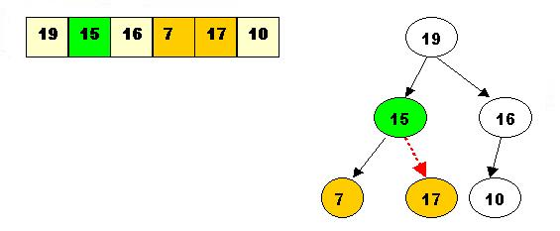
Heap Sort
As a result the situation is:
The children of array[2] are greater, and item 15 has to be moved down further, swapped with array[5].

Slide 30
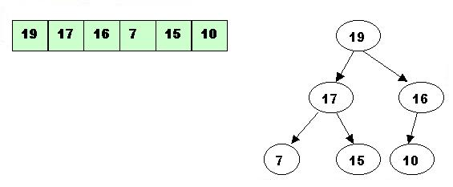
Heap Sort
Now the tree is ordered, and the binary heap is built.

Slide 31
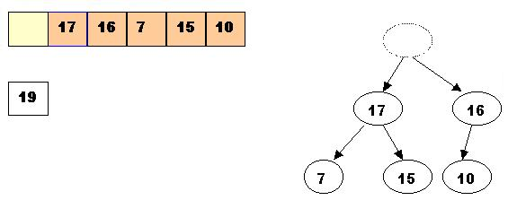
Heap Sort
Sorting - performing deleteMax operations:
1. Delete the top element 19.
1.1. Store 19 in a temporary place. A hole is created at the top

Slide 32
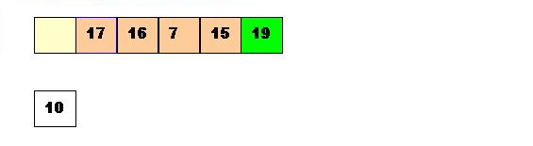
Heap Sort
1.2. Swap 19 with the last element of the heap.
As 10 will be adjusted in the heap, its cell will no longer be a part of the heap.
Instead it becomes a cell from the sorted array

Slide 33
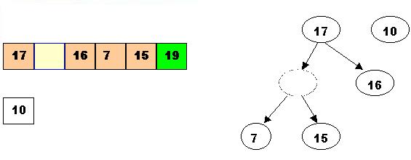
Heap Sort
1.3. Percolate down the hole

Slide 34
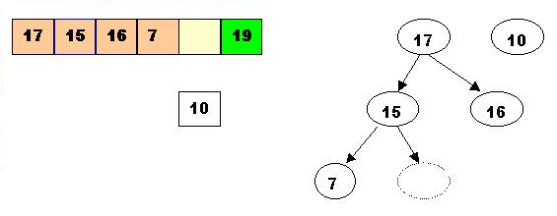
1.4. Percolate once more (10 is less that 15, so it cannot be inserted in the previous hole)

Slide 35
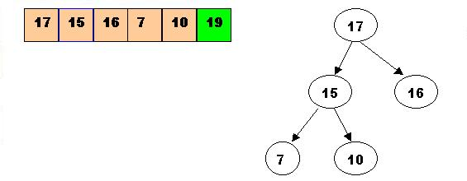
Now 10 can be inserted in the hole

Slide 36
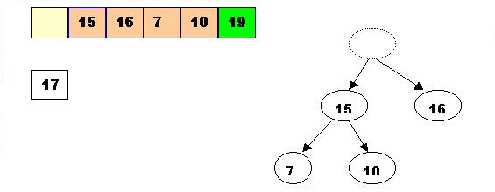
2. DeleteMax the top element 17
2.1. Store 17 in a temporary place. A hole is created at the top

Slide 37
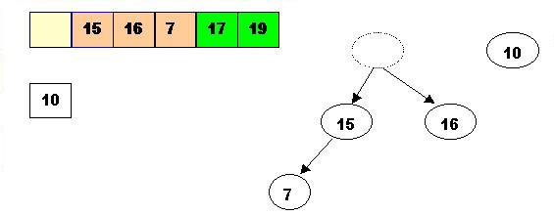
2.2. Swap 17 with the last element of the heap.
As 10 will be adjusted in the heap, its cell will no longer be a part of the heap.
Instead it becomes a cell from the sorted array

Slide 38
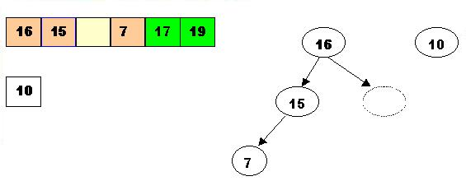
2.3. The element 10 is less than the children of the hole, and we percolate the hole down:

Slide 39
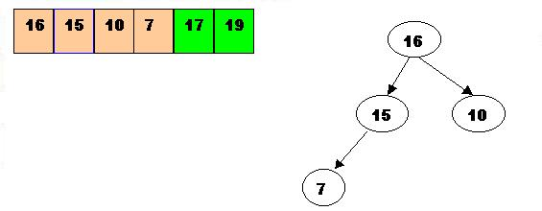
2.4. Insert 10 in the hole

Slide 40
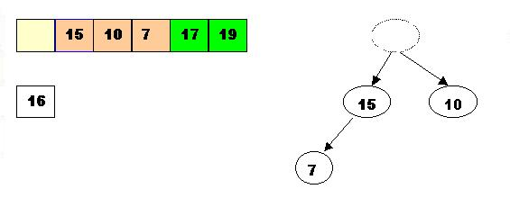
3. DeleteMax 16
3.1. Store 16 in a temporary place. A hole is created at the top

Slide 41
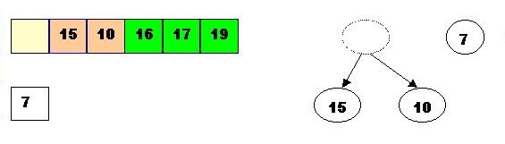
3.2. Swap 16 with the last element of the heap.
As 7 will be adjusted in the heap, its cell will no longer be a part of the heap.
Instead it becomes a cell from the sorted array

Slide 42
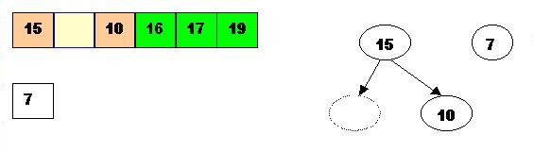
3.3. Percolate the hole down (7 cannot be inserted there - it is less than the children of the hole)

Slide 43
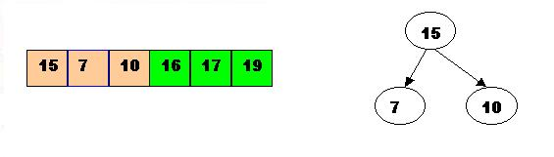
3.4. Insert 7 in the hole

Slide 44
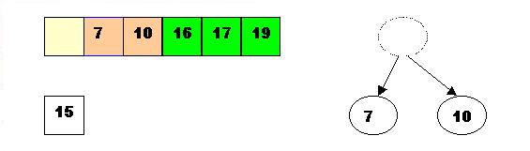
4. DeleteMax the top element 15
4.1. Store 15 in a temporary location. A hole is created.

Slide 45
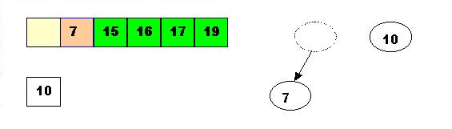
4.2. Swap 15 with the last element of the heap.
As 10 will be adjusted in the heap, its cell will no longer be a part of the heap.
Instead it becomes a position from the sorted array

Slide 46
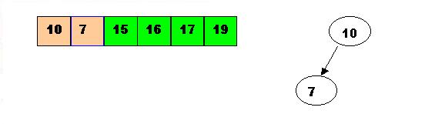
4.3. Store 10 in the hole (10 is greater than the children of the hole)

Slide 47
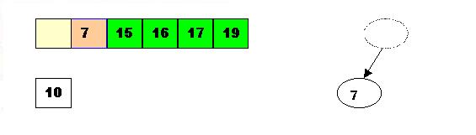
5. DeleteMax the top element 10.5.1. Remove 10 from the heap and store it into a temporary location

Slide 48
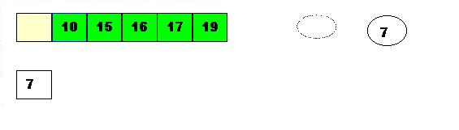
5.2. Swap 10 with the last element of the heap.
As 7 will be adjusted in the heap, its cell will no longer be a part of the heap. Instead it becomes a cell from the sorted array

Slide 49

5.3. Store 7 in the hole (as the only remaining element in the heap

Slide 50

7 is the last element from the heap, so now the array is sorted

Slide 51
void heapsort(element list[], int n)
{
int i, j;
for (i=n/2; i>0; i--) adjust(list, i, n);
for (i=n-1; i>0; i--) {
SWAP(list[1], list[i+1]);
adjust(list, 1, i);
}
}

Slide 52
void adjust(element list[], int root, int n) {
int child, rootkey; element temp;
temp=list[root]; rootkey=list[root].key;
child=2*root;
while (child <= n) {
if ((child < n) && (list[child].key < list[child+1].key)) child++;
if (rootkey > list[child].key) break;
else {
list[child/2] = list[child];
child *= 2;
}
}
list[child/2] = temp;
}
Complexity of heap sort: O(NlogN)

