Slide 1
Graphs

Slide 2
Konigsberg Bridge Problem
A river Pregel flows around the island Keniphof and then divides into two.
Four land areas A, B, C, D have this river on their borders.
The four lands are connected by 7 bridges a – g.
Determine whether it’s possible to walk across all the bridges exactly once in returning back to the starting land area.

Slide 3
Konigsberg Bridge Problem (Cont.)
c
C
d
g
A
Kneiphof
e
D
C
f
g
a
B
c
d
b
e
A
D
a
b
f
B

Slide 4
Euler’s Graph
Define the degree of a vertex to be the number of edges incident to it
Euler showed that there is a walk starting at any vertex, going through each edge exactly once and terminating at the start vertex iff the degree of each vertex is even. This walk is called Eulerian.
No Eulerian walk of the Konigsberg bridge problem since all four vertices are of odd edges.

Slide 5
Application of Graphs
Analysis of electrical circuits
Finding shortest routes
Project planning
Identification of chemical compounds
Linguistics
Social Sciences, and so on …

Slide 6
Definition of A Graph
A graph, G, consists of two sets, V and E.
  V is a finite, nonempty set of vertices.
  E is set of pairs of vertices called edges.
The vertices of a graph G can be represented as V(G).
Likewise, the edges of a graph, G, can be represented as E(G).
Graphs can be either undirected graphs or directed graphs.
For a undirected graph, a pair of vertices (u, v) or (v, u) represent the same edge.
For a directed graph, a directed pair <u, v> has u as the tail and the v as the head. Therefore, <u, v> and <v, u> represent different edges.

Slide 7
Three Sample Graphs
0
0
0
1
2
1
2
1
3
3
4
5
6
2
V(G₁) = {0, 1, 2, 3}
V(G₂) = {0, 1, 2, 3, 4, 5, 6}
V(G₃) = {0, 1, 2}
E(G₁) = {(0, 1), (0, 2), (0, 3), (1, 2), (1, 3), (2, 3)}
E(G₂) = {(0, 1), (0, 2), (1, 3), (1, 4), (2, 5), (2, 6)}
E(G₃) = {<0, 1>, <1, 0>, <1, 2>}
(a) G₁
(b) G₂
(c) G₃

Slide 8
Graph Restrictions
A graph may not have an edge from a vertex back to itself.
  (v, v) or <v, v> are called self edge or self loop. If a graph with self edges, it is called a graph with self edges.
A graph may not have multiple occurrences of the same edge.
  If without this restriction, it is called a multigraph.

Slide 9
Complete Graph
The number of distinct unordered pairs (u, v) with u≠v in a graph with n vertices is n(n-1)/2.
A complete unordered graph is an unordered graph with exactly n(n-1)/2 edges.
A complete directed graph is a directed graph with exactly n(n-1) edges.

Slide 10
Examples of Graphlike Structures
0
0
1
1
3
2
2
(a) Graph with a self edge
(b) Multigraph

Slide 11
Graph Edges
If (u, v) is an edge in E(G), vertices u and v are adjacent and the edge (u, v) is the incident on vertices u and v.
For a directed graph, <u, v> indicates u is adjacent to v and v is adjacent from u.

Slide 12

Subgraph and Path
Subgraph: A subgraph of G is a graph G’ such that V(G’) V(G) and E(G’) E(G).
Path: A path from vertex u to vertex v in graph G is a sequence of vertices u, i₁, i₂, …, i_{k}, v, such that (u, i₁), (i₁, i₂), …, (i_{k}, v) are edges in E(G).
  The length of a path is the number of edges on it.
  A simple path is a path in which all vertices except possibly the first and last are distinct.
  A path (0, 1), (1, 3), (3, 2) can be written as 0, 1, 3, 2.
Cycle: A cycle is a simple path in which the first and last vertices are the same.
Similar definitions of path and cycle can be applied to directed graphs.

Slide 13
G₁ and G₃ Subgraphs
0
0
0
1
2
1
2
1
2
3
(i)
(ii)
(iii)
(iv)
3
(a) Some subgraphs of G₁
0
0
0
0
1
1
1
(i)
(ii)
2
2
2
(a) Some subgraphs of G₃
(iii)
(iv)

Slide 14
Connected Graph
Two vertices u and v are connected in an undirected graph iff there is a path from u to v (and v to u).
An undirected graph is connected iff for every pair of distinct vertices u and v in V(G) there is a path from u to v in G.
A connected component of an undirected is a maximal connected subgraph.
A tree is a connected acyclic graph.

Slide 15
Strongly Connected Graph
A directed graph G is strongly connected iff for every pair of distinct vertices u and v in V(G), there is directed path from u to v and also from v to u.
A strongly connected component is a maximal subgraph that is strongly connected.

Slide 16
Graphs with Two Connected Components
H₁
H₂
0
0
1
2
1
2
3
3
G₄

Slide 17
Strongly Connected Components of G₃
0
1
2

Slide 18
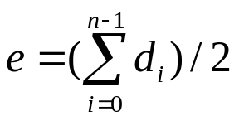
Degree of A Vertex
Degree of a vertex: The degree of a vertex is the number of edges incident to that vertex.
If G is a directed graph, then we define
  in-degree of a vertex: is the number of edges for which vertex is the head.
  out-degree of a vertex: is the number of edges for which the vertex is the tail.
For a graph G with n vertices and e edges, if d_{i} is the degree of a vertex i in G, then the number of edges of G is

Slide 19
Abstract of Data Type Graphs
class Graph
{
// objects: A nonempty set of vertices and a set of undirected edges
// where each edge is a pair of vertices
public:
Graph(); // Create an empty graph
void InsertVertex(Vertex v);
void InsertEdge(Vertex u, Vertex v);
void DeleteVertex(Vertex v);
void DeleteEdge(Vertex u, Vertex v);
Boolean IsEmpty(); // if graph has no vertices return TRUE
List<List> Adjacent(Vertex v);
// return a list of all vertices that are adjacent to v
};

Slide 20
Adjacent Matrix
Let G(V, E) be a graph with n vertices, n ≥ 1. The adjacency matrix of G is a two-dimensional nxn array, A.
  A[i][j] = 1 iff the edge (i, j) is in E(G).
  The adjacency matrix for a undirected graph is symmetric, it may not be the case for a directed graph.
For an undirected graph the degree of any vertex i is its row sum.
For a directed graph, the row sum is the out-degree and the column sum is the in-degree.

Slide 21
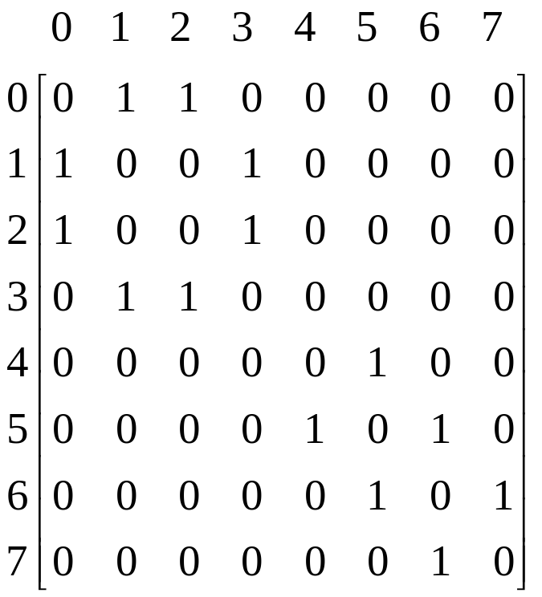
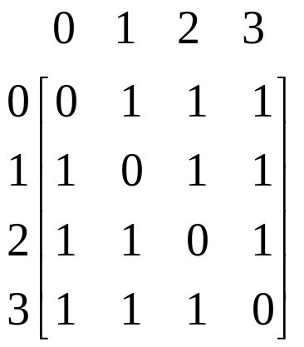
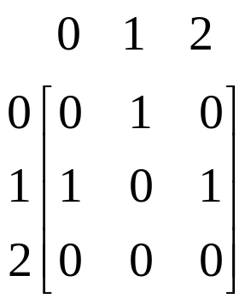
Adjacency Matrices
0
0
0
1
2
1
2
1
3
3
4
5
6
2
(a) G₁
(b) G₃
(c) G₄

Slide 22
Adjacency Lists
Instead of using a matrix to represent the adjacency of a graph, we can use n linked lists to represent the n rows of the adjacency matrix.
Each node in the linked list contains two fields: data and link.
  data: contain the indices of vertices adjacent to a vertex i.
  Each list has a head node.
For an undirected graph with n vertices and e edges, we need n head nodes and 2e list nodes.
The degree of any vertex may be determined by counting the number nodes in its adjacency list.
The number of edges in G can be determined in O(n + e).
For a directed graph (also called digraph),
  the out-degree of any vertex can be determined by counting the number of nodes in its adjacency list.
  the in-degree of any vertex can be obtained by keeping another set of lists called inverse adjacency lists.

Slide 23
Adjacent Lists
[0]
3
1
2
0
0
HeadNodes
[1]
2
3
0
0
1
2
[2]
1
3
0
0
[3]
0
1
2
0
3
(a) G₁
0
1
HeadNodes
[0]
1
0
[1]
2
0
0
2
[2]
0
(b) G₃
(b) G₃

Slide 24
Adjacent Lists (Cont.)
HeadNodes
[0]
2
1
0
[1]
3
0
0
[2]
0
3
0
[3]
1
1
0
[4]
5
0
[5]
6
4
0
[6]
5
7
0
[7]
6
0
(c) G₄

Slide 25
Weighted Edges
Very often the edges of a graph have weights associated with them.
  distance from one vertex to another
  cost of going from one vertex to an adjacent vertex.
  To represent weight, we need additional field, weight, in each entry.
  A graph with weighted edges is called a network.

Slide 26
Graph Operations
A general operation on a graph G is to visit all vertices in G that are reachable from a vertex v.
  Depth-first search
  Breath-first search

Slide 27
Depth-First Search
Starting from vertex v, an unvisited vertex w adjacent to v is selected and a depth-first search from w is initiated.
When the search operation has reached a vertex u such that all its adjacent vertices have been visited, we back up to the last vertex visited that has an unvisited vertex w adjacent to it and initiate a depth-first search from w again.
The above process repeats until no unvisited vertex can be reached from any of the visited vertices.

Slide 28
Graph G and Its Adjacency Lists
0
1
2
3
4
5
6
HeadNodes
[0]
1
2
0
7
[1]
0
3
4
0
[2]
0
5
6
0
[3]
1
7
0
[4]
1
7
0
o/p: 0,1,3,7,4,5,2,6
[5]
2
7
0
[6]
2
7
0
[7
3
4
5
6
0

Slide 29
DFS Algorithm
/*Given an undirected graph G = (V,E) with n vertices and an array VlSlTED(n) initially set to False, this algorithm visits all vertices reachable from v. G and VISITED are global.*/
int Visited[]
Algorithm DFS(v)
{
VISITED[v] = True
for each vertex w adjacent to v do
if VISlTED[w] =False then
call DFS(w)
}

Slide 30
Analysis of DFS
If G is represented by its adjacency lists, the DFS time complexity is O(e).
If G is represented by its adjacency matrix, then the time complexity to complete DFS is O(n²).

Slide 31
Breath-First Search
Starting from a vertex v, visit all unvisited vertices adjacent to vertex v.
Unvisited vertices adjacent to these newly visited vertices are then visited, and so on.
If an adjacency matrix is used, the BFS complexity is O(n²).
If adjacency lists are used, the time complexity of BFS is O(e).
o/p: 0,1,2,3,4,5,6,7

Slide 32


Slide 33
Spanning Tree
Any tree consisting solely of edges in G and including all vertices in G is called a spanning tree.
Spanning tree can be obtained by using either a depth-first or a breath-first search.
When a nontree edge (v, w) is introduced into any spanning tree T, a cycle is formed.
A spanning tree is a minimal subgraph, G’, of G such that V(G’) = V(G), and G’ is connected. (Minimal subgraph is defined as one with the fewest number of edges).
Any connected graph with n vertices must have at least n-1 edges, and all connected graphs with n – 1 edges are trees. Therefore, a spanning tree has n – 1 edges.

Slide 34
A Complete Graph and Three of Its Spanning Trees

