Slide 1
Performance Measurement

Slide 2
Program Performance
Program performance is the amount of computer memory and time needed to run a program.
  Analytically - performance analysis
  Experimentally - performance measurement
The performance of a program depends on
  the number and type of operations performed, and
  the memory access pattern for the data and instructions

Slide 3
Performance Analysis
Paper and pencil.
Do NOT need a working computer program or even a computer.

Slide 4
Some Uses of Performance Analysis
Why do want to do a performance analysis of algorithms?
To determine the practicality of algorithm
To predict run time on large instance
To compare two algorithms that have different asymptotic complexity
  - e.g., O(n) and O(n²)

Slide 5
Limitations of Performance Analysis
Does NOT account for constant factors.
But constant factors may dominate
1000n vs. n²
especially if we are interested only in n < 1000
Modern computers have a hierarchical memory organization with different access times for memory at different levels of the hierarchy.

Slide 6
Memory Hierarchy
MAIN
L2
L1
ALU
R
8-32
32KB
512KB
512MB
1C
2C
10C
100C
C = CPU cycle
Notes:
1 cycle to add data that are in the registers
2 cycles to copy data from L1 cache to a register
10 cycles to copy from L2 to L1 and register

Slide 7
Limitations of Performance Analysis
Performance analysis does not account for this difference in memory access times.
Programs that do more work may take less time than those that do less work.
  e.g., a program with a large operation count and a small number of accesses to slow memory may take less time than a program with a small operation count and a large number of accesses to slow memory

Slide 8
Performance Measurement
Concerned with obtaining the actual space and time requirements of a program
Actual space and time are dependent on
  Compiler and options
  Specific computer

Slide 9
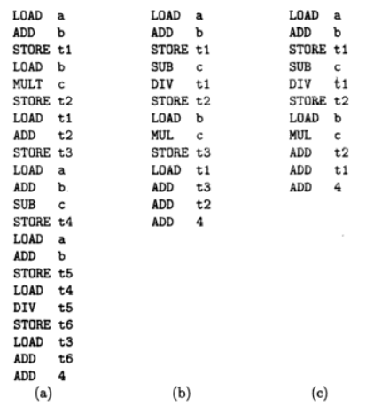
Following code can be generated for the exp: a+b+b-c+(a+b-c)/(a+b)+4

Slide 10
Performance Measurement Needs (1)
programming language
working program
computer
compiler and options to use g++ –O, –O2, -O3 (see manual pages for g++)

Slide 11
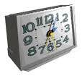
Performance Measurement Needs (2)
data to use for measurement
  worst-case data
  best-case data
  average-case data
  What is the worst-case, best-case, average-case data for insertionSort and how do you generate them?
timing mechanism --- clock

Slide 12
Space Complexity:
Space Complexity of an algorithm is the amount of memory it needs to run to completion i.e. from start of execution to its termination. Space need by any algorithm is the sum of following components:
Fixed Component: This is independent of the characteristics of the inputs and outputs. This part includes: Instruction Space, Space of simple variables, fixed size component variables, and constants variables.
Variable Component: This consist of the space needed by component variables whose size is dependent on the particular problems instances(Inputs/Outputs) being solved, the space needed by referenced variables and the recursion stack space is one of the most prominent components. Also this included the data structure components like Linked list, heap, trees, graphs etc.
Therefore the total space requirement of any algorithm 'A' can be provided as
Space(A) = Fixed Components(A) + Variable Components(A)

Slide 13
Space Complexity:
Among both fixed and variable component the variable part is important to be determined accurately, so that the actual space requirement can be identified for an algorithm 'A'. To identify the space complexity of any algorithm following steps can be followed:
1. Determine the variables which are instantiated by some default values.
2. Determine which instance characteristics should be used to measure the space requirement and this is will be problem specific.
3. Generally the choices are limited to quantities related to the number and magnitudes of the inputs to and outputs from the algorithms.
4. Sometimes more complex measures of the interrelationships among
the data items can used.

Slide 14
Space Complexity:
In above example, when calculating the space complexity we will be looking for both fixed and variable components. here we have
Fixed components as 'result','count' and 'size' variable there for total space required is three(3) words.
Variable components is characterized as the value stored in 'size' variable (suppose value store in variable 'size 'is 'n'). because this will decide the size of 'number' list and will also drive the for loop. therefore if the space used by size is one word then the total space required by 'number' variable will be 'n'(value stored in variable 'size').
Therefore the space complexity can be written as Space(Sum) = 3 + n;
Algorithm Sum(number,size) { //this calculates the sum of element of array
result=0.0;
for count = 1 to size do \\will repeat from 1,2,3,4,....size times
result= result + number[count];
return result; }

Slide 15
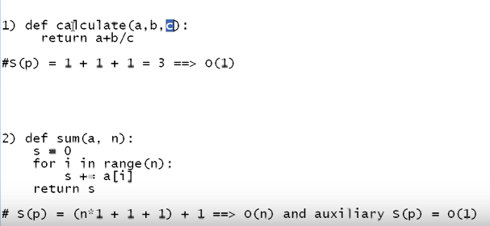
Examples:

Slide 16
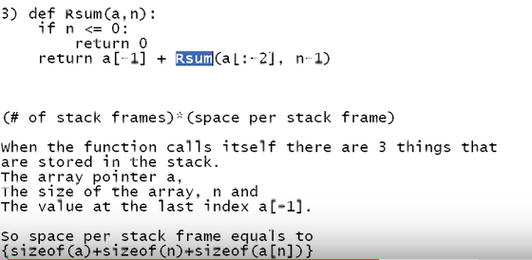
Space Complexity for recursive function:

Slide 17
Time Complexity:
Time Complexity of an algorithm(basically when converted to program) is the amount of computer time it needs to run to completion.
The time taken by a program is the sum of :
the compile time and
the run/execution time .
The compile time is independent of the instance(problem specific) characteristics.
Following factors effect the time complexity:
1. Characteristics of compiler used to compile the program.
2. Computer Machine on which the program is executed and physically clocked.
3. Multiuser execution system.
4. Number of program steps.
Therefore the time complexity consist of two components fixed(factor 1 only) and variable/instance(factor 2,3 & 4), so for any algorithm 'A' it is provided as:
Time(A) = Fixed Time(A) + Instance Time(A)

Slide 18
Time Complexity:
Here the number of steps is the most prominent instance characteristics and The number of steps any program statement is assigned depends on the kind of statement like :
- comments count as zero steps,
- an assignment statement which does not involve any calls to other
algorithm is counted as one step,
- for iterative statements we consider the steps count only for the control
part of the statement etc.

Slide 19
Time Complexity:
Example:
Statement | Steps per execution | Frequency | Total Steps
Algorithm Sum(number,size) | 0 | - | 0
{ | 0 | - | 0
result=0.0; | 1 | 1 | 1
for count = 1 to size do | 1 | size+1 | size + 1
result= result + number[count]; | 1 | size | size
return result; | 1 | 1 | 1
} | 0 | - | 0
Total |  |  | 2size + 3

Slide 20
Time Complexity:
In previous example if you analyze carefully frequency of "for count = 1 to size do" it is 'size +1' this is because-
the statement will be executed one time more to die to condition check for false situation of condition.
Now once the total steps are calculated they will resemble the instance characteristics in time complexity of algorithm.
Also the repeated compile time of an algorithm will also be constant every time we compile the same set of instructions so-
we can consider this time as constant 'C'. Therefore the time complexity can be expressed as: Time(Sum) = C + (2size +3)

