Slide 1
Queue
A queue is an ordered list in which all insertions take place at one end and all deletions take place at the opposite end. It is also known as First-In-First-Out (FIFO) lists.
a₀
a₁
a₂
a_{n-1}
front
rear

Slide 2
Queue: a First-In-First-Out (FIFO) list
A
B
A
C
B
A
D
C
B
A
rear
front
D
C
B
rear
front
rear
front
rear
front
Rear
front
Rear
front
*Figure : Inserting and deleting elements in a queue

Slide 3
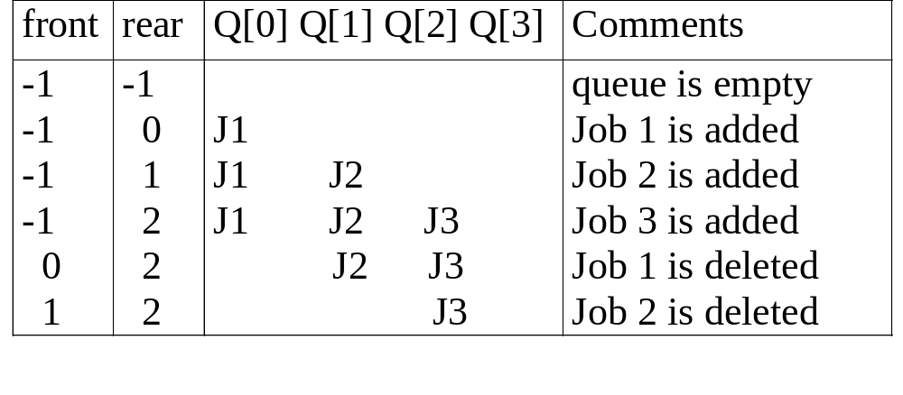
Application: Job scheduling
*Figure : Insertion and deletion from a sequential queue

Slide 4
# define MAX_QUEUE_SIZE 100/* Maximum queue size */ element queue[MAX_QUEUE_SIZE]; int rear = -1; int front = -1; int IsEmpty(){return (front == rear) ; } int IsFull(){return (rear == MAX_QUEUE_SIZE – 1);}
…
Implementation 1: using array

Slide 5
Add to a queue
void Insert( int item)
{
/* add an item to the queue */
if (! IsFull())
queue [++rear] = item;
else
printf(“Queue Overflow”);
}
*Function: Add to a queue

Slide 6
Delete from a queue
Int Delete()
{
/* remove element at the front of the queue */
if (!IsEmpty())
return queue [++ front];
else
{
printf(“Queue Underflow”);
return -1
}
}
*Function: Delete from a queue

Slide 7
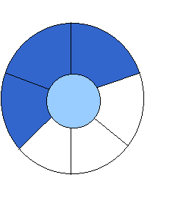
Implementation 2: regard an array as a circular queue
front: one position counterclockwise from the first element
rear: current end
EMPTY QUEUE
[3] [2] [3]
[2]
J2
J3
[1] [4] [1] [4]
J1
[0] [5] [0] [5]
front = 0 front = 0
rear = 0 rear = 3
*Figure: Empty and nonempty circular queues

Slide 8

Problem: one space is left when queue is full
FULL QUEUE FULL QUEUE
[2] [3] [2] [3]
J2 J3
J8 J9
J7
[1] [4][1] [4]
J1 J4
J5
J6 J5
[0] [5] [0] [5]
front =0
rear = 5
front =4
rear =3
*Figure: Full circular queues and then we remove the item

Slide 9
void addq(element item)
{
/* add an item to the queue */ int k = (rear +1) % MAX_QUEUE_SIZE; if (front == k) /* reset rear and print error */
{ printf(“ Q Full”); return;
} rear = k; queue[rear] = item;
}
*Function: Add to a circular queue
Add to a circular queue
[2] [3]
J2
J3
[1] [4]
J1
[0] [5]
front = 0
rear = 3

Slide 10
element deleteq()
{ element item;
/* remove front element from the queue and put it in item */ if (front == rear)
{ printf(“ Q Empty”); return ERROR;
}
/* queue_empty returns an error key */ front = (front+1) % MAX_QUEUE_SIZE; return queue[front];
}
*Function: Delete from a circular queue
Delete from a circular queue
[2] [3]
J2
J3
[1] [4]
J1
[0] [5]
front = 0
rear = 3

Slide 11
Queue Manipulation Issue
It’s intuitive to use array for implementing a queue. However, queue manipulations (add and/or delete) will require elements in the array to move. In the worse case, the complexity is of O(MaxSize).

Slide 12
Shifting Elements in Queue
front
rear
front
rear
front
rear

Slide 13
Circular Queue
To resolve the issue of moving elements in the queue, circular queue assigns next element to q[0] when rear == MaxSize – 1.
Pointer front will always point one position counterclockwise from the first element in the queue.
Queue is empty when front == rear. But it is also true when queue is full. This will be a problem.

Slide 14
Circular Queue (Cont.)
4
J4
4
J3
n-4
n-4
3
3
J2
J1
n-3
J2
n-3
2
J1
2
J3
n-2
J4
n-2
1
1
0
n-1
0
n-1
front = 0; rear = 4
front = n-4; rear = 0

Slide 15
Circular Queue (Cont.)
To resolve the issue when front == rear on whether the queue is full or empty, one way is to use only MaxSize – 1 elements in the queue at any time.
Each time when adding an item to the queue, newrear is calculated before adding the item. If newrear == front, then the queue is full.
Another way to resolve the issue is using a flag to keep track of last operation. The drawback of the method is it tends to slow down Add and Delete function.

