Slide 1
CHAPTER 6 GRAPHS
All the programs in this file are selected from
Ellis Horowitz, Sartaj Sahni, and Susan Anderson-Freed
“Fundamentals of Data Structures in C”,
Computer Science Press, 1992.

Slide 2
Definition
A graph G consists of two sets
a finite, nonempty set of vertices V(G)
a finite, possible empty set of edges E(G)
G(V,E) represents a graph
An undirected graph is one in which the pair of vertices in a edge is unordered, (v0, v1) = (v1,v0)
A directed graph is one in which each edge is a directed pair of vertices, <v0, v1> != <v1,v0>
tail
head

Slide 3
Examples for Graph
0
0
0
1
2
1
2
1
3
3
4
5
6
G1
2
G2
complete graph
incomplete graph
G3
V(G1)={0,1,2,3} E(G1)={(0,1),(0,2),(0,3),(1,2),(1,3),(2,3)}
V(G2)={0,1,2,3,4,5,6} E(G2)={(0,1),(0,2),(1,3),(1,4),(2,5),(2,6)}
V(G3)={0,1,2} E(G3)={<0,1>,<1,0>,<1,2>}
complete undirected graph: n(n-1)/2 edges
complete directed graph: n(n-1) edges

Slide 4
Complete Graph
A complete graph is a graph that has the maximum number of edges
for undirected graph with n vertices, the maximum number of edges is n(n-1)/2
for directed graph with n vertices, the maximum number of edges is n(n-1)
example: G1 is a complete graph

Slide 5
Adjacent and Incident
If (v0, v1) is an edge in an undirected graph,
v0 and v1 are adjacent
The edge (v0, v1) is incident on vertices v0 and v1
If <v0, v1> is an edge in a directed graph
v0 is adjacent to v1, and v1 is adjacent from v0
The edge <v0, v1> is incident on v0 and v1

Slide 6
Figure 6.3
*Figure 6.3:Example of a graph with feedback loops and a
multigraph (p.260)
0
0
2
1
3
1
2
self edge
multigraph:
multiple occurrences
of the same edge
(a)
(b)

Slide 7
Subgraph and Path
A subgraph of G is a graph G’ such that V(G’) is a subset of V(G) and E(G’) is a subset of E(G)
A path from vertex vp to vertex vq in a graph G, is a sequence of vertices, vp, vi1, vi2, ..., vin, vq, such that (vp, vi1), (vi1, vi2), ..., (vin, vq) are edges in an undirected graph
The length of a path is the number of edges on it

Slide 8
Figure 6.4: subgraphs of G₁ and G₃ (p.261)
0
0
0
1
2
0
1
2
1
2
3
1
2
3
3
G1
(i) (ii) (iii) (iv)
(a) Some of the subgraph of G₁
0
0
0
0
0
1
1
1
1
2
2
2
(i) (ii) (iii) (iv)
(b) Some of the subgraph of G₃
G3

Slide 9
Simple Path and Style
A simple path is a path in which all vertices, except possibly the first and the last, are distinct
A cycle is a simple path in which the first and the last vertices are the same
In an undirected graph G, two vertices, v0 and v1, are connected if there is a path in G from v0 to v1
An undirected graph is connected if, for every pair of distinct vertices vi, vj, there is a path from vi to vj

Slide 10
connected
0
0
1
2
1
2
3
3
4
5
6
G1
G2
tree (acyclic graph)

Slide 11
Connected Component
A connected component of an undirected graph is a maximal connected subgraph.
A tree is a graph that is connected and acyclic.
A directed graph is strongly connected if there is a directed path from vi to vj and also from vj to vi.
A strongly connected component is a maximal subgraph that is strongly connected.

Slide 12
*Figure 6.5: A graph with two connected components (p.262)
connected component (maximal connected subgraph)
H₁
0
H₂
4
2
1
5
3
6
7
G₄ (not connected)

Slide 13
*Figure 6.6: Strongly connected components of G₃ (p.262)
strongly connected component
(maximal strongly connected subgraph)
not strongly connected
0
0
2
1
1
2
G3

Slide 14
Degree
The degree of a vertex is the number of edges incident to that vertex
For directed graph,
the in-degree of a vertex v is the number of edges that have v as the head
the out-degree of a vertex v is the number of edges that have v as the tail
if di is the degree of a vertex i in a graph G with n vertices and e edges, the number of edges is

Slide 15
degree
3
0
undirected graph
0
2
1
2
3
1
2
3
3
3
3
4
5
6
3
3
1
G1
1
G2
1
1
0
in:1, out: 1
directed graph
in-degree
out-degree
1
in: 1, out: 2
2
in: 1, out: 0
G3

Slide 16
ADT for Graph
structure Graph is
objects: a nonempty set of vertices and a set of undirected edges, where each edge is a pair of vertices
functions: for all graph ∈ Graph, v, v₁ and v₂ ∈ Vertices
Graph Create()::=return an empty graph
Graph InsertVertex(graph, v)::= return a graph with v inserted. v has no incident edge.
Graph InsertEdge(graph, v1,v2)::= return a graph with new edge between v1 and v2
Graph DeleteVertex(graph, v)::= return a graph in which v and all edges incident to it are removed
Graph DeleteEdge(graph, v1, v2)::=return a graph in which the edge (v1, v2) is removed
Boolean IsEmpty(graph)::= if (graph==empty graph) return TRUE
else return FALSE
List Adjacent(graph,v)::= return a list of all vertices that are adjacent to v

Slide 17
Graph Representations
Adjacency Matrix
Adjacency Lists

Slide 18
Adjacency Matrix
Let G=(V,E) be a graph with n vertices.
The adjacency matrix of G is a two-dimensional n by n array, say adj_mat
If the edge (vi, vj) is in E(G), adj_mat[i][j]=1
If there is no such edge in E(G), adj_mat[i][j]=0
The adjacency matrix for an undirected graph is symmetric; the adjacency matrix for a digraph need not be symmetric

Slide 19
Examples for Adjacency Matrix
0
0
4
0
2
1
5
1
2
3
6
3
1
7
2
G2
G1
symmetric
undirected: n²/2
directed: n²
G4

Slide 20
Merits of Adjacency Matrix
From the adjacency matrix, to determine the connection of vertices is easy
The degree of a vertex is
For a digraph, the row sum is the out_degree, while the column sum is the in_degree

Slide 21
Data Structures for Adjacency Lists
Each row in adjacency matrix is represented as an adjacency list.
#define MAX_VERTICES 50
typedef struct node *node_pointer;
typedef struct node {
int vertex;
struct node *link;
};
node_pointer graph[MAX_VERTICES];
int n=0; /* vertices currently in use */

Slide 22
0
0
4
1
2
2
1
5
3
6
3
0
1
2
3
1
2
3
0
1
2
3
4
5
6
7
1
7
2
0
2
3
0
3
0
1
3
0
3
0
1
2
1
2
G1
0
5
4
6
0
1
2
1
5
7
0
2
1
6
G3
G4
2
An undirected graph with n vertices and e edges ==> n head nodes and 2e list nodes

Slide 23
Adjacency Lists vs. Matrix
Adjacency Lists
More compact than adjacency matrices if graph has few edges
Requires more time to find if an edge exists
Adjacency Matrix
Always require n² space
This can waste a lot of space if the number of edges are sparse
Can quickly find if an edge exists

Slide 24
Interesting Operations
degree of a vertex in an undirected graph
# of nodes in adjacency list
# of edges in a graph
determined in O(n+e)
out-degree of a vertex in a directed graph
# of nodes in its adjacency list
in-degree of a vertex in a directed graph
traverse the whole data structure

Slide 25
Some Graph Operations
Traversal Given G=(V,E) and vertex v, find all w∈V, such that w connects v.
Depth First Search (DFS) preorder tree traversal
Breadth First Search (BFS) level order tree traversal

Slide 26
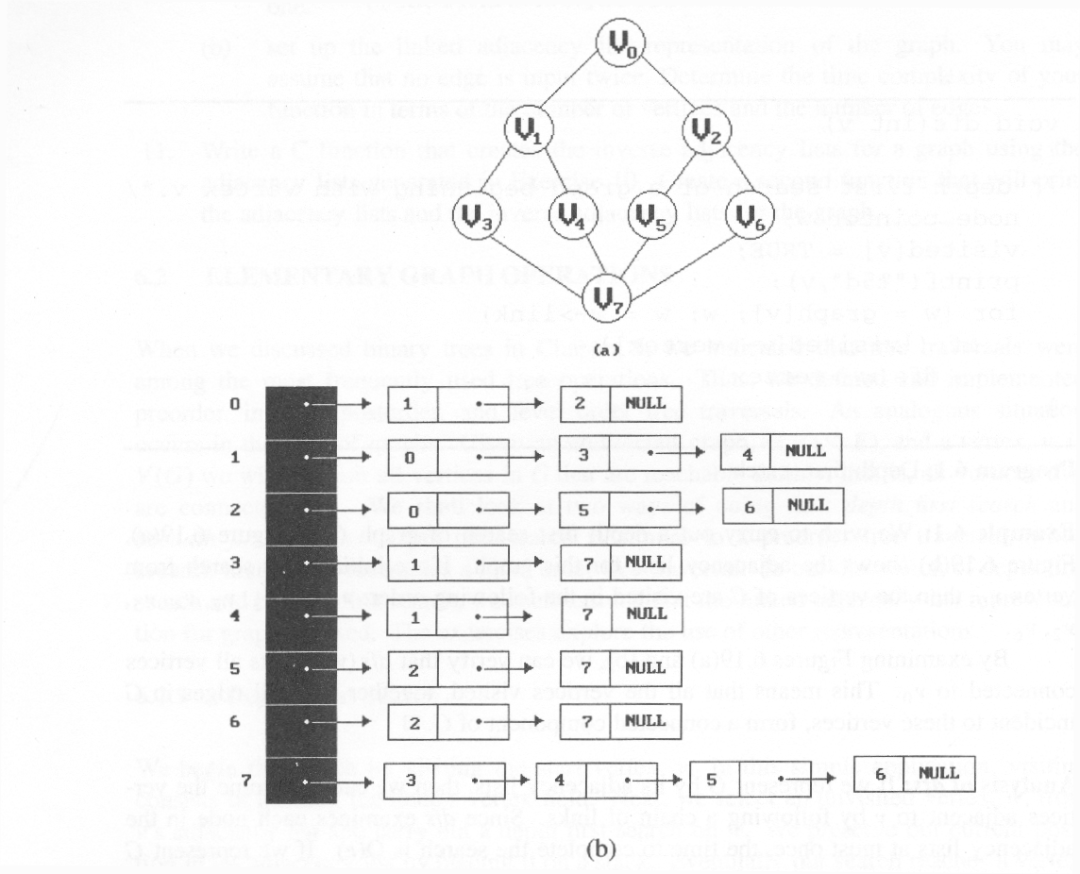
*Figure 6.19:Graph G and its adjacency lists (p.274)
depth first search: v0, v1, v3, v7, v4, v5, v2, v6
breadth first search: v0, v1, v2, v3, v4, v5, v6, v7

Slide 27
Depth First Search
#define FALSE 0
#define TRUE 1
short int visited[MAX_VERTICES];
void dfs(int v)
{
node_pointer w;
visited[v]= TRUE;
printf(“%5d”, v);
for (w=graph[v]; w; w=w->link)
if (!visited[w->vertex])
dfs(w->vertex);
}
Data structure
adjacency list: O(e)
adjacency matrix: O(n²)

Slide 28
Breadth First Search
typedef struct queue *queue_pointer;
typedef struct queue {
int vertex;
queue_pointer link;
};
void addq(queue_pointer *, queue_pointer *, int);
int deleteq(queue_pointer *);

Slide 29
Breadth First Search (Continued)
void bfs(int v)
{
node_pointer w;
queue_pointer front, rear;
front = rear = NULL;
printf(“%5d”, v);
visited[v] = TRUE;
addq(&front, &rear, v);
adjacency list: O(e)
adjacency matrix: O(n²)

Slide 30
while (front) {
v= deleteq(&front);
for (w=graph[v]; w; w=w->link)
if (!visited[w->vertex]) {
printf(“%5d”, w->vertex);
addq(&front, &rear, w->vertex);
visited[w->vertex] = TRUE;
}
}
}

Slide 31
Connected Components
void connected(void)
{
for (i=0; i<n; i++) {
if (!visited[i]) {
dfs(i);
printf(“\n”);
}
}
}
adjacency list: O(n+e)
adjacency matrix: O(n²)

Slide 32
Spanning Trees
When graph G is connected, a depth first or breadth first search starting at any vertex will visit all vertices in G
A spanning tree is any tree that consists solely of edges in G and that includes all the vertices
E(G): T (tree edges) + N (nontree edges) where T: set of edges used during search N: set of remaining edges

Slide 33
Examples of Spanning Tree
0
0
0
0
1
2
1
2
1
2
1
2
3
3
3
3
G1
Possible spanning trees

