Slide 1
SORTING
All the programs in this file are selected from
Ellis Horowitz, Sartaj Sahni, and Susan Anderson-Freed
“Fundamentals of Data Structures in C”,
Computer Science Press, 1992.
CHAPTER 7

Slide 2
Sequential Search
Example
44, 55, 12, 42, 94, 18, 06, 67
CHAPTER 7

Slide 3
* (P.320)
# define MAX-SIZE 1000/* maximum size of list plus one */ typedef struct { int key;
/* other fields */
} element; element list[MAX_SIZE];
CHAPTER 7

Slide 4
*Program 7.1:Sequential search (p.321) int seqsearch( int list[ ], int searchnum, int n )
{
/*search an array, list, that has n numbers. Return i, if list[i]=searchnum. Return -1, if searchnum is not in the list */ int i; list[n]=searchnum; sentinel for (i=0; list[i] != searchnum; i++)
; return (( i<n) ? i : -1);
}
CHAPTER 7

Slide 5
*Program 7.2: Binary search (p.322) int binsearch(element list[ ], int searchnum, int n)
{
/* search list [0], ..., list[n-1]*/ int left = 0, right = n-1, middle; while (left <= right) { middle = (left+ right)/2; switch (COMPARE(list[middle].key, searchnum)) { case -1: left = middle +1; break; case 0: return middle; case 1:right = middle - 1;
}
} return -1;
}
O(log₂n)
CHAPTER 7

Slide 6
Sorting Problem
Definition
  given (R₀, R₁, …, R_{n-1}), where R_{i} = key + data find a permutation σ, such that K_{σ(i-1)} ≤ K_{σ(i)}, 0<i<n-1
sorted
  K_{σ(i-1)} ≤ K_{σ(i)}, 0<i<n-1
CHAPTER 7

Slide 7
Quick Sort (C.A.R. Hoare)
Quick sort is developed by C. A. R. Hoare. The quick sort scheme has the best average behavior among the sorting methods.
In Quick sort the pivot key K_{i} is placed at the correct spot with respect to the whole list.
If key K_{i} is placed in position s(i), then K_{j} ≤ K_{s(i)} for j < s(i) and K_{j} ≥ s(i) for j > s(i).
Therefore, the sublist to the left of S(i) and to the right of s(i) can be sorted independently.

Slide 8
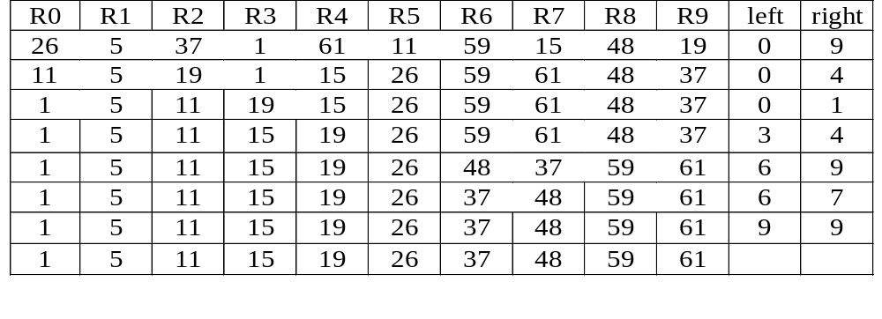
Example for Quick Sort
{
}
{
}
{
}
{
}
{
}
{
}
{
}
{
}
{
}
{
}
CHAPTER 7

Slide 9
Quick Sort
void quicksort(element list[], int left, int right)
{
int pivot, i, j;
element temp;
if (left < right) {
i = left; j = right+1;
pivot = list[left].key;
do {
do i++; while (list[i].key < pivot);
do j--; while (list[j].key > pivot);
if (i < j) SWAP(list[i], list[j], temp);
} while (i < j);
SWAP(list[left], list[j], temp);
quicksort(list, left, j-1);
quicksort(list, j+1, right);
}
}
CHAPTER 7

Slide 10
Analysis for Quick Sort
  The worst case O(n²)
Assume that each time a record is positioned, the list is divided roughly of same size, each of size n/2. Positioning within the list with n element needs O(n)
  Assume T(n) is the time taken to sort a list of size n:
T(n)<=cn+2T(n/2) for some c
<=cn+2(cn/2+2T(n/4))
...
<=cnlog n+nT(1)
=O(nlog n)
CHAPTER 7

Slide 11
Analysis of Quick Sort
Quick sort needs stack space to implement the recursion.
If the lists split evenly, the maximum recursion depth would be log n and the stack space is of O(log n).
The worst case is when the lists split into a left sublist of size n – 1 and a right sublist of size 0 at each level of recursion. In this case, the recursion depth is n, the stack space of O(n).

Slide 12
Time and Space for Quick Sort
Space complexity:
  Average case and best case: O(log n)
  Worst case: O(n)
Time complexity:
  Average case and best case: O(n log n)
  Worst case: O(n )
2
CHAPTER 7

Slide 13
Merge Sort
Given two sorted lists
(A, m)
(B, n)
generate a single sorted list
(C, m+n)
CHAPTER 7

Slide 14
Merge Sort
The process of merging of two sorted lists into a single sorted list is called simple merge.
CHAPTER 7

Slide 15
Example
10 | 20 | 40 | 50 | 15 | 25 | 30 | 10
10 | 20 | 40 | 50 | 15 | 25 | 30 | 10 | 15
10 | 20 | 40 | 50 | 15 | 25 | 30 | 10 | 15 | 20
10 | 20 | 40 | 50 | 15 | 25 | 30 | 10 | 15 | 20 | 25
10 | 20 | 40 | 50 | 15 | 25 | 30 | 10 | 15 | 20 | 25 | 30
10 | 20 | 40 | 50 | 15 | 25 | 30 | 10 | 15 | 20 | 25 | 30 | 40 | 50
10 | 20 | 40 | 50 | 15 | 25 | 30
CHAPTER 7

Slide 16
Merge Sort
void simplemerge(int A[], int B[], int m, int n)
{
int i,j,k;
i=j=k=0;
while (i<m && j<n) {
if (A[i]<B[j])
C[k++]= A[i++];
else
C[k++]= B[j++];
}
while (i<m) C[k++]= A[i++];
while(j<n) C[k++] = B[j++];
}
CHAPTER 7

Slide 17
SimpleMerge(a, low, mid, high)
//Merge 2 arrays with first array starting from low to mid and other array starting from mid+1 to high
void SimpleMerge(int A[], int low, int mid, int high)
{
  i = low, j=mid+1,k=low;
  m = mid+1, n = high+1;
  while (i<m && j<n) {
  if (A[i]<A[j])
  C[k++]= A[i++];
  else
  C[k++]= A[j++];
  }
  while (i<m) C[k++]= A[i++];
  while(j<n) C[k++] = A[j++];
  for i= low to high
      A[i] = c[i];
  }

Slide 18
Recursive Merge Sort
Recursive merge sort divides the list to be sorted into two roughly equal parts:
  the left sublist [left : (left+right)/2]
  the right sublist [(left+right)/2 +1 : right]
These sublists are sorted recursively, and the sorted sublists are merged.
Merge sort needs additional storage space proportional to the number of records in the file being sorted, while its computing time is O(n log n)

Slide 19
Recursive Merge Sort
General Procedure to sort the items using Merge Sort:
Assume low and high are lower and upper limits in an array.
  If (low< high)
    Divide the array into equal parts
    Sort the left part of the array
    Sort the right part of the array
    Merge the left and right part
CHAPTER 7

Slide 20
Recursive Merge Sort
lower
upper
void MergeSort(element list[], int low, int high)
{
int middle;
if (low < high) {
mid = (low+high)/2;
MergeSort(list,low,mid);
MergeSort(list,mid+1,high),
SimpleMerge(list, low, mid, high);
}
}
lower
middle
upper
CHAPTER 7

Slide 21
Sublist Partitioning For Recursive Merge Sort
26
5
77
1
61
11
59
15
48
19
5 26
11 59
19 48
5 26 77
1 61
11 15 59
19 48
1 5 26 61 77
11 15 19 48 59
1 5 11 15 19 26 48 59 61 77

Slide 22
Heap Sort
Refer text book.
CHAPTER 7

