Slide 1
RAPTOR
A tool for drawing and executing flowcharts
  RAPTOR , the Rapid Algorithmic
  Prototyping Tool for Ordered Reasoning
The RAPTOR development environment minimizes the amount of syntax so that learners can focus on the solution steps
CSE 1001 Computer science and Engg
Notes:
Additional notes on RAPTOR
RAPTOR is a flowchart-based programming environment, designed specifically to help students visualize their algorithms and avoid syntactic baggage. RAPTOR programs are created visually and executed visually by tracing the execution through the flowchart.
We use RAPTOR for several reasons.
1. The RAPTOR development environment minimizes the amount of syntax you must learn to write correct program instructions.
2. The RAPTOR development environment is visual.
3. RAPTOR programs are diagrams (directed graphs) that can be executed one symbol at a time. This will help you follow the flow of instruction execution in RAPTOR programs.
4. RAPTOR is designed for ease of use.
5. RAPTOR error messages are designed to be more readily understandable by beginning programmers.

Slide 2



Symbols used in RAPTOR
 | The assignment symbol is used to change the value of a variable. The right hand side of the assignment is evaluated, and the resulting value is placed in the variable on the left hand side. For example, consider the case where the value of x is currently 5, and the assignment "x <- x + 1" is executed. First "x+1" is evaluated, yielding the result 6. Then the value of x is changed to be 6. Note that assignment is very different from mathematical equality. The statement should be read "Set x to x+1" instead of "x equals x+1".
 | The call symbol is used to invoke procedures such as graphics routines and other instructor-provided procedures. The call symbol is also used to run subcharts included in a Raptor program.
 | The input symbol is used to ask the user for a number or string while the flowchart is executing. When an input symbol is executed, the user will be prompted with a dialog to enter a value that can be interpreted as either a number or string, depending on what the user types.
CSE 1001 Computer science and Engg

Slide 3



Symbols used in RAPTOR
 | The output symbol is used to either write a number or text to the Master Console window.
 | The selection structure is used for decision making. The programmer enters in the diamond an expression that evaluates to Yes (True) or No (False). Such expressions are formally referred to as Boolean expressions. Based on the result of the expression in the diamond, control of the program will branch either left (Yes, or True) or right (No, or False).
 | The loop structure is used to repeat a sequence of symbols until a certain condition is met. When execution reaches the bottom of the loop, it starts over again at the top. The loop is exited when the diamond symbol is executed and the Boolean expression in the diamond evaluates to Yes (True).
  Syntax
  Additional Information
  Control Flow
  Video clip
  Case studies
  Notes on RAPTOR
CSE 1001 Computer science and Engg

Slide 4
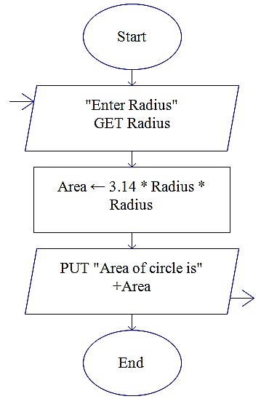
Algorithm and Flowchart for area of the circle
Name of the algorithm : Compute the area of a circle
Step1: Input radius
Step 2: [Compute the area]
Area ← 3.1416 * radius*radius
Step 3: [Print the Area]
Print ‘Area of a circle =‘, Area
Step 4: [End of algorithm]
Stop
  Flowchart:
  AreaC
  Syntax
  Additional Information
  Control Flow
  Video clip
  Case studies
  Do it yourself
CSE 1001 Computer science and Engg

Slide 5
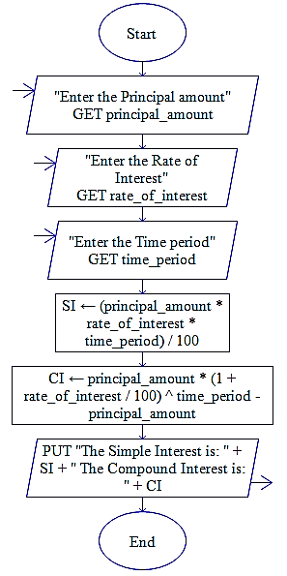
Algorithm & Flowchart for SI and CI
Name of the algorithm: Calculate SI and CI
Step1: [ Read the values of P, T and R]
Input P,R,T
Step 2: [Compute the simple interest]
SI ← ( P*R*T)/100
Step 3: [Compute the compound interest]
CI ← P*(1+ R/100)^{T} - P
Step 4: [Print the simple and compound interest]
Print ‘Simple Interest=‘,SI
Print ‘Compound Interest=‘,CI
Step 5: [End of Algorithm]
Stop
  Syntax
  Additional Information
  Control Flow
  Video clip
  Case studies
  Do it yourself
Flowchart:
  SI&CI
CSE 1001 Computer science and Engg

Slide 6
Algorithm for arithmetic operations
Name of the algorithm: Perform various Arithmetic operations
Step1: [Read the value of numbers (n1 and n2)]
Input n1, n2
Step2: [Compute the sum, difference and product and quotient]
sum ← n1 + n2
difference← n1 – n2
product ← n1 * n2
quotient ← n1 / n2
  Syntax
  Additional Information
  Control Flow
  Video clip
  Case studies
  Do it yourself
CSE 1001 Computer science and Engg

Slide 7
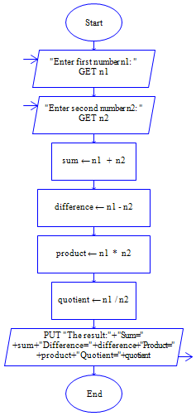
Flowchart for arithmetic operations
Step 3: [Print the contents of sum, diff, prod and quotient]
Print ‘The result’
Print ‘Sum =‘, sum
Print ‘Difference =‘, difference
Print ‘Product =‘, product
Print ‘Quotient =‘, quotient
Step4: [End of Algorithm]
Stop
  Syntax
  Additional Information
  Control Flow
  Video clip
  Case studies
  Do it yourself
Flowchart:
  arith
CSE 1001 Computer science and Engg

Slide 8
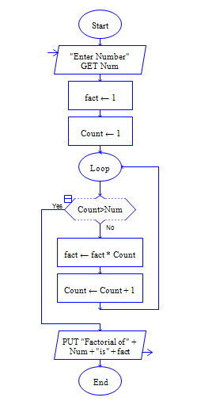
Flowcart to find factorial of given no
  Syntax
  Additional Information
  Control Flow
  Video clip
  Case studies
  Do it yourself
CSE 1001 Computer science and Engg
Notes:
Factorial computing
Factorials are very simple things. They're just products, indicated by an exclamation mark. For instance, "four factorial" is written as "4!" and means 1×2×3×4 = 24. In general, n! ("enn factorial") means the product of all the whole numbers from 1 to n; that is, n! = 1×2×3×...×n.

Slide 9
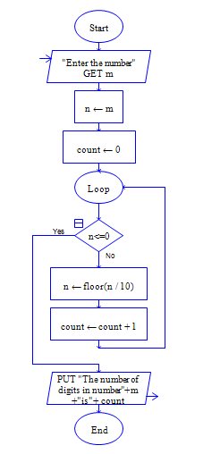
Flowchart to find no of digits of a given no
  Syntax
  Additional Information
  Control Flow
  Video clip
  Case studies
  Do it yourself
CSE 1001 Computer science and Engg
Notes:
Additional notes on FLOOR
The floor functions return the largest integral value less than or equal to x.
For example
Floor of 12.5 is 12.0; floor of 12.6 is also 12.0.

