Slide 1
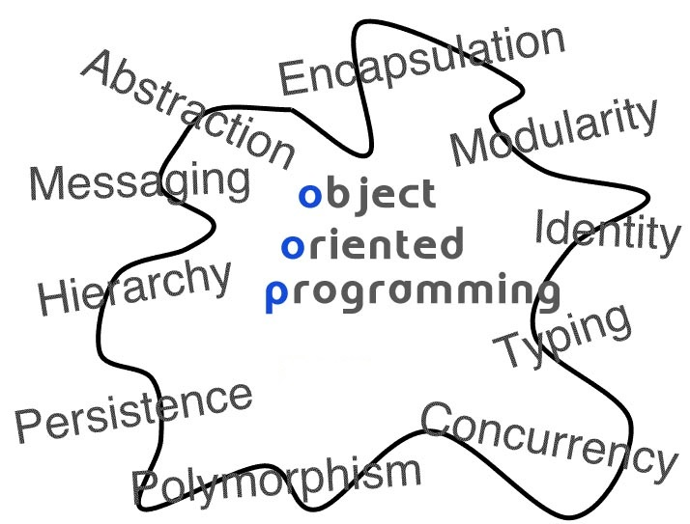
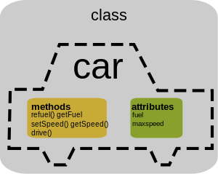
Introduction to Object Oriented Programming
L36-L38

Slide 2
Objectives
To learn and appreciate the following concepts
Procedure oriented programming versus object oriented programming
Basic concepts of object oriented programming
Benefits of object oriented programming

Slide 3
Session outcome
At the end of session the student will be able to understand
basic concepts of object oriented programming
benefits of object oriented programming

Slide 4
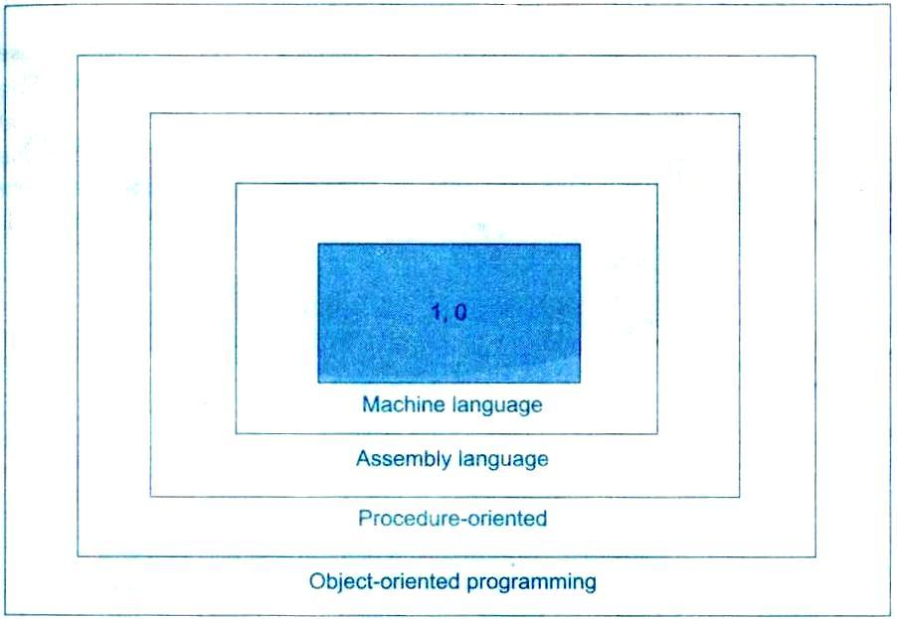
Layers

Slide 5
Procedure Oriented Programming
Emphasis is on doing things (algorithms).
Large programs are divided into smaller programs known as functions.
Most of the functions share global data.
Data move openly around the system from function to function.
Employs top-down approach in program design.

Slide 6
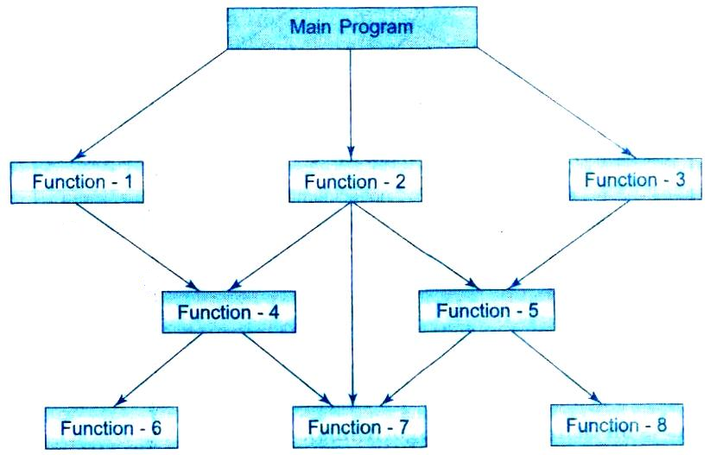
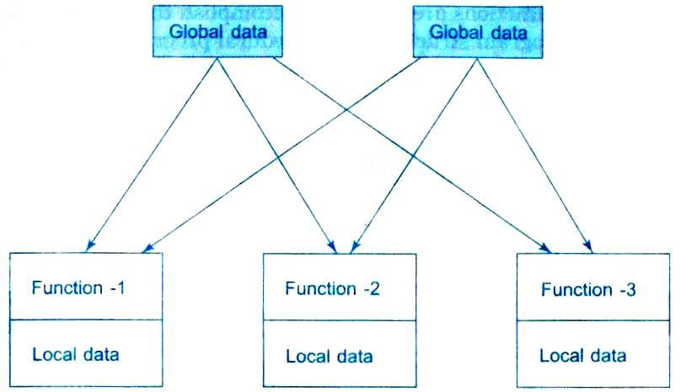
Procedure Oriented Programming
Structure of Procedure-oriented programs
Relationship of data and functions in procedural programming

Slide 7
Concepts of Object Oriented Programming
Emphasis is on data rather than procedure.
Programs are divided into what are known as objects.
Data structures are designed such that they characterize the objects.
Data is hidden and cannot be accessed by external functions.

Slide 8
Concepts of Object Oriented Programming
Functions that operate on the data of an object are tied together in the data structure.
Objects may communicate with each other through functions.
Follows bottom-up approach in program design.

Slide 9
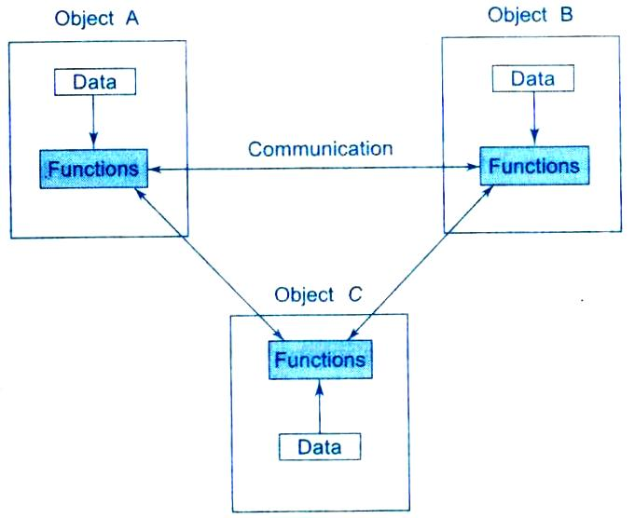
Concepts of Object Oriented Programming
Organization of data and functions in OOP

Slide 10
Concepts of Object Oriented Programming
Objects
Classes
Data abstraction and Encapsulation
Inheritance
Polymorphism

Slide 11
Objects
Objects are the basic run-time entities in an object oriented system.
They may represent a place, a bank account, a table of data or any item that the program has to handle.

Slide 12
Objects
When a program is executed, the objects interact by sending messages to one another.
For example, if “customer” and “account” are two objects in a program, then the customer object may send a message to the account object requesting for the bank balance.
Each object contains data, and code to manipulate the data.

Slide 13
Classes
The entire set of data and code of an object can be made a user defined data type with the help of a class.
Objects are variables of the type class.
Once a class has been defined, we can create any number of objects belonging to that class.

Slide 14
Classes
Classes are user defined data types and behave like the built-in types of a programming language.
Internal data of a class – member data
Internal functions of a class – member functions

Slide 15
Data Encapsulation
The wrapping of data and functions into a single unit (called class) is known as encapsulation.
The data is not accessible to the outside world, and only those functions which wrapped in the class can access it.
These functions provide the interface between the object’s data and the program.
This insulation of the data from direct access by the program is called data hiding or information hiding.

Slide 16
Data Abstraction
Data Abstraction refers to the act of representing essential features without including the background details or explanations.
Classes use the concept of abstraction.
They encapsulate all the essential properties of the objects that are to be created.

Slide 17
Inheritance
Inheritance is the process by which objects of one class acquire the properties of another class.
It supports the concept of hierarchical classification.
In OOP, the concept of inheritance provides the idea of reusability.

Slide 18
Inheritance
This means that we can add additional features to an existing class without modifying it.
This is possible by deriving a new class from the existing one. (Base class and derived class)
The new class will have the combined features of both the classes

Slide 19
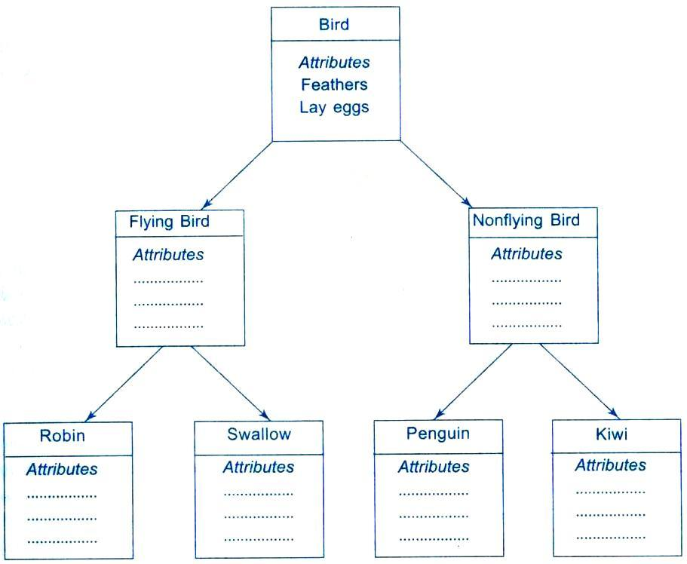
Inheritance

Slide 20
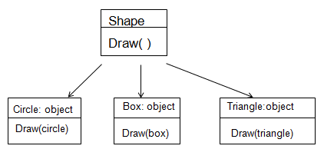
Polymorphism
Polymorphism means the ability to take more than one form. The behavior depends upon the types of data used in the operation.
This is something similar to a particular word having several different meanings depending on the context.

Slide 21
General form of a class declaration
class class_name
{
private:
variable declarations;
function declarations;
public:
variable declarations;
function declarations;
};
The private class members can only be accessed from within the class.
The public class members can be accessed from outside the class also.
By default, the members of a class are private.

Slide 22
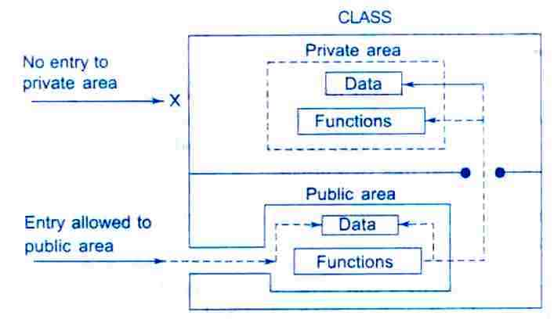
Data access
Data hiding in classes
The variables declared inside the class are known as data members and functions are known as member functions.
Only member functions can have access to the private data members and private functions.
Public members (both functions and data) can be accessed from outside.

Slide 23
A simple class example
class item
{
int number;
float cost;
public:
void getdata(int a, float b);
void putdata(void);
};
2 data members and 2 member functions

Slide 24
Creating Objects
item x,y,z; // x,y and z are objects of type item.
The class specification provides only a template & does not create any memory space for the objects.
The declaration of an object is similar to that of a variable of any basic type.
The necessary memory space is allocated to an object when it is declared.

Slide 25
Accessing Class Members
Format for calling a member function:
object-name.function-name(actual-arguments);
Ex:- x.getdata(100,75.5);
This statements assigns 100 to number and 75.5 to cost of the object x.
A member function can be invoked only by using an object.
getdata(100,75.5); //illegal
Notes:
number (declared private) can be accessed only through a member function.
x. number=100; // illegal

Slide 26
Defining Member functions
Outside the class definition
return-type class-name:: function-name (argument declaration)
{
Function body
}
The membership label class-name :: tells the compiler that the function function-name belongs to the class class-name.
The symbol :: is called the scope resolution operator.
Member functions can also be defined inside the class definition without using ::

Slide 27
A C++ program with a class
class student{
char name[30];
int rollno;
public:
void getdata(char a[ ],int n){
strcpy(name, a);
rollno=n;
}
void putdata( );
};
void student::putdata( ){
cout<<“Name:”<<name;
cout<<“Roll No:”<<rollno;
}
void main( ){
student s1;
char name1[20];
int roll1;
cout<<“\nEnter name”<<endl;
cin>>name1;
cout<<“\nEnter roll no”<<endl;
cin>>roll1;
s1.getdata(name1,roll1);
s1.putdata( );
}

Slide 28
Sorting an array using OOP
const int size=10;
class array
{
int a[size];
public:
void setval( );
void display( );
void sort( );
};
int i ,j, temp;
void array :: setval( )
{
cout<<“enter 10 values”;
for (i=0; i<size; i++)
cin >> a[i];
cout<< endl;
}
void array::sort(void)
{
for(i=0;i<size-1;i++)
for(j=i+1;j<size ;j++)
if(a[i]>a[j])
{
temp=a[i];
a[i]=a[j];
a[j]=temp;
}
}
void array :: display( )
{
for(i=0; i<size; i++)
cout<<a[i]<<“ ”;
cout<<endl;
}

Slide 29
Sorting an array using OOP
void main( )
{
array obj1;
objl. setval( );
cout<<“original array”<<endl;
objl.display( );
objl.sort( );
cout<<“sorted array”<< endl;
objl.display( );
getch( );
}

Slide 30
Benefits of Object Oriented Programming
Through inheritance, we can eliminate redundant code and extend the use of existing classes.
We can build programs from the standard working modules that communicate with one another, rather than having to start writing the code from scratch.
This leads to saving of development time and higher productivity.

Slide 31
Benefits of Object Oriented Programming
Data hiding helps the programmer to build secure programs that cannot be invaded by code in other parts of the program.
It is possible to map objects in the problem domain to those in the program.
Easy to partition the work in a project based on objects.
Object oriented systems can be easily upgraded from small to large systems - Scalability.
Software complexity can be easily managed.

Slide 32
Summary
Procedure oriented programming versus object oriented programming
Basic concepts of object oriented programming:- class, inheritance, polymorphism
Example programs
Benefits of object oriented programming
Syntax
Notes
Do’s
Don’ts
Video clip
Case studies
Do it yourself

