Slide 1
C++ Programming Fundamentals L5-L6

Slide 2
Objectives
To learn and appreciate the following concept
Some Fundamentals
Program Structure
Compiling and running your first C++ program
Debugging program errors
Best practices for programming
Input and Output operations

Slide 3
Session outcome
At the end of session one will be able to understand
Some Fundamentals
Program Structure
Compiling and running your first C++ program
Debugging program errors
Best practices for programming
Input and Output operations

Slide 4
History of C
C is a high level language.
Evolved by Dennis Ritchie and Brain Kernighan(1978)
from two previous programming languages, BCPL (Basic Combined Programming Language )and B
Used to develop UNIX system software routines
Is implemented on UNIX operating system
Structural / Modular Programming
Portable & have compilers for almost all architectures.

Slide 5
History of C++
“C with classes” (1979) →C++ (1983)
Superset of C developed by Bjarne Stroustrup at Bell Labs and provides object-oriented capabilities named “c with classes”.
Object-oriented design is very powerful
10 to 100 fold increase in productivity
Dominant language in industry and academia.

Slide 6
The first C++ program
uses standard library
input and output functions
(cout)
#include <iostream.h>
int main (void)
{
cout<<"Programming is fun.\n");
return 0;
}
the program
begin of program
statement(s)
end of program
main: a special name that indicates where the program must begin execution. It is a special function.
first statement: calls a routine named cout, with argument the string of characters “Programming is fun. \n”
last statement: finishes execution of main and returns to the system a status value of 0 (conventional value for OK)

Slide 7
Simple C++ program
Write a program to display “My first C++ program”
// Single line comment
#include <iostream.h> // preprocessor directive
void main( ) // Entry point for program execution
{ // block of statements: Begin
clrscr( ); //Each Statement ends with ;
cout << “My first C++ program”;
} // block of statements: End
Notes:
Additional notes
Commenting a statement in C++
Any line that starts with a // is a comment. Unlike the C type of comments that start /* and end */, the double forward slashes end with the end of line. To comment large swathes of code out, you would still use /* comments here */ as adding // to the start of each line is tedious.
Preprocessor directives in C++
Preprocessor directives are lines included in the code of our programs that are not program statements but directives for the preprocessor. These lines are always preceded by a hash sign (#). The preprocessor is executed before the actual compilation of code begins, therefore the preprocessor digests all these directives before any code is generated by the statements. These preprocessor directives extend only across a single line of code. As soon as a newline character is found, the preprocessor directive is considered to end. No semicolon (;) is expected at the end of a preprocessor directive. The only way a preprocessor directive can extend through more than one line is by preceding the newline character at the end of the line by a backslash (\).
clrscr() function
This function performs to clear text mode window. It clears the current text window and places the cursor in the upper left-hand corner (1, 1 position). If we don’t use this function we’ll see the previous output window written any text.

Slide 8
The format in C++
Statements are terminated with semicolons
Indentation is nice to be used for increased readability.
Free format: white spaces and indentation is ignored by compiler
C++ is case sensitive – pay attention to lower and upper case letters when typing !
All keywords and standard functions are lower case
Typing INT, Int, etc instead of int is a compiler error
Strings are placed in double quotes
New line is represented by \n (Escape sequence)

Slide 9
Compiling and running C++ programs
Editor
Source code
file.cpp
Compiler
Object code
file.obj
Libraries
Linker
Executable code
file.exe
IDE (Integrated Development Environment)

Slide 10
Compilers and IDE’s
One can:
use a text editor to edit source code, and then use independent command-line compilers and linkers
use an IDE: everything together + facilities to debug, develop and organize large projects
There are several compilers and IDE’s that support various C++ compilers
Lab: Turbo C++, Dev-C++ IDE for C and C++, Free Software (under the GNU General Public License)
Notes:
Additional information on Turbo C++
Turbo C++ was a C++ compiler and integrated development environment and computer language originally from Borland. Most recently it was distributed by Embarcadero Technologies, which acquired all of Borland's compiler tools with the purchase of its Code Gear division in 2008. The original Turbo C++ product line was put on hold after 1994, and was revived in 2006 as an introductory-level IDE, essentially a stripped-down version of their flagship C++ Builder. Turbo C++ 2006 was released on September 5, 2006 and was available in 'Explorer' and 'Professional' editions. The Explorer edition was free to download and distribute while the Professional edition was a commercial product. In October 2009 Embarcadero Technologies discontinued support of its 2006 C++ editions. As such, the Explorer edition is no longer available for download and the Professional edition is no longer available for purchase from Embarcadero Technologies. Turbo C++ is succeeded by C++ Builder.
Menu Options:
File : New, Open(F3), Save(F2), Save as, Change directory, Quit(Alt + x)
Edit : Undo, Redo, cut, copy, paste
Run : Run(Ctrl + F9), Program reset(ctrl + F2), go to cursor(F4), Trace into(F7), Step Over(F8), Break-point (Ctrl+F8)
Compile : Compile(Alt + F9)
Debug : Watch window(add watch (Ctrl+F7), delete watch, Edit watch, remove all watches)
Windows : User Screen( Alt + F5)
Help : <Ctrl> F1 or right click (keep cursor on the word)

Slide 11
Debugging program errors
Editor
Syntactic
Errors
Source code
file.cpp
Compiler
Object code
file.obj
Libraries
Linker
Executable code
file.exe
Semantic
Errors

Slide 12
Syntax and Semantics
Syntax errors: violation of programming language rules (grammar)
"Me speak English good."
Use valid C or C++ symbols in wrong places
Detected by the compiler
Semantics errors: errors in meaning:
"This sentence is excellent Italian."
Programs are syntactically correct but don’t produce the expected output
User observes output of running program

Slide 13
Second program
#include <iostream.h>
void main (void)
{
cout<<"Programming is fun.\n";
cout<<"And programming in C++ is even more fun.\n";
}

Slide 14
Displaying multiple lines of text
#include <iostream.h>
void main (void)
{
cout<<"Testing...\n..1\n...2\n....3\n";
}
It is not necessary to make a separate call to cout for each line of output !
Output:
Testing...
..1
...2
....3

Slide 15
Displaying multiple values
#include <iostream.h>
void main (void)
{
int value1, value2, sum;
value1 = 50;
value2 = 25;
sum = value1 + value2;
cout<<"The sum of “<<value1<<“+”<<value2<<“ is”<<sum;
}
The format must contain as many output operators as constant strings and values

Slide 16
Using comments in a program
Comment statements are used in a program to document it and to enhance its readability.
Useful for human readers of the program – compiler ignores comments
Ways to insert comments in C or C++:
When comments span several lines: start marked with /*, end marked with */
Comments at the end of a line: start marked with //
Notes:
General Commenting Guidelines
Comments are used to document programs and improve readability.
The ratio of code to comments should be 10 : 3
Whenever there is a block of code which is doing something complex, sufficient amount of comments should be put in to explain.
Comment should not be in the same line as the code.
Use only C/C++ Style comments (/* This is a line of comment */)

Slide 17
Using comments in a program
/* This program adds two integer values
and displays the results */
#include <iostream.h>
void main (void)
{
// Declare variables
int value1, value2, sum;
// Assign values and calculate their sum
value1 = 50;
value2 = 25;
sum = value1 + value2;
// Display the result
cout<<"The sum of ”<<value1<<“ and ”<<value2<<“ is “<<sum;
}

Slide 18
Best Practices for Programming
Naming Variables According to Standards
Prefix Data Type Example
i int and unsigned int iTotalMarks
f float fAverageMarks
d double dSalary
l long and unsigned long lFactorial
c signed char and unsigned char cChoice
ai Array of integers aiStudentId
af Array of float afQuantity
ad Array of double adAmount
al Array of long integers alSample
ac Array of characters acEmpName

Slide 19
Importance of following coding standards
Advantages
Improves readability of the program
Improves clarity of the program
Makes it easy to debug and maintain the program
Notes:
Additional information on coding standards
Introduction
Coding standards are important for many reasons. First and foremost, they specify a common format for the source code and comments. This allows developers to easily share code, and the ideas expressed within the code and comments, between each other. It also specifies how comments (internal documentation) should be handled. More importantly, a well-designed standard will also detail how certain code should be written, not just how it looks on screen.
More important than the reasons for having a standard is actually adhering to it consistently. Having a coding standard documented and available means nothing if developers are not using it consistently. If that becomes the case, it is no longer a coding standard; it has become a coding suggestion. Worse yet are the developers that do not have a style or standard at all, and think that their lack of a style/standard is a coding style/standard!
Coding Standards vs. Coding Styles
Most coding standards that I have encountered are little more than coding style documents. What is the difference? A coding style specifies things like how you indent, tabs vs. spaces, use of "reverse-Hungarian" notation for naming of variables, etc. A coding standard often includes a coding style, but goes beyond just how to name a variable: it tells you how that variable should be treated and when it should (and should not be) used.
The coding standards may differ from project to project
This may vary from customer to customer
Every company prepares their own coding standards

Slide 20
File Header Block
All source and header files must contain at the beginning of the file, a section providing information about the source or the header file
/****************************************
File : <File Name>
Description : <Problem Statement>
Author : <author> <company>
Version : <version number>
Date : <date>
******************************************/
Here description should be a brief of what the code in the file does

Slide 21
File Footer Block
All files should have this footer at the end of the file
/*****************************************
End of <File Name>
******************************************/

Slide 22
Function comment Block
All functions (or methods) should be preceded by a comment block
/****************************************
File : <File Name>
Description : <Problem Statement>
Input : <Input parameters>
<parameter 1> - <brief description>
<parameter 2> - <brief description>
… …
Returns : <returns values in both cases of success and error conditions >
******************************************/

Slide 23
General Commenting Guidelines
Comments are used to document programs and improve readability.
The ratio of code to comments should be 10 : 3
Whenever there is a block of code which is doing something complex, sufficient amount of comments should be put in to explain.
Comment should not be in the same line as the code.
Use only C/C++ Style comments (/* This is a line of comment */)

Slide 24
Indentation of code
Indentation is the practice by Software Engineers to use spaces or tabs consistently in every line of code to group lines together based on their scope for easy readability
An indented code looks better and can be understood easily.
The code in a line should not exceed 80 columns.
If the column size exceeds 80, then \ can be used to continue in the next line.
Notes:
Additional information – Indentation
There is a semantic way of using tab characters in source code: tabs for indentation, spaces for alignment. This ensures that the code is displayed correctly everywhere, regardless of the viewer’s tab size.
The approach can be summed up in two points:
1. Tabs are only used at the beginning of lines. Everything else, like ASCII art and tables, should be formatted with spaces.
2. Tabs are only used for expressing the indentation level. One tab per “block” – any remaining whitespace is spaces only.

Slide 25
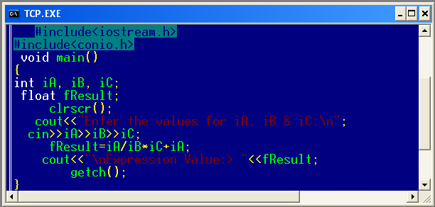

Bad Indentation

Slide 26
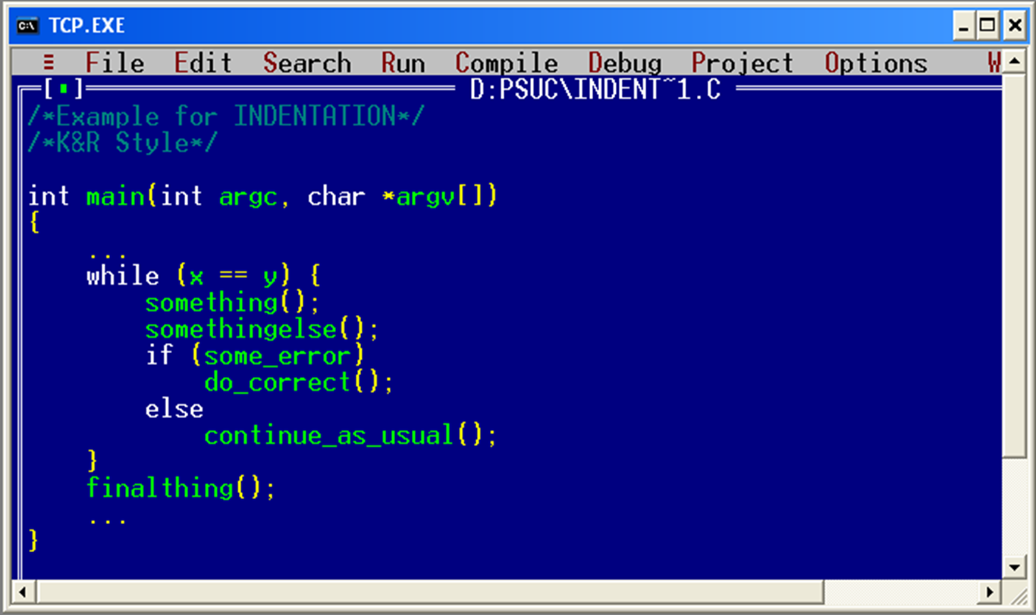

Good Indentation
Notes:
Notes on placement of braces (curly brackets)
As we have seen early on the statement selection, compound statement are very important in C++, they also are subject of different coding styles, that recommend different placements of opening and closing braces ({ and }). Some recommend putting the opening brace on the line with the statement, at the end. Others recommend putting these on a line by itself, but not indented (ANSI C++). GNU recommends putting braces on a line by itself, and indenting them half-way. We recommend picking one brace-placement style and sticking with it.

Slide 27
Standard input/output
Standard I/O: cin, cout
#include <iostream.h>
Character I/O: getchar(), putchar()
#include <stdio.h>

Slide 28
#include <iostream.h>
Lines beginning with a sign (#) are directives for the preprocessor.
They are not regular code lines.
directive #include <iostream.h> tells the preprocessor to include the iostream standard header file.
This specified file (iostream.h) includes the declarations of the basic standard input-output library in C++, and it is included because its functionality is going to be used later.
Notes:
Additional information on few preprocessor directives
#include<conio.h>
conio.h is Turbo C++ header file from Borland. It is used for clrscr(), getch() functions..
#include<math.h>
Used for mathematics related operations. (Eg. To compute square root etc.)

Slide 29
cout statement
<< known as insertion or put to operator
It inserts the contents of the variable on its right to the object on its left.
Eg: cout<<“welcome to MIT”;
Notes:
cout represents the standard output stream in C++. meaning of the entire statement is to insert a sequence of characters into the standard output stream (which is usually the screen).
(;) This character is used to mark the end of the statement and in fact it must be included at the end of all expression statements [other than control structures & main()] in all C++ programs.

Slide 30
cin statement
>> known as extraction or get from operator.
It extracts the value from keyboard & assign it to the variable on its right.
Ex: cin>>a;
Notes:
Integer read
Ignores/skips leading white space characters (space, tab, new line)
Begins collecting digits, stops at the first non-digit character (leaving that character in the buffer)
Character read
Ignores/skips leading white space characters (space, tab, new line)
Reads next character (any valid ASCII character)

Slide 31
Summary
Some Fundamentals
Program Structure
Compiling and running your first C++ program
Debugging program errors
Best practices for programming
Input and Output operations
Syntax
Additional Information
Do’s
Don’ts
Control Flow
Case studies
Do it yourself

