Slide 1
C++ Programming Concepts
L7 – L8

Slide 2
Objectives
To learn and appreciate the following concept
Variables, Data Types, and Arithmetic Expressions
Working with Variables
Understanding Data Types and Constants
Working with Arithmetic Expressions
The Assignment Operators

Slide 3
Session outcome
At the end of session one will be able to understand
Variables, Data Types, and Arithmetic Expressions
Working with Variables
Understanding Data Types and Constants
Working with Arithmetic Expressions
The Assignment Operators

Slide 4
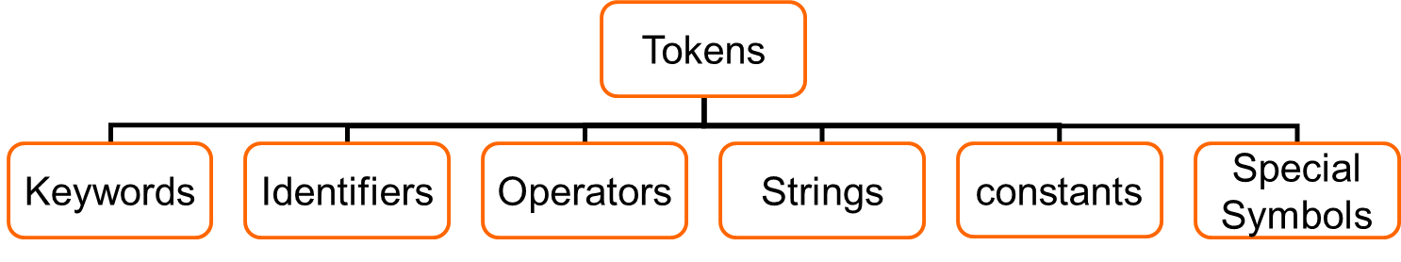
C++ Tokens
A token is a group of characters that logically belong together.
The programmer can write a program by using tokens.
C++ uses the following types of tokens.
break
int
float
…
hello
name
…
+
*
%
…
“hello”
“name”
“s”
…
124
21.3
‘A’
‘9’
“4+5”
…
;
?
>
&{
}
Notes:
In a passage of text, individual words and punctuation marks are called tokens.
Similarly in a C program the smallest individual units are known as tokens.

Slide 5
Variables
Programs can use symbolic names for storing computation data
Variable: a symbolic name for a memory location
programmer doesn’t have to worry about specifying (or even knowing) the value of the location’s address
In C or C++, variables have to be declared before they are used
Variable declaration: [datatype, symbolic name(identifier)]
int a;
Declarations that reserve storage are called definitions
The definition reserves memory space for the variable, but doesn’t put any value there
Values get into the memory location of the variable by initialization or assignement int a=10;
Notes:
A variable is a data name that may be used to store a data value.
A variable may take different values at different times during execution.
Variable name chosen by the programmer in a meaningful way.
Each variable needs an identifier that distinguishes it from the others.
( rules similar to identifier)

Slide 6
Variables - Examples
int a; // declaring a variable of type int
int sum, a1,a2; // declaring 3 variables
int x=7; // declaring and initializing a variable
a=5; // assigning to variable a the value 5
a1=a; // assigning to variable a1 the value of a
L-value
R-value
a1=a1+1; // assigning to variable a1 the value of a1+1
// (increasing value of a1 with 1)
Notes:
Primary Type declaration:
write the keyword of the desired data type (like int, char, float...) followed by a valid variable identifier.
data-type V₁, V₂,…,V_{n}
The process of giving initial values to variables→ “Initialization”.
external & static variables initialized to zero by default.
const int class_size = 40;
const tells the compiler the value of variable class_size must not modified by the program. It can be used on the right hand side of any assignment statement.

Slide 7
Using and Displaying Variables
#include <iostream.h>
void main (void)
{
int sum;
sum = 50 + 25;
cout<<"The sum of 50 and 25 is “<<sum;
}
Variable sum declared of type int
Variable sum assigned expression 50+25
Value of variable sum is printed
The cout routine call has now 2 arguments: first argument a string, and the second that holds variable with integer value of summation.

Slide 8
Variable declarations
Data type Variable name
Which data types
are possible in C++ ?
Which variable names
are allowed in C++ ?

Slide 9
Variable names
Rules for valid variable names (identifiers) :
Name must begin with a letter or underscore ( _ ) and can be followed by any combination of letters, underscores, or digits.
Any name that has special significance to the C++ compiler (reserved words) cannot be used as a variable name.
Examples of valid variable names: Sum, pieceFlag, I, J5x7, Number_of_moves, _sysflag
Examples of invalid variable names: sum$value, 3Spencer, int.
C++ is case-sensitive: sum, Sum, and SUM each refer to a different variable !
Variable names can be as long as you want, although only the first 63 (or 31) characters might be significant. (Anyway, it’s not practical to use variable names that are too long)
Choice of meaningful variable names can increase the readability of a program

Slide 10
Declaring variables
Some older languages (FORTRAN, BASIC) allow you to use variables without declaring them.
Other languages (C, C++, Pascal) impose to declare variables
Advantages of languages with variable declarations:
Putting all the variables in one place makes it easier for a reader to understand the program
Thinking about which variables to declare encourages the programmer to do some planning before writing a program ( What information does the program need? What must the program to produce as output? What is the best way to represent the data?)
The obligation to declare all variables helps prevent bugs of misspelled variable names.
Compiler knows the amount of statically allocated memory needed
Compiler can verify that operations done on a variable are allowed by its type (strongly typed languages)

Slide 11
Declaration vs Definition
Variable declaration: [Type, Identifier]
int a;
Variable definition: a declaration which does also reserve storage space (memory) !
Not all declarations are definitions.
In the examples seen so far, all declarations are as well definitions.

Slide 12
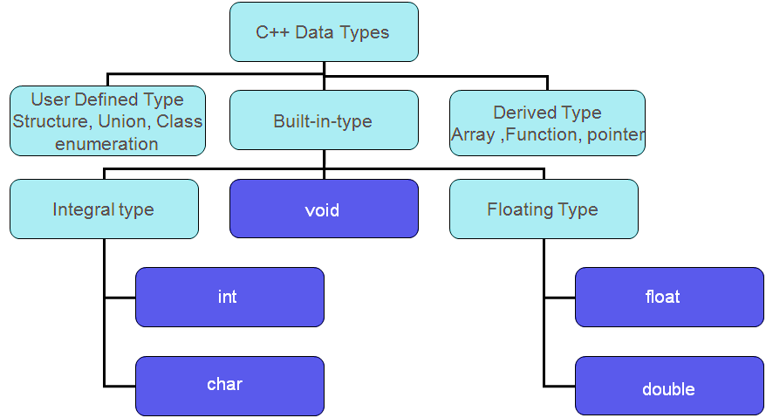
Data types
Notes:
The data type allows the user/programmer to select the type appropriate to the needs of the application as well as machine.
ALL C compilers support 5 fundamental data types

Slide 13
Data types
Basic data types: int, float, double, char, and void.
Data type int: can be used to store integer numbers (values with no decimal places)
Data type float: can be used for storing floating-point numbers (values containing decimal places).
Data type double: the same as type float, only with roughly twice the precision.
Data type char: can be used to store a single character, such as the letter a, the digit character 6, or a semicolon.
Data type void:
To specify the return type of a function when it is not returning any value
To indicate an empty argument list to a function

Slide 14
Example: Using data types
#include <iostream.h>
void main (void)
{
int integerVar = 100;
float floatingVar = 331.79;
double doubleVar = 8.44e+11;
char charVar = 'W';
cout<<"integerVar = "<< integerVar;
cout<<"\n floatingVar = "<< floatingVar;
cout<<"\n doubleVar = "<< doubleVar;
cout<<"\n doubleVar = "<< doubleVar;
cout<<"\n charVar = "<< charVar;
}

Slide 15
The basic data type int
Examples of integer constants: 158, –10, and 0
No embedded spaces are permitted between the digits, and values larger than 999 cannot be expressed using commas. (The value 12,000 is not a valid integer constant and must be written as 12000.)
Integers can also be expressed in a base other than decimal (base 10): octal (base 8) or hexa (base 16).
Notes:
The basic integer type is int
The size of an int depends on the machine and on PCs it is normally 16 or 32 or 64 bits
modifiers
short: typically uses less bits
long: typically uses more bits
unsigned
signed

Slide 16
The floating number type float
A variable declared to be of type float can be used for storing values containing decimal places.
Examples of floating-point constants : 3., 125.8, –.0001
Floating-point constants can also be expressed in scientific notation. The value 1.7e4 represents the value 1.7 × 10⁴.
The value before the letter e is known as the mantissa, whereas the value that follows is called the exponent. This exponent, which can be preceded by an optional plus or minus sign, represents the power of 10 by which the mantissa is to be multiplied.

Slide 17
The extended precision type double
Type double is very similar to type float, but it is used whenever the range provided by a float variable is not sufficient. Variables declared to be of type double can store roughly twice as many significant digits as can a variable of type float.
Most computers represent double values using 64 bits.
Unless told otherwise, all floating-point constants are taken as double values by the C++ compiler!
To explicitly express a float constant, append either an f or F to the end of the number: 12.5f

Slide 18
The character type char
A char variable can be used to store a single character.
A character constant is formed by enclosing the character within a pair of single quotation marks. Valid examples: 'a', ';', and '0‘.
Character zero ( ‘0’ ) is not the same as the number (integer constant) 0.
Do not confuse a character constant with a character string: character ‘0’ and string “0”.
The character constant ‘\n’—the newline character—is a valid character constant : the backslash character is a special character in the C system and does not actually count as a character.
There are other special characters (escape sequences) that are initiated with the backslash character: \\, \”, \t
To handle characters internally, the computer uses a numerical code in which certain integers represent certain characters. The most commonly used code is the ASCII (American Standard Code for Information Interchange) code.
A – Z 65 – 90 ( in decimal)
a – z 97 – 122
0 – 9 48 – 57
Notes:
ASCII ( ^{i}/ˈæski/ ASS-kee), abbreviated from American Standard Code for Information Interchange, is a character-encoding scheme. Originally based on the English alphabet, it encodes 128 specified characters into 7-bit binary integers.

Slide 19
Assigning values to char
char letter; /* declare variable letter of type char */
letter = ‘A'; /* OK */
letter = A; /* NO! Compiler thinks A is a variable */
letter = “A"; /* NO! Compiler thinks “A" is a string */ letter = 65; /* ok because characters are really
stored as numeric values (ASCII code),
but poor style */

Slide 20
Data display vs data storage
/* displays ASCII code for a character */
#include <iostream.h>
void main(void)
{
char ch;
ch='A';
cout<<"The code for <<ch<<“ is “<< (int)ch;
}
0 1 0 0 0 0 0 1
storage (ASCII code)
ch
(int)ch
program
A
65
display

Slide 21
Storage sizes and ranges
Every type has a range of values associated with it.
This range is determined by the amount of storage that is allocated to store a value belonging to that type of data.
In general, that amount of storage is not defined in the language. It typically depends on the computer you’re running, and is, therefore, called implementation- or machine-dependent.
For example, an integer might take up 32 bits on your computer, or it might be stored in 64. You should never write programs that make any assumptions about the size of your data types !

Slide 22
Type Specifiers: long, short, unsigned, signed
Type specifiers: extend or limit the range of certain basic types on certain computer systems
If the specifier long is placed directly before the int declaration, the declared integer variable is of extended range on some computer systems.
Example of a long int declaration: long int factorial;
On many systems, an int and a long int both have the same range and either can be used to store integer values up to 32-bits wide (2³¹–1, or 2,147,483,647).
A constant value of type long int is formed by optionally appending the letter L (upper- or lowercase) at the end of an integer constant.
Example: long int numberOfPoints = 131071100L;

Slide 23
Basic Data Types - Summary
Type | Meaning | Constants Ex.
int | Integer value; guaranteed to contain at least 16 bits | 12, -7, 0xFFE0, 0177
short int | Integer value of reduced precision; guaranteed to contain at least 16 bits | -
long int | Integer value of extended precision; guaranteed to contain at least 32 bits | 12L, 23l, 0xffffL

Slide 24
Basic Data Types - Summary (contd.)
Type | Meaning | Constants Ex.
unsigned int | Positive integer value; can store positive values up to twice as large as an int; guaranteed to contain at least 16 bits (all bits represent the value, no sign bit) | 12u, 0XFFu
unsigned short int |  | -
unsigned long int |  | 12UL, 100ul, 0xffeeUL

Slide 25
Basic Data Types - Summary (contd.)
Type | Meaning | Constants Ex.
float | Floating-point value; a value that can contain decimal places; guaranteed to contain at least six digits of precision. | 12.34f, 3.1e-5f
double | Extended accuracy floating-point value; guaranteed to contain at least 10 digits of precision. | 12.34, 3.1e-5,
long double | Extra extended accuracy floating-point value; guaranteed to contain at least 10 digits of precision. | 12.341, 3.1e-5l

Slide 26
Basic Data Types - Summary (contd.)
Type | Meaning | Constants Ex.
char | Single character value; on some systems, sign extension might occur when used in an expression. | 'a', '\n'
unsigned char | Same as char, except ensures that sign extension does not occur as a result of integral promotion. | -
signed char | Same as char, except ensures that sign extension does occur as a result of integral promotion. | -
Notes:
Integral Promotion =================== All chars and shorts are promoted to int(signed) before any operating is done on them. If an unsigned short has the same bit-size as int, then the promotion is to unsigned int. Integral promotion is done as an intermediate step for all common computations. Ex: char a = 9; unsigned b = 4; a = b + a; /* a and b both converted to int before addition */ /* the result is then converted back to char by the assignment */

Slide 27
Knowing actual ranges for types
Defined in the system include files <limits.h> and <float.h>
<limits.h> contains system-dependent values that specify the sizes of various character and integer data types:
the maximum size of an int is defined by the name INT_MAX
the maximum size of an unsigned long int is defined by ULONG_MAX
<float.h> gives information about floating-point data types.
FLT_MAX specifies the maximum floating-point number,
FLT_DIG specifies the number of decimal digits of precision for a float type.

Slide 28
Working with arithmetic expressions
Basic arithmetic operators: +, -, *, /
Precedence: one operator can have a higher priority, or precedence, over another operator.
Example: * has a higher precedence than +
a + b * c
if necessary, you can always use parentheses in an expression to force the terms to be evaluated in any desired order.
Associativity: Expressions containing operators of the same precedence are evaluated either from left to right or from right to left, depending on the operator. This is known as the associative property of an operator
Example: + has a left to right associativity
More on Precedence and Associativity in forthcoming classes.
Notes:
C++ has only 5 arithmetic operators and it does not have any operator for exponentiation, which means the statements a ** b, a ^ b are invalid statements for exponential expressions.
Please note that an arithmetic expression without parentheses will be evaluated from left-to-right using the rules of precedence of operators.
The Arithmetic Operators
C / C++ Arithmetic operators take two operands as listed in the Table
Operator Symbol Action Example
Addition + Adds its two operands x + y
Subtraction - Subtracts the second operand from the first operand x - y
Multiplication * Multiplies its two operands x * y
Division / Divides the first operand by the second operand x / y
Modulus % Gives the remainder when the first operand is divided by the second operand x % y

Slide 29
Working with arithmetic expressions
#include <iostream.h>
void main (void)
{
int a = 100;
int b = 2;
int c = 25;
int d = 4;
int result;
result = a - b; // subtraction
cout<<"a - b = “<< result;
result = b * c; // multiplication
cout<<“\nb * c “<< result;
result = a / c; // division
cout<<“\na / c = “<< result;
result = a + b * c; // precedence
cout<<“\na + b * c = “<< result;
cout<<“\na * b + c * d = “<< a * b + c * d;
}
Notes:
All variables can be declared on the same line with one int keyword.
Integer Arithmetic
When both the operands in a single arithmetic expression such as ‘a + b’ are integers, the expression is called an integer expression and the operation is called integer arithmetic.
Integer arithmetic always yields an integer value.
Example: Let a=14 b=4
a – b = 10
a + b = 18
a * b = 56
a / b = 3
a % b = 2
Division: If both operands are of the same sign, the result is truncated toward zero.
If one of them is negative, the direction of truncation is implementation dependent.
Ex:
6 / 7 = 0 -6 / -7 = 0
-6/7 may be zero or -1 (machine dependent)

Slide 30
Integer arithmetic and the unary minus operator
// More arithmetic expressions
#include <iostream.h>
void main (void)
{
int a = 25;
int b = 2;
float c = 25.0;
float d = 2.0;
cout<<"6 + a / 5 * b = “<< 6 + a / 5 * b;
cout<<"\n a / b * b = “<< a / b * b;
cout<<"\n c / d * d = “<< c / d * d;
cout<<"\n -a = "< -a;
}
Notes:
Add integer, floating point, mixed mode arithmetic

Slide 31
The modulus operator
Modulo division: sign of the result is always the sign of the first operand (the dividend)
Examples
-14 % 3 = -2
-14 % -3 = -2
14 % -3 = 2
Cannot be used on floating point data
Notes:
Please make a note that Modulo operation can only be used on Integers. And always the resultant sign of Modulo division is the sign of the first operand.
Examples: Modulus Operation (Remainder after dividing with the denominator)
6 % 4 = 2
4 % 6 = 4
6 % 3 = 0
3 % 6 = 3
1 % 3 = 1
3 % 1 = 0
0 % 3 = 0

Slide 32
The modulus operator
// The modulus operator
#include <iostream.h>
void main (void)
{
int a = 25, b = 5, c = 10, d = 7;
cout<<"a % b = "<< a % b;
cout<<"\n a % c = "<< a % c;
cout<<"\n a % d = "<< a % d;
cout<<"\n a / d * d + a % d = "<< a / d * d + a % d;
}
Modulus operator: %
Binary operator
Gets the remainder resulting from integer division
% has equal precedence to * and /

Slide 33
Integer and Floating-Point Conversions
Assign an integer value to a floating variable: does not cause any change in the value of the number; the value is simply converted by the system and stored in the floating format.
Assign a floating-point value to an integer variable: the decimal portion of the number gets truncated.
Integer arithmetic (division):
int divided to int => result is integer division
int divided to float or float divided to int => result is real division (floating-point)
Notes:
Real Arithmetic
An Arithmetic operation involving only real operands.
A real operand may assume values either in decimal
or exponential notation.
Floating point values are rounded to the number of
significant digits permissible.
Ex: If x, y and z are floats, then
X = 6.0 / 7.0 = 0.857143
Y = 1.0 / 3.0 = 0.333333
Z = -2.0 / 3.0= -0.666667
Chances of computational errors:
Real values : Computer gives approximate values for real numbers and errors due to such approximations may lead to serious problems.
e.g. ......
x = 5.0 / 3.0;
y = x* 3.0;
We know that value of y must be equal to 5. But there is no guarantee. It may be 4.99999 also.
Division by zero: It may cause abnormal termination of the program or meaningless result. Care should be taken to test the denominator that is zero or likely to assume zero value after calculation.

Slide 34
Integer and Floating-Point Conversions
// Basic conversions
#include <iostream.h>
void main (void)
{
float f1 = 123.125, f2;
int i1, i2 = -150;
char c = 'a';
i1 = f1; // floating to integer conversion
cout<<f1 <<“ assigned to an int produces“<< i1;
f1 = i2; // integer to floating conversion
cout<<i2 <<“ assigned to a float produces “<< f1;
f1 = i2 / 100; // integer divided by integer
cout<< i2 <<“ divided by 100 produces “<< f1;
f2 = i2 / 100.0; // integer divided by a float
cout<< i2 <<“ divided by 100.0 produces “<< f2;
f2 = (float) i2 / 100; // type cast operator
cout<<(float)i2<<“ divided by 100 produces “<< f2;
}
Notes:
Mixed Mode Arithmetic
The most common scenario in any computation involves a mixture of both integer and real operands. The computer automatically consider the lower operand to act as the higher one, only for the computation purpose.
When one of the operands is real & the other is integer.
Only the real operation is performed & the result is always a real number.
Example:
15/10.0=1.5
15/10=1

Slide 35
The Type Cast Operator
f2 = (float) i2 / 100; // type cast operator
The type cast operator has the effect of converting the value of the variable i2 to type float for purposes of evaluation of the expression.
This operator does NOT permanently affect the value of the variable i2;
The type cast operator has a higher precedence than all the arithmetic operators except the unary minus and unary plus.
Examples of the use of the type cast operator:
(int) 29.55 + (int) 21.99 results in 29 + 21
(float) 6 / (float) 4 results in 1.5
(float) 6 / 4 results in 1.5
Notes:
Another example:
float a = 6.35;
cout<< (int) a; // note that the value of a doesn’t get permanently changed as a result of type casting. Rather it is the value of the
expression that undergoes type conversion whenever the cast appears.
cout<<a;
In the above code the value of a in first cout statement is 6 and in the second cout statement it is 6.35. Note the difference.

Slide 36
Assignment operator
Assignment operator is used to assign the result of an expression to a variable.
Format:
identifier = expression
Where identifier represents a variable, and expression represents a constant, a variable or a more complex expression. The variable on the L.H.S is called the target variable.
Example:
a=3;
x=y;
area=length * width;
Notes:
The assignment operator ‘=‘ and the equality operator ‘==‘ are different!
Example:
a=2 is not the same as a==2
If the two operands in an assignment expression are of different types, then the value of the expression on the right will automatically be converted to the type of the identifier on the left.
Ex: Truncation when real value is converted to an integer.
Multiple assignments of the form
Identifier1=identfier2= . . . =expression
are permitted. In such situations, the assignments are carried out from right to left.
Ex: Suppose i, j and k are integer variables.
i=j=k=5;
It assigns 5 to the all three variables: i, j and k.

Slide 37
The assignment operator
The C or C++ language permits you to join the arithmetic operators with the assignment operator using the following general format: op=, where op is an arithmetic operator, including +, –, ×, /, and %.
op can also be a logical or bit operator => later in this course
Example:
count += 10;
Equivalent with:
count=count+10;
Example: precedence of op=:
a /= b + c
Equivalent with:
a = a / (b + c)
addition is performed first because the addition operator has higher precedence than the assignment operator.
Notes:
For combining a binary mathematical operation with an assignment operation.
There is shorthand method.
For example:
x = x + 5; → x += 5;
The general notation is:
expression1 = expression1 operator expression2
The shorthand method is:
expression1 operator = expression2
Format: v op = exp;
Where v is a variable, op is a binary arithmetic operator and exp is an expression.
Example:
If x = 12;
Then,
z = x += 2; means
z = x = x + 2
= 12 + 2
= 14

Slide 38
Exercise
Which of the following arithmetic expressions are valid?
If valid, give the value of the expression; otherwise give
reason.
(25/3) %2
(+9/4) + 5
7.5 % 3
(14%3)+(7 % 2)
-14 % 3
15.25 + - 5.0
((5/3)*3)+(5%3)
= VALID; 0
= VALID; 7
= NOT VALID; illegal use of floating point
= VALID; 3
= VALID; -2
= VALID; 10.25
= VALID; 5
Notes:
0, 7, Not Valid[1], 3, -2, 10.25, 5

Slide 39
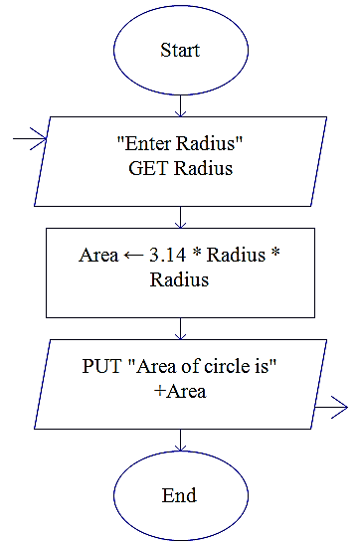
Example:
Algorithm and Flowchart for area of the circle
Name of the algorithm : Compute the area of a circle
Step1: Input radius
Step 2: [Compute the area]
Area ← 3.1416 * radius*radius
Step 3: [Print the Area]
Print ‘Area of a circle =‘, Area
Step 4: [End of algorithm]
Stop
Flowchart:
AreaC

Slide 40
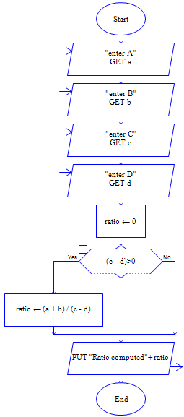
Example
Write the Algorithm and Draw the flowchart which reads four values a, b, c and d from the terminal (keyboard) and evaluates the ratio (a + b) to (c – d), if and only if c-d is greater than 0, and print the result.
i.e. if c-d >0 [condition]
then compute (a + b)/(c - d);

Slide 41
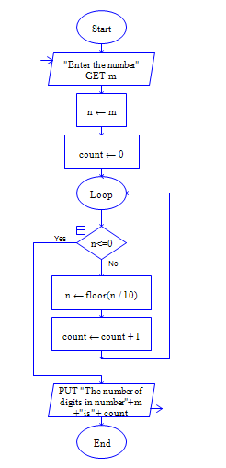
Example:
Algorithm and Flowchart Count the no of digits of a number
Name of the algorithm: Count the no of digits of a number
Step 1: Input N
Step 2: count ←0
Step 3: While N>0
begin
N←N/10 (integer )
count← count+1
end
Step 4 : Print ‘No. of digits=‘,count
Step 5: [End of Algorithm]
Stop

Slide 42
Summary
Variables, Data Types, and Arithmetic Expressions
Working with Variables
Understanding Data Types and Constants
Working with Arithmetic Expressions
The Assignment Operator
Syntax
Additional Information
Control Flow
Case studies
Do it yourself
MCQ’s-1
MCQ’s-2
MCQ’s-3

