Slide 1
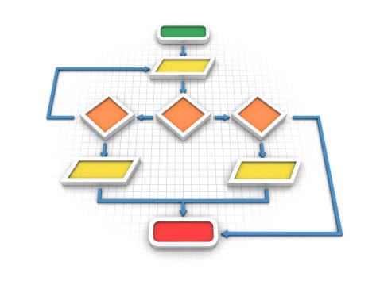
Decision Making & Branching
L9- L10

Slide 2
Objectives
To learn and appreciate the following concept
Making Decisions
The if Statement
The if-else Construct
Logical Operators
Nested if Statements
The else if Construct
The switch Statement
Bitwise Operators
The Conditional & comma Operators

Slide 3
Session outcome
At the end of session one will be able to understand
Making Decisions
The if Statement
The if-else Construct
Logical Operators
Nested if Statements
The else if Construct
The switch Statement
Bitwise Operators
The Conditional & comma Operators

Slide 4
Control Structures
A control structure refers to the way in which the Programmer specifies the order of executing the statements
The following approaches can be chosen depending on the problem statement:
Sequential (Serial)
In a Sequential approach, all the statements are executed in the same order as it is written.
Selectional (Decision Making and Branching)
In a Selectional approach, based on some conditions, different set of statements are executed.
Iterational (Repetition)
In an Iterational approach certain statements are executed repeatedly.
Notes:
C program is a set of statements, which are normally executed sequentially in the order in which they
appear. This happens when no options or no repetitions of certain calculations are necessary. However, in
practice we have a number of situations where we may have to change the order of execution of statements
based on certain conditions (Selection Construct), or repeat a group of statements until specified
conditions are met (Iteration Construct).
Control structures are used to alter the flow of execution of the program. Why do we need to alter the program flow ? The reason is “decision making“! In life, we may be given with a set of option like doing “Electronics” or “Computer science”. We do make a decision by analyzing certain conditions (like our personal interest, scope of job opportunities etc). With the decision we make, we alter the flow of our life’s direction. This is exactly what happens in a C++ program. We use control structures to make decisions and alter the direction of program flow in one or the other path(s) available.

Slide 5
The if statement
if ( expression )
program statement
If expression is true (non-zero), executes statement.
It gives you the choice of executing statement or skipping it.
expression
no
yes
Program statement
Notes:
(test Expression) is evaluated.
If TRUE (non-zero) the statement (or a block of statements) is executed.
If FALSE (zero) the next statement following the if
statement block is executed.
So, during the execution, based on some condition, some
code will not be executed (skipped).
For example: if (hours > 70)
cout<<“Good Work …”;
cout<< “Sorry, work< 70 hours”;

Slide 6
Example - if
// Program to calculate the absolute value of an //integer
void main (void)
{
int number;
cout<<"Type in your number: ";
cin>> number;
if ( number < 0 )
number = -number;
cout<<"The absolute value is “<< number;
}

Slide 7
The if-else statement
if ( expression )
program statement 1
else
program statement 2
if-else statement: enables you to choose between two statements
expression
yes
no
Program statement 1
Program statement 2
Notes:
Explanation:
1.The (expression) is evaluated.
2.If it evaluates to non-zero (TRUE), statement_1 is executed, otherwise, if it evaluates to zero (FALSE), statement_2 is executed.
3.They are mutually exclusive, meaning, either statement_1 is executed or statement_2, but not both.
4.The statements_ 1 and statements_ 2 can take the form of block and must be put in curly braces.
Example: if(job_code == 1)
rate = 7.00;
else
rate = 10.00;
cout<<“ rate is ”<<rate;

Slide 8
Example: if-else
// Program to determine if a number is even or odd
#include <iostream.h>
void main ()
{
int number_to_test, remainder;
cout<<"Enter your number to be tested: \n";
cin>>number_to_test;
remainder = number_to_test % 2;
if ( remainder == 0 )
cout<<"The number is even.\n";
else
cout<<"The number is odd.\n";
}

Slide 9
Attention on if-else syntax !
if ( expression )
program statement 1
else
program statement 2
In C++, the ; is part (end) of a statement !
if ( remainder == 0 )
cout<<"The number is even.\n";
else
cout<<"The number is odd.\n";
Syntactically OK (void statement on if) but probably a semantic error !
if ( x == 0 );
cout<<"The number is zero.\n";

Slide 10
Example: compound relational test
// Program to determine if a year is a leap year
#include <iostream.h>
void main (void)
{
int year, rem_4, rem_100, rem_400;
cout<<"Enter the year to be tested: ";
cin>>year;
rem_4 = year % 4;
rem_100 = year % 100;
rem_400 = year % 400;
if ( (rem_4 == 0 && rem_100 != 0) || rem_400 == 0 )
cout<<"It's a leap year.\n";
else
cout<<“It's not a leap year.\n";
}

Slide 11
Logical operators
Operator | Symbol | Meaning
AND | && | X && y is true if BOTH x and y are true
OR | || | X || y is true if at least one of x and y is true
NOT | ! | !x is true if x is false
Logical values as operands or in tests: true = non-zero, false=zero
Logical values returned as results of expressions: true = 1,
false=zero
Example: 5 || 0 is 1
Notes:
Logical Operators
&& (and) || (or)
unary operator ! negates the value of a logical operator
Example: !(n<=10) - n is not less than or equal to 10

Slide 12
Example
// Program to generate a table of prime numbers up to 50
#include <iostream.h>
void main (void) {
int p, d;
int isPrime;
for ( p = 2; p <= 50; ++p ) {
isPrime = 1;
for ( d = 2; d < p; ++d )
if ( p % d == 0 )
isPrime = 0;
if ( isPrime != 0 )
cout<< p;
}
cout<<"\n";
}
A flag: assumes only one of two different values. The value of a flag is usually tested in the program to see if it is “on” (TRUE) or “off ” (FALSE)
Equivalent test: (more in C-style):
if (isPrime)
Notes:
Example:
Determine the value of each of the following logical expression if a =5, b=10 and c=-6
a>b && a<c → 0
a<b && a>c → 1
a==c || b>a → 1
b>15&&c<0 || a>0 → 1
(a/2.0 == 0.0 && b/2.0!=0.0) || c<0.0 → 1
( for e). 5/2.0 != 0.0 so the expression (a/2.0 == 0.0 && b/2.0 !=0.0) will be false
c<0.0 is true so the total expression (a/2.0 == 0.0 && b/2.0 !=0.0) || c<0.0 results to True (1)

Slide 13
Operator precedence & Associativity
The operators within C++ are grouped hierarchically according to their precedence (i.e., order of evaluation)
Operations with a higher precedence are carried out before operations having a lower precedence.
High priority operators * / % …
Low priority operators + - …
The order in which consecutive operations within the same precedence group are carried out is known as Associativity.
For both the precedence group described above, associativity is “left to right”.
Notes:
The precedence table determines the order of binding in chained expressions, when it is not expressly specified by parentheses.
For example, ++x*3 is ambiguous without some precedence rule(s). The precedence table tells us that: x is 'bound' more tightly to ++ than to *, so that whatever ++ does (now or later—see below), it does it ONLY to x (and not to x*3); it is equivalent to (++x, x*3).
Similarly, with 3*x++, where though the post-fix ++ is designed to act AFTER the entire expression is evaluated, the precedence table makes it clear that ONLY x gets incremented (and NOT 3*x).
An arithmetic expression without parentheses will be evaluated from left-to-right using the rules of precedence of operators.
Priority levels:
High priority * / %
Low priority + -

Slide 14
Operator precedence & Associativity
Ex: a –b/c*d is equivalent to the algebraic formula
If a=1.0,b=2.0,c=3.0 and d=4.0 then the value is,

Slide 15
Operator precedence & Associativity
The natural precedence of operations can be altered through the use of “parentheses”.
Ex:(a-b)/(c*d) is equivalent to the algebraic formula (a-b)/(c x d)
(1.0-2.0)/(3.0*4.0)= -0.0833333
Parentheses can be nested, one pair within the other.
Ex:
((a+b)*(c-d))/(e+f)
The innermost operations are carried out first, then the next innermost operations, and so on.
Notes:
The basic evaluation procedure includes two left-to-right passes through the expression. During the first pass, the high priority operators (if any) are applied as they are encountered. During the second pass, the low priority operators (if any) are applied as they are encountered. The parentheses enjoys highest priority level (the innermost first, if nested).
Example: 10 / 2 + 3 will return 8.
10 / (2 + 3) will return 2.

Slide 16
Operator precedence & Associativity
Operator Precedence Groups
Operator Category Operators Associativity
Unary operators + – + + – – ! R→L
Arithmetic operators * / % L→R
Operators + – L→R
Relational operators < <= > >= L→R
Equality operators == != L→R
Logical and && L→R
Logical or || L→R
Assignment operator = += – = R→L
*= /= %=

Slide 17
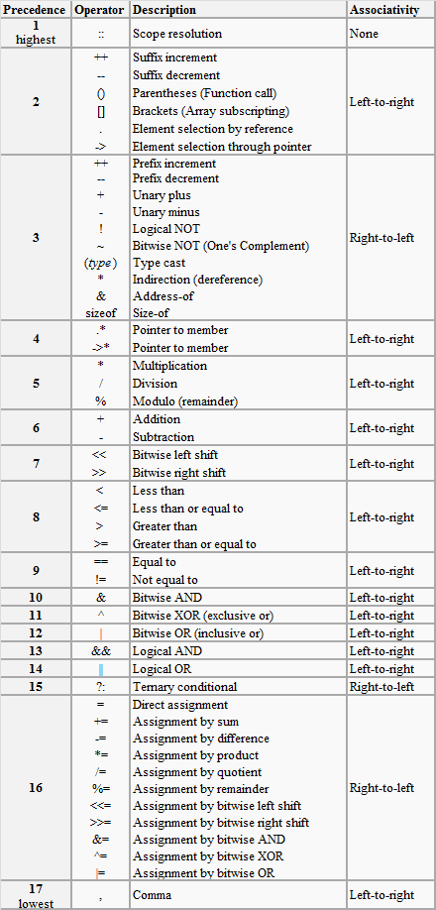
Summary of Operators
Detailed
Precedence
Table

Slide 18
Operator precedence & Associativity
Ex: (x==10 + 15 && y < 10)
Assume x=20 and y=5
Evaluation:
Addition (x==25 && y< 10)
< (x==25 && true)
== (False && true)
&& (False)

Slide 19
Operator precedence & Associativity
For nested parentheses (more than one parentheses), evaluation proceeds from the innermost expression outward.
For example:
x = 25 – (2 * (10 + (8 / 2)));
1. The innermost, 8/2 =4 is evaluated first. 25 – (2 * (10 + 4))
2. Moving outward, 10 + 4 = 14 25 – (2 * 14)
3. The outer most, 2 * 14 = 28 25 – 28
4. The final expression, 25 – 28 25 – 28 = -3
Use parentheses in expressions for clarity and readability, and must always be in pairs.

Slide 20
Operator precedence & Associativity
Show all the steps how the following expression is evaluated. Consider the initial values of i=8, j=5.
2*((i/5)+(4*(j-3))%(i+j-2))
2*((8/5)+(4*(5-3))%(8+5-2))
2*(1+(4*2)%11)
2*(1+8%11)
2*(1+8)
2*9
18

Slide 21
Operator precedence & Associativity
Program to illustrate evaluation of expressions:
void main()
{
float a,b,c,x,y,z;
a=9.0;
b=12.0;
c=3.0;
x=a-b/3+c*2-1;
y=a-b/(3+c)*(2-1);
z=a-(b/(3+c)*2)-1;
cout <<“x=“<<x< endl;
cout <<“y=“<<y< endl;
cout <<“z=“<<z< endl;
}
output:
x=10.000000
y=7.000000
z=4.000000

Slide 22
Testing for ranges
if (x >= 5 && x <= 10)
cout<<“in range";
if (5 <= x <= 10)
cout<<“in range";
?

Slide 23
Testing for ranges
if (x >= 5 && x <= 10)
cout<<“in range";
YES
if (5 <= x <= 10)
cout<<“in range";
Syntactically correct, but semantically an error !!!
Because the order of evaluation for the <= operator is left-to-right, the test expression is interpreted as follows:
(5<= x) <= 10 The subexpression 5 <= x either has the value 1 (for true) or 0 (for false). Either value is less than 10, so the whole expression is always true, regardless of x !
NO !

Slide 24
Testing for character ranges
char ch;
cin>>ch;
if (ch >= 'a' && ch <= 'z')
cout<<"lowercase char\n";
if (ch >= ‘A' && ch <= ‘Z')
cout<<“uppercase char\n";
if (ch >= ‘0' && ch <= ‘9')
cout<<“digit char\n";
This works for character codes such as ASCII, in which the codes for consecutive letters are consecutive numbers. However, this is not true for some codes (i.e. EBCDIC)
A more portable way of doing this test is to use functions from <ctype.h> islower(ch), isupper(ch), isdigit(ch)

Slide 25
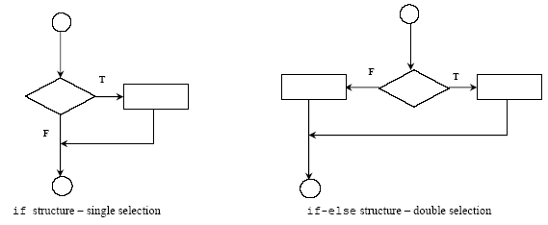
Flow of control

Slide 26
Nested if statements
if (number > 5)
if (number < 10)
cout<<“1111\n";
else cout<<“2222\n";
Rule: an else goes with the most recent if, unless braces indicate otherwise
if (number > 5) {
if (number < 10)
cout<<“1111\n";
}
else cout<<“2222\n";

Slide 27
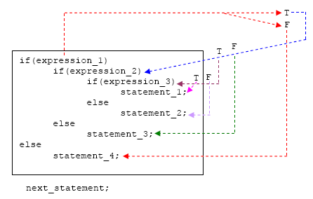
Nested if-else Statement
Notes:
Explanation
The if-else constructs can be nested (placed one within another) to any depth.
In this nested form, expression_1 is evaluated. If it is zero (FALSE-F), statement_4 is executed and the entire nested if statement is terminated;
if not (TRUE-T), control goes to the second if (within the first if) and expression_2 is evaluated. If it is zero, statement_3 is executed;
if not, control goes to the third if (within the second if) and expression_3 is evaluated. If it is zero, statement_2 is executed;
if not, statement_1 is executed. The statement_1 (inner most) will only be executed if all the if statement is true.

Slide 28
Smallest among three numbers
#include <iostream.h>
#include <conio.h>
void main()
{
int a, b, c, result;
cout<<"Enter a, b & c\n";
cin>>a>>b>>c;
if (a < b)
if (a < c)
result = a;
else
result = c;
else
if (b < c)
result = b;
else
result = c;
cout<<“Smallest is"<< result;
}

Slide 29
Example
balance and bonus are properly declared and initialized variables.
……………
If (code==1)
{
if (balance > 5000)
bonus=0.5*balance;
else
bonus=0.2*balance;
}
else {
bonus=0.2*balance;
}
balance= balance +bonus;
…………..
Note: code =1→First part
code =0→Second part
For inputs
balance=5000
code = 1
Output: balance
6000
For inputs
balance=5001
code = 0
Output: balance
6001.2

Slide 30
Variation of previous example
balance and bonus are properly declared and initialized variables.
……………
If (code==1)
if (balance > 5000)
bonus=0.5*balance;
else
bonus=0.2*balance;
balance= balance +bonus;
…………..
Note: else is linked to the closest non terminated if .
(i.e. here it is with inner if)
For inputs
balance=5000
code = 1
Output:
6000

Slide 31
Another variation
……………
If (code==1)
{
if (balance > 5000)
bonus=0.5*balance;
}
else
bonus=0.2*balance;
balance= balance +bonus;
…………..
(Here else is associated with outer if)
balance and bonus are properly declared and initialized variables.
For inputs
balance=5000
code = 1
Output:
6000 or 5000 ?
Output:
5000 !

Slide 32
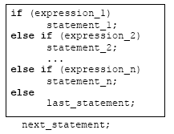
The else if Ladder
Notes:
Explanation
expression_1 is first evaluated. If it is TRUE, statement_1 is executed and the whole statement terminated and the next_statement is executed.
On the other hand, if expression_1 is FALSE, control passes to the else if part and expression_2 is evaluated.
If it is TRUE, statement_2 is executed and the whole system is terminated.
If it is False, other else if parts (if any) are tested in a similar way.
Finally, if expression n is True, statement_n is executed; if not, last_statement is executed.
Note that only one of the statements will be executed others will be skipped.
The statement_n’s could also be a block of statement and must be put in curly braces

Slide 33
Example: else-if
// Program to implement the sign function
#include <iostream.h>
void main (void)
{
int number, sign;
cout<<"Please type in a number: ";
cin>>number;
if ( number < 0 )
sign = -1;
else if ( number == 0 )
sign = 0;
else // Must be positive
sign = 1;
cout<<"Sign = "<< sign;
}

Slide 34
Multiple choices – else-if
int number;
if ( expression 1)
program statement 1
else if ( expression 2)
program statement 2
else
program statement 3
if
negative
else
if
zero
else
Program style: this unindented formatting improves the readability of the statement and makes it
clearer that a three-way decision is being made.
positive

Slide 35
Example: else-if
// Program to categorize a single character
// that is entered at the terminal
#include <iostream.h>
void main (void)
{
char c;
cout<<"Enter a single character:\n";
cin>>c;
if ((c >= 'a' && c <= 'z')||(c >= 'A' && c <= 'Z'))
cout<<"It's an alphabetic character.\n";
else if ( c >= '0' && c <= '9' )
cout<<"It's a digit.\n";
else
cout<<"It's a special character.\n";
}

Slide 36
Example – multiple choices
/* Program to evaluate simple expressions of the form
number operator number */
#include <iostream.h>
void main (void) {
float value1, value2;
char operator;
cout<<"Type in your expression.\n";
cin>> value1 >> operator >> value2;
if ( operator == '+' )
cout<< value1 + value2;
else if ( operator == '-' )
cout<< value1 - value2;
else if ( operator == '*' )
cout<< value1 * value2;
else if ( operator == '/' )
cout<< value1 / value2;
else cout<< "Unknown operator.\n";
}

Slide 37
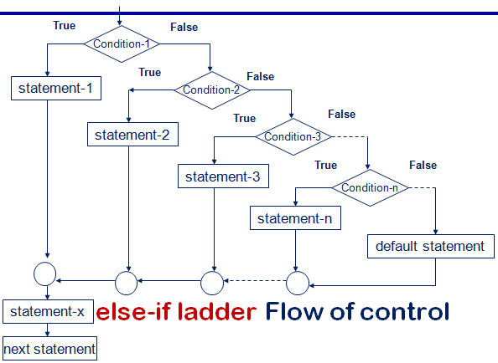
The else-if Ladder

Slide 38
WAP Using else-if ladder to calculate grade for the marks entered
void main() {
char cgrade;
int imarks;
cout<<"enter marks";
cin>> imarks;
if(imarks>79)
cgrade = 'A';
else if (imarks>59)
cgrade = 'B';
else if (imarks>49)
cgrade = 'C';
else if (imarks>39)
cgrade = 'D';
else
cgrade = 'F';
cout<<"\n grade = "<<cgrade;
}
if(imarks>79)
cgrade = 'A';
else if (imarks>59)
cgrade = 'B';
else if (imarks>49)
cgrade = 'C';
else if (imarks>39)
cgrade = 'D';
else
cgrade = 'F';

Slide 39
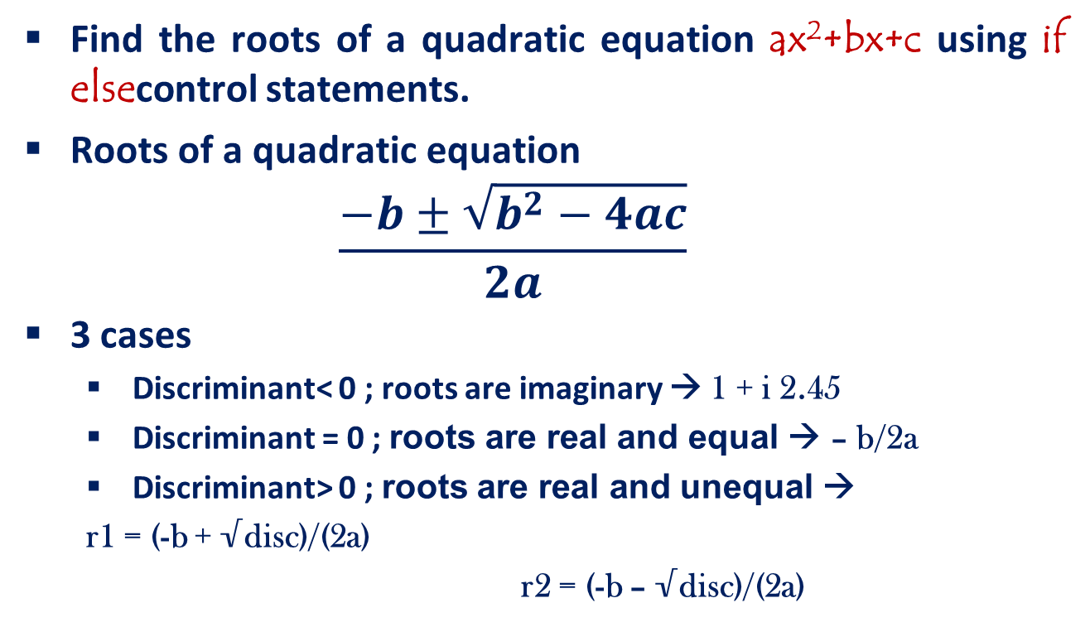
Problem…

Slide 40
Find the roots of Quadratic equation using if-else statement
#include<math.h>
void main() {
float a,b,c,root1,root2,re,im;
cin>>a>>b>>c;
disc=b*b-4*a*c;
if (disc<0)
{
cout<<“imaginary roots\n”;
re= - b / (2*a);
im = pow(fabs(disc),0.5))/(2*a);
cout<<re<<“+ i”<< im;
cout<<re<<“-i”<< im;
}
else if (disc==0){
cout<<“real & equal roots”;
re=-b / (2*a);
cout<<“Roots are”<<re;
}
else { /*disc > 0*/
cout<<“real & distinct roots”;
cout<<“Roots are”;
root1=(-b + sqrt(disc))/(2*a);
root2=(-b – sqrt (disc))/(2*a);
cout<<root1<<“and”<<root2;
}

Slide 41
The switch Statement
General form:
switch(expression)
{
case value_1 : statement(s);
break;
case value_2 : statement(s);
break;
...
case value_n : statement(s);
break;
default : statement(s);
}
next_statement;
Control Flow
Notes:
Switch is multiple–branching statement- based
on a condition, the control is transferred to one
of the many possible points.
The most flexible control statement in
selection structure of program control.
Enables the program to execute different
statements based on an expression that can
have more than two values. Also called
multiple choice statements.

Slide 42
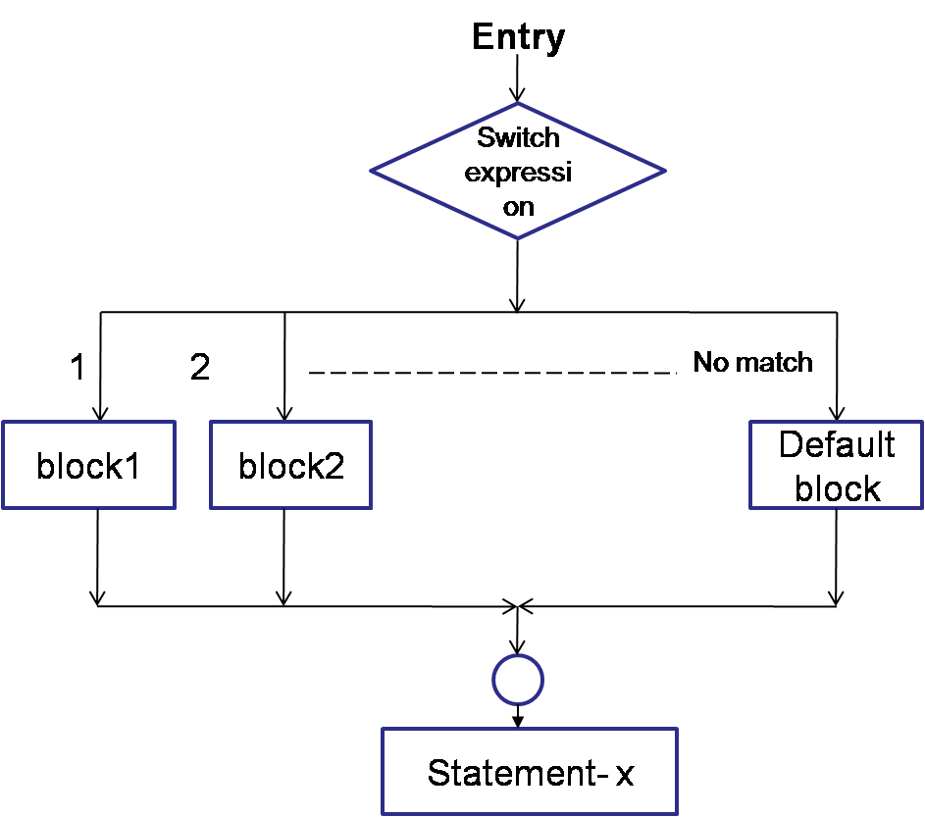
switch- control flow
Syntax
Control Flow
Notes:
Evaluates the (expression) and compares its integer or character value
with the values following each case label.
1. If a match is found between (expression) and one of the values, execution is transferred to the statement(s) that follows the case label.
2. If no match is found, execution is transferred to the statement(s) following the optional default label.
3. If no match is found and there is no default label, execution passes to the first statement following the switch statement closing brace, the next_statement.
4. To ensure that only the statements associated with the matching template are executed, include a break statement where needed, which terminates the entire switch statement.
5. As usual the statement(s) can also be a block of code put in curly braces.

Slide 43
Example - switch
/* Program to evaluate simple expressions of the form
value operator value */
#include <iostream.h>
void main (void) {
float value1, value2;
char operator;
cout<<"Type in your expression.\n";
cin>> value1 >> operator >> value2;
switch (operator) {
case '+': cout<< value1 + value2; break;
case '-': cout<< value1 - value2; break;
case '*': cout<< value1 * value2; break;
case '/':
if ( value2 == 0 ) cout<<"Division by zero.\n";
else cout<< value1 / value2;
break;
default: cout<<"Unknown operator.\n"; break;
}
}

Slide 44
The switch statement
switch ( expression )
{
case value1:
program statement
program statement
...
break;
case value2:
program statement
program statement
...
break;
...
case valuen:
program statement
program statement
...
break;
default:
program statement
program statement
...
break;
}
The expression is successively compared against the values value1, value2, ..., valuen. If a case is found whose value is equal to the value of expression, the program statements that follow the case are executed.
The switch test expression must be one with an integer value (including type char) (No float !).
The case values must be integer-type constants or integer constant expressions (You can't use a variable for a case label !)

Slide 45
The switch statement (cont)
Break can miss !
Statement list on a case can miss !
switch (operator)
{
...
case '*':
case 'x':
cout<< value1 * value2;
break;
...
}

Slide 46
Some guidelines for writing switch case statements
Order the cases alphabetically or numerically – improves readability. Put the normal cases first ; put the exceptional cases later. Order cases by frequency:-put the most frequently executed cases first and the least frequently used cases later. Use default case to detect errors and unexpected cases [user friendly messages].

Slide 47
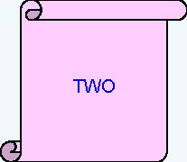
What is the output of the following code snippet?
int iNum = 2;
switch(iNum){
case 1:
cout<<“ONE”; break;
case 2:
cout<<“TWO”; break;
case 3:
cout<<“THREE”;break;
default:
cout<<“INVALID”;break;
}

Slide 48
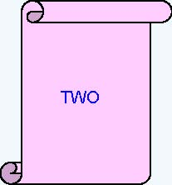
What is the output of the following code snippet?
iNum = 2;
switch(iNum) {
default:
cout<<“INVALID”;
case 1:
cout<<“ONE”;
case 2:
cout<<“TWO”;
break;
case 3:
cout<<“THREE”;
}

Slide 49
What is the output of the following code snippet?
switch (iDepartmentCode){
case 110 : cout<<“HRD”;
case 115 : cout<<“IVS”;
case 125 : cout<<“E&R”;
case 135 : cout<<“CCD”;
}
Assume iDepartmentCode is 115
find the output ?
IVSE&RCCD

Slide 50
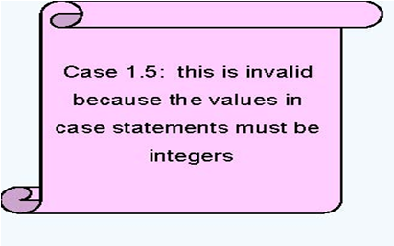
What is the output of the following code snippet?
int iNum = 2;
switch(iNum) {
case 1.5:
cout<<“ONE AND HALF”;
break;
case 2:
cout<<“TWO”;
case ‘A’ :
cout<<“A character”;
}

Slide 51
What is the output of the following code snippet?
unsigned int iCountOfItems = 5;
switch (iCountOfItems) {
case iCountOfItems >=10 :
cout<<“Enough Stock” ; break;
default :
cout<<“Not enough stock”; break;
}
Error: Relational Expressions cannot be used in switch statement

Slide 52
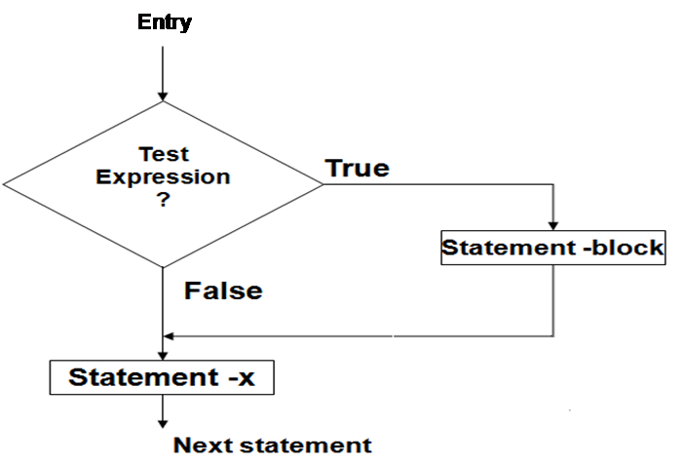
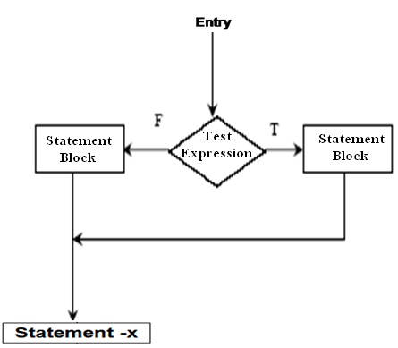
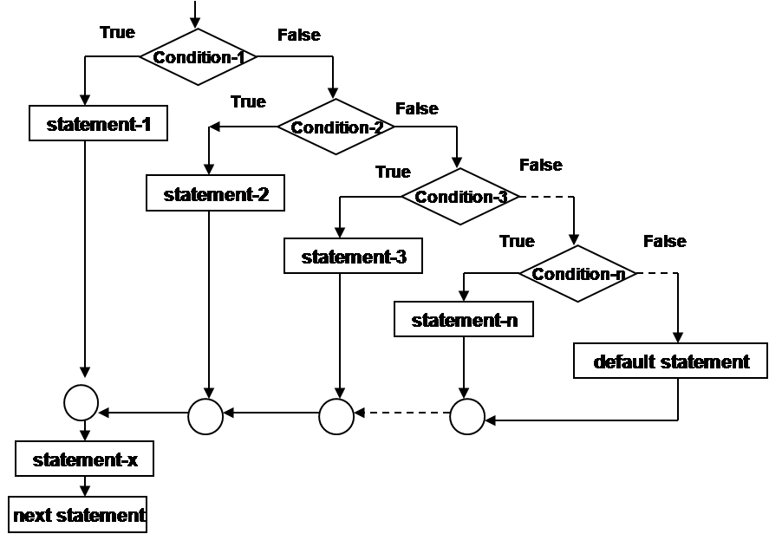
Flow of control in various control structures

Slide 53
Problem: Find the roots of Quadratic equation using switch statement
#include<math.h>
float a,b,c,re,im,root1,root2,disc;
int d;
cout<<"\nEnter the values of a, b & c:";
cin>>a>>b>>c;
disc=b*b – 4*a*c;
cout<<"\nDiscriminant= "<<disc;
if(disc<0) d=1;
if(disc==0) d=2;
if(disc>0) d=3;

Slide 54
Problem: Find the roots of Quadratic equation using switch statement
switch(d) {
case 1:
cout<<"\nThe roots are imaginary.\n";
re=-b/(2*a);
im=pow( – disc ,0.5)/(2*a);
cout<<"\nRoot1= "<<re<<" + i " <<im;
cout<<"\nRoot2= "<<re<<" - i "<<im;
break;
case 2:
cout<<"\nRoots are real and equal.\n";
root1=-b/(2*a);
cout<<"Root1 = Root2 = "<<root1;
break;

Slide 55
Problem: Find the roots of Quadratic equation using switch statement
case 3:
cout<<"\nRoots are real and unequal.\n";
root1=(– b + sqrt(disc))/(2*a);
root2=(– b - sqrt(disc))/(2*a);
cout<<"\nRoot1 = "<<root1;
cout<<"\nRoot2 = "<<root2;
break;
} // end of switch
} //End of Program

Slide 56
Bitwise Operators
Bitwise Logical Operators
Bitwise Shift Operators
Ones Complement operator

Slide 57
Bitwise Logical operators
&(AND),|(OR),^(EXOR)
These are binary operators and require two integer operands.
These work on their operands bit by bit starting from LSB (rightmost bit).
op1 | op2 | & | | | ^
1 | 1 | 1 | 1 | 0
1 | 0 | 0 | 1 | 1
0 | 1 | 0 | 1 | 1
0 | 0 | 0 | 0 | 0
Notes:
Bitwise operators used to manipulate the bits of integral operands, to modify the individual bits (bit by bit) rather than the number itself. Both operands in a bitwise expression must be of an integral type.
Below is the list of the bitwise operators.
Operator Description
& (ampersand - bitwise AND) The bit in the result are set to 1 if the corresponding bits in the two operands are both 1, otherwise it returns 0.
| (pipe - bitwise inclusive OR) The bit in the result is set to 1 if at least one (either or both) of the corresponding bits in the two operands is 1,
otherwise it returns 0.
^ (caret - bitwise exclusive OR) The bit in the result is set to 1 if exactly one of the corresponding bits in the two operands is 1.

Slide 58
Example
Suppose x = 10, y = 15
z = x & y sets z=10 like this
0000000000001010 ← x
0000000000001111 ← y
0000000000001010 ← z = x & y
Same way |,^ according to the table are computed.

Slide 59
Bitwise Shift operators
<< ,>>
These are used to move bit patterns either to the left or right.
They are used in the following form
op<<n or op>>n here op is the operand to be shifted and n is number of positions to shift.
Notes:
Operators Description
<< (bitwise shift left) Moves the bit of the first operand to the left by the number of bits specified by the second operand; it discards the far left bit ; fill
from the right with 0 bits.
>> (bitwise shift right) Moves the bit of the first operand to the right by the number of bits specified by the second operand; discards the far right bit; fill
from the right with 0 bits.

Slide 60
Bitwise Shift operator: <<
<< causes all the bits in the operand op to be shifted to the left by n positions.
The leftmost n bits in the original bit pattern will be lost and the rightmost n bits that are vacated are filled with 0’s

Slide 61
Bitwise Shift operator: >>
>> causes all the bits in operand op to be shifted to the right by n positions.
The rightmost n bits will be lost and the left most vacated bits are filled with 0’s if number is unsigned integer
If the number is signed the operation is machine dependent.

Slide 62
Bitwise Shift operators
Op and n can be constants or variables.
There are 2 restrictions on the value of n
n cannot be –ve
n should not be greater than number of bits used to represent Op.(E.g.: suppose op is int and size is 2 bytes then n cannot be greater than 16).

Slide 63
Examples
Suppose X is an unsigned integer whose bit pattern is 0000 0000 0000 1011
x<<1 0000 0000 0001 0110
x>>1 0000 0000 0000 0101
Add ZEROS
Add ZEROS

Slide 64
Examples
Suppose X is an unsigned integer whose bit pattern is 0000 0000 0000 1011 whose equivalent value in decimal number system is 11.
x<<3 0000 0000 0101 1000 = 88
x>>2 0000 0000 0000 0010 = 2
Note:
x=y<<1; same as x=y*2 (Multiplication)
x=y>>1; same as x=y/2 (Division)
Add ZEROS
Add ZEROS
Notes:
Another example for <<, lets say the variable declaration is:
unsigned int p = 5;
In binary, p = 00000000 00000101
For p<<1 in binary,
00000000 00000101 << 1 = 00000000 00001010 = 10 decimal
For p<<2 in binary,
00000000 00000101 << 2 = 00000000 00010100 = 20 decimal
Example for >>:
unsigned int p = 40960, for 16 bits,
In binary, p = 10100000 00000000
For p >> 1 in binary,
10100000 00000000 >> 1 = 01010000 00000000 = 20480 decimal
For p>>3 in binary,
10100000 00000000 >> 3 = 00010100 00000000 = 5120 decimal

Slide 65
Bitwise complement operator
The complement operator(~) is an unary operator and inverts all the bits represented by its operand.
Suppose x=1001100010001111
~x=0110011101110000 (complement)
Also called as 1’s complement operator.
Notes:
Operator Description
~ (tilde - bitwise complement) Negation. 0 bit set to 1, and 1 bit set to 0. Also used to create destructors.

Slide 66
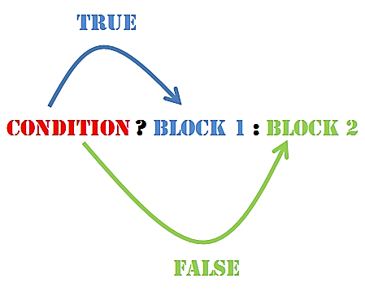
The conditional operator (? :)
condition ? expression1 : expression2
condition is an expression that is evaluated first.
If the result of the evaluation of condition is TRUE (nonzero), then expression1 is evaluated and the result of the evaluation becomes the result of the operation.
If condition is FALSE (zero), then expression2 is evaluated and its result becomes the result of the operation.
maxValue = ( a > b ) ? a : b;
Equivalent to:
if ( a > b )
maxValue = a;
else
maxValue = b;
Notes:
The C / C++ only ternary operator, it takes 3 operands.
The syntax:
Expression1 ? expression2 : expression3;
If expression1 evaluates as true (non zero), the entire expression is evaluated to the value of expression2. If expression1 evaluates as false (zero), the entire expression is evaluated to the value of expression3.
For example:
x = y ? 1 : 100;
Assign value 1 to x if y is true.
Assign value 100 to x if y is false.
It also can be used as an if statement.
Example:
z = (x > y)? x : y;
Can be written as:
if(x > y)
z = x;
else
z = y;

Slide 67
The conditional operator (? :)
#include<iostream.h>
void main()
{
int num;
cout<<"Enter the Number : ";
cin>>num;
flag = ((num%2==0)?1:0);
if(flag==1)
cout<<"\nEven";
else
cout<<"\nOdd";
}
More simply we can write
(num%2==0)?cout<<"Even":cout<<Odd";

Slide 68
Comma (,)operator
The coma operator is used basically to separate expressions.
i = 0 , j = 10; // in initialization [l→r]
or
i++ , j--;
So, the meaning of the comma operator in the general expression
e1 , e2
is ``evaluate the sub expression e1, then evaluate e2; the value of the expression is the value of e2.''

Slide 69
Summary
Making Decisions
The if Statement
The if-else Construct
Logical Operators
Nested if Statements
The else if Construct
The switch Statement
Bitwise Operators
The Conditional & comma Operators
Syntax
Notes
Control Flow
Case studies – 1
Case studies – 2
Do it yourself-1
Do it yourself-2
MCQ’s-1
MCQ’s-2

