Slide 1

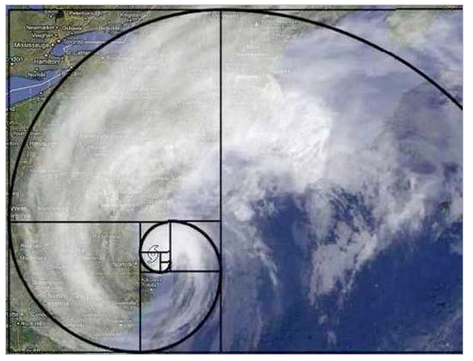


CS 46B: Data Structures Collections
Professor Phil Heller

Slide 2

The Collections Framework
What’s a
framework?
Copyright Scott & Borgman

Slide 3
A Framework Is …
Response to a broad need
Interfaces
Classes that implement the interfaces
Use the classes if you can
Else extend the classes if you can
Else implement the interfaces
How to use a framework:

Slide 4
A Framework Is …
The
Collections
/
Response to a broad need
Interfaces
Classes that implement the interfaces
Use the classes if you can
Else extend the classes if you can
Else implement the interfaces
How to use a framework:

Slide 5
A Framework Is …
The
Collections
/
Response to a broad need aggregation & retrieval
Interfaces
Classes that implement the interfaces
Use the classes if you can
Else extend the classes if you can
Else implement the interfaces
How to use a framework:

Slide 6
A Framework Is …
The
Collections
/
A broad need aggregation & retrieval
Interfaces Collection, Set, Map, many more
Classes that implement the interfaces
Use the classes if you can
Else extend the classes if you can
Else implement the interfaces
How to use a framework:

Slide 7
A Framework Is …
The
Collections
/
public class Sky
{
private ArrayList<Cloud> clouds;
public Sky()
{
clouds = new ArrayList<Cloud>();
}
. . .
}
A broad need aggregation & retrieval
Interfaces Collection, Set, Map, many more
Classes that implement the interfaces
Use the classes if you can
Else extend the classes if you can
Else implement the interfaces
ArrayList, HashSet, TreeSet, many more
How to use a framework:

Slide 8
A Framework Is …
The
Collections
/
public class Sky
{
private ArrayList<Cloud> clouds;
public Sky()
{
clouds = new ArrayList<Cloud>();
}
. . .
}
A broad need aggregation & retrieval
Interfaces Collection, Set, Map, many more
Classes that implement the interfaces
Use the classes if you can
Else extend the classes if you can
Else implement the interfaces
ArrayList, HashSet, TreeSet, many more
How to use a framework:

Slide 9
A Framework Is …
The
Collections
/
public class TreeFilmArchive
extends TreeSet<Movie>
{
. . .
}
A broad need aggregation & retrieval
Interfaces Collection, Set, Map, many more
Classes that implement the interfaces
Use the classes if you can
Else extend the classes if you can
Else implement the interfaces
ArrayList, HashSet, TreeSet, many more
How to use a framework:

Slide 10
A Framework Is …
The
Collections
/
public class TreeFilmArchive
extends TreeSet<Movie>
{
. . .
}
A broad need aggregation & retrieval
Interfaces Collection, Set, Map, many more
Classes that implement the interfaces
Use the classes if you can
Else extend the classes if you can
Else implement the interfaces
ArrayList, HashSet, TreeSet, many more
How to use a framework:

Slide 11
Implement interface when there’s no reasonable superclass in the framework
public class ProfessorPhilCollection
implements Collection {
public void add() …
public void remove() …
. . .
}

Slide 12
Implement interface when there’s no reasonable superclass in the framework
I wanted this earlier this semester …
Something like an ArrayList<Student>
add() & remove() methods
Specialized traversal
First 180 students: alphabetical order (like a TreeSet)
Next 20 students: order of insertion (like an ArrayList)
Remaining students: random order
ENROLLED
WAIT LIST
FINGERS CROSSED

Slide 13
Interfaces review
interface Flier {
void flap();
void glide();
}
class Parrot implements Flier {
public void flap() { . . . }
public void glide() { . . . }
public void speak() { . . . }
public void squawk() { . . . }
}

Slide 14
Upcoming Agenda
Today 4/3: Finish collections
Weds 4/5: Graphs (no trees)
Monday 4/10: Review
Weds 4/12: Midterm 2

Slide 15
Interfaces review: class Parrot implements Flier
Stack Heap
Parrot polly = new Parrot();
polly.speak(); polly.squawk();
polly.flap(); polly.glide();
Flier f = polly;
f.flap();
f.glide();
f.speak();
f.squawk();
Compiler error
Notes:
Start here 10/26/16

Slide 16
Superinterfaces, Subinterfaces
interface Superface {
boolean xxx();
int yyy();
}
interface Subface
extends Superface {
double zzz();
}
class A
implements Superface {
public boolean xxx() {…}
public int yyy() {…}
}
class B implements Subface {
public boolean xxx() {…}
public int yyy() {…}
public double zzz() {…}
}

Slide 17
What do ArrayList, HashSet, and TreeSet have in common?
In package java.util
Generic (HashSet<Whatever>)
Methods
public boolean add()
public boolean remove()
public boolean contains( )
Enhanced for-loop
for (Movie m: myFilmArchive) {…}

Slide 18
interface
interface
Collection
Map
interface
interface
class
List
Set
AbstractMap
class
class
class
class
ArrayList
AbstractSet
HashMap
TreeMap
class
class
Extends
Implements
HashSet
TreeSet
Notes:
Good MT question: what are the 2 top-level interfaces of the Collections framework?

Slide 19

Generics
HashSet<Cloud> sky = new HashSet<Cloud>();
Introduced to prevent a common cause of bugs
Before generics: ArrayList a = new ArrayList();
public boolean add(Object x)
public Object get(int index)
Example: studying the Pacific Ocean with satellites and robosubs
class Sub
class Satellite

Slide 20
In the bad old days
ArrayList sats = new ArrayList();
ArrayList subs = new ArrayList();
Satellite seaStar = new Satellite();
sats.add(seaStar);
Satellite cloudSat = new Satellite();
sats.add(cloudSat);
// and many others
sub andril = new Sub();
subs.add(andril);
sub nereus = new Sub();
subs.add(nereus);
// and many others

Slide 21
Thousands of lines later…
// Stone-age code: no fancy for-loops.
for (int i=0; i<sats.size(); i++) {
Satellite s = (Satellite)sats.get(i);
s.launch();
s.orbit();
}
for (int i=0; i<subs.size(); i++) {
Sub s = (Sub)subs.get(i);
s.descend();
s.explore();
}
Why is this bad?

Slide 22
In the bad old days
ArrayList sats = new ArrayList();
ArrayList subs = new ArrayList();
Satellite seaStar = new Satellite();
sats.add(seaStar);
Satellite cloudSat = new Satellite();
subs.add(cloudSat);
// and many others
sub andril = new Sub();
subs.add(andril);
sub nereus = new Sub();
subs.add(nereus);
// and many others
oops

Slide 23

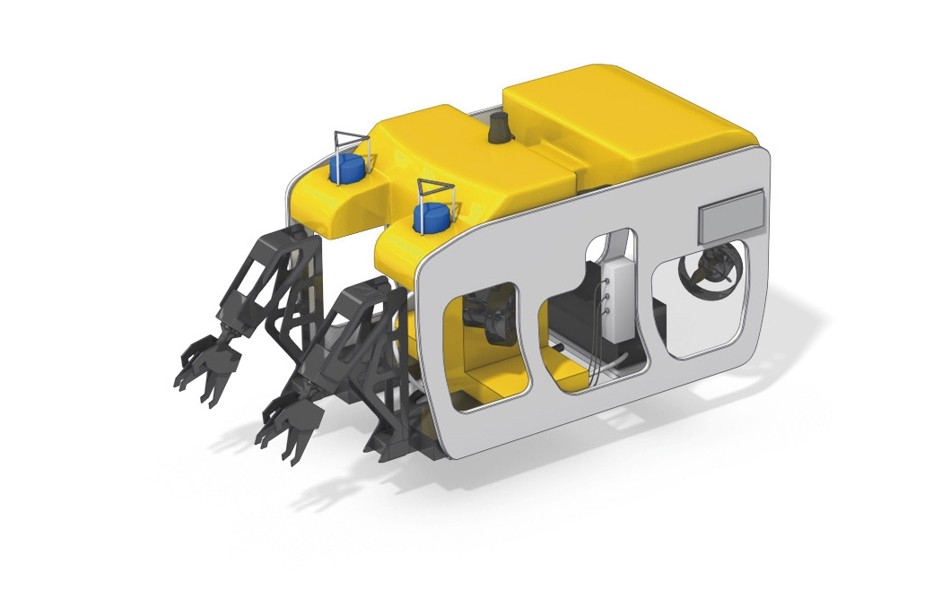
What we wanted:
sats
seaStar cloudSat
subs
andril nereus

Slide 24
What we got:
sats
seaStar
subs
andril nereus cloudSat

Slide 25
And later …
for (int i=0; i<sats.size(); i++) {
Satellite s = (Satellite)sats.get(i);
s.launch();
s.orbit();
}
for (int i=0; i<subs.size(); i++) {
Sub s = (Sub)subs.get(i);
s.descend();
s.explore();
}
cloudSat is never launched
ClassCastException
when loop gets to cloudSat

Slide 26
You can’t prevent people from typing this …
ArrayList sats = new ArrayList();
ArrayList subs = new ArrayList();
Satellite seaStar = new Satellite();
sats.add(seaStar);
Satellite cloudSat = new Satellite();
subs.add(cloudSat);
// and many others
sub andril = new Sub();
subs.add(andril);
sub nereus = new Sub();
subs.add(nereus);
// and many others
But you can make
the compiler
find it
oops
That’s good because…

Slide 27
A compile-time problem
is always better than
a run-time problem

Slide 28
In modern times
ArrayList<Satellite> sats =
new ArrayList<Satellite>();
ArrayList<Sub> subs = new ArrayList<Sub>();
Satellite seaStar = new Satellite();
sats.add(seaStar);
Satellite cloudSat = new Satellite();
subs.add(cloudSat);
Compiler
Error
The type of sats is ArrayList<Satellite>, not ArrayList

Slide 29
What’s a map?
Collection
Map
List
Set
AbstractMap
ArrayList
AbstractSet
HashMap
TreeMap
Extends
Implements
HashSet
TreeSet

Slide 30
Map: A set where every member is associated with another object
aryabhata
alSufi
ptolemy
newton
gamow
deGrasse Tyson
Map’s key set
Map’s values
Notes:
Key set can be a hash set or a tree set

Slide 31
Map: Keys are unique, values don’t have to be
aryabhata
alSufi
ptolemy
newton
gamow
deGrasse Tyson
Map’s key set
Map’s values
Notes:
Here after spring break

Slide 32
TreeMap<Star, Astronomer> starToDiscoverer
= new TreeMap<Star, Astronomer>();
Generic class has <2 parameters>
That’s a lot of typing
You are allowed to do this:
<> is called the “diamond operator”
Ok, where were we?
TreeMap<Star, Astronomer> starToDiscoverer
= new TreeMap<>();
Notes:
The declaration is still long but rhs is shorter.

Slide 33
Using a tree map
Astronomer arybhata, ptolemy, …;
Star bigStar, littleStar, …;
TreeMap<Star, Astronomer> starToDiscoverer
= new TreeMap<Star, Astronomer>();
starToDiscoverer.put(bigStar, aryabhata);
starToDiscoverer.put(littleStar, ptolemy);
. . .
Astronomer a =
starToDiscoverer.get(littleStar);

Slide 34
Using a tree map
TreeMap<String, Integer> warriorToHt
= new TreeMap<>();
warriorToHt.put(“Curry”, 75);
warriorToHt.put(“Thompson”, 79);
warriorToHt.put(“Green”, 80);
warriorToHt.put(“Durant”, 81);
for (String name: warriorToHt.keySet()) {
Integer inches = warriorToHt.get(name);
System.out.println(name + “ is “ +
inches + “ inches tall.”);
}

Slide 35
Tree map traversal order: sorted keys
Curry is 75 inches tall.
Durant is 81 inches tall.
Green is 80 inches tall.
Thompson is 79 inches tall.
Key type must implement Comparable
Compatible with equals() & hashCode()
1st type in param list: TreeMap<String, Integer>
Because inside every TreeMap<K, V> is a TreeSet<K>
If we used a HashMap<String, Integer>, output order would have been arbitrary
Because inside every HashMap<K, V> is a HashSet<K>

Slide 36
Using a hash map
HashMap<String, Integer> warriorToHt
= new HashMap<>();
warriorToHt.put(“Curry”, 75);
warriorToHt.put(“Thompson”, 79);
warriorToHt.put(“Green”, 80);
warriorToHt.put(“Durant”, 81);
for (String name: warriorToHt.keySet()) {
Integer inches = warriorToHt.get(name);
System.out.println(name + “ is “ +
inches + “ inches tall.”);
}

Slide 37
Hash map traversal order: arbitrary
Green is 80 inches tall.
Curry is 75 inches tall.
Thompson is 79 inches tall.
Durant is 81 inches tall.
(for example)
Key type doesn’t have to implement Comparable
equals() & hashCode(), compatible with each other
Because inside every HashMap<K, V> is a HashSet<K>

Slide 38
java.util.Stack<T>: pushing & popping
L.I.F.O. = Last In, First Out
public T push(T pushMe)
Inserts pushMe into the stack
Returns pushMe, which you’ll rarely need
public T pop()
Returns the most recently pushed object
Removes that object from the stack
public T peek()
Returns the most recently pushed object
Doesn’t change contents of the stack
Notes:
Start here Mon 4/7

Slide 39
Stack<Star> galaxy =
new Stack<>();
galaxy.push( );
galaxy.push( );
galaxy.push( );

Slide 40
Stack<Star> galaxy =
new Stack<>();
galaxy.push( );
galaxy.push( );
galaxy.push( );

Slide 41
Stack<Star> galaxy =
new Stack<>();
galaxy.push( );
galaxy.push( );
galaxy.push( );

Slide 42
Stack<Star> galaxy =
new Stack<>();
galaxy.push( );
galaxy.push( );
galaxy.push( );

Slide 43
Stack<Star> galaxy =
new Stack<>();
galaxy.push( );
galaxy.push( );
galaxy.push( );

Slide 44
“top”of the stack
“bottom”of the stack

Slide 45
Star s1 = galaxy.pop();
Star s2 = galaxy.pop();
Star s3 = galaxy.pop();

Slide 46
Star s1 = galaxy.pop();
Star s2 = galaxy.pop();
Star s3 = galaxy.pop();
s1 →

Slide 47
Star s1 = galaxy.pop();
Star s2 = galaxy.pop();
Star s3 = galaxy.pop();
s1 →
s2 →

Slide 48
Star s1 = galaxy.pop();
Star s2 = galaxy.pop();
Star s3 = galaxy.pop();
s1 →
s2 →
s3 →

Slide 49
Do our brains have neural stacks?
(That’s a rhetorical question)
Water
Cat
My neural stack
answers the question:
“Now then…
Where was I?”
Kitchen
Coffee
Slide
Notes:
* I sat down at my desk to make this slide * I realized I wanted coffee * So I went to the kitchen * When I got there the cat reminded me to feed him. Then I heated water. When the water boiled I made my coffee * returned from the kitchen to my desk, drank my coffee, and made this slide

Slide 50
Your JVM has a “Call Stack”
1 public static void main(String[] args) {
2 System.out.println(“STARTING”);
3 x();
4 y();
5 }
6
7 private static void x() {
8 System.out.println(“In x()”);
9 y();
10 }
11
12 private static void y() {
13 System.out.println(“In y()”);
14 }
Notes:
Now then … where was I?

Slide 51
Your JVM has a “Call Stack”
1 public static void main(String[] args) {
2 System.out.println(“STARTING”);
3 x();
4 y();
5 }
6
7 private static void x() {
8 System.out.println(“In x()”);
9 y();
10 }
11
12 private static void y() {
13 System.out.println(“In y()”);
14 }
2

Slide 52
Your JVM has a “Call Stack”
1 public static void main(String[] args) {
2 System.out.println(“STARTING”);
3 x();
4 y();
5 }
6
7 private static void x() {
8 System.out.println(“In x()”);
9 y();
10 }
11
12 private static void y() {
13 System.out.println(“In y()”);
14 }
3

Slide 53
Your JVM has a “Call Stack”
1 public static void main(String[] args) {
2 System.out.println(“STARTING”);
3 x();
4 y();
5 }
6
7 private static void x() {
8 System.out.println(“In x()”);
9 y();
10 }
11
12 private static void y() {
13 System.out.println(“In y()”);
14 }
8
3

Slide 54
Your JVM has a “Call Stack”
1 public static void main(String[] args) {
2 System.out.println(“STARTING”);
3 x();
4 y();
5 }
6
7 private static void x() {
8 System.out.println(“In x()”);
9 y();
10 }
11
12 private static void y() {
13 System.out.println(“In y()”);
14 }
13
9
3

Slide 55
Your JVM has a “Call Stack”
1 public static void main(String[] args) {
2 System.out.println(“STARTING”);
3 x();
4 y();
5 }
6
7 private static void x() {
8 System.out.println(“In x()”);
9 y();
10 }
11
12 private static void y() {
13 System.out.println(“In y()”);
14 }
13
9
3

Slide 56
Your JVM has a “Call Stack”
1 public static void main(String[] args) {
2 System.out.println(“STARTING”);
3 x();
4 y();
5 }
6
7 private static void x() {
8 System.out.println(“In x()”);
9 y();
10 }
11
12 private static void y() {
13 System.out.println(“In y()”);
14 }
9
3

Slide 57
Your JVM has a “Call Stack”
1 public static void main(String[] args) {
2 System.out.println(“STARTING”);
3 x();
4 y();
5 }
6
7 private static void x() {
8 System.out.println(“In x()”);
9 y();
10 }
11
12 private static void y() {
13 System.out.println(“In y()”);
14 }
13
4

Slide 58
When Recursion Breaks…
4
1 static int nthTriangular(int n) {
2 if (n == 1)
3 return 1;
4 return nthTriangular(n-1);
5 }
6
7 public static void main(String[] a) {
8 nthTriangular(-1);
9 }
4
4
4
4
4
4
4
StackOverflowError
8

Slide 59

The call stack isn’t just for return addresses
1 static void xyzzy() {
2 int a = 10;
3 double d = 1.4;
4 Star hawking = new BlackHole(); }
5 public static void main(String[] a) {
6 xyzzy(); }
Stack Heap
hawking:
d: 1.4
a: 10
6

Slide 60
Sets and maps: Best practice
Sets: you don’t always know which implementation is best for your situation:
Start with HashSet, change your mind → TreeSet, change again → LinkedHashSet
Maps: you still don’t always know which implementation is best for your situation:
Start with HashMap, change your mind → TreeMap, change again → LinkedHashMap

Slide 61
More best practice
The classes that implement the Set interface have 2 kinds of method:
Methods of the interface
Others
The classes that implement the Map interface have 2 kinds of method:
Methods of the interface
Others
The “others” are (almost) never needed
You (almost) never need to know the implementing class, you just need to know the interface

Slide 62
class Parrot implements Flier (which defines flap & glide)
Stack Heap
Parrot polly = new Parrot();
polly.speak(); polly.squawk();
polly.flap(); polly.glide();
Flier f = polly;
f.flap();
f.glide();
f.speak();
f.squawk();
Compiler error

Slide 63
Sets and maps: Best practice
Sets: you don’t always know which implementation is best for your situation:
Start with HashSet, change your mind → TreeSet, change again → LinkedHashSet
Maps: you still don’t always know which implementation is best for your situation:
Start with HashMap, change your mind → TreeMap, change again → LinkedHashMap

Slide 64
HashSet<String> warriors = new HashSet<>();
warriors.add(“Curry”);
warriors.add(“Thompson”);
warriors.add(“Green”);
warriors.add(“Durant”);
bookPlaneTicketsToPlayoffs(warriors);
payAllSalaries(warriors);
printHotelRoomNumbers(warriors);

Slide 65
void bookPlaneTicketsToPlayoffs
(HashSet<String> players) {
for (String p: players) {
retrieveSeatingPreference(p);
bookSeat(p);
}
}
Yellow code doesn’t require any particular ordering of the players
So HashSet is appropriate but any other set type is also fine

Slide 66
HashSet<String> warriors = new HashSet<>();
warriors.add(“Curry”);
warriors.add(“Thompson”);
warriors.add(“Green”);
warriors.add(“Durant”);
bookPlaneTicketsToPlayoffs(warriors);
payAllSalaries(warriors);
printHotelRoomNumbers(warriors);

Slide 67
void payAllSalaries
(HashSet<String> players) {
for (String p: players) {
double d = p.getSalary()/12;
directDeposit(p, d);
}
}
Yellow code doesn’t require any particular ordering of the players
So HashSet is appropriate but any other set type is also fine

Slide 68
HashSet<String> warriors = new HashSet<>();
warriors.add(“Curry”);
warriors.add(“Thompson”);
warriors.add(“Green”);
warriors.add(“Durant”);
bookPlaneTicketsToPlayoffs(warriors);
payAllSalaries(warriors);
printHotelRoomNumbers(warriors);

Slide 69
void printHotelRoomNumbers
(HashSet<String> players) {
for (String p: players) {
int room = getRoomNum(p);
System.out.println(p + “ in “ + room);
}
}
// sb TreeSet
Yellow code does require ordering of the players
The printout should be alphabetical by player name
HashSet should be TreeSet

Slide 70
TreeSet
TreeSet
HashSet<String> warriors = new HashSet<>();
warriors.add(“Curry”);
warriors.add(“Thompson”);
warriors.add(“Green”);
warriors.add(“Durant”);
bookPlaneTicketsToPlayoffs(warriors);
payAllSalaries(warriors);
printHotelRoomNumbers(warriors);

Slide 71
TreeSet
void bookPlaneTicketsToPlayoffs
(HashSet<String> players) {
for (String p: players) {
retrieveSeatingPreference(p);
bookSeat(p);
}
}

Slide 72
TreeSet
void payAllSalaries
(HashSet<String> players) {
for (String p: players) {
double d = p.getSalary()/12;
directDeposit(p, d);
}
}

Slide 73
TreeSet
void printHotelRoomNumbers
(HashSet<String> players) {
for (String p: players) {
int room = getRoomNum(p);
System.out.println(p + “ in “ + room);
}
}
1 edit for each method called by the original code (could be a lot in practice)
+ 2 edits in the original code
Every time you change your mind about which set class to use

Slide 74
class Parrot implements Flier (which defines flap & glide)
Stack Heap
Parrot polly = new Parrot();
polly.speak(); polly.squawk();
polly.flap(); polly.glide();
Flier f = polly;
f.flap();
f.glide();
f.speak();
f.squawk();
Compiler error

Slide 75
HashSet<String> warriors = new HashSet<>();
warriors.add(“Curry”);
warriors.add(“Thompson”);
warriors.add(“Green”);
warriors.add(“Durant”);
bookPlaneTicketsToPlayoffs(warriors);
payAllSalaries(warriors);
printHotelRoomNumbers(warriors);

Slide 76
void bookPlaneTicketsToPlayoffs
(HashSet<String> players) { . . . }
void payAllSalaries
(HashSet<String> players) { . . . }
void printHotelRoomNumbers
(HashSet<String> players) { . . . }

Slide 77
Best Practice
All references to sets are of type Set<T>
The interface, not any implementing class
The implementing class name only appears in the ctor call
Set<StarChart> starAtlas = new TreeSet<>();
Method arg types are interfaces, not implementing classes
Use the same practice for maps
Notes:
Figure out what this means for the next midterm
Don’t ask someone and hope they got it right

Slide 78
In fact…
void bookPlaneTicketsToPlayoffs
(Collection<String> players) { . . . }
void payAllSalaries
(Collection<String> players) { . . . }
void printHotelRoomNumbers
(Collection<String> players) { . . . }
Because HashSet implements Set,
and Set “extends” Collection
HashSet implements Collection
Now you can pass any List<String> or Stack<String>

