Slide 1
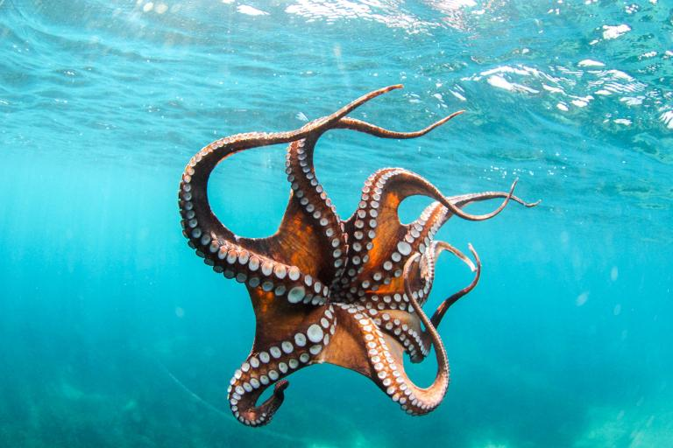

Spring 2017 CS 46B: Data Structures Module 2: Inheritance & Polymorphism
Professor Phil Heller

Slide 2

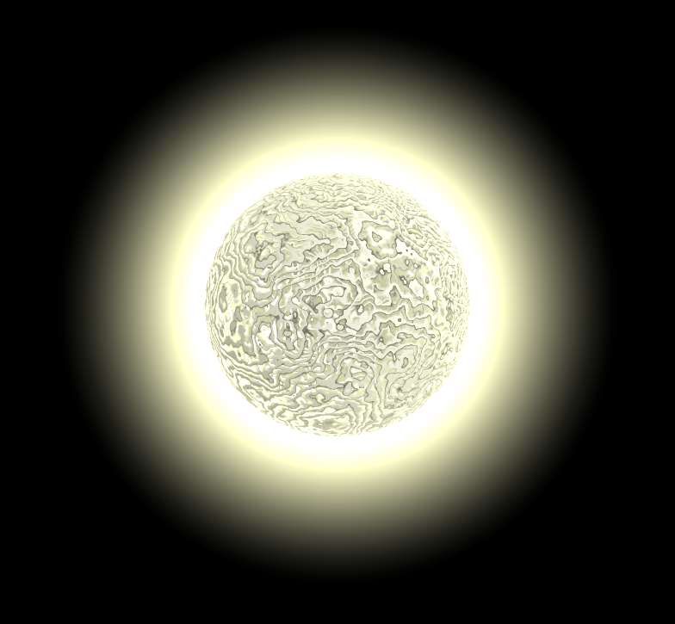

The reason for inheritance: Suppose you’re an astronomer
class RedGiant { … }
class WhiteDwarf { … }
class BlackHole { … }

Slide 3
class RedGiant {
double mass;
void setMass(double mass) {
this.mass = mass;
}
double getMass() {
return this.mass;
}
}
Notes:
I’ve left out the access modifiers to keep the examples simple. You know that all variables in all classes should be private unless there’s a specific reason for looser access.

Slide 4
class WhiteDwarf {
double mass;
void setMass(double mass) {
this.mass = mass;
}
double getMass() {
return this.mass;
}
}

Slide 5
class BlackHole {
double mass;
void setMass(double mass) {
this.mass = mass;
}
double getMass() {
return this.mass;
}
}

Slide 6
It’s natural to think of categories as belonging to broader categories
Red giant, white dwarf, and black hole are kinds of star.
House, apartment, and dorm are kinds of home.
Printed and online are kinds of newspaper.
Gorilla, elephant, and whale are kinds of mammal.
Notes:
Next slide = same, in color

Slide 7
It’s natural to think of categories as belonging to broader categories
Red giant, white dwarf, and black hole are kinds of star.
House, apartment, and dorm are kinds of home.
Printed and online are kinds of newspaper.
Gorilla, elephant, and whale are kinds of mammal.
Notes:
Up to now you would model all the red and green names as ordinary classes: class House, etc.
We’re going to see how it’s useful to model the red names as subclasses of the green names: class Elephant extends Mammal

Slide 8
Superclasses & subclasses
class Star {
double mass;
void setMass(double mass) {
this.mass = mass;
}
double getMass() {
return this.mass;
}
}
class RedGiant extends Star {
}
Notes:
RedGiant gets (we say “inherits”) all the non-private data and methods of Star.

Slide 9
A class has access to non-private data & methods
of all its superclasses
“Inherited” from Star superclass
RedGiant aldebaran = new RedGiant();
aldebaran.setMass(1.5e30);
System.out.println(aldebaran.getMass());
Have to understand what
happens here
Notes:
Only 1 immediate superclass. Which, if it isn’t Object, has 1 immediate superclass. Which, if it isn’t Object, has etc etc etc

Slide 10
The Onion Diagram
class Animal {
String name;
float weight;
}
class Duck extends Animal {
int nQuacksPerDay;
}
Duck
Animal
name;
weight;
nQuacksPerDay;
Notes:
This is just a picture to help you think about how subclasses are constructed. Of course the computer memory that contains this data isn’t really round.
Notice I’ve left a little space in the heart of the onion. Later we’ll see what goes there.

Slide 11
Constructing a duck
Duck d = new Duck();
Duck
Animal
name;
weight;
nQuacksPerDay;
Notes:
# The inherited animal parts (data and methods) of a duck are constructed first.
# Then the duck-specific parts are constructed. I like to think of the duck parts as being layered over the animal parts. It’s just a picture, and other diagrams show this in other ways.

Slide 12
Inheritance can be deep
class Animal {
String name;
float weight;
}
class Duck extends Animal {
int nQuacksPerDay;
}
class CartoonDuck extends Duck {
String cartoonist;
}

Slide 13
Constructing a cartoon duck
Duck daffy =
new CartoonDuck();
CartoonDuck
Duck
Animal
name;
weight;
nQuacksPerDay;
Java builds onions from
the inside, out
cartoonist

Slide 14
Object – the heart of the onion
Duck
CartoonDuck
Animal
Object

Slide 15
All classes implicitly extend Object if they don’t explicitly extend some other superclass
class Robot
class Robot extends Object
is an abbreviation for
Therefore all classes eventually extend Object

Slide 16
What Object provides to every (sub)class
Method | 46B?
toString() | Yes
equals() | Yes
hashCode() | Yes
clone() | Probably not
wait() | Definitely not
notify() | Definitely not
Notes:
Convention: parens after method names so you know they aren’t variables.

Slide 17
Constructing a cartoon duck
Duck daffy =
new CartoonDuck();
CartoonDuck
Duck
Animal
Object
name;
weight;
nQuacksPerDay;
You build an onion from
the inside, out
cartoonist

Slide 18
Layers can access inner layers
CartoonDuck
Duck
Animal
Object
name;
weight;
nQuacksPerDay;
cartoonist

Slide 19
Why?
class Animal {
String name;
float weight;
void setWeight(float w) {
weight = w;
}
class Duck
extends Animal {
int nQuacksPerDay;
}
class CartoonDuck
extends Duck {
String cartoonist;
}
Suppose the Duck constructor wants to call setWeight(10)
That will assign 10 to weight
weight needs to exist
Any line in any constructor may access any data in any superclass
So the data in all the superclasses has to exist
Therefore the onion
Notes:
Classes are aware of their superclasses. They aren’t aware of their subclasses.

Slide 20
Every constructor of every class* begins with a call to a constructor of the superclass. This is often invisible.
class Star {
Star() { }
Star(double mass) { this.mass = mass; }
Star(double mass, double spin) { . . . }
}
class WhiteDwarf extends Star {
WhiteDwarf() { . . . }
}
* Except Object

Slide 21
Every constructor of every class* begins with a call to a constructor of the superclass. This is often invisible.
class Star {
Star() { }
Star(double mass) { this.mass = mass; }
Star(double mass, double spin) { . . . }
}
class WhiteDwarf extends Star {
WhiteDwarf() { . . . }
}
* Except Object

Slide 22
If you omit that call, the compiler invisibly inserts a call to the superclass’ no-args ctor
class WhiteDwarf extends Star {
WhiteDwarf() {
temp = 150000;
age = 12000000000;
}
}
Is the same as
class WhiteDwarf extends Star {
WhiteDwarf() {
super(); // not necessary for you to add this
temp = 150000;
age = 12000000000;
}
}
Notes:
The compiler hopes that Star really has a no-args ctor.

Slide 23
Every class needs at least 1 ctor
If you don’t provide a ctor, the compiler invisibly creates a no-args version that calls the superclass’ no-args ctor
public class BlackHole extends Star {
public void eatTheUniverse() { . . . }
}
Is the same as
public class BlackHole extends Star {
public BlackHole() { super(); }
public void eatTheUniverse() { . . . }
}

Slide 24
Polymorphism
Πολυμορϕοσ
Poly = many
Morphos = shape/form/appearance
Notes:
A category concept like “Star” or “Bird” can take many specific forms, like White Dwarf or Black Hole or Duck or Eagle.

Slide 25
Polymorphism: The big idea
Animal[] zoo = new Animal[10];
zoo[0] = new Duck();
zoo[1] = new Tiger();
zoo[2] = new Bear();
for (Animal a: zoo)
System.out.println(a.getWeight());
OR
zoo =
new ArrayList<Animal>();
zoo.add(new Duck());
zoo.add(new Tiger());
zoo.add(new Bear());
for (Animal a: zoo)
System.out.println(a.getWeight());
class Animal {
String name;
float weight;
void getWeight() {
return weight;
}
class Duck extends Animal {
int nQuacksPerDay;
}
class Tiger extends Animal { … }
class Bear extends Animal { … }
Notes:
Polymorphism: where a superclass is expected, a subclass is accepted. The type of zoo[0] is Animal, but it doesn’t reject a Duck and it wouldn’t reject a Tiger or a Bear. zoo,.add() expects an animal, but that includes ducks, tigers, and bears.
Without polymorphism, the zoo would need one container for all the ducks, one for tigers, one for bears, in fact one for every kind of animal.

Slide 26
A polymorphic galaxy
class Galaxy {
private ArrayList<Star> stars;
Galaxy() { stars = new ArrayList<Star>(); }
void addStar(Star s) { stars.add(s); }
}
Where a superclass is expected, a subclass is accepted
Galaxy milkyWay = new Galaxy();
RedGiant aldebaran = new RedGiant();
BlackHole hawking = new BlackHole();
milkyWay.addStar(aldebaran);
milkyWay.addStar(hawking);

Slide 27
A polymorphic galaxy
class Galaxy {
private ArrayList<Star> stars;
. . .
double getAverageMass() {
double totalMass = 0;
for (Star s: stars)
totalMass = totalMass + s.getMass();
return totalMass / stars.size();
}
}
How does calling getMass() on hawking work? hawking
is a BlackHole, but getMass() belongs to Star
➔Where a superclass is expected, a subclass is accepted

Slide 28
Calling getMass() on a BlackHole
JVM looks at BlackHole’s methods, hoping to find getMass()
JVM realizes that BlackHole doesn’t have a getMass()
JVM looks at BlackHole’s immediate superclass ( = Star), hoping to find getMass()
JVM finds getMass() in Star
So that’s what gets executed
:- (
:- )

Slide 29
Calling wait() on a BlackHole
JVM looks at BlackHole’s methods, hoping to find wait()
JVM realizes that BlackHole doesn’t have a wait() :-(
JVM looks at BlackHole’s immediate superclass ( = Star), hoping to find wait()
No luck :-(
JVM looks at Star’s immediate superclass ( = Object), hoping to find wait()
Finds it there :-)
So that’s what gets executed
Notes:
wait() is a method in Object, so everything inherits it.

Slide 30

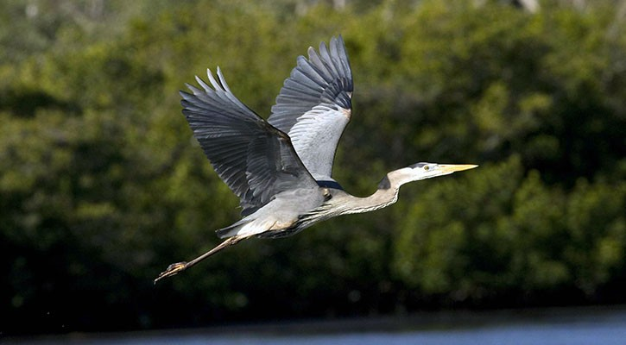
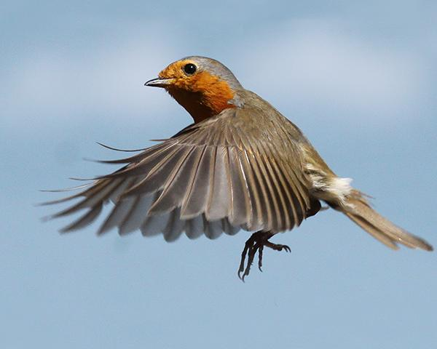
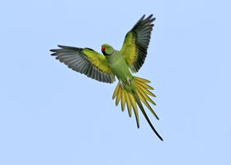
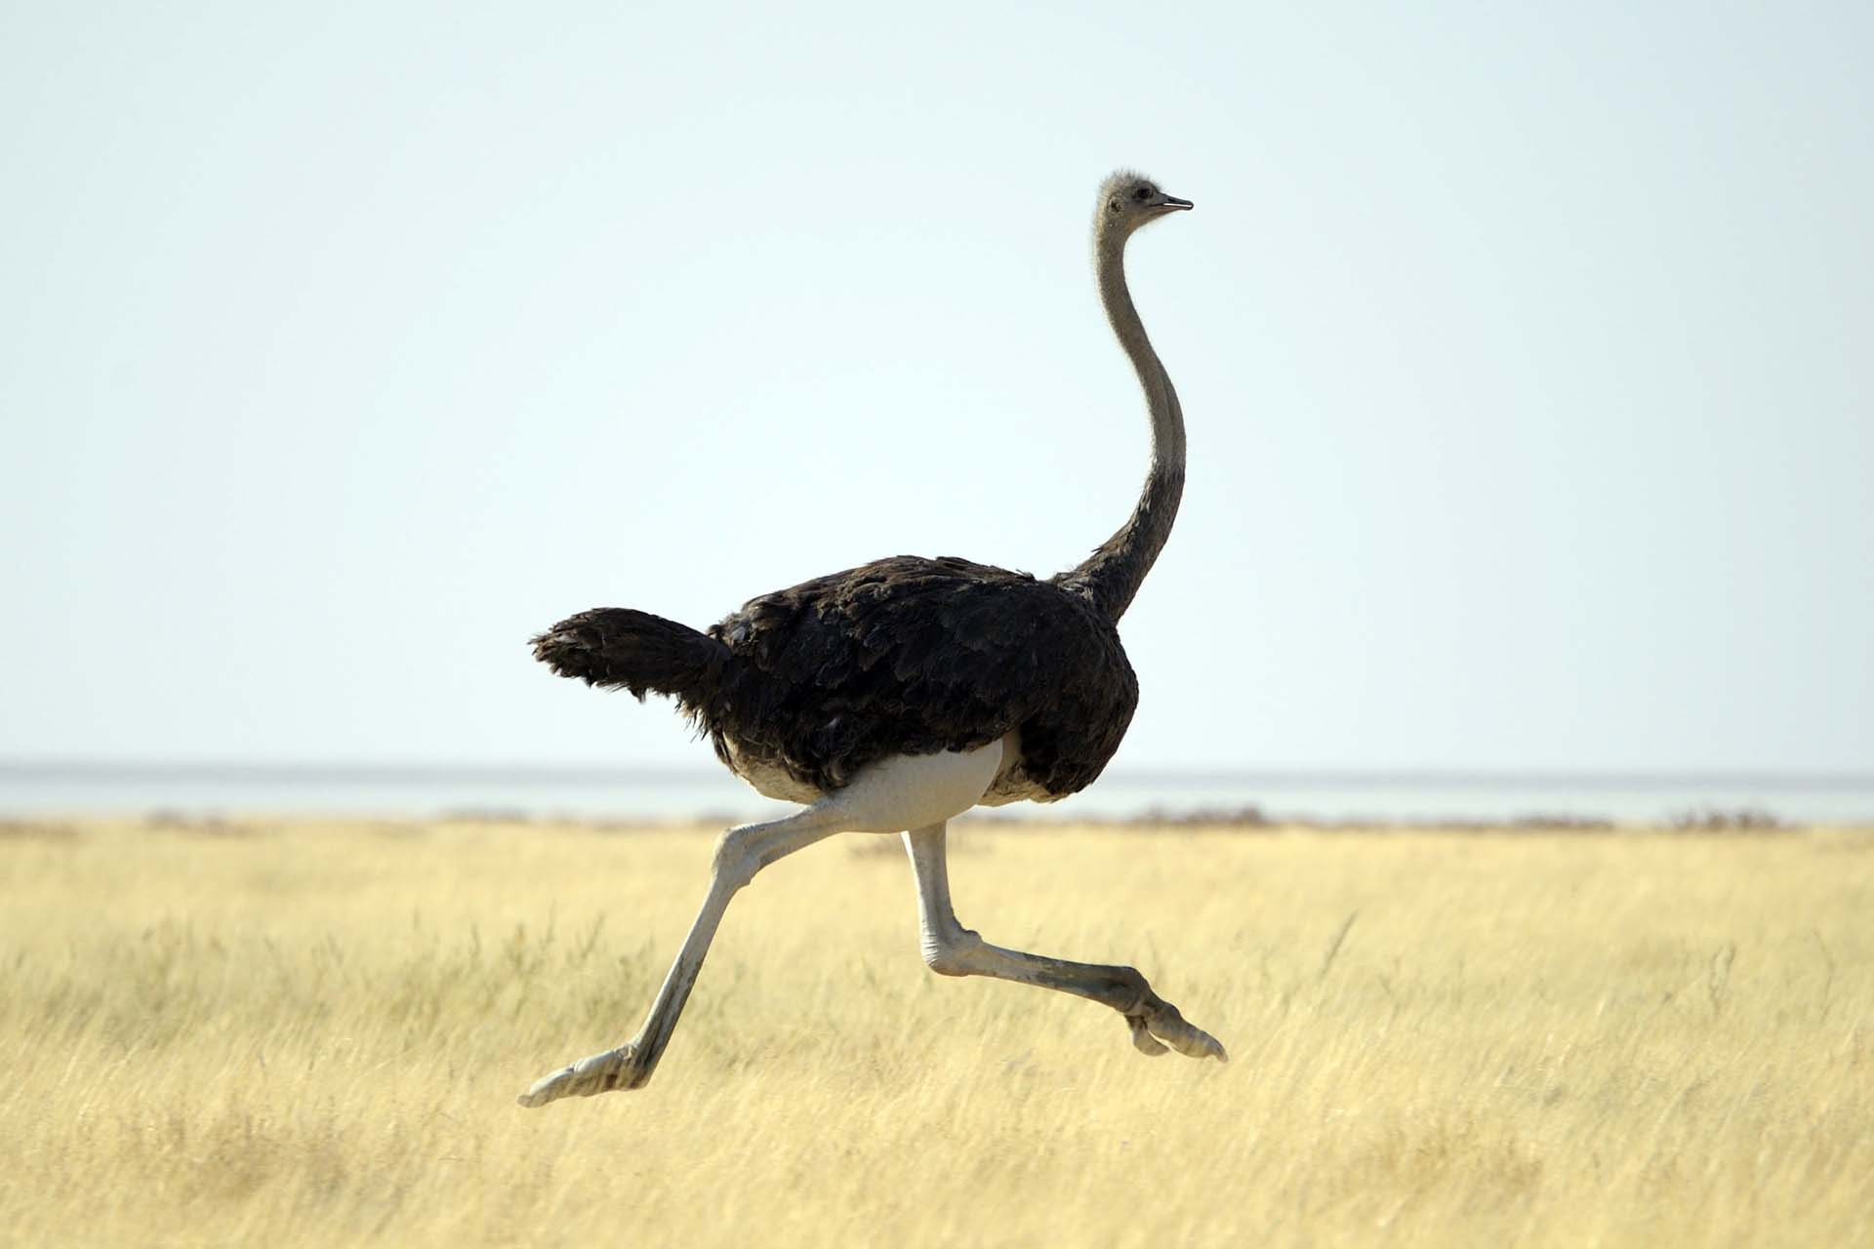
Overriding … How birds escape their enemies
Gulls fly away
Parrots fly away
Herons fly away
Robins fly away
Ostriches run away
Notes:
So next slide doesn’t quite work

Slide 31
class Bird {
void fly() { /* whatever */ }
void run() { /* whatever */ }
void shriek() { /* whatever */ }
void escape() {
shriek();
fly(); }
}
class Gull extends Bird { }
class Heron extends Bird { }
class Parrot extends Bird { }
class Robin extends Bird { }
class Ostrich extends Bird { }
They all inherit escape() from Bird. That’s what you want except for Ostrich.

Slide 32
Easy fix: Ostrich “overrides” escape()
class Ostrich extends Bird {
void escape() { run(); }
}
aGull.escape()
anOstrich.escape()
JVM looks for escape() in Gull
Doesn’t find it :-(
Looks for escape() in Gull’s immediate superclass (Bird)
Finds it :-)
aGull shrieks & flies away
JVM looks for escape() in Ostrich
Finds it :-)
anOstrich runs away

Slide 33
Overriding is for when shared behavior, implemented in the superclass, isn’t right for some subclass(es)
Flightless
birds
Notes:
Pretty much everywhere in biology

Slide 34

Overriding is for when shared behavior, implemented in the superclass, isn’t right for some subclass(es)
Mammals
that lay eggs
Notes:
In the real world, abstract categories are imperfect. There’s always something that mostly fits the abstraction, but not quite. That’s when you override methods.

Slide 35
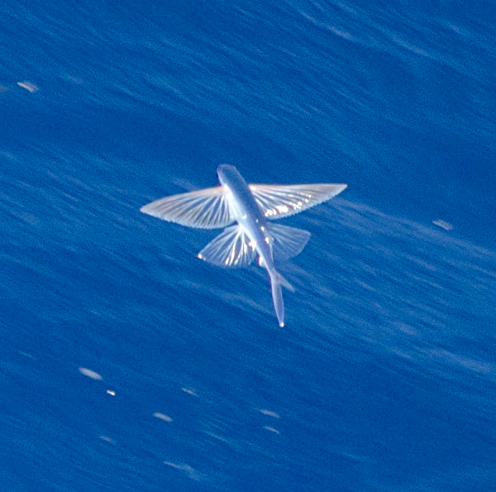
Overriding is for when shared behavior, implemented in the superclass, isn’t right for some subclass(es)
Fish
that fly
Notes:
In the real world, abstract categories are imperfect. There’s always something that mostly fits the abstraction, but not quite. That’s when you override methods

Slide 36

Overriding is for when shared behavior, implemented in the superclass, isn’t right for some subclass(es)
Clouds that don’t make rain
Notes:
In the real world, abstract categories are imperfect. There’s always something that mostly fits the abstraction, but not quite. That’s when you override methods

Slide 37
Which is better design, A or B?
A
B
Gull, Heron, Parrot, Robin, and Ostrich extend Bird
In Bird:
In Ostrich:
Gull, Heron, Parrot, Robin, and Ostrich extend Bird
In Bird:
In Gull, Heron, Parrot, Robin:
void escape() {
shriek();
fly();
}
void escape() {
run();
}
void escape() {
run();
}
void escape() {
shriek();
fly();
}

Slide 38
Where a superclass is expected, a subclass is accepted
1. Parrot polly = new Parrot();
2. Bird b = polly;
Line 2 is a “conversion assignment”
The underlying object doesn’t change
What methods can you call using b?
Methods of Bird and Object (but not Parrot)
And nothing else (enforced by compiler)
The underlying object is a Parrot, and Parrot inherits all methods of Bird and Object
Notes:
Be clear on the difference between references and the objects they point to. Often they have different types, especially in good polymorphic code.

Slide 39
Where a superclass is expected, a subclass is accepted
1. Parrot polly = new Parrot();
2. Bird b = polly;
When I look at
this part of the assignment, I expect the RHS to be a bird…
Instead of a bird on the RHS, there’s a parrot. Java accepts this.
Where superclass Bird is expected in line 2,
subclass Parrot is accepted
Notes:
RHS = Right-Hand Side (of an assignment)

Slide 40
Where a superclass is expected, a subclass is accepted
class Galaxy {
private ArrayList<Star> stars;
Galaxy() { stars = new ArrayList<Star>();
void addStar(Star s) { stars.add(s); }
}
Galaxy milkyWay = new Galaxy();
BlackHole hawking = new BlackHole();
milkyWay.addStar(hawking);
milkyWay.addStar() expects a Star, accepts a BlackHole
Notes:
Same idea, different context: method calling.

Slide 41
What about the other direction?
Star s;
RedGiant rg;
. . .
s = rg; // ok
rg = s;
Type mismatch:
cannot convert from
Star to RedGiant
Notes:
Similar compiler error if pass superclass to a method.

Slide 42
The fix: casting
Rare
We’ll cover casting in depth later
You’ll need it eventually
(RedGiant)means “I know what I’m doing. Trust me.”
Star s;
RedGiant rg;
. . .
s = rg; // ok
rg = (RedGiant)s;
Notes:
Compiler doesn’t know how s started out in life (doesn’t know whose constructor built the underlying object). That means the assignment is risky. Feel free to speculate about that risk on Piazza.

Slide 43
JVM uses 2 kinds of storage
References go on “the stack”
Objects go on “the heap”
After creation, the class of an object never changes
An object may be referred to by references of various types
Actual class of the object
Any superclass of the object
Certain interfaces (later for that!)
Notes:
Stacks are fundamental to how computers work. We will cover them soon.
Heaps are mostly used by people writing things like JVMs. We won’t cover them.
For now, these are just names of 2 places in JVM memory where 2 different kinds of data are stored.

Slide 44
Parrot polly = new Parrot();
Bird birdy = polly;
Stack Heap
Notes:
The heap stores objects. The stack stores references to objects.

Slide 45
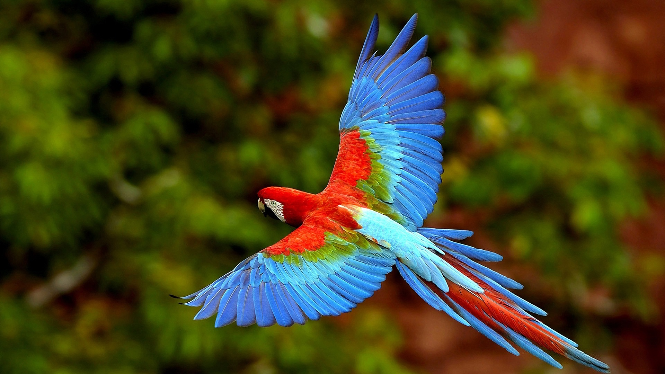
Parrot polly = new Parrot();
Bird birdy = polly;
Stack Heap
104c8e3f
Notes:
“new Parrot()” causes construction of an object in heap memory. Let’s say its address there is 104c8e3f. That’s a 32-bit number expressed in base 16, which is how memory addresses are commonly expressed.
This object is, and always will be, a Parrot. Until it gets garbage collected.

Slide 46
Parrot polly = new Parrot();
Bird birdy = polly;
Stack Heap
104c8e3f
Parrot polly
104c8e3f

Slide 47
Parrot polly = new Parrot();
Bird birdy = polly;
Stack Heap
104c8e3f
Parrot polly
104c8e3f
Bird birdy
104c8e3f

Slide 48
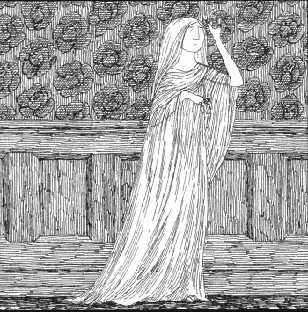
It’s time for a ghost story
Edward Gorey

Slide 49
The 11:45 PM ghost
10:00 – create class Star
10:30 – create subclass RedGiant extends Star
11:00– read about constructors
11:15– decide you want to add a ctor to Star
11:30 – RedGiant breaks, and you didn’t even touch it!
11:45 – Decide your JVM is haunted

Slide 50
What really happened: 10:00
class Star {
double mass;
void setMass(double mass) {
this.mass = mass;
}
double getMass() {
return this.mass;
}
}
Invisible
Minimal
No args
Star() { super(); }

Slide 51
What really happened: 10:30
class Star {
}
Invisible
Minimal
No args
Star() { super(); }
class RedGiant extends Star {
}
Invisible
Minimal
No args
RedGiant() { super(); }

Slide 52
What really happened: 11:15
class Star {
Star(double mass) {
this.mass = mass;
}
}
You added explicit ctor
You demonstrated onion knowledge
No more invisible Star ctor for you!
Star() { super(); }
class RedGiant extends Star {
}
RedGiant() { super(); }

Slide 53
What really happened: 11:30
class Star {
Star(double mass) {
this.mass = mass;
}
}
Star() { super(); }
class RedGiant extends Star {
}
Call to a ctor that no longer exists
RedGiant() { super(); }
Notes:
RedGiant actually broke at 11:15. You noticed it was broken at 11:30.

Slide 54
The fix: RedGiant ctor calls a Star ctor that still exists
class Star {
double mass;
Star(double mass) {
this.mass = mass;
}
}
class RedGiant extends Star {
RedGiant() {
super(5.5) // units = solar masses
}
Notes:
Or add an explicit no-args ctor to Star.

Slide 55


Slide 56
I strongly suggest
Become confident in your understanding of the 2 invisible ctor-related things that Java adds:
IN CLASSES: Invisible minimal no-args ctor (in classes that have no ctors)
IN CTORS: Invisible 1st-line call to superclass no-args ctor (in ctors that don’t start with “super …”)
Notes:
This will help you in lots of situations … like exams!

