Slide 1
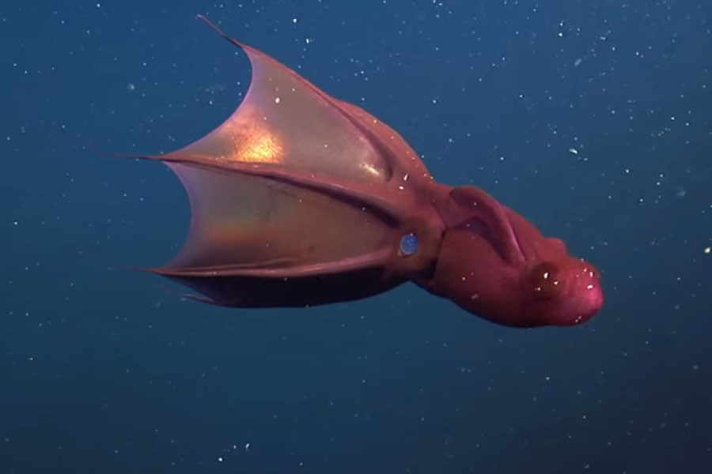

CS 46B: Data Structures Module 4
Exceptions and I/O
Notes:
2846

Slide 2
Exceptions: The Big Idea
Provide a mechanism for cleanly reporting and handling trouble, without using special return values.
Return values require special checking after method calls. Prone to failure. It’s bad when your failure mechanism is prone to failure!
Exceptions cleanly separate the “happy path” from the error path.
There are 4 kinds of trouble:
Nobody’s fault (sunspots knocked out a network satellite)
Your fault (you shouldn’t have divided by zero)
Java’s fault ☺
Trouble you provoked while stress-testing your code (assertions)

Slide 3
How NOT to handle errors
float squareRoot(float x) {
if (x < 0)
return -1;
// (do the real work here)
}
float f = squareRoot(-100);
if (f == -1) {
System.out.println(“Yikes”);
// (handle the error somehow)
}
else {
// (be happy, process f)
}
Notes:
-1 is a legitimate square root. So are all other float values. Historically, magic numbers led to industrial errors, so industry invented exceptions.

Slide 4

What’s so evil about that?
Magic cookies / magic
numbers / sentinels are
hard to keep track of
Might represent
legitimate return values
(now or in the future)
Notes:
In response to a student’s question in lecture, I said that I don’t like magic numbers and will provide better options.

Slide 5
A tale of pure evil that will curdle your blood
This really happened
Notes:
How evil was it?

Slide 6
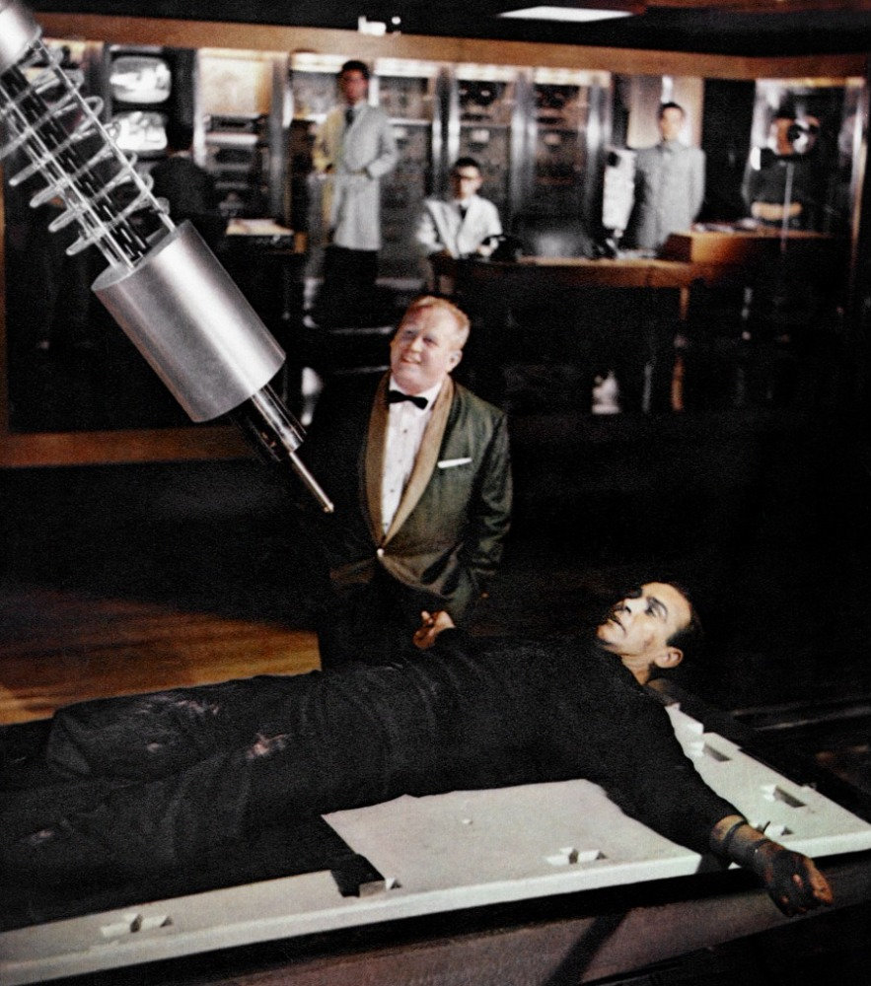
A tale of pure evil that will curdle your blood

Slide 7

A tale of pure evil that will curdle your blood

Slide 8

A tale of pure evil that will curdle your blood

Slide 9
int doImportantThing( ) {
}
~18 args
9000 lines

Slide 10
int doImportantThing( ) {
if (f1(manyArgs)==5 || f2()<0) {
} else {
}
}

Slide 11
int doImportantThing( ) {
if (f1(manyArgs)==5 || f2()<0) {
if (twisted condition) {
x = 5;
y = 10;
} else {
// well, you get the idea
}
} else {
if (twisted condition) {
x = 5;
y = 10;
} else {
// well, you get the idea
}
}
}

Slide 13
What’s so evil about that?

Slide 14
You never know which is the no-error path
Return
Return

Slide 15
You never know which is the no-error path
Return
Return
Exceptions make the no-error aka “happy” path obvious,
and eliminate magic return values
Notes:
Aka happy path

Slide 16
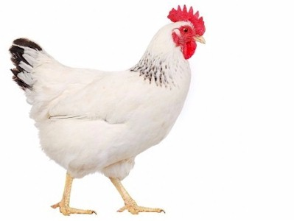
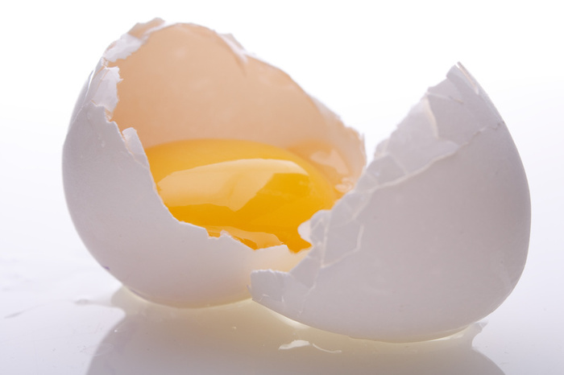
to understand Exceptions you need
to understand I/O you need
to understand I/O you need
to understand Exceptions you need
Notes:
Start here Sept 19.

Slide 17
So we’ll begin in the middle
Files and dirs are represented by the java.io.File class
2 main ctors:
Path
Parent directory file, path
Doesn’t create a file, just creates a representation of a file that might or might not exist
File dirf =
new File(“/users/philipheller”); // a dir
File logf =
new File(dirf, “log.txt”); // a file

Slide 18
Some ordinary methods of File
boolean exists()
boolean isFile()
boolean isDirectory()
String[] list()
long length()
String getAbsolutePath()
Notes:
These don’t throw exceptions

Slide 19
File dirf =
new File(“/users/philipheller”);
if (dirf.exists() && dirf.isDirectory()) {
for (String kid: dirf.list()) {
File kidf = new File(dirf, kid);
System.out.println(kidf.getAbsolutePath()
+ “: “ + kid.length());
}
}

Slide 20
An “exceptional” method of File
boolean createNewFile() – If the file exists on the hard drive, just returns false. Otherwise creates the (empty) file on the hard drive and returns true.
A different kind of method: changes the hard drive.
What if the hard drive was full, or failed at just the wrong moment?

Slide 21
File dirf =
new File(“/users/philipheller”);
File logf =
new File(dirf, “log.txt”);
logf.createNewFile();
Unhandled exception
type IOException

Slide 22
Embed the flagged line in a “try block”
Ok to put other code in the try block
Follow the try block with a “catch block”
Caught exception type matches type in error message
File dirf = new File(“/users/philipheller”);
File logf = new File(dirf, “log.txt”);
try {
logf.createNewFile();
System.out.println(“Ok”);
}
catch (IOException x) {
System.out.println(“Stress: “ + x.getMessage());
}
System.out.println(“Done”);

Slide 23
Embed the flagged line in a “try block”
Ok to put other code in the try block
Follow the try block with a “catch block”
Caught exception type matches type in error message
File dirf = new File(“/users/philipheller”);
File logf = new File(dirf, “log.txt”);
try {
logf.createNewFile();
System.out.println(“Ok”);
}
catch (IOException x) {
System.out.println(“Stress: “ + x.getMessage());
}
System.out.println(“Done”);

Slide 24
Embed the flagged line in a “try block”
Ok to put other code in the try block
Follow the try block with a “catch block”
Caught exception type matches type in error message
File dirf = new File(“/users/philipheller”);
File logf = new File(dirf, “log.txt”);
try {
logf.createNewFile();
System.out.println(“Ok”);
}
catch (IOException x) {
System.out.println(“Stress: “ + x.getMessage());
}
System.out.println(“Done”);

Slide 25
Embed the flagged line in a “try block”
Ok to put other code in the try block
Follow the try block with a “catch block”
Caught exception type matches type in error message
File dirf = new File(“/users/philipheller”);
File logf = new File(dirf, “log.txt”);
try {
logf.createNewFile();
System.out.println(“Ok”);
}
catch (IOException x) {
System.out.println(“Stress: “ + x.getMessage());
}
System.out.println(“Done”);

Slide 26
Embed the flagged line in a “try block”
Ok to put other code in the try block
Follow the try block with a “catch block”
Caught exception type matches type in error message
File dirf = new File(“/users/philipheller”);
File logf = new File(dirf, “log.txt”);
try {
logf.createNewFile();
System.out.println(“Ok”);
}
catch (IOException x) {
System.out.println(“Stress: “ + x.getMessage());
}
System.out.println(“Done”);
Notes:
Identifier after “IOException” is a var whose scope is the catch block.

Slide 27
File dirf = new File(“/users/philipheller”);
File logf = new File(dirf, “log.txt”);
try {
logf.createNewFile();
System.out.println(“Ok”);
}
catch (IOException x) {
System.out.println(“Stress: “ + x.getMessage());
}
System.out.println(“Done”);
Ok
Done
Stress: Disk is full
Done
(& the new empty file is created)

Slide 28
File dirf = new File(“/users/philipheller”);
File logf = new File(dirf, “log.txt”);
try {
logf.createNewFile();
System.out.println(“Ok”);
}
catch (IOException x) {
System.out.println(“Stress: “ + x.getMessage());
}
System.out.println(“Done”);
Try-block is the “happy path”
If all goes well
Try-block executes
Catch-block is skipped
Execution continues after end of catch-block (println)
Notes:
Green code is what executes if all goes well

Slide 29
File dirf = new File(“/users/philipheller”);
File logf = new File(dirf, “log.txt”);
try {
logf.createNewFile();
System.out.println(“Ok”);
}
catch (IOException x) {
System.out.println(“Stress: “ + x.getMessage());
}
System.out.println(“Done”);
Catch-block is the problem handler
If createNewFile() has trouble
Try-block executes until moment of failure
Remainder of try-block is abandoned
Catch-block executes
Execution continues after end of catch-block (println)
Notes:
Red code is what executed if trouble

Slide 30
File dirf = new File(“/users/philipheller”);
File logf = new File(dirf, “log.txt”);
try {
logf.createNewFile();
System.out.println(“Ok”);
}
catch (IOException x) {
System.out.println(“Stress: “ +
x.getMessage());
}
System.out.println(“Done”);
Trouble details are modeled by an instance of IOException
IOException inherits from Exception
Very useful methods:
getMessage()
printStackTrace()
Notes:
Red code is what executed if trouble

Slide 31
File dirf = new File(“/users/philipheller”);
File logf1 = new File(dirf, “log1.txt”);
File logf2 = new File(dirf, “log2.txt”);
File logf3 = new File(dirf, “log3.txt”);
try {
logf1.createNewFile();
System.out.println(“1 Ok”);
logf2.createNewFile();
System.out.println(“2 Ok”);
logf3.createNewFile();
System.out.println(“3 Ok”);
}
catch (IOException x) {
System.out.println(“Stress: “ + x.getMessage());
}
System.out.println(“Done”);
1 Ok
2 Ok
3 Ok
Done
Stress…
Done
1 Ok
Stress…
Done
1 Ok
2 Ok
Stress…
Done
Trouble:
logf1.createNewFile()
Trouble:
logf2. createNewFile
All ok
Trouble:
logf3.createNewFile
Notes:
In case of trouble, execution of the troubled call & the rest of the try block is abandoned.

Slide 32
to understand Exceptions you need
to understand I/O you need
to understand I/O you need
to understand Exceptions you need

Slide 33
I/O Streams
Low-level streams read characters from the world and deliver them to other objects
Usually those other objects are high-level streams
High-level streams read characters from low-level streams, & assemble them into more useful objects (e.g. Strings)

Slide 34
Text
lines
Text
lines
www
chars
URL Reader
BufferedReader
BufferedReader
chars
chars
URL Reader
chars
chars
JVM
FileReader
FileReader
File
System
chars
Notes:
There is no URLReader class. We’ll look closer when we have more background. Here “URL Reader” means the reader that you retrieve from a URL object

Slide 35
Example: Bird Census
100 bird watchers go into a national park
Mission: determine what birds are present
Each time anyone sees a bird, they enter its name on a tablet
Later, 1 file is generated for each bird watcher
Robin
Duck
Robin
Golden Eagle
Golden Eagle
Robin
Robin
Duck
Duck
Duck
Duck
Duck
Duck
Penguin
Owl
Duck
Pigeon
Pigeon
Pigeon
Owl
Ostrich
. . .
List1.txt
List100.txt
List2.txt
Notes:
Objective: alphabetical list of observed birds.

Slide 36
TreeSet<String> allBirds = new TreeSet<String>();
File dirf = new File("/users/philipheller/birdlists");
for (int i=1; i<=100; i++) {
File listf = new File(dirf, "List" + i);
try {
FileReader fr = new FileReader(listf);
BufferedReader br = new BufferedReader(fr);
String line;
boolean done = false;
while (!done) {
line = br.readLine();
if (line == null)
done = true; // EOF
else
allBirds.add(line);
}
br.close();
fr.close();
}
catch (FileNotFoundException x) {
System.out.println("No such file: " + listf);
}
catch (IOException x) {
System.out.println("IO trouble"); }}
There’s a better way
Notes:
2 catch blocks … at most 1 will execute per exception
br.readline reads chars from fr until newline or end of file. Returns next line, or null at EOF

Slide 37
String line;
boolean done = false;
while (!done) {
line = br.readLine();
if (line == null)
done = true; // EOF
else
allBirds.add(line);
}
String line;
while ((line = br.readline()) != null)
allBirds.add(line);

Slide 38
In Java, assignments have value
The value of “var = expression” is the value of the expression that gets assigned to variable.
The value of “y = 5” is 5.
The value of “y = 5*2” is 10.
The value of “line = br.readLine()” is the String returned by readLine(), which is null if br is at the end of file.

Slide 39
1) Read next line of text (or null if EOF) from br
2) Assign next line of text (or null) to line
3) Compare that to null
while ( (line = br.readline() ) != null)
allBirds.add(line);

Slide 40
TreeSet<String> allBirds = new TreeSet<String>();
File dirf = new File("/users/philipheller/birdlists");
for (int i=1; i<=100; i++) {
File listf = new File(dirf, "List" + i);
try {
FileReader fr = new FileReader(listf);
BufferedReader br = new BufferedReader(fr);
String line;
while ((line = br.readLine()) != null
allBirds.add(line); br.close();
fr.close();
}
catch (FileNotFoundException x) {
System.out.println("No such file: " + listf);
}
catch (IOException x) {
System.out.println("IO trouble"); }}
Simpler logic
Preferred practice

Slide 41
to understand Exceptions you need
to understand I/O you need
to understand I/O you need
to understand Exceptions you need

Slide 42
4 kinds of trouble, 4 kinds of Throwable
Checked exceptions
Like what you’ve seen (IOException)
Caused by unavoidable environmental conditions
Runtime exceptions
Consequences of 100% avoidable programming mistakes
Assertion errors
Trouble that you deliberately cause in order to stress-test your app
Other errors
Severe JVM trouble
Usually seen when you run out of memory
Notes:
Memorize these

Slide 43
Java models trouble with java.lang.Throwable and its subclasses
Contains a String message and a stack trace.
public String getMessage() and public void printStackTrace()
Subclass names also convey information about the problem, e.g. NumberFormatException or IOException
Throwable
Error
Exception
Runtime
Exception
IO
Exception
AssertionError
others
others
Arithmetic
Exception
NumberFormat
Exception
Notes:
You don’t need to memorize this

Slide 44
Stack traces
Notes:
When you see this in your Eclipse console, you can click on blue line numbers to jump there. Find topmost line that links to a source that you wrote.

Slide 45

Multiple exceptions, and finally
try {
aaaaa(); // throws IOException
bbbbb(); // throws EOFException
}
catch (EOFException x) {
sop (“EOF Stress: “ + x.getMessage());
}
catch (IOException x) {
sop (“IO Stress: “ + x.getMessage());
}
finally {
cleanup();
}
whateverComesNext();
A finally block (optional) always executes before proceeding past the try block, whether or not an exception was thrown.
Typically used for cleanup.

Slide 46
Multiple exceptions, and finally
try {
aaaaa(); // throws IOException
bbbbb(); // throws EOFException
}
catch (EOFException x) {
sop (“EOF Stress: “ + x.getMessage());
}
catch (IOException x) {
sop (“IO Stress: “ + x.getMessage());
}
finally {
cleanup();
}
whateverComesNext();
With multiple exceptions, at most 1 catch block executes:
The 1st catch block whose type is the same as, or a superclass of, the throws exception
So the exception reference can legally point to the exception

Slide 47
Passing the Buck
Suppose you want a slightly verbose version of File.createNewFile:
But you need to deal with that IOException:
boolean verboseCreateNewFile(File f) {
System.out.println(“About to create file”);
boolean success = f.createNewFile();
System.out.println (“Done. Success = “ + success);
return success;
}
boolean verboseCreateNewFile(File f) {
System.out.println (“About to create file”);
try {
boolean success = f.createNewFile();
System.out.println (“Done. Success = “ + success);
return success;
}
catch (IOException x) {
System.out.println (“Stress: “ + x.getMessage());
return false;
}
}
- OR … -
Notes:
Start here Sept 21

Slide 48
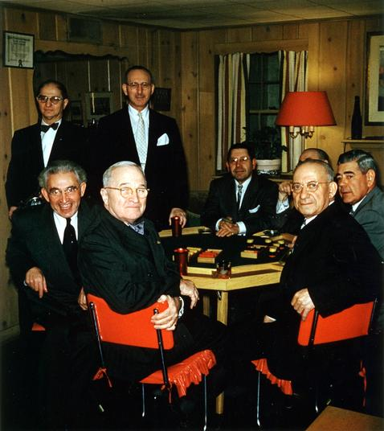
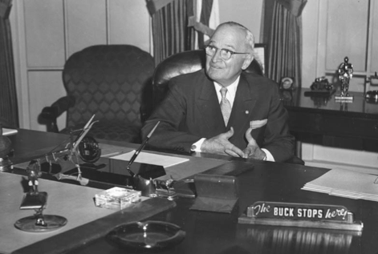
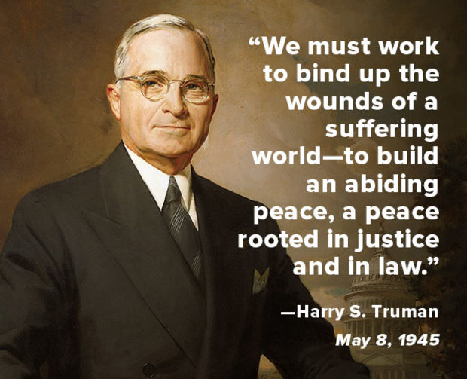
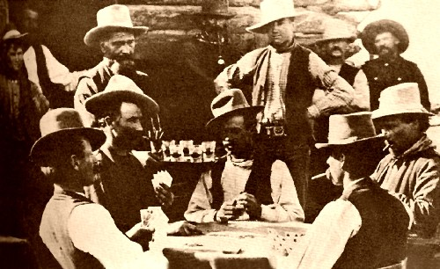


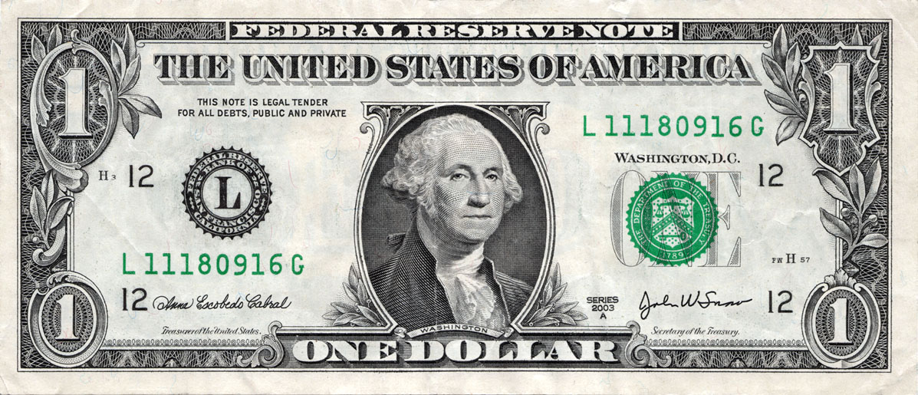

Passing the Buck vs. The Buck Stops Here

Slide 49
Passing the Buck
Suppose you want a slightly verbose version of File.createNewFile:
boolean verboseCreateNewFile(File f) {
System.out.println(“About to create file”);
boolean success = f.createNewFile();
System.out.println (“Done. Success = “ + success);
return success;
}
But you need to deal with that IOException thrown by createNewFile:
boolean verboseCreateNewFile(File f) {
try {
System.out.println (“About to create file”);
boolean success = f.createNewFile();
System.out.println (“Done. Success = “ + success);
return success;
}
catch (IOException x) {
System.out.println (“Stress: “ + x.getMessage());
return false;
}
}
- OR … -

Slide 50
boolean verboseCreateNewFile(File f) throws IOException {
System.out.println(“About to create file”);
boolean success = f.createNewFile();
System.out.println (“Done. Success = “ + success);
return success;
}
void xxx() {
File theFile = new File(“/users/philipheller/log.txt”);
try {
verboseCreateNewFile(theFile);
}
catch (IOException x) {
System.out.println(“Stress”);
x.printStackTrace();
}
}

Slide 51
Pass the buck of exception handling up the calling chain
boolean verboseCreateNewFile(File f) throws IOException {
System.out.println(“About to create file”);
boolean success = f.createNewFile();
System.out.println (“Done. Success = “ + success);
return success;
}
Now whoever calls verboseCreateNewFile() has the same problem you had 2 minutes ago: they’re calling a method that throws IOException, and have to choose between handling it and passing the buck.

Slide 52
throws IOException
void xxx() {
File theFile = new File(“/users/philipheller/log.txt”);
try {
verboseCreateNewFile(theFile);
}
catch (IOException x) {
System.out.println(“Stress”);
x.printStackTrace();
}
}
void xxx() {
File theFile = new File(“/users/philipheller/log.txt”);
verboseCreateNewFile(theFile);
}
try {
xxx();
}
catch (IOException x) {
// Handle the exception.
}

Slide 53
Runtime Exceptions
Not checked
You may deal with them with try/catch or throws
But you don’t have to
And almost never should
Point to the 4th circle
Point to the 10th circle
Notes:
There is no 10th circle, so the instruction is incoherent

Slide 54
Clicker Quiz: What is 5/0 ?
5
0
Infinity
Something else

Slide 55
What is 5 / 0?
Easy answer: infinity
Wrong!
As x → 0, 5/x “grows without bounds”
Infinity is not a number, it’s a property of certain processes, e.g. dividing 5 by smaller and smaller and smaller numbers
“5/0” is a misuse of the language of math
So never do it
int x = 5; int y = x/0; is an attempt to express in Java something without meaning
So never do it

Slide 56
Runtime exceptions (almost) always say you did something meaningless
ArithmeticException: integer division by zero
ArrayIndexOutOfBoundsException: index is too big
int x = 5;
int y = 0;
int z = x / y;
int[] xs = new int[6];
xs[20] = 12345;

Slide 57
Catching and repairing is (almost) never the best way to deal with runtime exceptions .. Don’t do this:
try {
int x = 5;
int y = 0;
int z = x / y;
} catch (ArithmeticException x) {
System.out.println(“Oops, sorry.”);
// Now what?
}
Fix the problem
at its origin
Notes:
Instead: fix your algorithm so that it only does meaningful computation

Slide 58
private int intmean(ArrayList<Integer> ints) {
int sum = 0;
for (int x: ints)
sum += x;
int mean = x / ints.size();
return mean;
}
What if ints is empty?
You never should have called intmean with an empty list
Notes:
Assertions help avoid this situation

Slide 59
private void
printMovies(Movie[] movies) {
for (int i=0; i< movies.length; i++) {
System.out.println(movies[i]);
}
private void
printMovies(Movie[] movies) {
for (int i=0; i<=movies.length; i++) {
try {
System.out.println(movies[i]);
}
catch (ArrayIndexOutOfBoundsException x) { }
}
}
<= is a bug: should be strictly <
Don’t fix code bugs by adding more code
Eliminate the bug

Slide 60
 | Checked Exceptions | Runtime Exceptions
Can try/catch or throws | Yes | Yes
Should try/catch Or throws | Yes | Almost never

Slide 61
Almost never catch runtime exceptions?
These all throw runtime exception NumberFormatException
Byte.parseByte()
Short.parseShort()
Integer.parseInt()
. . .
Double.parseDouble()
No other easy way to tell if a string encodes a number
Notes:
Messy field reports are an accepted part of observational science.

Slide 62
private
int countFloats(ArrayList<String> words) {
int nFloats = 0;
for (String word: words) {
try {
Float.parseFloat(word);
nFloats++;
}
catch (NumberFormatException x) { }
return nFloats;
}

Slide 63
to understand Exceptions you need
to understand I/O you need
to understand I/O you need
to understand Exceptions you need

Slide 64
Text
lines
Text
lines
www
chars
URL Reader
BufferedReader
BufferedReader
chars
chars
URL Reader
chars
chars
JVM
FileReader
FileReader
File
System
Input
chars
Notes:
There is no URLReader class. We’ll look closer when we have more background. Here “URL Reader” means the reader that you retrieve from a URL object

Slide 65
Text
lines
Text
lines
www
Strings
URL Writer
PrintWriter
PrintWriter
chars
Strings
URL Writer
Strings
Strings
JVM
FileWriter
FileWriter
File
System
Output
chars

Slide 66
Output Example rev A
private void
writeNSquares(int nSquares, File f) {
try {
FileWriter fw = new FileWriter(f);
for (int i=1; i<=nSquares; i++) {
int iSquared = i * i;
fw.write(iSquared + “\n”);
}
fw.close();
}
catch (IOException x) {
// Handle the exception somehow.
}
}

Slide 67
Output Example rev B
throws
IOException
private void
writeNSquares(int nSquares, File f) {
FileWriter fw = new FileWriter(f);
for (int i=1; i<=nSquares; i++) {
int iSquared = i * i;
fw.write(iSquared + “\n”);
}
fw.close();
}
private void writeNSquares(int nSquares, f) {
try {
FileWriter fw = new FileWriter(f);
for (int i=1; i<=nSquares; i++) {
int iSquared = i * i;
fw.write(iSquared + “\n”);
}
fw.close();
}
catch (IOException x) {
// Handle the exception somehow.
}
}

Slide 68
Output Example rev C
throws
IOException
private void
writeNSquares(int nSquares, File f) {
FileWriter fw = new FileWriter(f);
PrintWriter pw = new PrintWriter(fw);
for (int i=1; i<=nSquares; i++) {
int iSquared = i * i;
//fw.write(iSquared + “\n”);
pw.println(iSquared);
}
fw.close();
}

Slide 69

Real World Example: fastq and fasta
Adenine (A)
Cytosine (C)
Guanine (G)
Thymine (T)

Slide 70
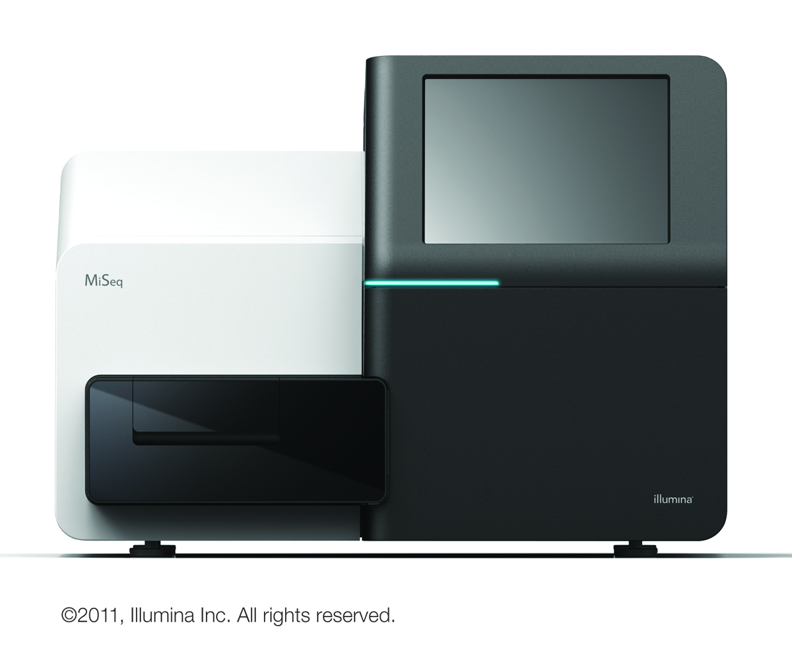
➔
➔
Fastq file

Slide 71
Fastq File Format
Each read (chunk of DNA, length ~= 200-800) is represented by 4 lines
Line 1: “Defline”:
Starts with @
Then some unique identifier for the read
Line 2: Sequence e.g. ACTTGTATATCTAGCT…
Line 3: +
Nobody remembers why
Line 4: 1 quality codes (1 coded char per base on line 2)
Then 4 more similar lines for each read molecule detected by the sequencer
Notes:
3rd lecture starts here

Slide 72
@EPWW3:02639:02539
CTATCGGTACGCATATTAAATATAGTACAGATAAAATTAATAGCACCTAAAATAGATGAAGCTCCA…
+
????AB>CBFB@@?CC<AA9A??@DDCB<==////(/)/)/9999;45555 //(/)/)/9999;(4=?ACGC?CC…
@EPWW3:03490:02075
AAATACCTAACAGGTGAACTGAAAAAATCAGCAAATGGAGGGTACATGGTCCAACTCGCGGCGG…
+
BH=BBB<AB?AAA?CDD=CBCDBBDD0D@??BAA:AB:B=BBBCC9;;?FF=C=B????4?AC>DB=CC…
@EPWW3:03756:02316
GTATTTAGATTTCGATCTGTAAGTAGTATTGTAATAGCTCCTGCTAAAACAGGGAGTGATAGTAG…
+
<+:8;8///;(//(/9<4988049495447=;=@@<B9:88*.(.8(;;;;;;3447=;=@@<B9:88*.(.8(...--8/55…
@EPWW3:03490:02076
AAATACCTAACAGGTGAACTGAAAAAATCAGCAAATGGAGGGTACATGGTCCAACTCGCGGCGG…
+
BH=BBB<AB?AAA?CDD=CBCDBBDD0D@??BAA:AB:B=BBBCC9;;?FF=C=B????4?AC>DB=CC…
. . . (thousands to hundreds of millions more records)

Slide 73
fasta format
Simpler than fastq: No quality info, no “+” line
2 lines per record:
Defline: Starts with >, then record identifier
Sequence: same as fastq
Common “pipeline” begins with converting fastq to fasta
Reject records with poor quality
Reduce data size by at least 50%
>EPPWblablabla
AGGTTATCGATACTAGCGTACGT…

Slide 74
@EPWW3:02639:02539
CTATCGGTACGCATACA…
+
????AB>CBFB@@?CC<…
@EPWW3:03490:02075
AAATACCTAACCGGCGG…
+
BH=BBB<AB?AAA?CDD…
@EPWW3:03756:02316
GTATTTAGATTTCGATGC…
+
<+:8;8///;(//.(.8(...--8/55…
@EPWW3:03490:02076
AAATACCTAACAGGTGGG…
+
BH=BBB<AB?AAA?CDD=…
…
>EPWW3:02639:02539
CTATCGGTACGCATACA…
>EPWW3:03490:02075
AAATACCTAACCGGCGG…
>EPWW3:03490:02076
AAATACCTAACAGGTGG…
…
Fasta
Fastq
Notes:
Suppose the 3rd record has poor quality and is rejected.

Slide 75
private void translate(File fastq, File fasta)
throws IOException {
FileReader fr = new FileReader(fastq);
BufferedReader br = new BufferedReader(fr);
FileWriter fw = new FileWriter(fasta);
PrintWriter pw = new PrintWriter(fw);
boolean done = false;
while (!done) {
String defline = br.readLine();
if (defline == null) { done = true; break; }
String sequence = br.readLine();
br.readLine(); // weird “+” line
String qual = br.readLine();
if (qualityIsOk(qual)) {
pw.println(“>” + defline.substring(1));
pw.println(sequence);
}
pw.close(); fw.close(); br.close(); fr.close();
}
}
Notes:
No explicit newline in the output.
System.out isa PrintWriter

Slide 76
to understand Exceptions you need
to understand I/O you need
to understand I/O you need
to understand Exceptions you need

Slide 77
4 kinds of trouble, 4 kinds of Throwable
Checked exceptions
Like what you’ve seen (IOException)
Caused by unavoidable environmental conditions
Runtime exceptions
Consequences of 100% avoidable programming mistakes
Assertion errors
Trouble that you deliberately cause in order to stress-test your app
Other errors
Severe JVM trouble
Usually seen when you run out of memory

Slide 78
Java models trouble with java.lang.Throwable and its subclasses
Contains a String message and a stack trace.
public String getMessage() and public void printStackTrace()
Subclass names also convey information about the problem, e.g. NumberFormatException or IOException
Throwable
Error
Exception
Runtime
Exception
IO
Exception
AssertionError
others
others
Arithmetic
Exception
NumberFormat
Exception

Slide 79
3 more thing to know about exceptions
Errors (very easy)
Throwing your own exceptions (very useful, medium cool)
Dealing with Assertions (easy, very useful, very cool)
Notes:
Errors are so easy we’ll deal with them first.

Slide 80
Errors
OutOfMemoryError
You can write code to catch it, but you never should
By the time it happens, your JVM is dead
So your catch code never executes
User will see error message from JVM
Other error types … rumors and folklore
Indicate bugs in the JVM

Slide 81

Throwing exceptions
We’ve seen that it’s evil to return magic values to indicate errors
We’ve seen that Java core classes (e.g. FileWriter) throw exceptions instead
We should do the same
public
float squareRoot(float x) {
if (x < 0)
return -1;
// (do the real work here)
}

Slide 82
public float squareRoot(float a) {
if (a < 0) {
String err = “Negative arg: “ + a;
IllegalArgumentException x =
new IllegalArgumentException(err);
throw x;
}
// (do the real work here)
}
For public methods, indicate bad input by throwing IllegalArgumentException
It extends RuntimeException
Method doesn’t declare that it throws IllegalArgumentException
Callers don’t have to deal with the exception, although they may … but they shouldn’t
Notes:
Pass a good clear string into the exception ctor

Slide 83
What if the fastq file was corrupted (didn’t match the expected format)?
private void translate(File fastq, File fasta)
throws IOException {
. . .
while (!done) {
String defline = br.readLine();
if (defline == null) { done = true; break; }
if (defline.charAt(0) != ‘@’) {
// Now what?
Notes:
Defline not starting with @ is just one of tons of ways the file could be corrupt

Slide 84
Right idea, wrong execution
private void translate(File fastq, File fasta)
throws IOException {
. . .
while (!done) {
String defline = br.readLine();
if (defline == null) { done = true; break; }
if (defline.charAt(0) != ‘@’) {
String err = “Unexpected start of defline: “
+ defline.charAt(0);
throw new IOException(err);
}
. . .
API page for java.io.IOException: “This class is the general class of exceptions
produced by failed or interrupted I/O operations.”
The input operation succeeded. It successfully & accurately delivered a weird defline.
Notes:
Defline not starting with @ is just one of tons of ways the file could be corrupt

Slide 85
We need a better exception type
Decide if we want to throw a runtime or a checked exception.
Look in the API for an appropriate Exception subclass that does or doesn’t extend RuntimeException.
If there isn’t one, create one.
In the fastq example, we want checked because the problem isn’t
caused by a faulty algorithm in our code.
Nothing appropriate.
Ok
Notes:
Very important

Slide 86
public class FastqException extends Exception {
FastqException(String err) {
super(err);
}
FastqException(File fastq, String err) {
super(“Trouble in fastq file “ +
fastq.getAbsolutePath() + “: “ + err);
}
}
Exception ctor takes a String arg…
… which is returned by calling getMessage() on the exception …
… which usually happens in an exception handler
Common practice: provide 1st form of ctor

Slide 87
Right idea, right execution
private void translate(File fastq, File fasta)
throws IOException, FastqException {
. . .
while (!done) {
String defline = br.readLine();
if (defline == null) { done = true; break; }
if (defline.charAt(0) != ‘@’) {
String err = “Unexpected start of defline: “
+ defline.charAt(0);
throw new FastqException(fastq, err);
}
. . .
Notes:
Defline not starting with @ is just one of tons of ways the file could be corrupt

Slide 88
How to call translate()
public void translateLungTumorFastq(int patientId) {
File dirf = new File(“/users/philipheller/genomes”);
File fastq = new File(dirf, “Patient_” + patientId +
”_LungTumor.fastq”);
File fasta = new File(dirf, “Patient_” + patientId +
”_LungTumor.fasta”);
try {
translate(fastq, fasta);
}
catch (IOException x) {
javax.swing.JOptionPane.showMessageDialog(null, x.getMessage);
}
catch (FastqException x) {
javax.swing.JOptionPane.showMessageDialog(null, x.getMessage);
}

Slide 89
How to call translate()
public void translateLungTumorFastq(int patientId) {
File dirf = new File(“/users/philipheller/genomes”);
File fastq = new File(dirf, “Patient_” + patientId +
”_LungTumor.fastq”);
File fasta = new File(dirf, “Patient_” + patientId +
”_LungTumor.fastq”);
try {
translate(fastq, fasta);
}
catch (IOException x) {
javax.swing.JOptionPane.showMessageDialog(null, x.getMessage);
}
catch (FastqException x) {
javax.swing.JOptionPane.showMessageDialog(null, x.getMessage);
}
Duplicate code … is there a better way?

Slide 90
How to call translate()
public void translateLungTumorFastq(int patientId) {
File dirf = new File(“/users/philipheller/genomes”);
File fastq = new File(dirf, “Patient_” + patientId +
”_LungTumor.fastq”);
File fasta = new File(dirf, “Patient_” + patientId +
”_LungTumor.fastq”);
try {
translate(fastq, fasta);
}
catch (Exception x) {
javax.swing.JOptionPane.showMessageDialog(null, x.getMessage);
}
Works, because IOException and FastqException both extend exception,
but 2 problems:
- Other people reading your code don’t know what exception types
actually might get thrown
- This catch block also catches any runtime exceptions
Notes:
If your customers see a dialog announcing a runtime exception, they will lose confidence in your ability to write correct algorithms.

Slide 91
How to call translate()
public void translateLungTumorFastq(int patientId) {
File dirf = new File(“/users/philipheller/genomes”);
File fastq = new File(dirf, “Patient_” + patientId +
”_LungTumor.fastq”);
File fasta = new File(dirf, “Patient_” + patientId +
”_LungTumor.fastq”);
try {
translate(fastq, fasta);
}
catch (IOException|FastqException x) {
javax.swing.JOptionPane.showMessageDialog(null, x.getMessage);
}
A recent addition to Java (Java7 or maybe Java8).
The list of exception types can be arbitrarily long.
Notes:
If your customers see a dialog announcing a runtime exception, they will lose confidence in your ability to write correct algorithms.

Slide 92
How to call translate()
public void translateLungTumorFastq(int patientId) throws IOException{
File dirf = new File(“/users/philipheller/genomes”);
File fastq = new File(dirf, “Patient_” + patientId +
”_LungTumor.fastq”);
File fasta = new File(dirf, “Patient_” + patientId +
”_LungTumor.fasta”);
try {
translate(fastq, fasta);
}
catch (FastqException x) {
javax.swing.JOptionPane.showMessageDialog(null, x.getMessage);
}
Throw one, catch one

Slide 93
Java models trouble with java.lang.Throwable and its subclasses
Contains a String message and a stack trace.
Subclass names also convey information about the problem, e.g. NumberFormatException or IOException
Throwable
Error
Exception
Runtime
Exception
IO
Exception
AssertionError
others
others
Arithmetic
Exception
IllegalArgument
Exception
NumberFormat
Exception
Notes:
Start here 9/26

Slide 94
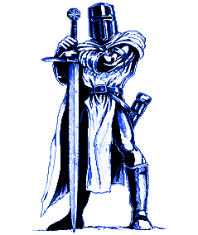


Assertions, or How the Knight Tried to Steal the Dragon’s Treasure
Notes:
Suppose you’re designing a game…

Slide 95
50’
Notes:
When the knight gets within 50’ of the treasure, the knight and the dragon fight.

Slide 96
if (george.distanceTo(theTreasure) <= 50)
fight(george, theDragon);
void fight (Knight knt, Dragon drgn) {
// (setup code here)
while (knt.isAlive() && drgn.isAlive()) {
// lots of code to
// fight 1 round
// (call lots of other methods to do this)
}
// (cleanup code here)
}

Slide 97
Conditions on fight() method
Method Entry
Knight is within 50’ of treasure
In loop:
Top: Knight & dragon in different locations
Bottom: Knight is within 50’ of treasure
Method Exit:
At least 1 corpse
Knight owns treasure or is dead
Notes:
During development, can’t guarantee that conditions are met. Other team members, or you when you were sleepy, could have forgotten about them.

Slide 98
Conditions on fight() method
Method Entry PRECONDITION
Knight is within 50’ of treasure
In loop: LOOP INVARIANTS
Top: Knight & dragon in different locations
Bottom: Knight is within 50’ of treasure
Method Exit: POSTCONDITIONS
At least 1 corpse
Knight owns treasure or is dead

Slide 99
fight() with conditions
void fight (Knight knt, Dragon drgn) {
assert knt.distanceTo(treasure) <= 50;
// (setup code here)
while (knt.isAlive() && drgn.isAlive()) {
assert knt.distanceTo(drgn) >= 1:
“Knight & dragon are too close”;
// fight 1 round, many lines of code
assert knt.distanceTo(treasure) <= 50 :
“Knight too far from treasure”;
}
// (cleanup code here)
assert knt.isDead() || drgn.isDead();
if (!knt.isDead())
assert knt.loot.contains(treasure);
}

Slide 100
How assert works
Command line must contain “-ea” or
“-enableassertions”
Easy to configure Eclipse to do this.
Run Menu -> Run Configurations… Select Arguments tab and type –ea under VM Arguments
Syntax:
assert boolean-statement -OR-
assert boolean-statement : string
If boolean statement is false, throws AssertionError (like an exception)
Terminates the program
Optional string becomes AssertionError message
Prints AssertionError’s stack trace (incl. message)
NEVER catch AssertionError

Slide 101
Text
lines
ParagraphReader
Paragraphs
BufferedReader
chars
FileReader
Black Belt Jedi Material
Notes:
There is no URLReader class. We’ll look closer when we have more background. Here “URL Reader” means the reader that you retrieve from a URL object

Slide 102
Typical text in a text file
In a hole in the ground there lived a hobbit. Not a nasty,
dirty, wet hole, filled with the ends of worms and an oozy
smell, nor yet a dry, bare, sandy hole with nothing in it to
sit down on or to eat: it was a hobbit-hole, and that means comfort.
The Bagginses had lived in the neighbourhood of The Hill for
time out of mind, and people considered them very respectable,
not only because most of them were rich, but also because they
never had any adventures or did anything unexpected.
Tolkein, J.R.R. "The Hobbit". 1937.

Slide 103
Text is chars organized into lines
In a hole in the ground there lived a hobbit. Not a nasty,
dirty, wet hole, filled with the ends of worms and an oozy
smell, nor yet a dry, bare, sandy hole with nothing in it to
sit down on or to eat: it was a hobbit-hole, and that means comfort.
The Bagginses had lived in the neighbourhood of The Hill for
time out of mind, and people considered them very respectable,
not only because most of them were rich, but also because they
never had any adventures or did anything unexpected.
Tolkein, J.R.R. "The Hobbit". 1937.
… which we could read using FileReader→BufferedReader

Slide 104
Text is chars organized into lines which are organized into paragraphs
In a hole in the ground there lived a hobbit. Not a nasty,
dirty, wet hole, filled with the ends of worms and an oozy
smell, nor yet a dry, bare, sandy hole with nothing in it to
sit down on or to eat: it was a hobbit-hole, and that means comfort.
The Bagginses had lived in the neighbourhood of The Hill for
time out of mind, and people considered them very respectable,
not only because most of them were rich, but also because they
never had any adventures or did anything unexpected.
Tolkein, J.R.R. "The Hobbit". 1937.
… which we could read using
FileReader→BufferedReader→ParagraphReader
… but first we have to invent ParagraphReader
… so let’s do that!

Slide 105
public class ParagraphReader {
private BufferedReader br;
private boolean atEOF; // EOF = end of file
public ParagraphReader(BufferedReader br) { this.br = br; }
public String readParagraph() throws IOException { … }
public static void main(String[] args) {
try
{
File textfile = new File("data/in.txt");
FileReader fr = new FileReader(textfile);
BufferedReader br = new BufferedReader(fr);
ParagraphReader pr = new ParagraphReader(br);
String para;
while ((para = pr.readParagraph()) != null)
System.out.println(para + "\n********");
br.close();
fr.close();
}
catch (IOException x) { x.printStackTrace(); }
}
}

Slide 106
// Returns null at end of file. End of paragraph is indicated
// by a blank line or end of file.
public String readParagraph() throws IOException {
// Previous call hit EOF.
if (atEOF)
return null;
String s = "";
String line;
while ((line = br.readLine()) != null) {
if (line.isEmpty())
return s; // para terminated by blank line
s += line + "\n";
}
// Here when hit EOF.
atEOF = true;
return s; // para terminated by EOF
}

Slide 107
Output:
In a hole in the ground there lived a hobbit. Not a nasty,
dirty, wet hole, filled with the ends of worms and an oozy
smell, nor yet a dry, bare, sandy hole with nothing in it to
sit down on or to eat: it was a hobbit-hole, and that means comfort.
********
The Bagginses had lived in the neighbourhood of The Hill for
time out of mind, and people considered them very respectable,
not only because most of them were rich, but also because they
never had any adventures or did anything unexpected.
********
Tolkein, J.R.R. "The Hobbit". 1937
********

