Slide 1

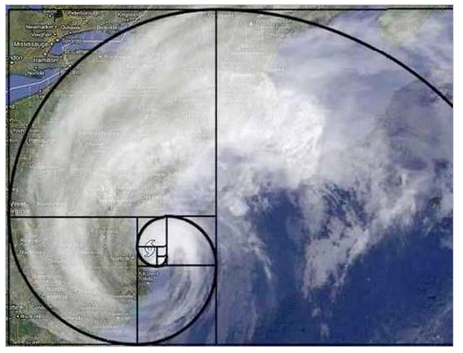


CS 46B: Data Structures Module 5: Midterm 1 & Recursion
Professor Phil Heller

Slide 2
Recursion: When a method calls itself
??????????????????????????????????????????????
Every calls passes simpler data than the previous call
Eventually: simple, almost trivial, input
public void computeKeyToHappiness() {
computeKeyToHappiness();
}
public int computeKeyToHappiness(int n) {
if (n <= 0)
return 42;
return computeKeyToHappiness(n-1);
}
trivial
case
regular
case:
n-1 is
simpler
than n
Notes:
Start here March 14.

Slide 3
Example 1: Sum of array members
// Calls the private recursive method.
public int addArrayMembers(int[] arr) {
return addRecurse(arr, 0);
}
// Recursively sums array members,
// starting at arr[x].
private int addRecurse(int[] arr, int x) {
if (x == arr.length-1)
return arr[x];
return arr[x] + addRecurse(arr, x+1);
}
trivial
case
Notes:
A silly way to add numbers, but a good illustration

Slide 4
// Calls the recursive method.
public int addArrayMembers(int[] arr) {
return addRecurse(arr, 0);
}
// Recursively sums array members, starting at [x].
private int addRecurse(int[] arr, int x) {
if (x == arr.length-1)
return arr[x];
return arr[x] + addRecurse(arr, x+1);
}
[0]
[1]
[2]
[3]
[4]
5
3
2
6
7
x is 0
5 + addRecurse(arr, 1)
23
x is 1
3 + addRecurse(arr, 2)
18
x is 2
2 + addRecurse(arr, 3)
15
x is 3
6 + addRecurse(arr, 4)
13
x is 4
7
7

Slide 5
Example 2: Triangular Numbers
1 3 6 10
15 21

Slide 6
. . .
n-2 boxes
n-1 boxes
Bottom row: n boxes

Slide 7
1 box
. . .
n-2 boxes
n-1 boxes
Bottom row: n boxes

Slide 8
tri(n-1)
n

Slide 9
int nthTriangular(int n) {
if (n < 0)
throw new IllegalArgumentException(“Bad n:” + n);
if (n == 1)
return 1;
return n + nthTriangular(n-1);
}

Slide 10
Example 3: Palindromes
A palindrome reads the same forward or backward
A Toyota
Madam, I’m Adam
Never odd or even
Able was I ere I saw Elba
A man, a plan, a canal: Panama

Slide 11
public boolean isPalindrome(String s) {
s = s.toUpperCase();
s.replace(“ “, “”);
return isPalindromeRecurse(s);
}
private boolean isPalindromeRecurse(String s) {
? ? ? ? ? ? ? ? ?
}

Slide 12
Lonely Tylenol
➔
LONELYTYLENOL
Redder
➔
REDDER
Philip
➔
PHILIP
Notes:
Ended here

Slide 13
public boolean isPalindrome(String s) {
s = s.toUpperCase();
s = s.replace(“ “, “”);
return isPalindromeRecurse(s);
}
private boolean isPalindromeRecurse(String s) {
if (s.length() <= 1)
return true;
else if (s.charAt(0) != s.charAt(s.length() – 1)
return false;
else
return isPalindromeRecurse
(s.substring(1, s.length()-1));
}

Slide 14
Example 4: Permutations
List all the ways to arrange n unique items
Wedding guests at tables
Possible DNA rearrangements in cancer cells
Assignments of people to tasks
Assign classes to classrooms
Assign students to lab sections
Routing messages
Laying out components in a computer chip
Predicting protein shapes for drug discovery
Possible next moves in certain games (e.g. cards)

Slide 15
Notes:
All 6 permutations of blue, red, and yellow.

Slide 16
Inputs: HashSet<Spot>
ArrayList<Spot>
ArrayList<Spot>
Outputs: ArrayList<ArrayList<Spot>>
ArrayList<Spot>
ArrayList<Spot>
. . .
Notes:
If inputs are some kind of set, members are guaranteed to be unique. That’s a requirement anyway. So the input structure prevents bad input.
A permutation is an array list. Output is a list of permutations.

Slide 17
For each input x:
Make a subset of everything except x
Compute permutations of the subset
Add x at start of each permutation
x
subset
Notes:
For this detailed example, we’ll only use 4 inputs

Slide 18
For each input x:
Make a subset of everything except x
Compute permutations of the subset
Add x at start of each permutation
x
subset
Notes:
For this detailed example, we’ll only use 4 inputs

Slide 19
For each input x:
Make a subset of everything except x
Compute permutations of the subset
Add x at start of each permutation
x
subset
Notes:
For this detailed example, we’ll only use 4 inputs

Slide 20
For each input x:
Make a subset of everything except x
Compute permutations of the subset
Add x at start of each permutation
x
subset
Repeat for x = , , &
Notes:
For this detailed example, we’ll only use 4 inputs

Slide 21
X subset permutations of subset add x at start
Notes:
For this detailed example, we’ll only use 4 inputs

Slide 22
X subset permutations of subset add x at start
Notes:
For this detailed example, we’ll only use 4 inputs

Slide 23
X subset permutations of subset add x at start
Notes:
For this detailed example, we’ll only use 4 inputs

Slide 24
X subset permutations of subset add x at start
Notes:
For this detailed example, we’ll only use 4 inputs

Slide 25
ArrayList<ArrayList<String>> permute(HashSet<String> in) {
ArrayList<ArrayList<String>> perms =
new ArrayList<ArrayList<String>>();
if (in.size() == 1) {
ArrayList<String> perm = new ArrayList<String>(in);
perms.add(perm);
}
else {
for (String s: in) {
HashSet<String> subset = new HashSet<String>(in);
subset.remove(s);
ArrayList<ArrayList<String>> subperms = permute(subset);
for (ArrayList<String> subperm: subperms) {
subperm.add(0, s);
perms.add(subperm);
}
}
}
return perms;
}
Notes:
Big-picture structure

Slide 26
ArrayList<ArrayList<String>> permute(HashSet<String> in) {
ArrayList<ArrayList<String>> perms =
new ArrayList<ArrayList<String>>();
if (in.size() == 1) {
ArrayList<String> perm = new ArrayList<String>(in);
perms.add(perm);
}
else {
for (String s: in) {
HashSet<String> subset = new HashSet<String>(in);
subset.remove(s);
ArrayList<ArrayList<String>> subperms = permute(subset);
for (ArrayList<String> subperm: subperms) {
subperm.add(0, s);
perms.add(subperm);
}
}
}
return perms;
}
Notes:
Only 1 string to permute. Trivial. Put it in an array list. Put the array list in perm. Done.

Slide 27
ArrayList<ArrayList<String>> permute(HashSet<String> in) {
ArrayList<ArrayList<String>> perms =
new ArrayList<ArrayList<String>>();
if (in.size() == 1) {
ArrayList<String> perm = new ArrayList<String>(in);
perms.add(perm);
}
else {
for (String s: in) {
HashSet<String> subset = new HashSet<String>(in);
subset.remove(s);
ArrayList<ArrayList<String>> subperms = permute(subset);
for (ArrayList<String> subperm: subperms) {
subperm.add(0, s);
perms.add(subperm);
}
}
}
return perms;
}

Slide 28
When not to use recursion
Recursive methods can be very time-costly
Deceptively few lines of code
Perfect example: Fibonacci numbers
fib(0) = 1
fib(1) = 1
fib(n) = fib(n-2) + fib(n-1)
1, 1, 2, 3, 5, 8, 13, 21, 34, 55, …

Slide 29

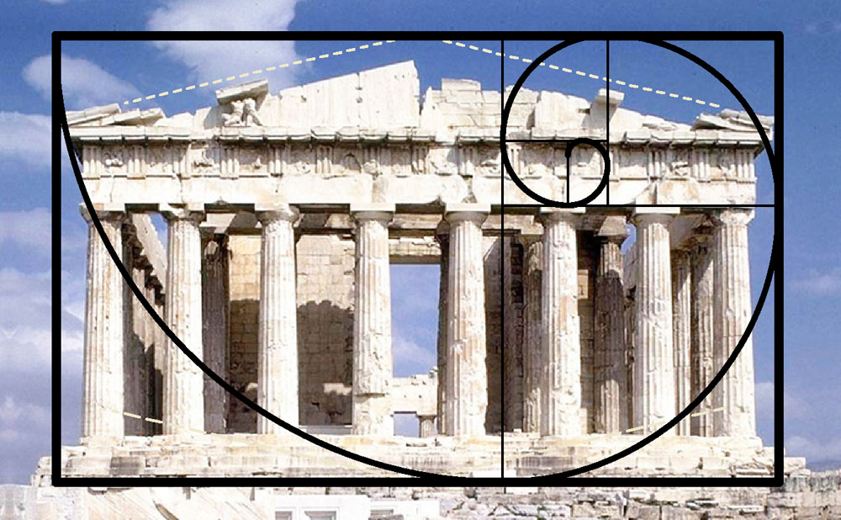

Fibonacci series in nature
Notes:
Fibonacci numbers are often seen in nature:
For example in the relative sizes of chambers in the spiral nautilus shell.
The Fibonacci spiral is also seen in the way flowers arrange their seeds, in the shape of storms, and classical architecture

Slide 30
Recursion to compute Fibonacci numbers
private int computeFibRecurse(int n)
{
if (n <= 2)
return 1;
else
return computeFibRecurse(n-2) +
computeFibRecurse(n-1);
}
Looks innocent
You’ll see in lab why it’s evil

Slide 31



Backtracking: Recursion for finding best solution(s)
Games
Puzzles
Navigation
Cosmology
Conceptis.com

Slide 32
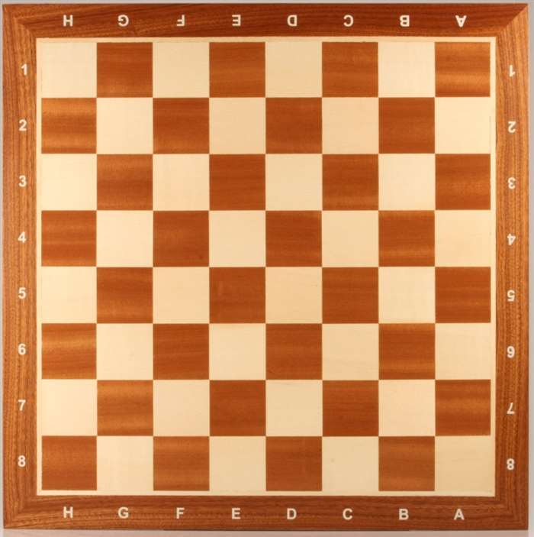
Backtracking example: 8 queens
Place 8 queens on a chess board so that no 2 queens lie in same row, column, or diagonal

Slide 33
Simplified example: 4 queens
Place 4 queens on a chess board so that no 2 queens lie in same row, column, or diagonal

Slide 34
The hard way (“Brute-force solution”)
Compute every possible placement of 4 queens on a 4x4 board.
Evaluate each placement until a legal solution is found
( )
= 16! / 4! * (16-4)!
16
4
= 16! / 4! * 12!
= 1820

Slide 35
The hard way (“Brute-force solution”)
Compute every possible placement of 8 queens on an 8x8 board.
Evaluate each placement until a legal solution is found
( )
= 64! / 8! * (64-8)!
64
8
= 64! / 8! * 56 !
= 3.9 x 10^16
= 39 quadrillion

Slide 36
NO!

Slide 37
NO!
NO!

Slide 38
NO!

Slide 39
NO!
NO!

Slide 40
NO!
NO!

Slide 41
NO!
NO!

Slide 42
NO!
NO!
NO!

Slide 43
NO!
NO!
NO!

Slide 44
NO!
NO!
NO!

Slide 45
NO!
NO!
NO!

Slide 46
NO!
NO!
NO!

Slide 47
NO!
NO!

Slide 48
NO!
NO!

Slide 49
NO!
NO!

Slide 50
So this can’t
be right

Slide 51
Nope

Slide 52
So this can’t
be right
Illegal

Slide 53
Try this with all possible yellows and greens (= 3rd and 4th queens)

Slide 54
Eventually …

Slide 55
Backtracking needs to:
possible
∧
Classify partial solutions: 3 possible results
Accept Abandon Continue
Generate all possible next moves from a partial solution
➔
, , …
Notes:
Accept → A complete legal board.
Abandon → An illegal board.
Continue → A legal but incomplete board.

Slide 56
Backtracking: pseudocode
public void solve() {
board ← create empty board
solveRecurse(board)
}
private void solveRecurse(board) {
evaluate board:
ACCEPT → add board to collection of solutions
REJECT → return
CONTINUE →
generate every next move as a list of boards;
for each board b in that list, solveRecurse(b)
}

Slide 57
Backtracking: real code
public HashSet<Board> solve() {
Board emptyBoard = new Board(nCellsPerSide);
solveRecurse(emptyBoard);
return solutions;
}
private void solveRecurse(Board board) {
int eval = board.evaluate();
if (eval == BoardEvaluation.ACCEPT)
solutions.add(board);
else if (eval == BoardEvaluation.ABANDON)
return;
else if (eval == BoardEvaluation.CONTINUE) {
ArrayList<Board> nextBoards =
board.generateAllNextBoards();
for (Board nextBoard: nextBoards)
solveRecurse(nextBoard);
}
}
Notes:
ACCEPT, ABANDON, & CONTINUE look like static constants in class BoardEvaluation

Slide 58
You might implement the constants like this:
class BoardEvaluation {
final static int ACCEPT = 0;
final static int ABANDON = 1;
final static int CONTINUE = 2;
}
Better than using literal 0, 1, & 2
Compiler checks your spelling.
But not great
Any erroneous int will be accepted by the compiler and hence become your problem at run time.
So use an enum instead
A class with a lot of restrictions
Notes:
ACCEPT, ABANDON, & CONTINUE look like static constants in class BoardEvaluation

Slide 59
You might implement the constants like this:
enum BoardEvaluation {
ACCEPT, ABANDON, CONTINUE;
}
Automatic creation of 3 instances of BoardEvaluation. Their names are ACCEPT, ABANDON, and CONTINUE
You refer to them as BoardEvaluation.ACCEPT etc.
Notes:
ACCEPT, ABANDON, & CONTINUE look like static constants in class BoardEvaluation

Slide 60
Backtracking: real code
public HashSet<Board> solve() {
Board emptyBoard = new Board(nCellsPerSide);
solveRecurse(emptyBoard);
return solutions;
}
private void solveRecurse(Board board) {
BoardEvaluation eval = board.evaluate();
if (eval == BoardEvaluation.ACCEPT)
solutions.add(board);
else if (eval == BoardEvaluation.ABANDON)
return;
else if (eval == BoardEvaluation.CONTINUE) {
ArrayList<Board> nextBoards =
board.generateAllNextBoards();
for (Board nextBoard: nextBoards)
solveRecurse(nextBoard);
}
}

Slide 61
Backtracking: complete code
2 classes and 1 enum
BoardEvaluation
Board
Solver
Sources are posted
Let’s use Eclipse to look at them

