Slide 1

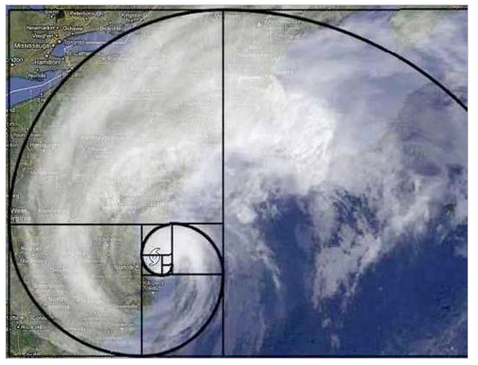


CS 46B: Data Structures Hash Codes
Professor Phil Heller

Slide 2
A hash code should…
Obey the contract
If x.equals(y) then x.hashCode() == y.hashCode()
If !x.equals(y) then x.hashCode() == y.hashCode() is ok, but should be rare. “Collision”.
Be easy to compute
Hashing is for speed.
If your hashCode() takes a long time to compute, it’s useless.
“Summarize” the important instance variables
Have some other traits that we won’t go into in 46B

Slide 3
class Star {
String astronomer;
int age;
public int hashCode() {
return astronomer.hashCode() + age;
}
}
s1 and s2 collide when the difference between astronomers’ hash codes is, by a really weird coincidence, exactly equal to the difference between ages.

Slide 4
Why we need hash codes
Hash codes let objects be stored in hash tables
Hash tables are a general C.S. term (not just Java)
In Java, class HashSet uses a hash table
Hash tables offer
Very fast add(): usually O(1)
Very fast remove(): usually O(1)
Very fast contains(): usually O(1)
What it uses
internally/privately
What it is

Slide 5
What is O(1)?
Time(n) = O(1)
Time(n) = k * 1 for some constant k that varies
From computer to computer
From OS to OS
From implementation to implementation
RHS doesn’t depend on n
k is a constant so time is a constant
O(1) is the best possible complexity

Slide 6
Why we need hash codes
Hash codes let objects be stored in hash tables
Hash tables are a general C.S. term (not just Java)
In Java, class HashSet uses a hash table
Hash tables offer
Very fast add(): usually O(1)
Very fast remove(): usually O(1)
Very fast contains(): usually O(1)
If
hashCode()
method
is good
(not too many
collisions)

Slide 7
Hash Table = Array of Linked Lists
Linked lists are called “buckets”
Array might be sparse (many null entries)
Most buckets contain 1 node, others are small (in a well-designed implementation)
Node data = objects being stored in the table
All objects with same hash code are in the same bucket (but not the opposite)
Index in array of any bucket is a simple function of its hash code

Slide 8
Example: hash table of strings
“Sue”.hashCode() = 83491
“Ugh”.hashCode() = 84982
“VII”.hashCode() = 84982
Just a
coincidence
. . .
84982
Ugh
VII
83491
Sue
. . .

Slide 9
Why adding is fast
. . .
84982
Ugh
VII
83491
Sue
. . .
Computing hash code of a string is fast
Finding bucket for hash code is fast
Inserting into a linked list is fast (do it at the head!)

Slide 10
Why removing is fast
Almost always
v
. . .
84982
Ugh
VII
83491
Sue
. . .
Computing hash code of a string is fast
Finding bucket for hash code is fast
Finding in a linked list is O(list length) ➔ fast if list is small
Removing from a linked list is fast

Slide 11
Why contains() is fast
Almost always
v
. . .
84982
Ugh
VII
83491
Sue
. . .
Computing hash code of a string is fast
Finding bucket for hash code is fast
Checking every member of a tiny linked list is fast
contains() is fast when bucket is small, otherwise O(bucket size)

Slide 12
It’s not quite that simple: Bucket Sharing
There are ~4 billion ints
➔ There are ~4 billion possible hash codes
➔ A hash table’s array of buckets would have to be length ~= 4 billion
We can’t afford that much memory.
Choose some array length e.g. 10,000
Bucket for hash code x is array[x % 10000]
Bucket contains objects with hash code = x or x+10000 or x+20000 or etc.
Hopefully buckets are still small

Slide 13
A safe way to implement hashCode()
All Java core classes have good hashCode() methods (String, Integer, Float, etc.)
All Java collections have good hashCode() methods (ArrayList, TreeMap, etc.)
“Good” means
fast
few collisions
Put them all in an ArrayList<Object>, and use its hash code!

Slide 14
class Star {
String discoverer;
long age;
double mass;
HashMap<String, String>
authorToArticleTitle;
public int hashCode() {
ArrayList<Object> list =
new ArrayList<>();
list.add(discoverer);
list.add(age);
list.add(mass);
list.add(authorToArticleTitle);
return list.hashCode();
}

Slide 15
class Star {
String discoverer;
long age;
double mass;
HashMap<String, String>
authorToArticleTitle;
public int hashCode() {
ArrayList<Object> list =
new ArrayList<>();
list.add(discoverer);
list.add(age);
list.add(mass);
list.add(authorToArticleTitle);
return list.hashCode();
}
This technique is
so useful!
How useful is it???
It’s so useful that
there will be a question
about it on the final

