Slide 1

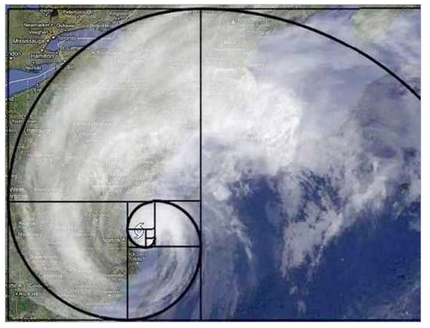


CS 46B: Data Structures Custom Collections
Professor Phil Heller

Slide 2
When to make your own data structure
Specific need that nobody else has ever addressed
Can’t use an existing class
Can’t extend an existing class

Slide 3
How to make your own data structure
Make it iterable (usually)
for (Student s: myRoster) { … } and not
for (int i=0; i<myRoster.size(); i++) {
Student s = (Student)myRoster.get(i);
. . .
}
Make it generic (usually)
class Roster<T> and not class Roster
Student s = myRoster.get(56); and not
Student s = (Student)myRoster.get(56);

Slide 4
Our Approach
Roster class
Not generic
Collects instances of Student
Works with for (Student s: aRoster) {…}
How to make a generic class
Bin Counter classes
Generic
Work with for (xxx: yyy) {…}

Slide 5
Iterables and enhanced for-loops
Suppose you have an ArrayList<Star>
And you want to do something with every star in the list, in list order:
Print the star
Schedule telescope time for observing the star
Allocate research funds for further study of the star
The old way:
for (int i=0; i<stars.size(); i++) {
Star s = stars.get(i);
System.out.println(s);
telescope.scheduleTime(s);
researchFunds.allocate(s);
}
Notes:
Start here May 4

Slide 6
The new way
for (int i=0; i<stars.size(); i++) {
Star s = stars.get(i);
System.out.println(s);
telescope.scheduleTime(s);
researchFunds.allocate(s);
}
➔
for (Star s: stars) {
System.out.println(s);
telescope.scheduleTime(s);
researchFunds.allocate(s);
}

Slide 7
What if stars is a TreeSet<Star> ?
for (int i=0; i<stars.size(); i++) {
Star s = stars.get(i);
System.out.println(s);
telescope.scheduleTime(s);
researchFunds.allocate(s);
}
Code doesn’t compile: no get(n) method in TreeSet
But TreeSet orders its members
And TreeSet<Star> implements Iterable<Star>, which provides an Iterator<Star>, so this is legal: for (Star s: stars) {…}

Slide 8
Enhanced for-loop is like this (same result but enhanced is usually more efficient)
ArrayList<T> list =
new ArrayList<T>(aCollectionOfTs);
for (int i=0; i<list.size(); i++) {
T t = list.get(i);
doWhatever(t);
}
➔
➔
for (T t: aCollectionOfTs) {
doWhatever(t);
}

Slide 9
In general, for any iterable collection
for (Star s: theCollection)
{
System.out.println(s);
telescope.scheduleTime(s);
researchFunds.allocate(s);
}
Do this to
every member
in the collection,
in order
In order = according to the collection’s iterator
TreeSet: Iterator uses compareTo order
ArrayList, LinkedList: Iterator uses FIFO order
HashSet: Iterator uses arbitrary-looking hashing order

Slide 10
Iterators and Iterable
How to make your classes work in enhanced for loops
Loop needs to ask instances of your class:
Have I looped through all your members?
Next member please.
If you can’t loop through (“iterate over”) a collection’s members, the collection isn’t very useful
We need an example

Slide 11
Iterable Example: class Roster
Not generic
Collects instances of Student
getName()
Comparable by name, or by i.d. if identical names
Iteration
First 180 students that were added are sorted by name
Next 20 are sorted by order of being added
Remaining are sorted randomly

Slide 12
public class Roster
{
private int maxEnrolled;
private int maxWaitlist;
private TreeSet<Student> enrolled;
private ArrayList<Student> waitList;
private HashSet<Student> hoping;
. . .
}

Slide 13
public Roster(int maxEnrolled,
int maxWaitlist)
{
this.maxEnrolled = maxEnrolled;
this.maxWaitlist = maxWaitlist;
enrolled = new TreeSet<Student>();
waitList = new ArrayList<Student>();
hoping = new HashSet<Student>();
}

Slide 14
public void add(Student s)
{
if (enrolled.size() < maxEnrolled)
enrolled.add(s);
else if (waitList.size() < maxWaitlist
waitList.add(s);
else
hoping.add(s);
}

Slide 15
public boolean contains(Student s)
{
return enrolled.contains(s) ||
waitList.contains(s) ||
hoping.contains(s);
}
Ok, now what????

Slide 16
Enrollment App
public static void main(String[] args) {
Roster roster = new Roster();
roster.add(you);
roster.add(personSittingInFrontOfYou);
roster.add(personSittingBehindYou);
for (Student s: everyoneElse)
roster.add(s);
// Print the roster.
for ( ????????? ) // umm, how???
System.out.println(aStudent);
}

Slide 17
Enhanced for loop requires some effort
You have to do some work before you can use it
Implement interface java.lang.Iterable (1 method)
Implement interface java.util.Iterator (2 methods)
It’s worth the effort

Slide 18




for (Player p: theGoldenStateWarriors) { … }
Suppose theGoldenStateWarriors
is an instance of class Team:
class Team implements Iterable<Player>

Slide 19





for (Robot r: theRobotArmy) { … }
Suppose theRobotArmy
is an instance of class RoboArmy:
Class RoboArmy implements Iterable<Robot>

Slide 20
for (MemberType m: aCollection) { … }
Suppose aCollection is an instance of class Coll
➔
Class Coll must implement Iterable<MemberType>

Slide 21
So …
public class Roster
{
. . .
}
➔
public class Roster
implements Iterable<Student>
{
. . .
public Iterator<Student> iterator() {
// What’s an Iterator??????
}
}

Slide 22
Because then we can say…
for (Student s: myRoster) {
System.out.println(s);
}

Slide 23
Where were we??
public class Roster
{
. . .
}
➔
public class Roster
implements Iterable<Student>
{
. . .
public Iterator<Student> iterator() {
// What’s an Iterator??????
}
}

Slide 24
Interface Iterator<T>
public boolean hasNext();
public T next();
Easiest implementation: an inner class in the collection
public class Roster implements Iterable<Student> {
. . .
public Iterator<Student> iterator() {
return new RosterIterator();
}
private class RosterIterator
implements Iterator<Student> {
public boolean hasNext() { . . . }
public Student next() { . . . }
}
}

Slide 25
What the compiler does because Roster implements Iterable<Student>)
for (Student s: myRoster) {
System.out.println(s);
}
Iterator<Student> it =
myRoster.iterator();
while (it.hasNext()) {
Student s = it.next();
System.out.println(s);
}

Slide 26
RosterIterator: The Big Idea
Ctor of inner class collects all students into a combined list
First the enrolled students, in alpha order
Then the waitlisted students, in sign-up order
Then the hopeful students, in random order - uses Collections.shuffle()
Class has an instance variable “index”
hasNext() ➔ is index bigger than the combined list?
next() ➔ return combined list’s student at index++

Slide 27
Useful method in Roster
private ArrayList<Student> collectToList() {
allStudents = new ArrayList<>(enrolled);
allStudents.addAll(waitList);
// Randomize the hoping students.
ArrayList<Student> hopeList =
new ArrayList<>(hoping);
Collections.shuffle(hopeList);
allStudents.addAll(hopeList);
}

Slide 28
RosterIterator (inner class in Roster)
class RosterIterator implements Iterator<Student>
{
private int index;
private ArrayList<Student> allStudents;
RosterIterator() {
allStudents = collectToList();
}
public boolean hasNext() {
return index < allStudents.size();
}
public Student next() {
Student s = allStudents.get(index++);
return s;
}
}

Slide 29
And now …
for (Student s: myRoster) {
System.out.println(s);
}

Slide 30
A Simpler Way:
I don’t need that inner class RosterIterator
I know how to combine students into a single ArrayList: call collectToList()
ArrayList<Student> implements Iterable<Student>
Check the API, or use common sense
So ArrayList<Student> can deliver an iterator
Roster.java
public Iterator<Student> iterator {
return collectToList().iterator();
}

Slide 31


Now that you have the power to make collections iterable
Use your power for good, not for evil

Slide 32
Use loops safely
Never change a collection in a loop over that collection
Common example: removing from the collection:
Instead:
In the loop, collect items to be removed
Remove them outside the loop
for (Star s: galaxy)
if (s.getAge() < 1.0e9)
galaxy.remove(s);

Slide 33
Use loops safely
for (Star s: galaxy)
if (s.getAge() < 1.0e9)
galaxy.remove(s);
NO!
Set<Star> removeUs = newHashSet<Star>();
for (Star s: galaxy)
if (s.getAge() < 1.0e9)
removeUs.add(s);
galaxy.removeAll(removeUs);
YES!
DEFINITELY exam question material

Slide 34
That’s how to make a Roster
Roster class
Not generic
Collects instances of Student
Works with for (Student s: aRoster) {…}
How to make a generic class
Bin Counter classes
Generic
Work with for (xxx: yyy) {…}

Slide 35
Generic Example: List Nodes
class Node {
private Node next;
private Object data;
Object getData() { return data; }
}
Before
The type variable
class Node<T> {
private Node next;
private T data;
T getData() { return data; }
}
After

Slide 36
Type Variables
class Node<T> {
private Node next;
private T data;
T getData() { return data; }
}
A class is generic if its declaration has 1 or more type variables in angle brackets
Within the class, treat T as if it were a class name
Variable types
Method return types
In any instance of the class, T is whatever will be inside the angle brackets when the instance isconstructed

Slide 37
class Node<T> {
private Node next;
private T data;
T getData() { return data; }
}
Node<Fish> n1 = new Node<Fish>();
class Node<T> {
private Node next;
private T data;
T getData() { return data; }
}
Fish
Fish
Node<Robot> n1 = new Node<Robot>();
class Node<T> {
private Node next;
private T data;
T getData() { return data; }
}
Robot
Robot

Slide 38
Using a custom generic collection class
Just like generics you’ve used since 46A
Decide what type of object the class will hold
Put that in the <angle brackets> when you declare instances
Appreciate the compiler

Slide 39
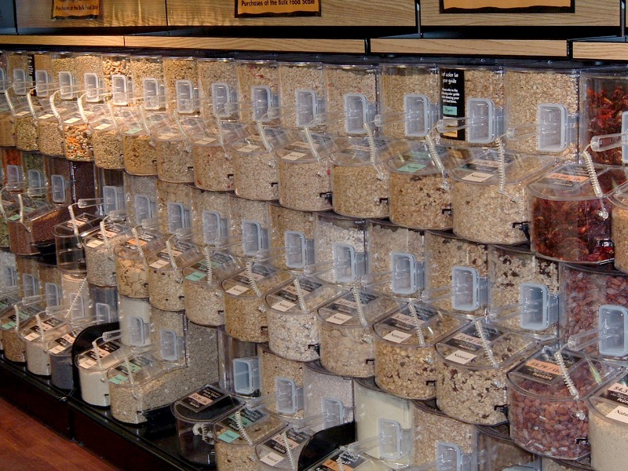

Another custom collection case study: Bin Counters

Slide 40
This example uses an abstract class
Abstract classes are marked with the abstract keyword
You aren’t allowed to construct an instance of an abstract class
abstract class Ab {
. . .
}
Ab myAb = new Ab();
Compiler error

Slide 41
So what’s the use of an abstract class?
Holds common methods for subclasses to inherit
Declares but doesn’t implement other methods that subclasses are required to implement
Like an ordinary superclass, but dictates that its subclasses have to implement certain methods

Slide 42
abstract class Bird {
void buildNest() { /* code */ }
void hatchEggs() { /* code */ }
void getWorms() { /* code */ }
abstract void fly();
}
class Heron
extends Bird {
void fly() {
run();
flap();
glide();
}
class Albatross
extends Bird {
void fly() {
shakeOffWater();
alignWithSwell();
flap();
glide();
}

Slide 43
abstract class Bird {
void buildNest() { /* code */ }
void hatchEggs() { /* code */ }
void getWorms() { /* code */ }
abstract void fly();
}
Looks like a line in an interface.
Similar idea: declare a method whose body is somewhere else.
We will use an abstract class in the next example
But first … define the problem

Slide 44

Bins in real life
In real life, bins are often storage for similar things
Bulk food
Trash / recycling / compost
In the post office:
local / USA / foreign letters
This kitchen thing, we all have one
When you see multiple bins:
The set of bins collect a broad category (grains, garbage, letters, cutlery)
Each individual bin collects a sub-category (1 bin for knives, 1 bin for forks, 1 bin for spoons)

Slide 45
Bins in real life
In real life, bins are often storage for similar things
Bulk food
Trash / recycling / compost
In the post office:
local / USA / foreign letters
This kitchen thing, we all have one
We often need to count bin populations:
? Enough place settings for dinner?
? Few enough bulk apples that we should restock?

Slide 46

Bins in software: Example: Die testing
Wafer
~ 10”

Slide 47


Dies

Slide 48
Bad
Good
Very good
Partial

Slide 49
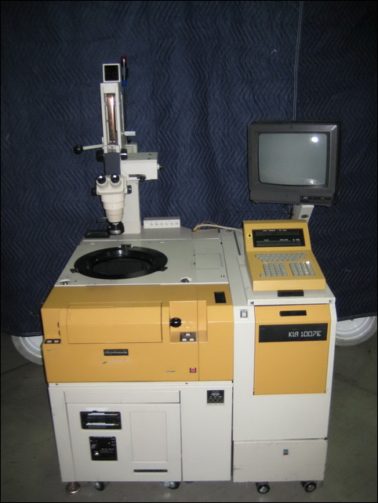
How do they know what die goes in what bin?
Robot arm
wafer

Slide 50
How to represent bins: 1995 (C)
int BIN_BAD = 0;
int BIN_GOOD = 1;
int BIN_VERY_GOOD = 2;
int BIN_PARTIAL = 3;

Slide 51
How to represent bins: 2016 (Java)
public enum Bin
{
BAD,
GOOD,
VERY_GOOD,
PARTIAL
}

Slide 52
How to count bin populations
Map<Bin, Integer> counter =
new HashMap<>();
void incrementForBin(Bin b) {
Integer count = count.get(b);
if (count == 0)
counter.put(b, 1);
else
counter.put(b, count+1);
}

Slide 53
But I want more functionality
Increment count for a bin by n
Sort bins by population
Useful toString() method
➔ Create a custom collection class
Class will use a map from bin to population … what kind?
Best choice depends on application … can I let the user decide?
TreeMap | Bins need to be Comparable | Iterate bins in natural order
HashMap | Bins need hashCode() | Arbitrary order

Slide 54
But I also want different kinds of bin
Kinds of DNA (virus, bacteria, human)
Kinds of book (paperback, hardcover, graphic novel)
Kinds of vehicle (car, motorcycle, space shuttle)
Classifier outcomes during a Sudoku analysis
Years of lifetime extension on new cancer drug
So make the class generic

Slide 55
BinCounter<B>
Almost
all of the
code
HashBinCounter<B>
TreeBinCounter<B>
Builds a HashMap<B>
for use by the superclass
Builds a TreeMap<B>
for use by the superclass
Notes:
Start here May 9

Slide 56
public class HashBinCounter<B>
extends BinCounter<B> {
Map<B, Integer> buildMap() {
return new HashMap<B, Integer>();
}
}
public class TreeBinCounter<B>
extends BinCounter<B> {
Map<B, Integer> buildMap() {
return new TreeMap<B, Integer>();
}
}

Slide 57
abstract class BinCounter<B> {
Map<B, Integer> map;
BinCounter() {
map = buildMap();
}
abstract Map<B, Integer>
buildMap();
. . .
}

Slide 58
Abstract
Abstract Methods
Abstract Classes
No method body, just ;
Like a method signature in an interface
May only be in abstract classes
May not be constructed by us
Only occur as superclasses of subclasses that implement the abstract methods

Slide 59
Abstract class,
with abstract
buildMap()
method
BinCounter<B>
HashBinCounter<B>
TreeBinCounter<B>
Subclass with implementation of
buildMap()
Subclass with implementation of
buildMap()

Slide 60
abstract class BinCounter<B> {
. . .
public String toString() {
String s = ”BinCounter";
for (B bin: map.keySet())
s += "\n " + bin + ": " +
map.get(key);
s += "\n" + map.size() + " bins";
return s;
}
. . .
}

Slide 61
abstract class BinCounter<B> {
. . .
public void
incrementForBin(B bin, int delta) {
Integer count = map.get(bin);
if (count == null)
map.put(bin, delta);
else
map.put(bin, count+delta);
}
public void incrementForBin(B bin) {
incrementForBin(bin, 1);
} . . .
}

Slide 62
abstract class BinCounter<B> {
. . .
// 0 if bin isn't a key in this map.
public int getCountForBin(B bin)
{
if (map.containsKey(bin))
return map.get(bin);
else
return 0;
}
. . .
}

