Slide 1
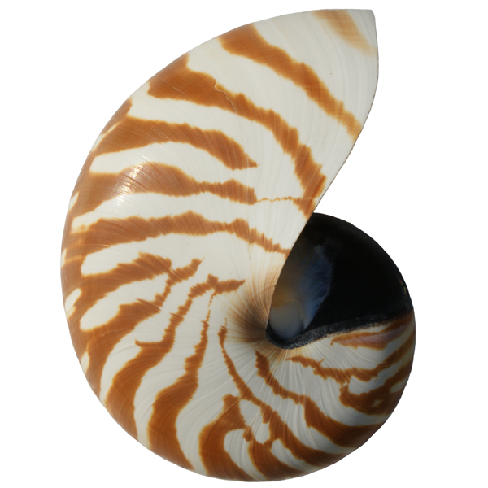
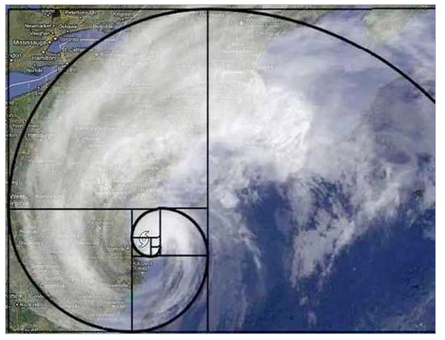


CS 46B: Data Structures Memory
Professor Phil Heller

Slide 2

How to think about memory

Slide 3
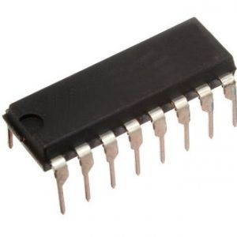
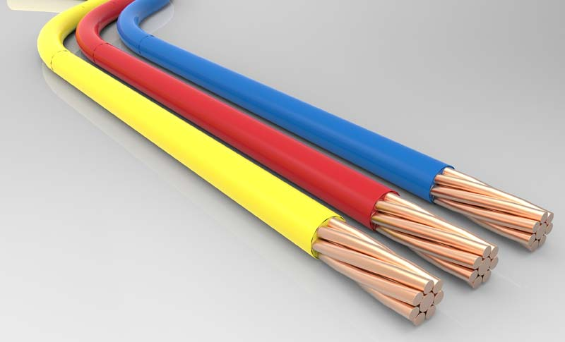
Circuits used to be made of these
~5 – 6 Volts is called “1”
~ 0 Volts is called “0”

Slide 4
Circuits used to be made of these
~5 – 6 Volts is called “1”
~ 0 Volts is called “0”

Slide 5
Circuits used to be made of these
1
0
~5 – 6 Volts is called “1”
~ 0 Volts is called “0”

Slide 6
Memory (“RAM”)
0
0
1
1
Address
Lines
2
0
3
1
4
1
5
0
. . .
8 address lines
Each is 0 or 1
➔ 256 combinations
Inside: 256 memory bits
254
1
255
0

Slide 7
Memory (“RAM”)
Address
Lines
Data
Line
0: Value on data line is
written to bit specified by
address lines
Control
Line
1: Value of bit specified by
address lines is written
to data line

Slide 8
Bigger RAM
0
01…
1
11…
2
01…
3
10…
8
Address
Lines
8
Data
Lines
4
11…
5
10…
. . .
254
10…
255
00…
8-bit bytes
Control
Line

Slide 9
Memory is a 1-dimensional array
Usually an array of 32-bit “words” or “shorts”
I’ll draw them as 8-bit bytes, like in 1980.
Anything else that seems to be in memory is an illusion/interpretation
Floats, doubles, longs
Multi-d arrays e.g. Star[20][100]
Text
Objects
References
Collections
Audio, video
Programs
0
01…
1
11…
2
01…
3
10…
4
11…
5
10…
. . .
254
10…
255
00…

Slide 10
How a processor interprets memory
0
01…
1
11…
2
01…
Program
3
10…
CPU
4
11…
5
10…
. . .
254
10…
Data
255
00…

Slide 11
The Program Counter (PC) contains the address of current instruction
0
01…
4
PC
1
11…
3
2
01…
Program
3
10…
CPU
4
11…
5
10…
. . .
254
10…
Data
255
00…

Slide 12
How the CPU interprets an instruction (1 of many possible designs)
Value in PC is an address in memory, containing an instruction
Value in PC+1 is address of 1st arg for that instruction
Value in PC+2 is address of 2nd arg for that instruction
Value in PC+3 is address where result will be stored
4
00100111
5
01000001
6
01000010
7
01001111
Notes:
Instructions are like tiny methods. They have arguments and they produce return values

Slide 13
How the CPU interprets an instruction (1 of many possible designs)
ADD
4
00100111
39
The value in mem[65]
01000001
5
65
+ The value in mem[66]
01000010
6
66
Store result in mem[79]
01001111
7
79

Slide 14
How the CPU interprets an instruction (1 of many possible designs)
SUBTRACT
4
40
The value in mem[65]
5
65
- The value in mem[66]
6
66
Store result in mem[79]
7
79

Slide 15

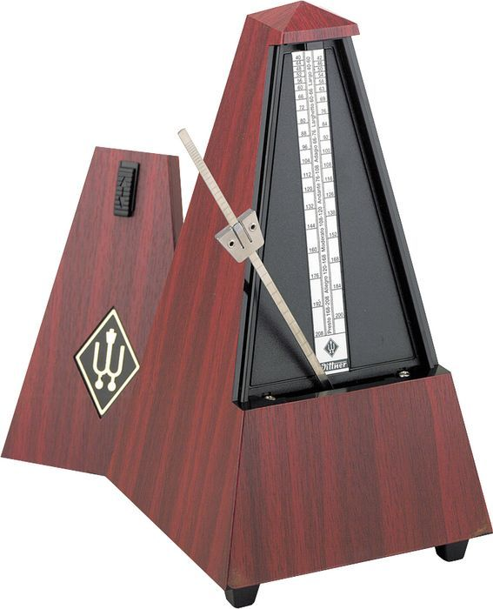
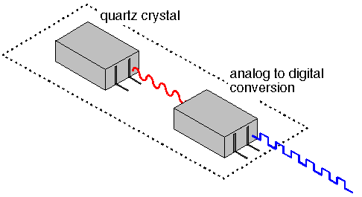
The CPU’s “Clock”
More like a metronome
Tiny sliver of quartz crystal
Emits electrical pulses at perfectly constant intervals
Pulses per second = clock speed
“per second” = Hertz

Slide 16
Adding needs 9 clock pulses:
Read mem[4]
Read mem[5]
Read mem[6]
Read mem[7]
Read mem[65]
Read mem[66]
Add
Store sum in mem[79]
PC ← PC + 4
ADD
4
39
mem[65]
5
65
+ mem[66]
6
66
result in mem[79]
7
79

Slide 17
History of Programming, Part 1
Write down the numbers on paper
Translate to binary
Enter mechanically into the machine
Screw/unscrew glass vaccuum tubes
Flip switches
Look out for bugs

Slide 18
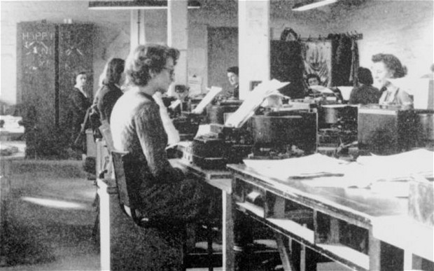
Until: A turning point
This
Sucks

Slide 19
Why it sucks
What the programmer wrote: ADD/65/66/79
What the programmer meant (maybe): population ← # of children + # of adults
Someone has to nail a chart to the wall:
mem[65] = # of children
mem[66] = # of adults
mem[79] = # total population
Error risks:
Wrong translation of “ADD” → 39
Wrong mem addresses for args

Slide 20
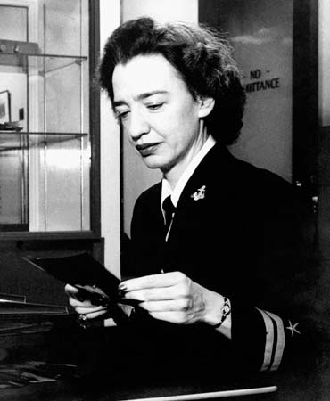
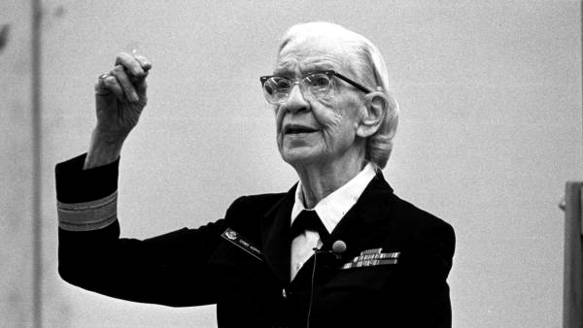
Here’s an idea …
Admiral Grace Hopper
Lieutenant Grace Hopper

Slide 21
Here’s an idea …
Programmer writes instructions symbolically
40/65/66/79 ➔ ADD #children, #adults, population
Symbolic program is translated mechanically and reliably … by the computer!
Example: #children
A symbolic reference to mem[65]
Value is not the # of children
Value is the address of the # of children
“Indirect” value

Slide 22
Soon: Lots of languages and data types
Compiler lets you think about what data means, rather than where it is in memory
Different data types are all 0s and 1s in memory, just interpreted differently by the machine
Integer numbers, floating-point numbers, booleans, pointers/references
Machine was originally physical; with Java and others it’s virtual

Slide 23
Pointers & References
Pointer: a variable whose value is the address of the associated data
Reference: a variable whose value is the address, or a simple function of the address, of the associated data

Slide 24

1972: C
No objects
Structs: the data part of objects, without methods
Programmer is responsible for memory management
That doesn’t sound
dangerous at all!

Slide 25
C: Structs & Memory Management
struct star {
float mass;
float age;
int distance;
};
struct star* polaris;
polaris = malloc(sizeof(struct star));
polaris->mass = 4.5;
polaris->age = 7.0e7;
polaris->distance = 378;
// And then, much later…
free(polaris);

Slide 26
C: Structs & Memory Management
struct star *polaris;
polaris =
malloc(sizeof(struct star);
polaris->mass = 4.5;
polaris->age = 7.0e7;
polaris->distance = 378;
// And then, much later…
free(polaris);
100
101
mass
10
bytes
age
Malloc
finds & allocates chunk of free mem
Returns address of (pointer to, reference to) 1st byte of that mem
distance

Slide 27
C: Structs & Memory Management
struct star *polaris;
polaris =
malloc(sizeof(struct star);
polaris->mass = 4.5;
polaris->age = 7.0e7;
polaris->distance = 378;
// And then, much later…
free(polaris);
100
101
4.5000
mass
7.000e7
age
What could possibly
go wrong?
distance
378

Slide 28
Problem 1: Allocated memory can be accessed like an array of unlimited size
// I guess you know what
// you’re doing
polaris[0] = 25;
mass
age
// Attack someone else’s data
polaris[10000] = 25;
dist
What else could possibly
go wrong?
// Read someone else’s data
X = polaris[10000];

Slide 29
Problem 2: Memory Fragmentation
x = malloc(500000);
free(x);
1 Mbyte

Slide 30
Problem 2: Memory Fragmentation
x = malloc(500000);
y = malloc(10);
free(x);
1 Mbyte
Almost 1,000,000 free bytes
Max allocation = 500,000 bytes

Slide 31
Problem 2: Memory Fragmentation
Eventually:
Lots of scattered allocated blocks
➔
Severely limited max block size
1 Mbyte
What else could possibly
go wrong?

Slide 32
Problem 3: Memory Leaks
Allocated memory that you forget to free
Eventually nothing left in free memory pool
Next malloc call crashes
What else could
possibly
go wrong?

Slide 33
Problem 4: Using freed memory
polaris = malloc(sizeof(struct star));
polaris.free();
polaris.age = 1234567;
I can alter memory that I previously freed, and has been allocated to some other use
Project killer

Slide 34
This Really Happened
160,000 lines of C code
Robot controller ➔ runs for weeks
Someone else’s function occasionally leaked a little memory
My function malloc’d lots of memory
➔ crash happened when my function was called
Everybody blamed me
Memory leaks are very hard to find
Especially in 160,000 lines
Everybody blamed me

Slide 35
Java Design Goal #1: Eliminate language features that cause common bugs
new: like malloc
Allocates memory for an object
Immediately initializes the object
Returns a reference to that memory (not the address, but very similar)
Limits on what you can do with that reference
Read/write an instance variable
Call a method
Can’t use it to access anything outside the constructed object

Slide 36
Java Design Goal #1: Eliminate language features that cause common bugs
There is no good way to do free()
Eliminate it
Need a way to recover memory
Garbage Collection
Low-priority thread
Notices unreachable objects
Makes their memory available to the JVM
Defragments memory as needed
Memory leaks are still possible, but much more rare

Slide 37
Why Garbage Collection Is Difficult
You have to explain to your parents
They paid your tuition for 4 years
Now you work in Garbage Collection
Certain class sizes cause surprisingly bad memory fragmentation
Example: average-length strings

Slide 38
What does this print?
String s1 = “abcde”;
String s2 = “abcde”;
System.out.println(s1==s2);
Stack Heap
s1
s2
“abcde”
“abcde”

Slide 39
A Literal String is defined in quotes in the source
String s1 = “abcde”;
String s2 = “abcde”;
System.out.println(s1==s2);
s1 = s2;
s2 = s1;
String s3 = new String(“xyz”);
String s4 = s3.substring(1);

Slide 40
The JVM’s Literal String Pool
A hash set containing every literal string in the app.
So every literal string appears exactly once.
s1 and s2 both reference the same string.
So s1 == s2 is true.
String s1 = “abcde”;
String s2 = “abcde”;

Slide 41
The JVM’s Literal String Pool … WHY?
The designers of Java only added complications for a really good reason
The web, many books, and other misguided sources say that it’s to save memory
That’s just silly
The real reason: on average, length of literal strings is just enough to badly fragment memory
Let’s think
for ourselves …

Slide 42
Suppose …
Suppose our app has 100,000 short literal strings
Suppose without the pool each string would be 20 bytes
Max saving due to literal pool = 2M
That’s insignificant
An app with 100k literal strings has several hundred k lines of code: a monster
Conclusion: Even an extremely large app, with extremely many lines, would not benefit significantly from the literal pool, if the pool were supposed to reduce memory

Slide 43
The JVM’s Literal String Pool … WHY?
The designers of Java only added complications for a really good reason
The web, many books, and other misguided sources say that it’s to save memory
That’s just silly
The real reason: on average, length of literal strings is just enough to badly fragment memory

