Slide 1
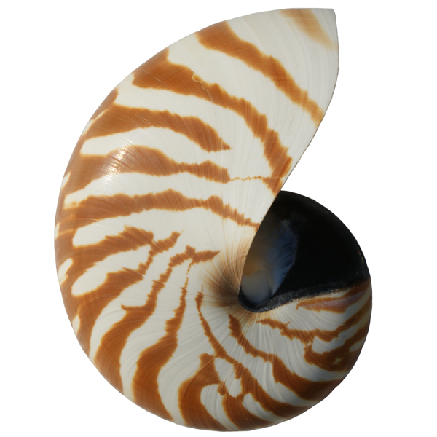
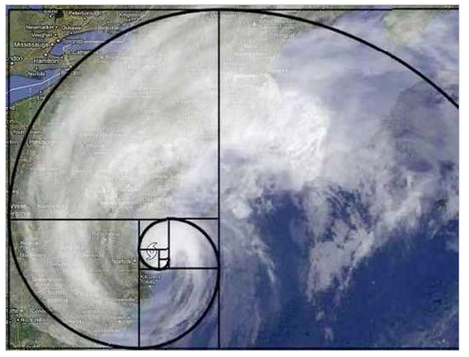
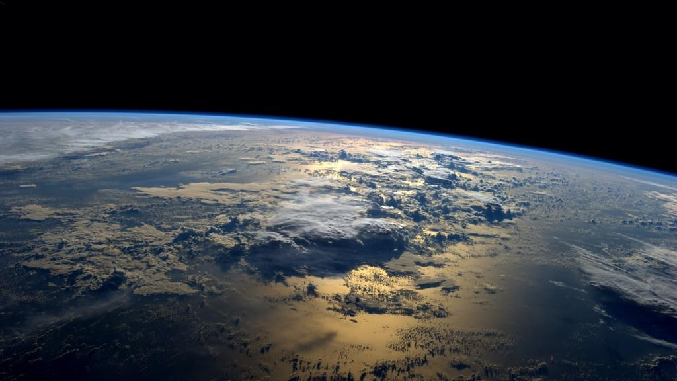

CS 46B: Data Structures Module 13: General Graphs
Professor Phil Heller

Slide 2
Lists
2 special nodes: head and tail
At most 1 edge from any node
Edge out of a node is represented by an instance variable in Node class
class Node {
private Node next;
private Object data;
. . .
}

Slide 3
Queues
2 special nodes: head and tail
Only add at tail
Only remove from head
Used by operating systems to know what to do next

Slide 4
Queue example
myQueue.add( );
myQueue.add( );
myQueue.add( );
myQueue.remove();
myQueue.add( );
myQueue.remove();

Slide 5
Queue example
myQueue.add( );
myQueue.add( );
myQueue.add( );
myQueue.remove();
myQueue.add( );
myQueue.remove();
head tail

Slide 6
Queue example
myQueue.add( );
myQueue.add( );
myQueue.add( );
myQueue.remove();
myQueue.add( );
myQueue.remove();
head tail

Slide 7
Queue example
myQueue.add( );
myQueue.add( );
myQueue.add( );
myQueue.remove();
myQueue.add( );
myQueue.remove();
head tail

Slide 8
Queue example
myQueue.add( );
myQueue.add( );
myQueue.add( );
myQueue.remove();
myQueue.add( );
myQueue.remove();
head tail

Slide 9
Queue example
myQueue.add( );
myQueue.add( );
myQueue.add( );
myQueue.remove();
myQueue.add( );
myQueue.remove();
head tail

Slide 10
Queue example
myQueue.add( );
myQueue.add( );
myQueue.add( );
myQueue.remove();
myQueue.add( );
myQueue.remove();
head tail
Notes:
Can make a queue by extending LinkedList

Slide 11
Trees
1 special node: root
N edges from any node
Edges out of a node are represented by an ArrayList in Node class
class Node {
private Object data;
private ArrayList<Node>
children;
. . .
}

Slide 12
General Graphs
No special nodes
LinkedList class only needed instance variables for its head and tail
Tree class only needed instance variable for its root
Graph class needs collection of all its nodes
ArrayList<Node> or HashSet<Node>
class Node<T> {
private T data;
private HashSet<Node<T>>
neighbors;
. . .
}

Slide 13
General Graphs
Edges often have associated weight
Miles between 2 cities
Commute time between 2 waypoints
Ticket price between 2 airports
“Associated” ➔ Use a map
class Node<T> {
private T data;
private HashSet<Node> neighbors;
}
HashMap<Node<T>, Float>
neighborToWeight;

Slide 14
Airline Fare Graph
SEA
$600
$150
JFK
SFO
$350
$600
$250
$350
MIA
$150
LAX

Slide 15
Questions for the Airline Graph
Is the graph connected?
Is there a route from any airport X to any airport Y?
What is the maximum # of plane changes between airport X and airport Y?
What is the cheapest route between airport X and airport Y?
Ph.D. level machine-learning question: how should we change the fares to maximize profits this summer?

Slide 16
Connected?
SEA
$600
$150
JFK
SFO
$350
$600
$250
$350
MIA
$150
LAX
Now customers can’t travel
between coasts

Slide 17
Route from SFO → JFK?
SEA
$600
$150
JFK
SFO
$350
$600
$250
$350
MIA
$150
LAX
Planes and customers can’t escape west coast

Slide 18
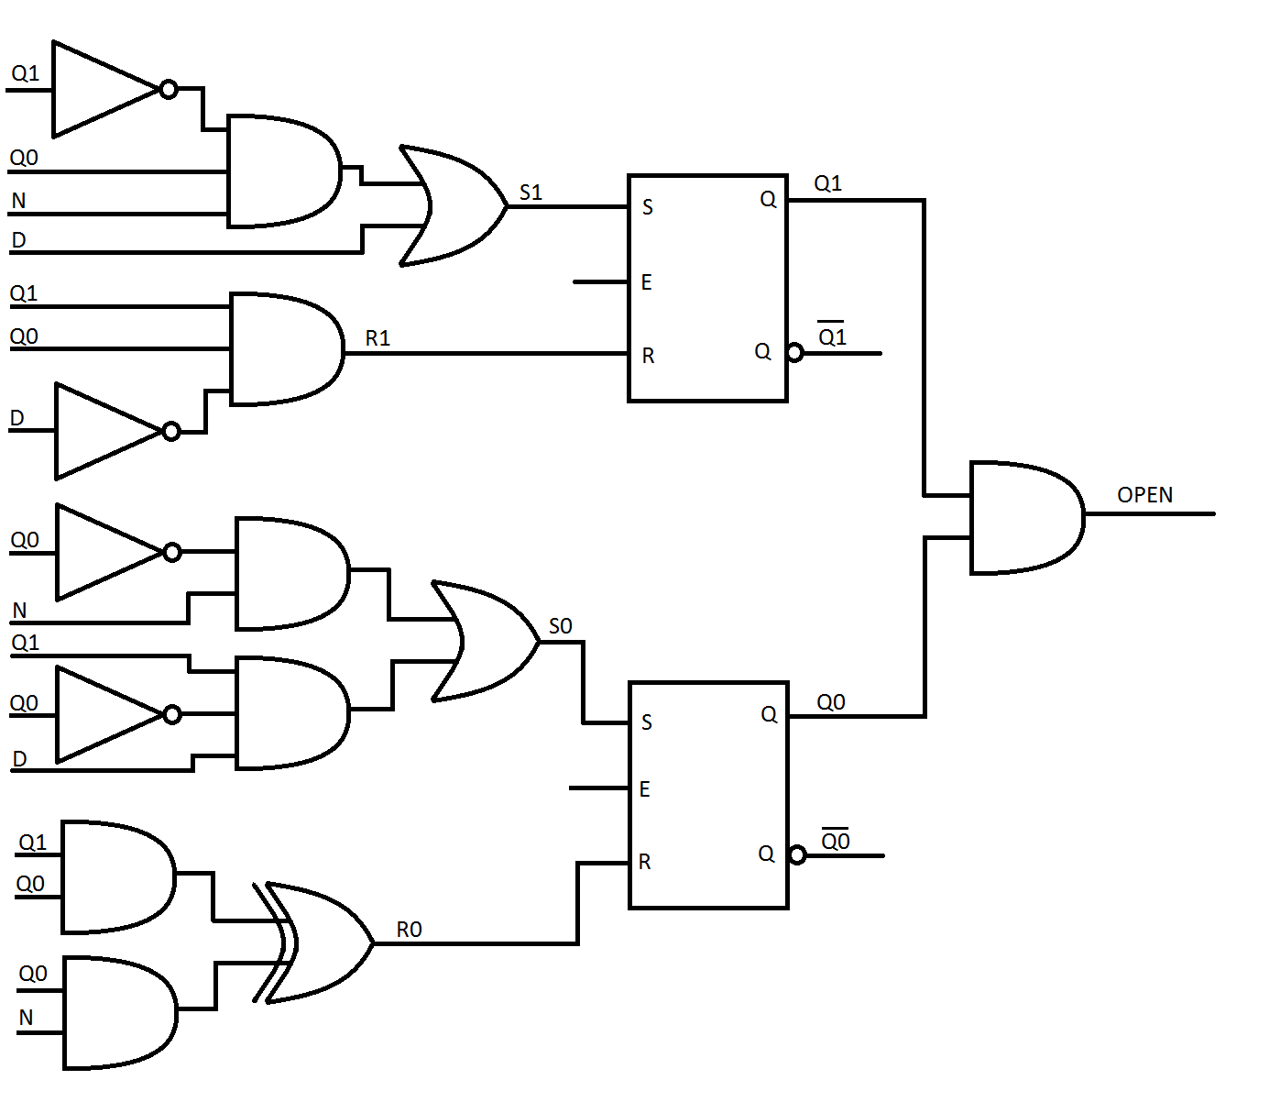
Circuit Design: What is the longest path?
c = 3*10^8 m/sec
= .3*10^8 nm/nsec
= .3 nm/cycle
of a 1GHz clock

Slide 19
Organic Chemistry: Name of a branched alkane is derived from longest path

Slide 20
Common Graph Problems E = # of edges, V = # of vertices (nodes)
Longest path in graph? NP hard
Shortest path between 2 nodes? O(E+V)
Eulerian path: Shortest path using all edges? O(E)
Hamiltonian Path: Shortest path that visits all nodes (“Traveling Salesman” Problem)? NP hard
Is graph connected? O(V)
Is graph a tree? Linked list? O(V)
Notes:
NP hard = worse than polynomial
Think of applications, post to Piazza

Slide 21
Thinking about graph problems
Think about nodes and edges
Draw pictures
Think about pictures
Then and only then think about how to write code
Example: Is a graph connected?

Slide 22
A connected graph

Slide 23
A disconnected graph

Slide 24
Is this graph connected?
Notes:
Clicker quiz … well, is it?

Slide 25
The easiest way to tell if a graph is connected
Create a HashSet<Node>
Pick any node and add it to the set
While (not done)
For every node in the set, add all of that node’s neighbors to the set
Done if the set didn’t grow
When done: graph is connected if set contains every graph in the node

Slide 26
1) Pick a dot. Any dot. Color it red.

Slide 27
2) Find all the red dot’s gray neighbors. Color them red.

Slide 28
3) Find all gray neighbors of red dots.
Color them red.

Slide 29
4) Find all gray neighbors of red dots.
Color them red.

Slide 30
5) Find all gray neighbors of red dots.
Color them red.

Slide 31
6) Find all gray neighbors of red dots.
Color them red.

Slide 32
7) Find all gray neighbors of red dots.
Color them red.

Slide 33
8) Find all gray neighbors of red dots.
THERE AREN’T ANY! ➔ done

Slide 34
9) Graph is connected if all dots are red
➔ This graph isn’t connected

Slide 35
Design Goals:
User thinks about data, not nodes
Need a fast way to find a node, given that node’s data. Ok to assume every node’s data is unique
Easy method for building the graph by specifying connections
graph.connect(“SFO”, “LAX”);
Specify a graph with a text file of comma-separated lines:
SFO,LAX
LAX, JFK
SFO, CDG

Slide 36
Generic Node Class
class Node<T> {
private T data;
private HashSet<Node<T>> neighbors;
Node(T data) {
this.data = data;
this.neighbors = new HashSet<>();
}
public boolean equals(Object x) {
Node<T> that = (Node<T>)x;
return this.data.equals(that.data);
}
void addNeighbor(Node<T> neighbor) {
neighbors.add(neighbor);
} . . .

Slide 37
Generic Node Class
. . .
void addNeighbor(Node<T> neighbor) {
neighbors.add(neighbor);
}
HashSet<Node<T>> getNeighbors() {
return neighbors;
}
T getData() {
return data;
}
No surprises

Slide 38
Graph class
Also generic: same type as node’s <T>
connect(T data1, T data2) { . . . }
Needs a Map<T, Node<T>>
connect() method has data, needs to find nodes
HashMap or TreeMap?
T might not be comparable ➔ HashMap
public class Graph<T>
extends HashMap<T, Node<T>>
{
. . .
}

Slide 39
public void connect(T data1, T data2) {
// Get node that contains data1. If no such node
// exists, create it and add to this map.
Node<T> node1 = getNodeForData(data1);
if (node1 == null) {
node1 = new Node<T>(data1);
put(data1, node1);
}
// Same for data2.
Node<T> node2 = getNodeForData(data2);
if (node2 == null) {
node2 = new Node<T>(data2);
put(data2, node2);
}
// Connect. Each node becomes a neighbor of the other.
node1.addNeighbor(node2);
node2.addNeighbor(node1);
}
Connecting 2 nodes
Notes:
In the Graph class

Slide 40
public void connect(T data1, T data2) {
// Get node that contains data1. If no such node
// exists, create it and add to this map.
Node<T> node1 = get(data1);
if (node1 == null) {
node1 = new Node<T>(data1);
put(data1, node1);
}
// Same for data2.
Node<T> node2 = get(data2);
if (node2 == null) {
node2 = new Node<T>(data2);
put(data2, node2);
}
// Connect. Each node becomes a neighbor of the other.
node1.addNeighbor(node2);
node2.addNeighbor(node1);
}

Slide 41
connect(“JFK”, “LAX”);
SEA
JFK
SFO
Earlier, edges were directed and weighted
Here: undirected and unweighted (keeping it simple)
LAX

Slide 42
Node<String>
“SEA”
“SEA”
SEA
LAX
JFK
SFO
JFK
Node<String>
SFO
“JFK”
“JFK”
SFO
SEA
Node<String>
LAX
“SFO”
“SFO”
LAX
JFK
SEA
Node<String>
Graph
“LAX”
“LAX”
SEA
SFO

Slide 43
connect(“JFK”, “LAX”);
Node<String>
“SEA”
“SEA”
// Get node that contains
// data1. If no such node
// exists, create it and
// add to this map.
Node<T> node1 = get(data1);
if (node1 == null) {
node1 =
new Node<T>(data1);
put(data1, node1);
}
. . .
LAX
JFK
SFO
Node<String>
“JFK”
“JFK”
SFO
SEA
Node<String>
“SFO”
“SFO”
LAX
JFK
SEA
node1
Node<String>
“LAX”
“LAX”
SEA
SFO

Slide 44
connect(“JFK”, “LAX”);
Node<String>
“SEA”
“SEA”
. . .
// Same for data2.
Node<T> node2 = get(data2);
if (node2 == null) {
node2 =
new Node<T>(data1);
put(data1, node2);
}
. . .
LAX
JFK
SFO
Node<String>
“JFK”
“JFK”
SFO
SEA
Node<String>
“SFO”
“SFO”
LAX
JFK
SEA
node1
Node<String>
“LAX”
“LAX”
node2
SEA
SFO

Slide 45
Connect(“JFK”, “LAX”);
Node<String>
“SEA”
“SEA”
. . .
// Connect. Each node
// becomes a neighbor of
// the other.
node1.addNeighbor(node2);
node2.addNeighbor(node1);
LAX
JFK
SFO
Node<String>
“JFK”
“JFK”
SFO
SEA
LAX
Node<String>
“SFO”
“SFO”
LAX
JFK
SEA
node1
Node<String>
“LAX”
“LAX”
node2
SEA
SFO
JFK

