Slide 1


CS 46B: Data Structures BSTs and Threads
Professor Phil Heller

Slide 2
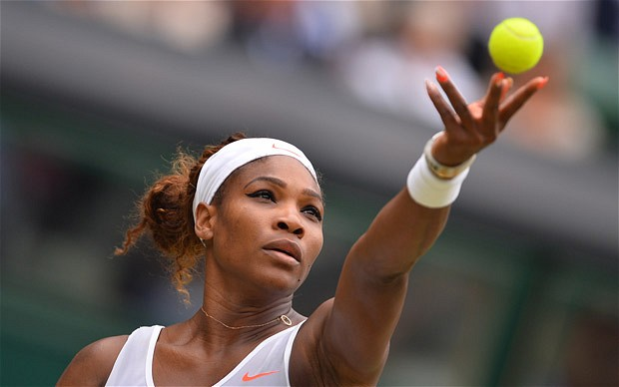
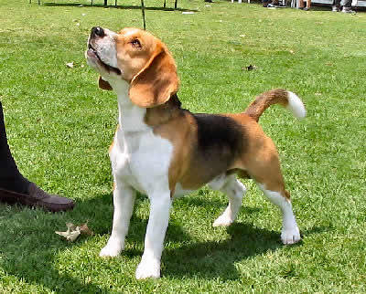
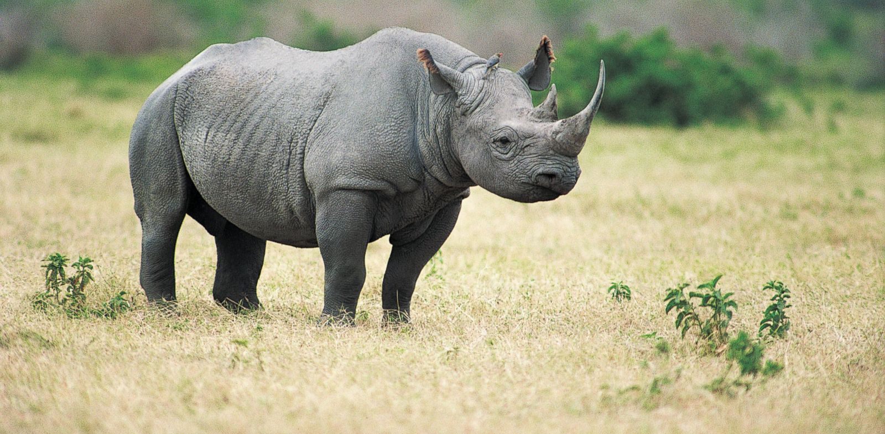



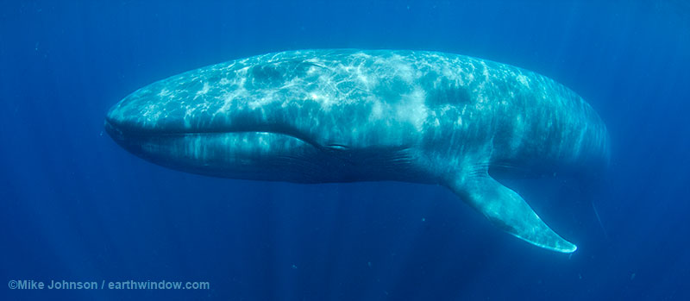
All descendants to
the left of Serena weigh less than Serena
150 lbs
22 lbs
3000 lbs
1 oz
110 lbs
700 lbs
350,000 lbs

Slide 3
All descendants to
the right of Serena weigh more than Serena
150 lbs
22 lbs
3000 lbs
1 oz
110 lbs
700 lbs
350,000 lbs

Slide 4
All descendants to
the left of any node weigh less than that node
All descendants to
the right of any node weigh more than that node
150 lbs
22 lbs
3000 lbs
1 oz
110 lbs
700 lbs
350,000 lbs

Slide 5
Binary Search Trees
Binary tree property: Tree where every node has 0, 1, or 2 children
Binary search tree property:
Binary tree property, plus …
Every descendant in a node’s left subtree is < the node, according to compareTo () applied to node’s data
Every descendant in a node’s right subtree is > the node, according to compareTo() applied to node’s data
Goals:
Rapid searching, insertion, deletion
Sorted traversal
Know This!!

Slide 6
Find an animal that weighs 110 lbs
Start at the root
Is 110 > or < or ==
the weight at this node?
150 lbs
22 lbs
3000 lbs
1 oz
110 lbs
700 lbs
350,000 lbs
If ==, then you found it.
Else if < then search the left subtree, else search the right subtree.

Slide 7
Find an animal that weighs 110 lbs
Search this subtree:
Is 110 > or < or ==
the weight at this node?
150 lbs
22 lbs
3000 lbs
1 oz
110 lbs
700 lbs
350,000 lbs
If ==, then you found it.
Else if < then search the left subtree, else search the right subtree.

Slide 8
Find an animal that weighs 110 lbs
Search this subtree:
Is 110 > or < or ==
the weight at this node?
150 lbs
22 lbs
3000 lbs
1 oz
110 lbs
700 lbs
350,000 lbs
If ==, then you found it.
Else if < then search the left subtree, else search the right subtree.

Slide 9

Insert a 3-lb duck
Start at the root
Is 3 > or < the
weight at this node?
3lbs
150 lbs
22 lbs
3000 lbs
1 oz
110 lbs
700 lbs
350,000 lbs

Slide 10
Insert a 3-lb duck
Is 3 > or < the
weight at this node?
3lbs
150 lbs
22 lbs
3000 lbs
1 oz
110 lbs
700 lbs
350,000 lbs
Check: all descendants to the right of the frog, weigh more then the frog

Slide 11
Removing … It’s complicated
Section 17.3.3 in the book
Remove a leaf node
Easy: Remove it from the tree
Remove an intermediate node that has 1 child
Almost easy: move the child upRemove an intermediate node that has 2 children
Complicated:

Slide 12
Binary Search Tree Node
Generic
2 children: leftChild, rightChild
public class BSTNode<T> {
private T data;
private BSTNode<T> parent;
private BSTNode<T> leftChild;
private BSTNode<T> rightChild;
BSTNode(T data) { this.data; }
// Also the usual getters & setters.
}

Slide 13
1 of many ways to implement BSTree
public class BSTree<T> {
private BSTNode<T> root;
// Also find, add, & delete methods
}
Can be improved
Add integrity checkers to be called after every operation that changes structure
What about iteration?

Slide 14
Integrity checking
Tree?
“Topology checks”
Has to be connected, can’t have loops
Binary?
Node class only has 2 variables for children ➔ always binary
Binary Search Tree?
Root has integrity if left child < root < right child
Any node has integrity if left child < node < right child (recursive definition)

Slide 15
Iteration
public class BSTree<T> ➔ public class BSTree<T> implements Iterable<T>
BSTree needs method iterator(), which returns an object that implements Iterable<T>
public boolean hasNext()
public T next()
2 design choices, like Roster
Inner class that knows how to explore the tree (hard)
iterator() method builds an ArrayList<T>, then returns the ArrayList’s iterator (easy)

Slide 16
Iteration
public class BSTree<T> implements Iterable<T> {
private BSTNode<T> root;
. . .
public Iterator<T> iterator() {
ArrayList<T> list = new ArrayList<>();
collectRecurse(root, list);
return list.iterator();
}
private void collectRecurse(Node<T> node,
ArrayList<T> list) {
if (node == null) return;
collectRecurse(node.getLeftChild(), list);
list.add(node.getData());
collectRecurse(node.getRightChild(), list);
}

Slide 17

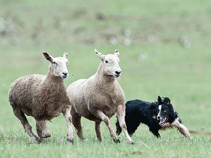
Threads: How 1 CPU looks like many
Theads are like Superboy playing ping pong
Or sheep dogs

Slide 18
Before there were threads … 197?: Processes
Minicomputers shared by n users with terminals.
Each user experiences apparently continuous access to the computer, which is apparently 1/n times as fast as advertised.
O.S. gives a fraction of a second to each user process in turn
Each process has its own independent memory space. No process can access another thread’s memory.
Swapping is slow.

Slide 19
1988: Sun introduces “Lightweight Processes” 1991: Java
Like threads: swapped in and out of the CPU
Swapping is fast
Memory is shared, needs to be protected from corruption
Threads are integrated into the JVM
Garbage collection
Checking for mouse/keyboard input
Refreshing the screen

Slide 20
Example: How to go broke the day after Christmas
January: start an e-commerce company with a server that doesn’t do threads
February: 20 orders
Customer
Connected?
No
Yes
Service the order

Slide 21
March: 100 orders
April:150 orders
May: 200 orders
June: Investors give you millions of dollars
July: Buy a bigger server
August, September, October, November: 250/300/350/400 orders

Slide 22
December
Christmas shopping
1000 orders per hour
When a customer hits “BUY”, no response until all earlier customers have been serviced
Customers cancel orders
Customers complain on Facebook & Twitter
Day after Christmas: investors take their money back.

Slide 23
The server you should have built
Customer
Connected?
No
Yes
Start a new thread to service the order

Slide 24
What’s the difference?
Customer
Connected?
Customer
Connected?
No
No
Yes
Yes
Service the order
Start a new thread to service the order
A few minutes
A few microseconds

Slide 25
Thread Contention
The reason thread programming is hard
Threads start/pause running at unpredictable times
At any moment JVM can say “that’s enough time for you, it’s someone else’s turn for a while”
That moment can be inconvenient or even damaging

Slide 26
1 thread wants to delete 1 thread wants to delete
Find node just before
That’s
tail = ;
Find node just before
That’s
tail = ;
If we’re lucky,
this thread finishes
first
Then this
thread finishes
tail

Slide 27
1 thread wants to delete 1 thread wants to delete
Find node just before
That’s
tail = ;
Find node just before
That’s
tail = ;
Bad luck:
this thread finishes
first
tail

Slide 28
1 thread wants to delete 1 thread wants to delete
Find node just before
That’s
tail = ;
Find node just before
That’s
tail = ;
Bad luck:
this thread finishes
first
Then this thread
tries to set
tail = ;
tail

Slide 29
Functional Programming: the way of the future
Integrates big data requirements into the Java language and JVM
Big data problems should be solved on big systems
Many CPUs
Many many CPUs
Many many many CPUs
Big collections of data objects are transformed into big collections of other data objects

Slide 30
A 3rd way to iterate a collection
1995
for (int i=0; i<galaxy.size(); i++) {
Star s = galaxy.get(i);
. . .
}
1999
for (Star s: galaxy) {
. . .
}
2014
galaxy.stream() . . .

Slide 31
Collect rotation of all stars older than 4 billion years and smaller than our sun
ArrayList<Double> rotations =
galaxy.stream()
.filter(star -> star.getAge()>4.0e9)
.filter(star -> star.getMass()<1.0)
.map(star -> star.computeRotation())
.collect();
Watch closely …
This next thing is sweeeeet

Slide 32

Imagine a Collection<T> as a bottle containing lots of Ts
galaxy =
new ArrayList<Star>();
galaxy.add(sol);
galaxy.add(naboo);
galaxy.add(cetaganda);
galaxy.add(blackHole28);

Slide 33
galaxy.stream() = pour out the bottle

Slide 34
.filter(star -> star.getAge()>4.0e9)

Slide 35
.filter(star -> star.getMass()<1)

Slide 36
.map(star -> star.computeRotation())
2.5
1.8

Slide 37
.collect()
2.5
1.8

Slide 38
.collect()
Didn’t think about:
Controlling loops
If/else
Did think about:
Members of data structures
Transformation of members
1.8
2.5

Slide 39

This next part is sweeeeet

Slide 40
ArrayList<Double> rotations =
galaxy.stream()
.filter(star -> star.getAge()>4.0e9)
.filter(star -> star.getMass()<1.0)
.parallel()
.map(star -> star.computeRotation())
.collect();
parallel()
Uses all available cores
As any core completes star.computeRotation(), it is assigned another star

