Slide 1


Data Analysis
Notes:
Hello and welcome, my name is Harshita and today I will be presenting to you the results of the Data Analytics task.

Slide 2


Today's agenda
Project recap
Problem Statement
Process
Insights
Summary

Slide 3

S
The HR Analytics Dashboard provides a detailed analysis of employee attrition, average salary, and tenure within the company, identifying key factors contributing to employee turnover and offering actionable insights for improving retention strategies.
Attrition Analysis: Identified reasons for leaving and highlighted high-turnover departments.
Salary Analytics: Provided average salary data and highlighted departmental salary discrepancies.
Tenure Analysis: Determined average tenure and identified critical drop-off points.
Project Recap

Slide 4

Problem Statement
Improving Employee Retention
We aim to identify and address the factors driving employee attrition, focusing on career advancement, compensation equity, and work-life balance. Our goal is to enhance employee satisfaction and retention through data-driven insights and targeted strategies.

Slide 5
Process
1
Data Understanding
2
Data Cleaning
3
Data Modelling
4
Data Analysis
5
Uncover Insights

Slide 6

Insights
238
Attrition of Employees
1480
Total Number of Employees
16.1%
Attrition Rate

Slide 7
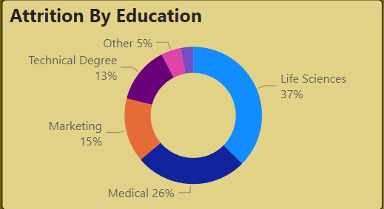

Slide 8
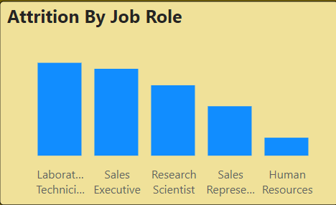

Slide 9
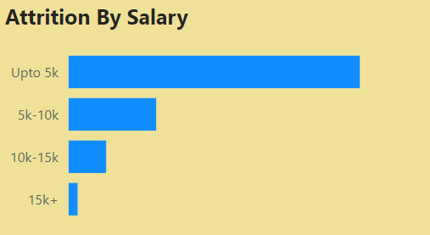

Slide 10
SUMMARY
Key Insight: High attrition among employees with life sciences education background.
Affected Roles: Primarily laboratory and technician profiles.
Salary Data: The Average salary for these roles is up to 5k.
Implication: Indicates a need for targeted retention strategies in these specific roles and salary brackets.

Slide 11
Thank you!
ANY QUESTIONS?
Notes:
Thank you very much for listening, please feel free to ask any questions that you may have!

