Slide 1
TRUSTLENS.
Does a package do what it says it does?
Problem statement
PS 1: Trust Nothing, Provenance for Your Own Dependencies
Team
[Team name]
Members
[Member 1, Member 2, Member 3]
Notes:
Hi, we are [team]. We picked Problem Statement 1, Trust Nothing. Our tool is TrustLens: it checks whether a package actually does what its README says, before you install it.

Slide 2
THE PROBLEM.
npm install = running a stranger’s code.
You trust the README. Attackers know that.
Typosquatting
a look-alike name: “reqeusts” vs “requests”
1
Today’s scanners match known-bad signatures, so a brand-new malicious package gets through.
Dependency confusion
a public package wins over your private one
2
Real cases: event-stream (2018) stole crypto wallets; ua-parser-js (2021) installed a miner and password stealer through an install script.
Malicious install scripts
code runs the moment you type npm install
3
Notes:
Installing a package runs someone else’s code on your machine. Supply-chain attacks like typosquatting, dependency confusion and malicious install scripts work because developers cannot quickly tell whether a package behaves differently from what it claims. Existing scanners look for known-bad signatures, so new attacks slip through.

Slide 3
OUR IDEA.
Don’t ask “is this known to be bad?”
Ask “does it do what it says?”
 | Signature scanners | TrustLens
Looks at | Code patterns of known attacks | What the package actually does when run
Compares with | A list of past malware | The package’s own README and metadata
New attacks | Missed until someone reports them | Caught if behaviour doesn’t match the claims
Hiding tricks | Not checked | Runs it 5 ways: normal, CI, future date, other host, other user
Notes:
Instead of matching signatures, we fingerprint behaviour and compare it with what the package itself claims. So a brand-new attack is caught as long as it does something its README does not mention. We also run every package five ways to catch code that only misbehaves on build servers or on a certain date.

Slide 4
HOW IT WORKS.
1
2
3
4
5
Get it
npm / PyPI name or upload. Download only, nothing runs
Read README
What it promises: hosts, files, env vars, programs
Sandbox ×5
Install, import, run examples. A hook logs everything
Fingerprint
net · files · env vars · processes
Compare
claimed · expected · unclaimed · contradicted
The sandbox: a sealed room with a camera
Fresh Docker container
per run, deleted after
No internet
attempts are logged, never reach anyone
None of your files
read-only, no admin, CPU/memory capped
Hook inside Node / Python
records connections, files, env reads, programs
Stack: Python + FastAPI · Docker · Node/Python runtime hooks · React UI
Notes:
Five steps. We download the package and its dependencies without running anything. We read the README into a list of promises. Then we install and run it inside a sealed Docker sandbox with no internet, none of your files and no admin rights, while a small hook inside Node or Python logs every connection, file, environment variable and program. That log is the behavioural fingerprint, and we compare it line by line with the promises. All of this happens five times with different environments.

Slide 5
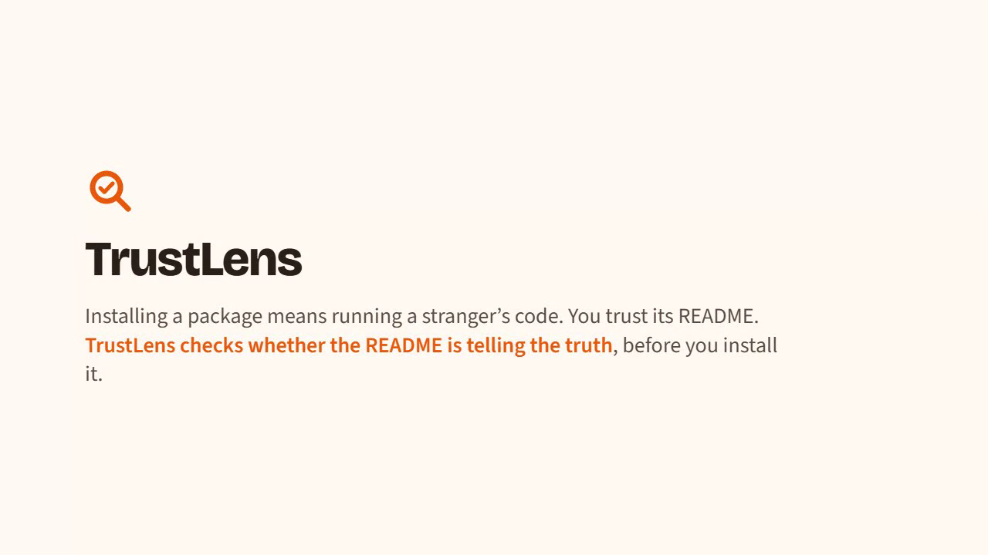
DEMO.
pad-clean fine
does nothing, as promised
http-fetchy suspicious
calls a server on import, never mentioned
postinstall-probe suspicious
runs a program during install
ci-sleeper dangerous
calls home only in CI; README says “no network”
py-titlecase dangerous
Python; goes quiet in CI to hide
Click to play the 90-second recorded run · live app at localhost:5173
Notes:
Play the 90-second video or click through the live app. Our test cases are harmless packages built to behave like real attacks. Highlight ci-sleeper: it looks clean in a normal run, but only when it thinks it is on a CI server does it call home, and its README says no network access. Organiser test cases can be uploaded as a .zip/.tgz/.whl or typed as npm:name@version.

Slide 6
RESULTS & LIMITS.
5 / 5
0
~1 min
attack-style test packages flagged, incl. CI-only and evasion
false alarms on 9 real packages (express, axios, requests, dotenv…)
per full scan, 5 runs, even with 69 dependencies
Honest gaps
Sees what happens inside Node/Python, not inside native binaries it starts
No internet in the sandbox: we see where it tries to send data, not what
Short runs (seconds) and README examples only, so rare code paths can hide
README reading is rule-based, so unusual wording can be missed
Notes:
Every attack-style test package was flagged with the right reason, including one that only misbehaves in CI and one that hides in CI. Nine real popular packages came back clean or minor, so no false alarms. A scan takes about a minute. Limits: we only see inside Node and Python, we cannot see payload contents because there is no network, runs are short, and README reading is rule-based.

Slide 7
NEXT STEPS.
1
System-level tracing
strace / eBPF to see native binaries too
2
Fake internet
a safe sink that shows what data a package tries to send
3
Smarter README reading
an LLM pass for wording rules miss (never the verdict)
4
Pre-install guard
GitHub Action / npm hook that scans before install
GitHub: [github.com/your-team/trustlens]
Notes:
Next we would add system-level tracing for native code, a safe fake internet to see payloads, an LLM pass to read READMEs better, and a pre-install guard for CI. The code is on GitHub at [link]. Thank you, happy to take questions.

