Slide 1


SMS Spam Detection

Slide 2


Table of Content
Introduction
Dataset used
Method Used
Explanation
Result

Slide 3

Introduction
Detection of spam is important for securing message and e-mail communication. The accurate detection of spam is a big issue. To solve this issue, we have proposed a method for spam detection using machine learning predictive models.

Slide 4

We used the dataset available on kaggle. The data set have 2 column- type which indicates whether the sms is spam or ham and other column is the message column.
Dataset Used

Slide 5
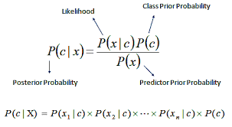
Method used
This Project is based on SMS Spam detection classification with Machine Learning. We will be using the multinomial Naive Bayes implementation.

Slide 6
Result
There are various mechanisms so let’s do a quick recap of them.
Accuracy measures how often the classifier makes the correct prediction. It’s the ratio of the number of correct predictions to the total number of predictions.
Precision tells us what proportion of messages we classified as spam, actually were spam.
Recall tells us what proportion of messages that actually were spam were classified by us as spam.
F1 score weighted average of the precision and recall scores.

Slide 7
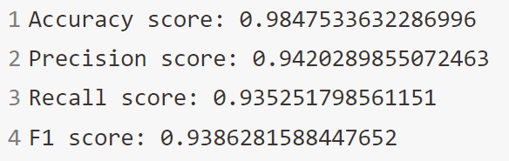
Result
The machine Learning model we prepared provide the following result:

Slide 8
Thank You

