Slide 1
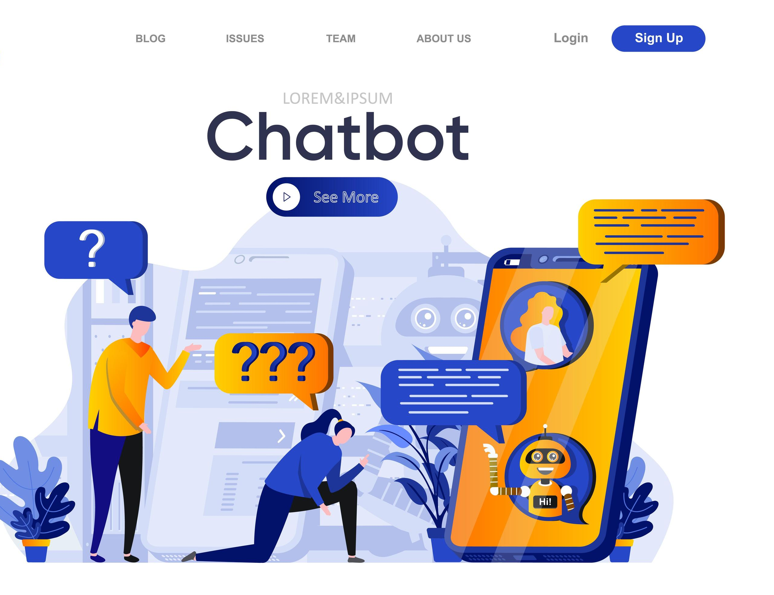
FinGuard Chatbot BAM 3034 - Sentiment Analysis and Text Mining
Group Members:
Harmeet Singh (c0892997)
Harshita Harshadbhai Shiroya (c0894233)
Mihir Bhagvanbhai Chaudhary (c0893689)
Nikitha Mummidi (c0896336)
Swetha Sara Abraham (c0902578)
Tanvi Dhirajbhai Patel (c0907214)

Slide 2
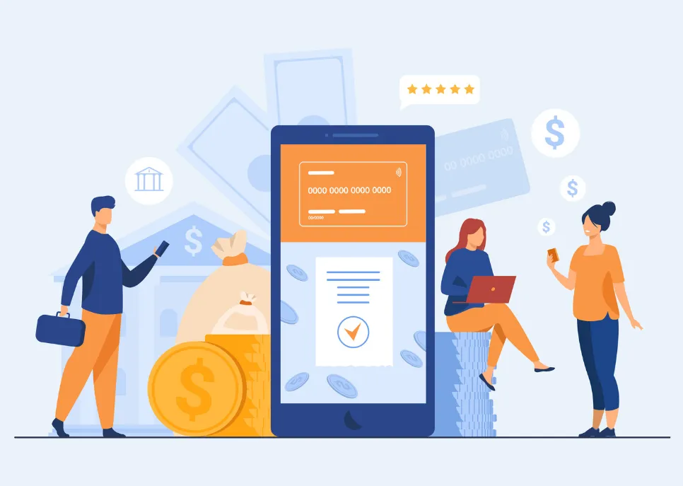
PROBLEM
FinGuard is an intelligent chatbot designed to assist NBC Bank customers with their banking-related queries. Utilizing Natural Language Processing (NLP) and Machine Learning (ML) techniques, FinGuard provides quick and accurate responses to customer inquiries, enhancing the overall customer service experience.
NBC Bank faces challenges in providing timely and efficient customer service due to high volumes of customer inquiries. This leads to long wait times and customer dissatisfaction.
FinGuard addresses this issue by automating responses to common banking queries, thereby reducing the workload on human customer service representatives and improving response times.

Slide 3
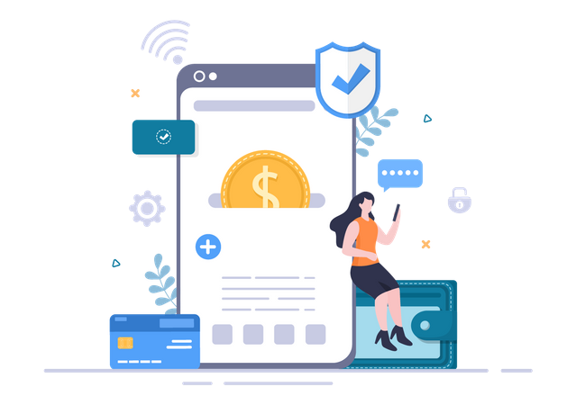
Financial Viability
Cost Reduction
Improved Efficiency
Enhanced Customer Experience
Regulatory Compliance
Long-Term Savings

Slide 4
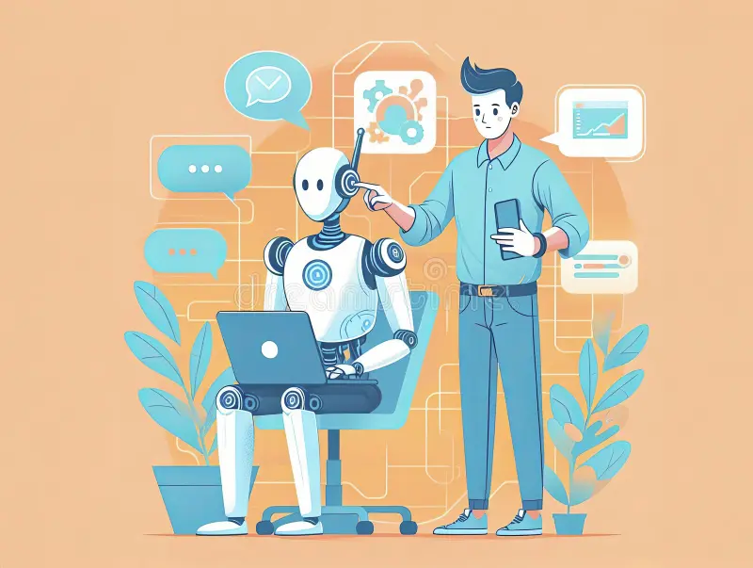
Main NLP Concepts
Data Collection
Data Processing
Model Training
Model Deployment
Response Generation

Slide 5

Future Work and Enhancements
Enhanced Personalization
Voice Integration
Advanced Fraud Detection
Multilingual Support

Slide 6

REFERENCES
https://www.coursera.org/articles/what-is-a-chatbot?utm_medium=sem&utm_source=gg&utm_campaign=B2C_NAMER__coursera_FTCOF_career-academy_pmax-enhanced-NRL-w/in-14d-new-cust-country-US-country-CA&campaignid=20397118025&adgroupid=6490599411&device=c&keyword=&matchtype=&network=x&devicemodel=&adposition=&creativeid=6490599411&hide_mobile_promo&gad_source=1&gclid=Cj0KCQjwh7K1BhCZARIsAKOrVqFdqVhupxblBoZUd7PdpZBsFnHZF9L-r8gmusMUWB868EfVCbfYqgAaAolFEALw_wcB
https://realpython.com/build-a-chatbot-python-chatterbot/
https://www.irjet.net/archives/V10/i5/IRJET-V10I575.pdf
https://tovie.ai/blog/banking-chatbots-examples-and-best-practices-for-implementation
https://yellow.ai/blog/chatbots-in-banking/#:~:text=How%20do%20banking%20chatbots%20work,as%20balance%20inquiries%20and%20transactions.

