Slide 1

1

Slide 2
Minor
Project Title: Secure Password Manager and Generator
Mentor: Mrs. Shikha Aggarwal
Names: Ankita Singh Gangwar, Harshita Singh
Affiliation: Raj Kumar Goel Institute of Technology.
2

Slide 3
Introduction
DOMAIN
Security is evolving at a fast pace and it is a facility that is as needed by the laymen as much as it is by the professionals.
MOTIVATION
We know that the world is moving deeper in the field of technology and digitalization.
People tend to make many online accounts on various platforms for work as well as personal interests, so it becomes difficult to remember strong passwords for these various platforms. Password managers are the safest way to keep track of your passwords, as they allow you to use stronger passwords without needing to memorize anything.
PURPOSE
The proposed solution of our project is to provide a simple, application for a user to manage multiple passwords, securely.
3

Slide 4
Secure password vault (Where we use XOR cipher to encrypt the password and use file handling to store the encrypted password.)
Password Complexity Checker (common password list and show the complexity and how much time it will take to brute force your password.)
Strong password generator and suggesting good practices
Proposed Model
4

Slide 5
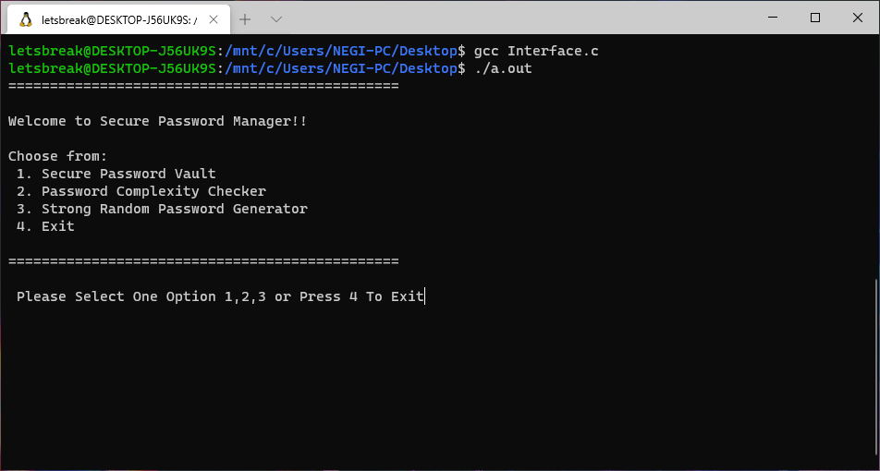
Implementation and Methodology
5

Slide 6
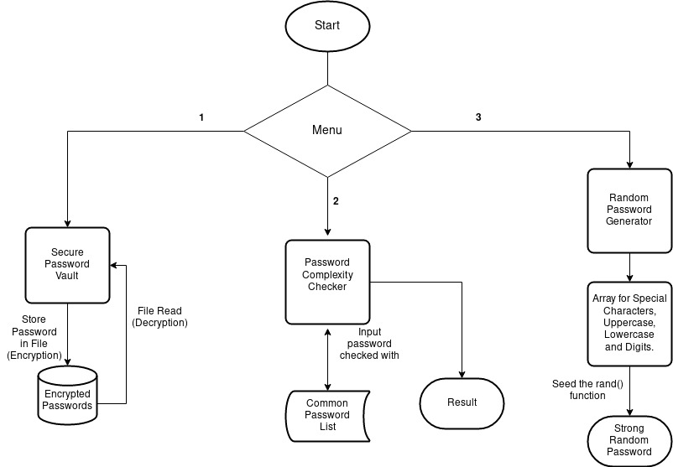
General flow chart for the program

Slide 7
Secure Password Vault - It stores the passwords and email associated with it through file handling in C. This Password Vault is secured by the encryption technique ‘simple XOR cipher’, which is a variation of ‘Vigenere cipher’ which encrypts the passwords stored in this vault, and also this vault is opened with a private key which is only known to the user and the system.

Slide 8
^{[1]}The simple XOR cipher is a variation of the Vigenère cipher. It differs from the original version because it operates on bytes, which are stored in computer memory, instead of letters.
Instead of adding two alphabet letters, as in the original version of the Vigenere cipher, the XOR algorithm adds subsequent plaintext bytes to secret key bytes using XOR operation. After using the last secret key byte, one should return to the first byte (as in the Vigenere encryption).
In order to decrypt ciphertext bytes, one should take the same steps as during encryption. Subsequent ciphertext bytes should be added to subsequent secret key bytes using XOR operation.

Slide 9
Password Complexity Checker - ^{[2]}It contains a list of common passwords with which it analysis the password entered by the user and shows the Complexity, The Time complexity in how much time it will take to Brute Force the password, and Strength of the entered password. This will help in improving and determining the password selection for the user.

Slide 10
Formulae used are:
To Calculate Password Complexity = (log(length_of_all_char)/log(2))*L ..... (1)
where length_of_all_char = sum of all the printable characters,
L = length of the password provided by user
Time to Brute Force Password = (3*math.pow(10, -11))*(math.pow(total_length, L)) ....(2)
where math.pow() = pre defined C function to calculate power of a number,
length_of_all_char = sum of all the printable characters,
L = length of the password provided by user

Slide 11
From the below table we can calculate the password strength according to the given conditions :
Type | Pool of characters possible
Lowercase | 26
Lower & Upper Case | 52
Alphanumeric | 36
Alphanumeric & Upper Case | 62
Common ASCII Characters | 30
Diceware Words List | 7776
English Dictionary Words | 171000

Slide 12
Password strength is determined with this chart:
< 28 bits = Very Weak; might keep out family members
28 - 35 bits = Weak; should keep out most people, often good for desktop login passwords
36 - 59 bits = Reasonable; fairly secure passwords for network and company passwords
60 - 127 bits = Strong; can be good for guarding financial information
128+ bits = Very Strong; often overkill

Slide 13
Strong password Generator and good suggesting practices - It will provide the user with some good and Strong Category random passwords so that the user can choose and set one of the passwords for their account. The password generated is too strong that it will be very difficult for the hacker to even try it with its password breaking attacks as all password generated are unique and are a combination of character, number, and unique tokens.
Algorithm for generating strong random password:
Step-1: Create 4 arrays for Uppercase, Lowercase, Digits and Special symbols
Step-2: Seed the rand function using a combination fo time and process id for increased randomness
Step-3: Loop 16 times randomly choosing one of the arrays created above and then randomly choosing a value within the array to get a password of length 16

Slide 14
Encryption using XOR cipher - The simple XOR cipher is a variation of the Vigenere cipher. It differs from the original version because it operates on bytes, which are stored in computer memory, instead of letters.
Algorithm for XOR cipher encryption:
Step-1: Open the file containing the plaintext password in rb(read binary) mode.
Step-2: Read the file contents character by character and XOR them with the key, close the plain text file.
Step-3: Open another file ab (append binary), append the encrypted string and close the plain text file and the encrypted file.
Step-4: Open the plain text password file in w+ mode and overwrite the file.
Step-5: To decrypt the password, open the file containing the ciphertext and XOR with the key used before.

Slide 15
Password complexity checker – This program will prompt a user for any password to check and will show the output to the user which will contain password complexity, time to brute force it and its status. Also the password will be checked from a wordlist which will contain some common passwords so that user can choose a different and strong password.
Algorithm for checking password complexity:
Step-1: Define the character sets for lowercase, uppercase, special characters and digits
Step-2: User will enter choice either to exit or to check password complexity
Step-3: if choice = 1, then user will enter password to which will tell its complexity, status and time to brute force it
Step-4: After this user will we again asked to either continue or exit
Step-5: if new_choice = 1, the program will execute again
Step-6: else, program exits
Step-7: else, program exits

Slide 16
Conclusion
We are creating a program, that is easy to use and is secure. Also we are able to generate strong random passwords and we are able to check their complexity and time taken to bruteforce the password. Apart from that we are making a password vault which will encrypt passwords and store them.
16

Slide 17
References
http://www.crypto-it.net/eng/simple/simple-xor.html/
https://en.wikipedia.org/wiki/Password_cracking
http://www.jetir.org/papers/JETIR1703043.pdf
https://thycotic.force.com/support/s/article/Calculating-Password-Complexity
https://www.dcode.fr/vigenere-cipher
https://en.wikipedia.org/wiki/Password_strength
https://passwordsgenerator.net/
https://www.geeksforgeeks.org/vigenere-cipher/
17

Slide 18
18

