Slide 1
SUBURBIA MEXICO
FW2027 WOMEN'S COLLECTION

Slide 2
Market Direction
This season's collection responds to emerging silhouettes and styling directions observed across the women's sweater and blouse market, curated into a focused, commercially-ready assortment.
Collection Overview
Total Styles: 6

Slide 3
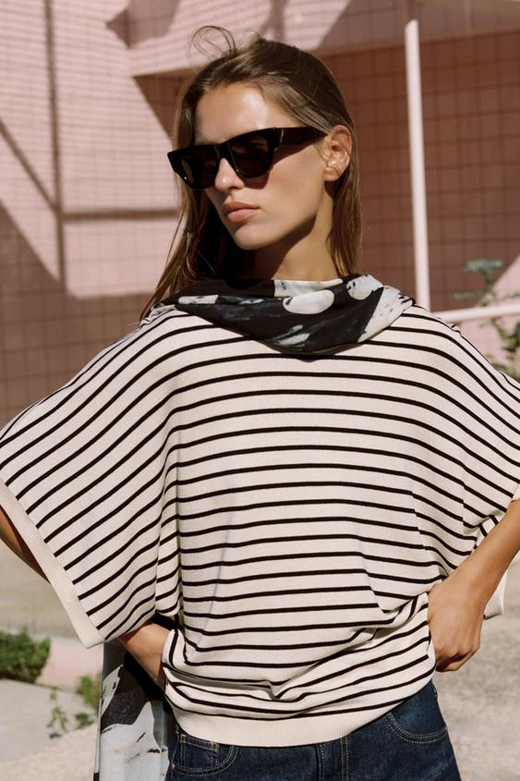
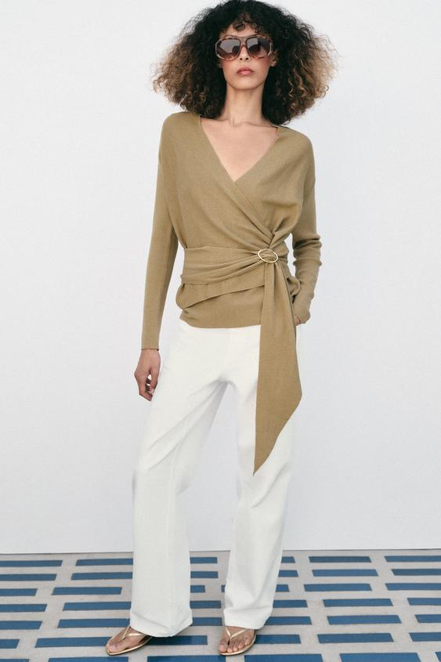
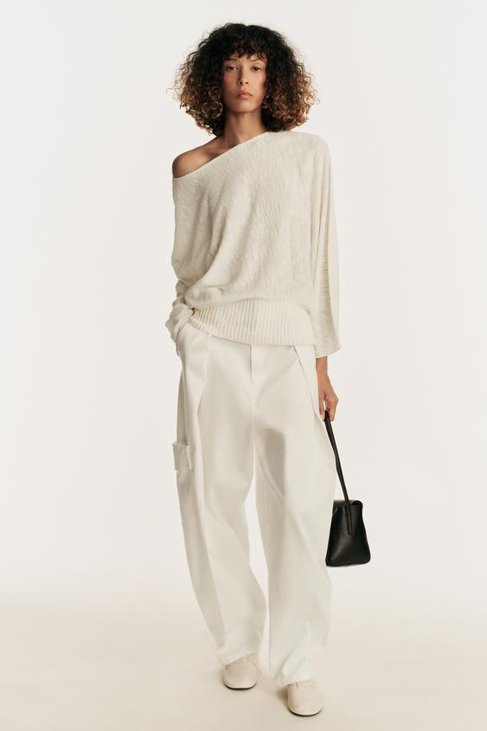
WIDE SHORT SLEEVE KNIT TOP
WRAP KNIT CARDIGAN
KNIT JUMPER WITH VOLUMINOUS SLEEVES
Model height: 177 cm Top featuring a round neck and wide short sleeves.
Model height: 174 cm V-neck cardigan with long sleeves. Featuring a front wrap design with matching fabric tie and gold-tone buckle fastening.
Jumper with a boat neck and long sleeves with wide armholes. Fitted combined hem.
Target Price: USD 2,050.00
Target Price: USD 2,950.00
Target Price: USD 2,550.00

Slide 4
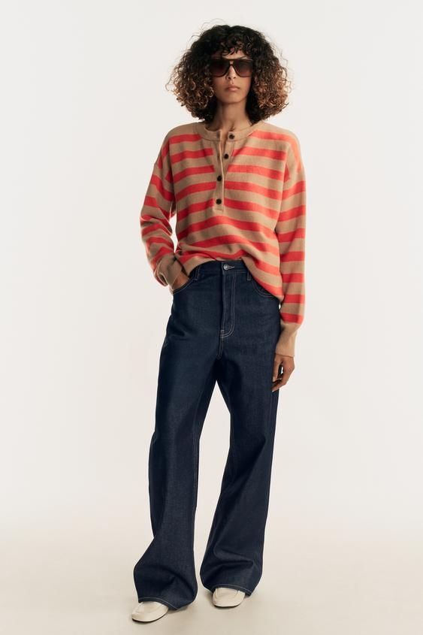
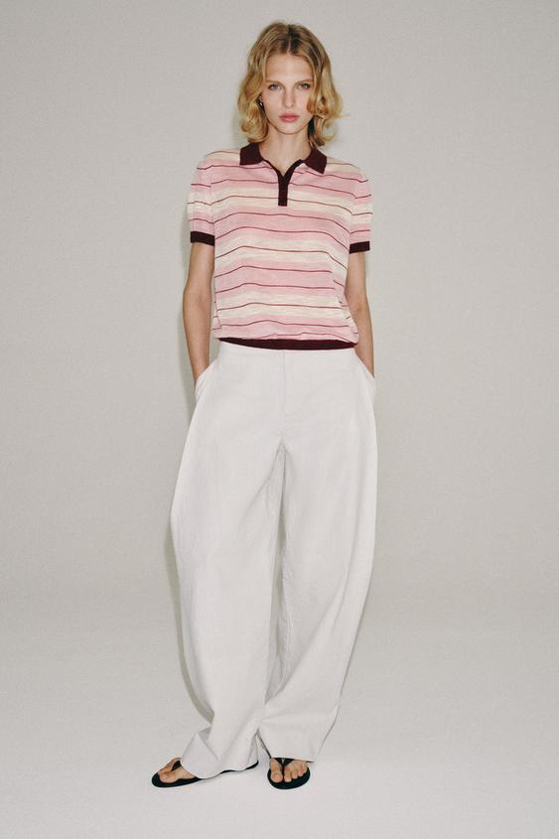
STRIPED WOOL AND CASHMERE JUMPER
STRIPED KNIT POLO SHIRT
WIDE SHORT SLEEVE KNIT TOP
Model height: 174 cm Jumper made of wool and cashmere. Featuring a round neck, long sleeves and button fastening at the front.
Model height: 179 cm Short sleeve top with a polo collar and front button fastening.
Model height: 177 cm Top featuring a round neck and wide short sleeves.
Target Price: USD 8,550.00
Target Price: USD 2,350.00
Target Price: USD 2,050.00

Slide 5
Next Steps
Sample Selection → Commercial Discussion → Style Confirmation → Order Placement

