Slide 1
SUBURBIA MEXICO
FW2027 WOMEN'S COLLECTION

Slide 2
Market Direction
This season's collection responds to emerging silhouettes and styling directions observed across the women's sweater and blouse market, curated into a focused, commercially-ready assortment.
Collection Overview
Total Styles: 6

Slide 3
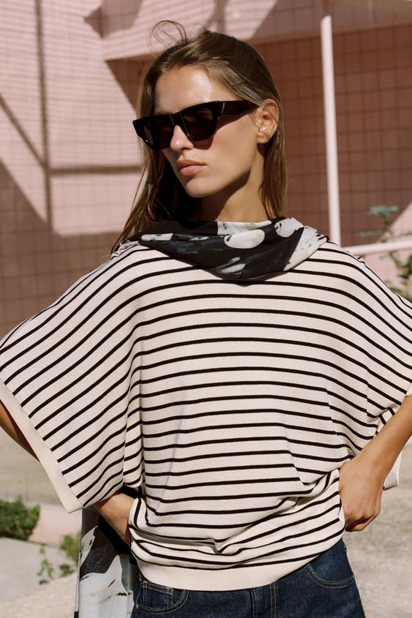
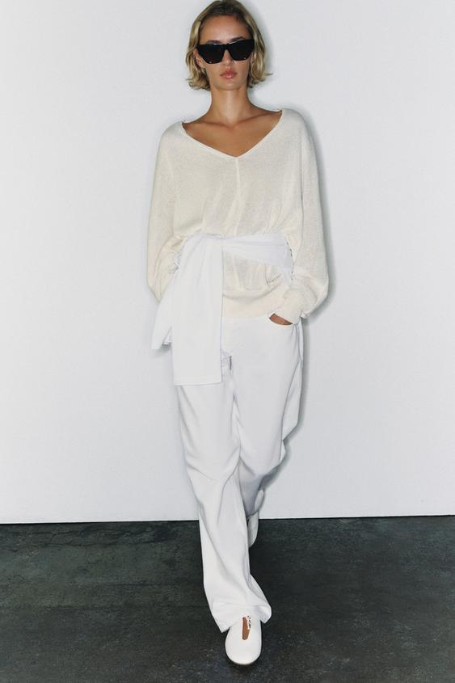
WIDE SHORT SLEEVE KNIT TOP
V-NECK KNIT JUMPER
V-NECK KNIT JUMPER
Model height: 177 cm Top featuring a round neck and wide short sleeves.
V-neck jumper with long sleeves ending in cuffs and wide armholes.
V-neck jumper with long sleeves ending in cuffs and wide armholes.
Target Price: USD 2,050.00
Target Price: USD 2,950.00
Target Price: USD 2,950.00

Slide 4
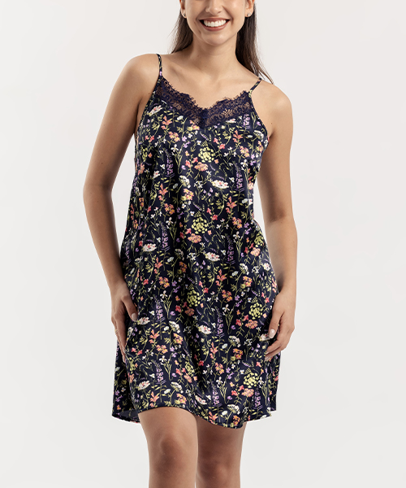
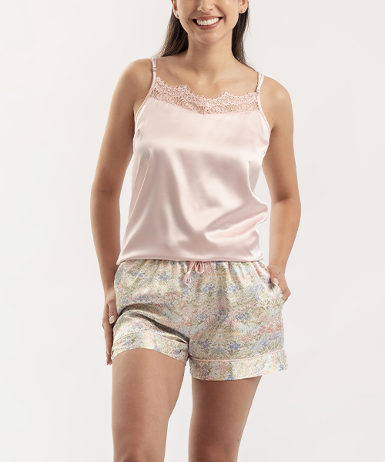
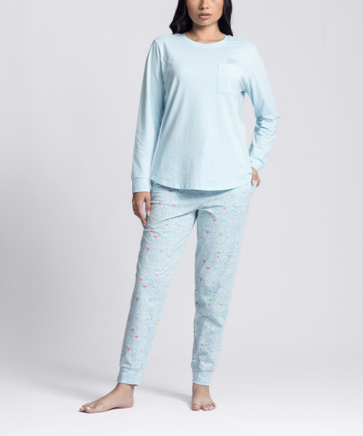
Textilón - Tienda online
Textilón - Tienda online
Textilón - Tienda online
Target Price: BOB 299.00
Target Price: BOB 369.00
Target Price: BOB 499.00

Slide 5
Next Steps
Sample Selection → Commercial Discussion → Style Confirmation → Order Placement

