Slide 1
SUBURBIA MEXICO
FW2027 WOMEN'S COLLECTION

Slide 2
Market Direction
This season's collection responds to emerging silhouettes and styling directions observed across the women's sweater and blouse market, curated into a focused, commercially-ready assortment.
Collection Overview
Total Styles: 1 Sweater Styles: 1 Blouse Styles: 0 Key Colors: —

Slide 3
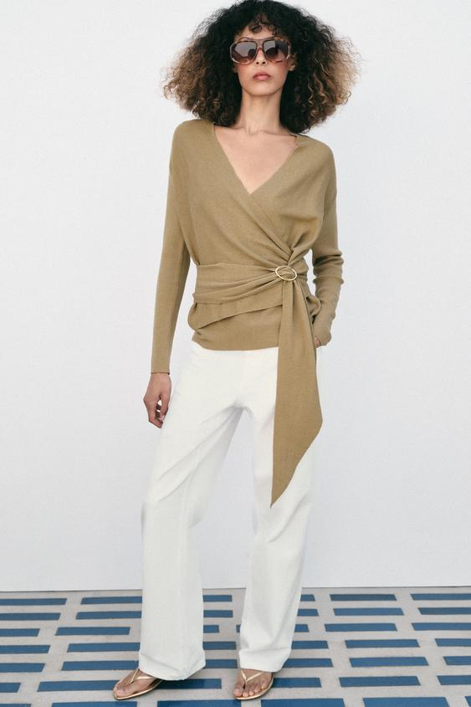
WRAP KNIT CARDIGAN
Model height: 174 cm V-neck cardigan with long sleeves. Featuring a front wrap design with matching fabric tie and gold-tone buckle fastening. Target Price: $2,950.00
REFERENCE — competitor sourced

Slide 4
Next Steps
Sample Selection → Commercial Discussion → Style Confirmation → Order Placement

