Slide 1
When the Route Breaks, Coldfront Knows
What to Do.
Coldfront
Supply Chain Disruption Assistant & Fleet Utilisation Optimizer
RouteX | AI Track | Problem L2 — Logistics & Ports
Rules decide. Models predict. AI explains. Humans approve.
Notes:
01 / 08
ROUTEX · COLDFRONT

Slide 2

One Disruption Creates Four Problems.
SHIPMENTS
Which shipments are affected? What is value at risk?
COLD CHAIN
Will temperature remain within envelope?
ROTTERDAM PORT CLOSURE
One disruption creates four connected problems
REROUTING
Which alternative is actually safe?
FLEET
Which idle asset can respond?
Existing tools show parts of the problem. Operators need one decision.
Notes:
02 / 08
ROUTEX · COLDFRONT

Slide 3
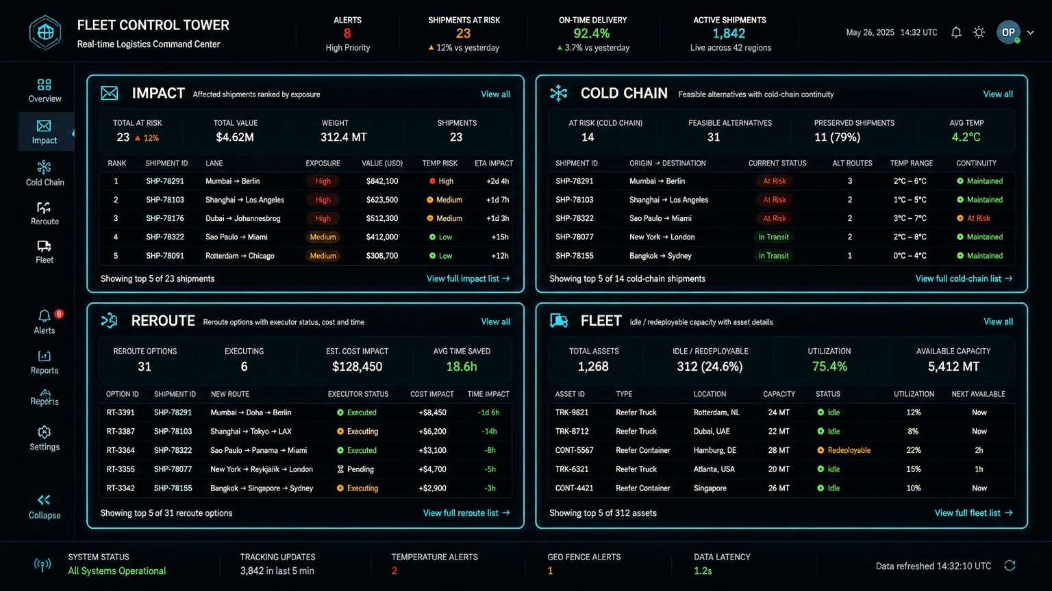



Meet Coldfront — One Crisis, One Worklist.
WHAT HAPPENED?
COLDFRONT
WHAT SHOULD I DO?
Coldfront turns disruption data into a ranked operator worklist.
Notes:
03 / 08
ROUTEX · COLDFRONT

Slide 4
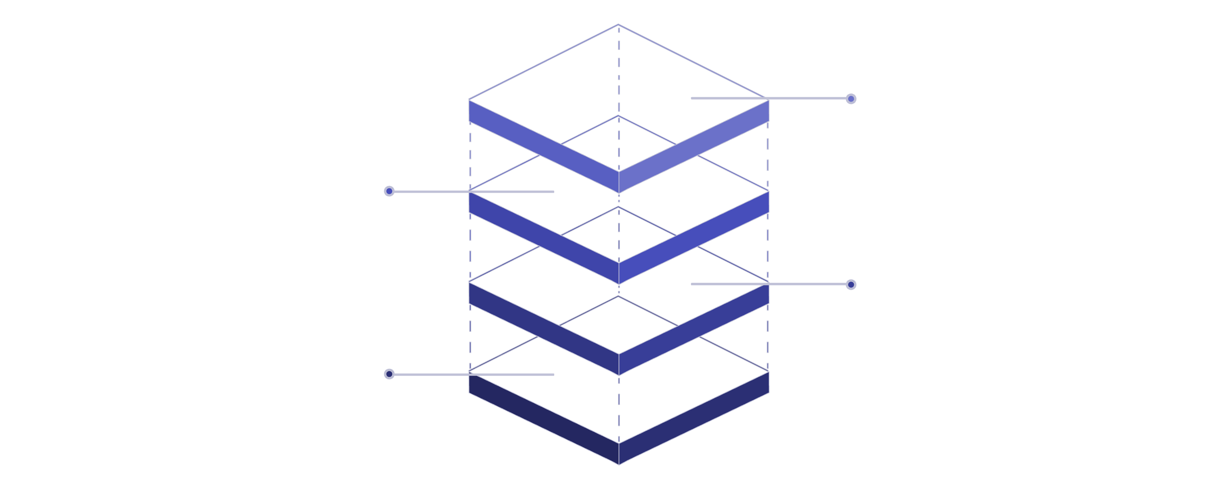
Rules Decide. Models Predict. AI Explains.
OPERATOR
Reviews and approves actions
INTELLIGENCE
Predictive ML & AI explanations
DECISION ENGINES
Impact, Cold-Chain, Reroute, Fleet
DATA
Disruption feeds, telemetry, IoT
LLM NEVER DECIDES THE VERDICT.
Deterministic rules/engines produce the decision.
ML predicts future risk.
LLM explains the result.
Human approves the action.
Notes:
04 / 08
ROUTEX · COLDFRONT

Slide 5
The Vaccine Shipment: From Warning to Action.
STAGE 1: NORMAL
STAGE 2: PREDICTED RISK
STAGE 3: EXCURSION
STAGE 4: ACTION
Temperature: 5.2°C
Status: Within envelope
Cold-chain-safe reroute selected
+
Idle reefer identified
"4-hour breach probability"
78%
PREDICTION
Temperature crosses: 8°C
BREACH DETECTED
Degree-minutes / thermal exposure
PREDICT → DETECT → EXPLAIN → REROUTE → RECOVER
Notes:
05 / 08
ROUTEX · COLDFRONT

Slide 6
Where IBM Fits Into Coldfront
IBM Bob
watsonx.ai (Granite)
Coldfront Decision Engines
AI-assisted application development (planning, implementation, and review throughout)
AI / language explanation layer (natural-language explanation with deterministic template fallback)
Operational decision logic (impact, cold-chain, rerouting, fleet)
ML Layer (scikit-learn)
FastAPI
React
Predictive cold-chain risk (breach forecasting, leg duration regression)
Application/API layer
Control Tower interface
SQLite
Operational persistence
AI doesn't replace the control tower. It makes the control tower actionable.
Notes:
06 / 08
ROUTEX · COLDFRONT

Slide 7
From Data Overload to a Ranked Decision.
BEFORE
COLDFRONT
Manual impact analysis
Retrospective temperature alarms
Separate route comparison
Manual fleet search
Difficult decision traceability
Ranked affected shipments
Predictive cold-chain warning
Cold-chain-aware rerouting
Redeployable fleet ranking
Evidence-backed decisions
DEMO SCENARIO
11
3
1
1
Affected shipments
Reroute alternatives
Cold-chain-safe recommendation
Idle reefer surfaced
The goal isn't to show more data, The goal is to reduce decision time.
Notes:
07 / 08
ROUTEX · COLDFRONT

Slide 8
Built by RouteX — From Data to Decision
ABHAY
HARSHIT
Frontend & Research
Backend & Testing
Coldfront Control Tower UI
Shipment visibility and disruption views
Cold-chain monitoring interface
Reroute workflow
Fleet-utilisation interface
Operator workflow research
FastAPI backend/API layer
Frontend-to-engine integration
Backend workflow integration
Functional and integration testing
PRINCE
PRIT
Machine Learning & Testing
Database & Documentation
Predictive ML layer
Cold-chain excursion/breach prediction
Predictive analytics
ML output validation
Prediction workflow testing
SQLite persistence/data layer
Shipment/disruption/sensor/fleet data storage
Data structure and repository support
Technical documentation
Architecture and demo documentation
One team. One control tower. One decision.
Notes:
08 / 08
ROUTEX · COLDFRONT

