Slide 1
PROCURA
$ procura --review
Scheduling personal tasks with operating-system policies, grounded AI diagnosis, and self-healing recovery
[Your Name] · Operating Systems · github.com/harshitchhabi/procura
Notes:
Procura applies the scheduling, fairness, resource-management and self-healing mechanisms of real operating systems to an ordinary to-do list. In the next twenty minutes: the problem, how the system works, what the measurements show, and what we found when we verified it against the running system.

Slide 2
To-do apps ignore forty years of scheduling research
$ cat problem.txt
Priority is a label
Fairness isn't measured
Failures aren't handled
A task is High, Medium or Low because the user said so. Nothing combines deadline urgency, time already waited and cost into an actual order.
Whether attention is spread evenly across competing tasks is assumed, never reported.
A blocked or starved task shows a red flag. Nothing explains why it failed, and nothing repairs it.
OS answer: scheduling policies
OS answer: Jain's Fairness Index
OS answer: self-healing loop
Procura's question: can these mechanisms be applied faithfully — same formulas, same state machines — to personal tasks?
Notes:
Three gaps. First, priority is a label the user types, not something computed from urgency, waiting time and cost. Second, nobody measures whether attention is distributed fairly. Third, when a task stalls because a shared resource such as time or budget runs out, the tool shows a red flag rather than an explanation or a fix. Each of these has a precise answer in operating-systems research.

Slide 3
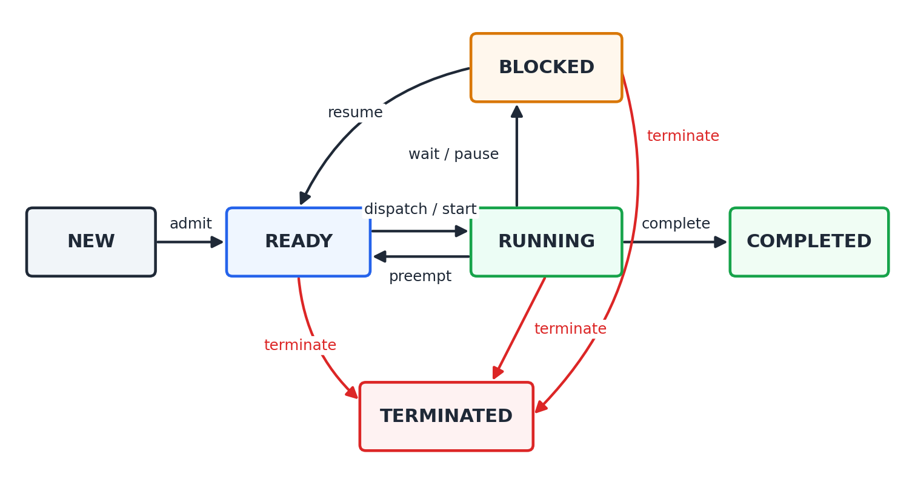
Every task is a process
$ procura --model
Task
→
Process with a PID
Estimated effort
→
Burst time (minutes)
Importance + deadline
→
Effective priority
Memory / CPU needed
→
Resource requests
Stuck on someone else
→
Wait-for edge
Notes:
A task gets a PID and every attribute an operating system needs to schedule it: a priority, a burst time — the estimated minutes of work — a deadline, and memory and CPU requirements. It moves through the six-state lifecycle on the right. The server rejects any transition that isn't drawn here with HTTP 409, and the interface only offers the valid actions for each state.

Slide 4
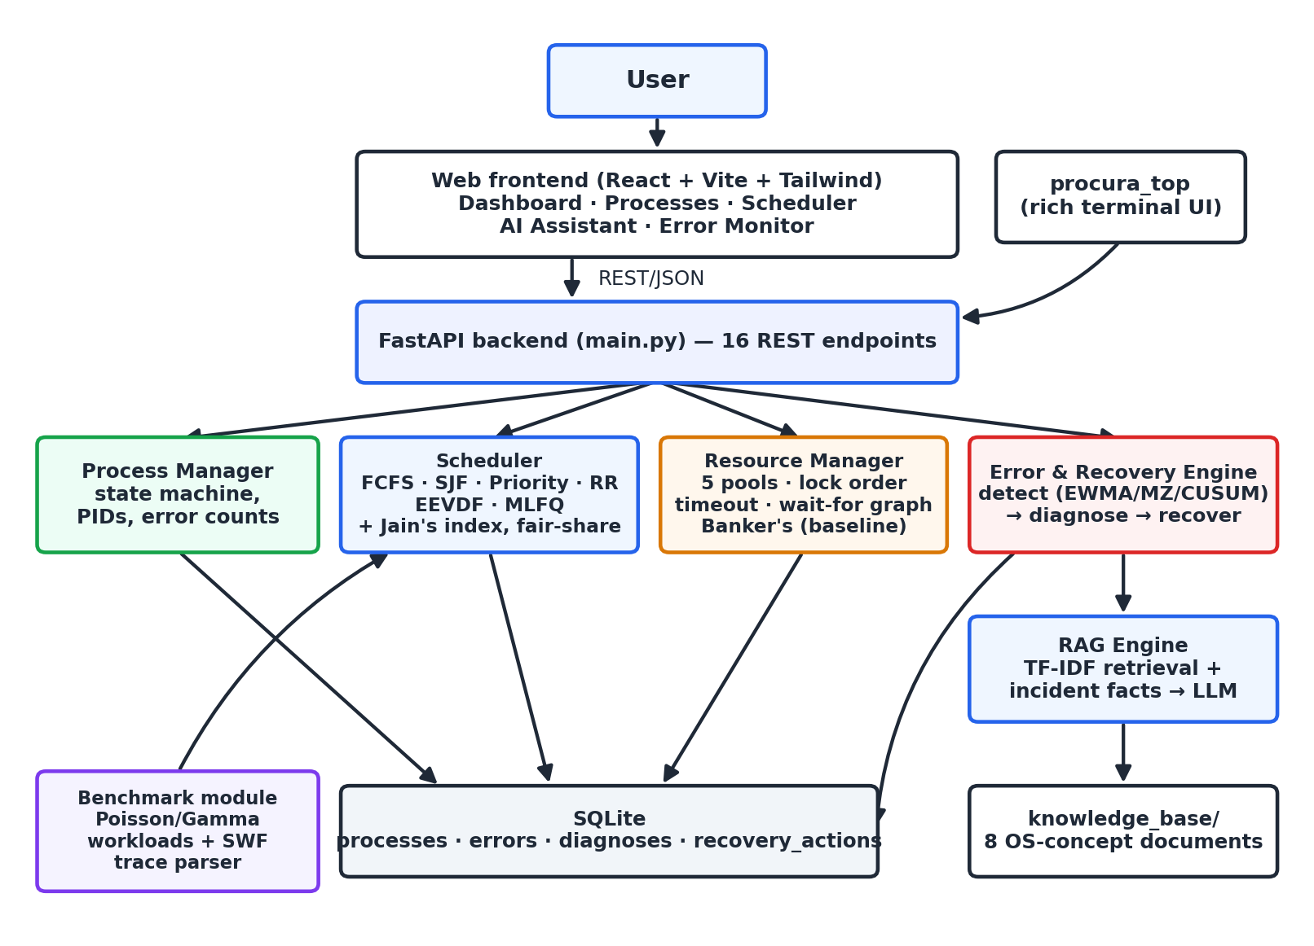
One backend, four subsystems, two interfaces
$ procura --architecture
Local-first
No account; works fully offline
Explainable
AI answers grounded in the system's own logs
Safe automation
AI explains; fixed scripts act
Verified
83 automated tests, all passing
Notes:
A React web app and an htop-style terminal dashboard talk to one FastAPI backend with sixteen REST endpoints. The backend coordinates the process manager, the scheduler, the resource manager and the error-and-recovery engine, which calls the retrieval-augmented assistant. Everything is persisted in one SQLite file. It is local-first: no account, and no network unless you configure a language-model key.

Slide 5
Six scheduling policies, from textbook to production
$ procura schedule --list
FCFS
textbook
SJF
textbook
Priority
Slurm-inspired
Runs tasks in arrival order. Simple; long tasks delay everyone behind them.
Shortest arrived task first. Lowest average wait; long tasks can starve.
Five-term effective priority with aging and Slurm-style fair-share decay.
Round Robin
textbook
EEVDF
Linux since 6.6
MLFQ
OSTEP
Every task gets a 4-minute turn in rotation. Bounded wait between turns.
Weighted fair sharing: eligible tasks by earliest virtual deadline.
Three queues, demotion on allotment use, periodic boost against starvation.
Notes:
Four textbook policies and two that run real systems today. EEVDF has been Linux's default scheduler since kernel 6.6 in 2023, replacing CFS. MLFQ is the adaptive scheduler from Operating Systems: Three Easy Pieces. Priority uses a five-term score: user priority, deadline urgency, waiting-time aging so nothing starves, resource cost, and a Slurm-style fair-share penalty that decays with a 60-minute half-life.

Slide 6
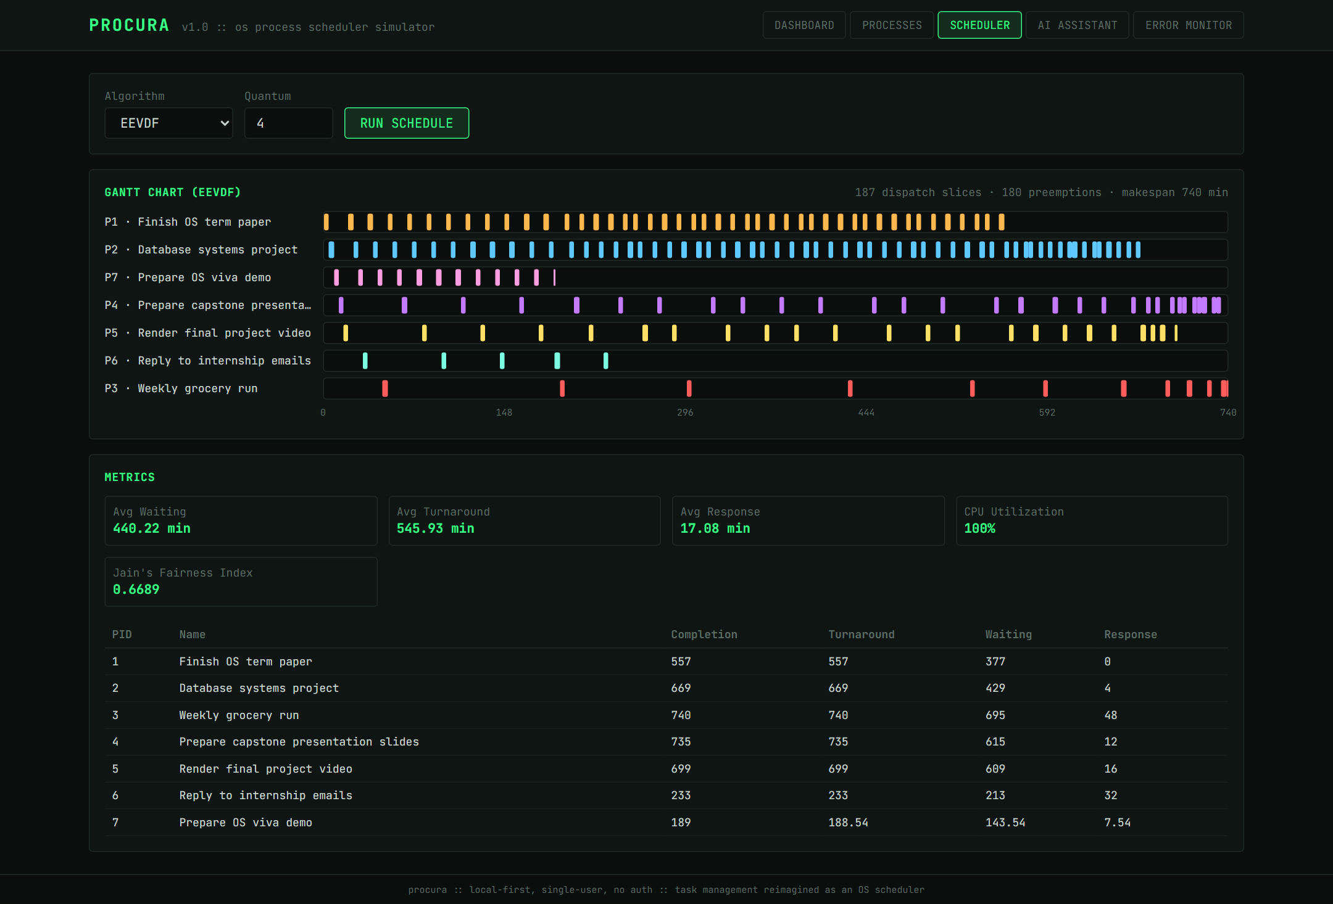
EEVDF turns priority into weighted sharing
$ procura schedule --algo eevdf
187
dispatch slices on a 740-minute timeline
0 min
until the High-priority term paper first runs
~48 min
until the Low-priority errand runs — but it always does
Notes:
This is the live scheduler screen running EEVDF on seven tasks. One lane per task; each tick is a four-minute slice. The two high-priority tasks at the top are dispatched far more often than the low-priority errand at the bottom — yet the errand is never starved, because its lag grows until it becomes eligible again. Same 187 slices as Round Robin, but weighted.

Slide 7
SJF minimises the average wait — not the worst case
$ python -m benchmark.run_benchmark --seed 42
34 min
SJF average wait — lowest of all six
163 vs 134
SJF vs FCFS worst-case wait (min)
228.67
identical makespan: all six are work-conserving
Notes:
All six policies on the same 30-job Poisson workload, fully reproducible with seed 42. Every policy keeps the CPU busy, so makespan is identical at 228.67 minutes; they differ only in who waits. SJF has by far the lowest average wait, 34 minutes against 62 for FCFS. But look at the amber bars: SJF's worst-case wait is higher than FCFS's, because long jobs keep getting overtaken. That's the textbook starvation trade-off, measured.

Slide 8
Preemption buys responsiveness with waiting time
$ procura schedule --compare --live
431 min
173 min
12 min
FCFS — average time until a task first runs
SJF — non-preemptive, shortest first
Round Robin and MLFQ — every task starts almost at once
Average response time, seven tasks, 740-minute makespan for every policy
All six policies reach 100% CPU utilisation — the difference is who waits, not how much work gets done
Jain's Fairness Index is identical (0.6689) across all six: every task eventually gets exactly its burst time, so it measures how much, not when
Notes:
Same seven tasks, live demo. Without preemption, the average task waits over seven hours to start under FCFS and almost three under SJF. Round Robin and MLFQ start every task within about twelve minutes on average. The price is a higher average waiting time, because long tasks are interleaved to the end. EEVDF sits in between at seventeen minutes, deliberately favouring high-priority work.

Slide 9
Detect → diagnose → recover, like AIOps platforms
$ procura detect
01
DETECT
02
DIAGNOSE
03
RECOVER
EWMA · modified Z-score · CUSUM (NIST)
Memory exhaustion
Wait-for-graph cycles
TF-IDF retrieval over 8 OS documents
+ the incident's own logged facts
→ LLM, or offline answer
Deterministic, audited scripts
retry · suspend_and_retry
terminate cycle victim
The AI explains. A fixed script acts.
Every error, diagnosis and action is written to SQLite and shown in the Error Monitor — a full audit trail.
Notes:
The same loop Kubernetes controllers and AIOps platforms such as Datadog Watchdog run. Detection uses three statistical methods from the NIST handbook instead of a fixed 1.5-times threshold, plus direct checks for memory exhaustion and deadlock cycles. Diagnosis is retrieval-augmented and grounded in the logged facts. And the key safety rule: the language model only explains. A fixed, auditable script decides and acts — the same pattern as PagerDuty or AWS runbooks.

Slide 10
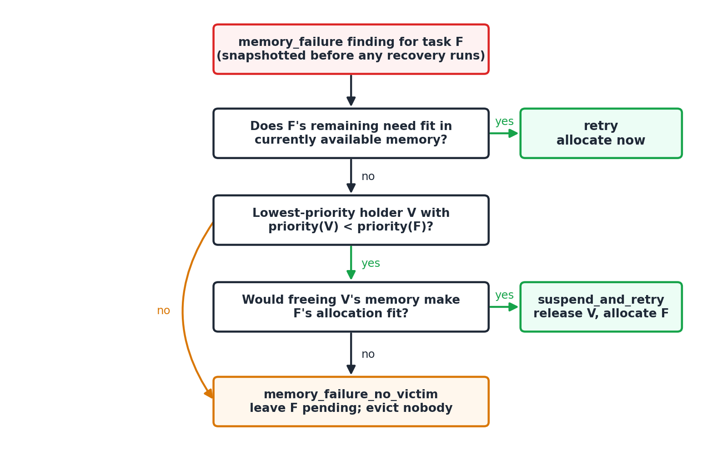
Recovery follows Kubernetes-style preemption rules
$ procura detect --memory
P2
suspend_and_retry
768 MB
evicts lower-priority P3; now fits
P4
retry
256 MB
memory freed by P2's recovery
P7
retry
256 MB
memory still available
P5
no_victim
1600 MB
nothing lower-priority frees enough
Notes:
We created memory pressure: the low-priority grocery errand hogs 1200 megabytes, leaving 248 free. One detection pass found four failures and handled each differently. The database project suspends the errand — it's strictly lower priority, and freeing it actually makes room. Two small tasks just retry, because that freed memory is now available. The video render is left pending: nothing lower-priority could free 1600 megabytes. Without these rules, an earlier version had tasks evicting each other in a loop.

Slide 11
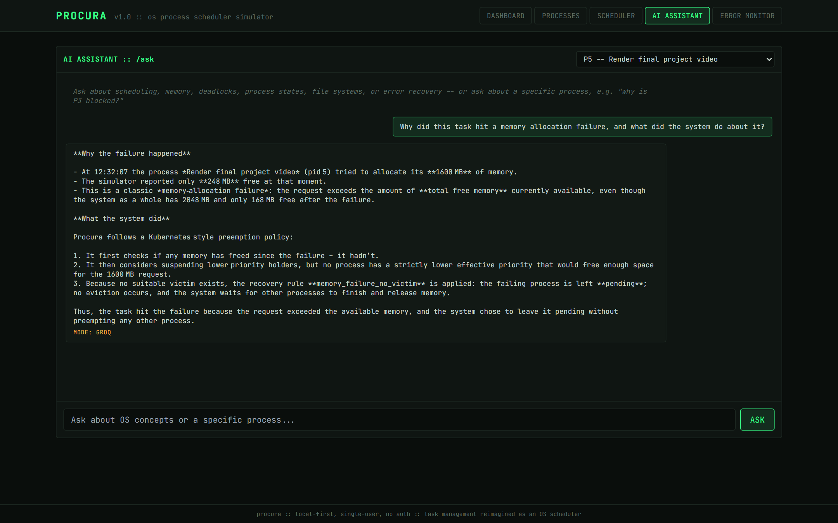
Grounding fixed the AI, not a bigger model
$ procura ask --pid 5
BEFORE
"Caused by memory fragmentation" — invented; never in the log
AFTER
1600 MB requested, 248 MB free; no lower-priority holder could free enough, so nothing was evicted
Same model. The difference was what it was given.
Notes:
Asked why the video render failed, the first version blamed memory fragmentation — plausible, and false: the log shows 1600 requested, 248 free. The model had never been shown the log. Once the recorded incident facts went into the prompt as ground truth, the same model gave the correct answer shown here. Same story with EEVDF: the knowledge base predated it, so the model invented an acronym; extending the knowledge base fixed it. Retrieval quality bounds answer quality.

Slide 12
Running the system found what unit tests missed
$ python -m pytest tests/ -v
83
SJF idled the CPU
The test asserted the bug (avg wait 5.75 vs textbook 5.25)
automated tests, all passing
Recovery ping-pong
12
Two tasks evicted each other; now strictly-lower priority only
defects found by running the system
AI invented causes
No incident data in the prompt; now injected as ground truth
1
Tests called a live LLM
published result inverted, then corrected
load_dotenv re-added deleted keys; now blanked
Notes:
Unit tests passed throughout — yet capturing screenshots of every screen and reading them closely exposed twelve defects. The most serious: SJF and Priority idled the CPU waiting for late arrivals, and the unit test had been written to expect that behaviour, so it protected the bug. That bug inverted our published result — SJF looked worse than FCFS when it is actually the best on average wait. All twelve are fixed and each now has a test. The paper documents every one.

Slide 13
Limitations and what comes next
$ procura --limits
Limitations
Future work
A simulation on one abstract CPU, not a real kernel
Small workloads: 30 synthetic jobs, a 15-job trace, 7 live tasks
AI evaluated qualitatively; it can still overstate
Single local user, no authentication by design
Fairness over waiting time and allocation rate, not only totals
Replay full Parallel Workloads Archive traces
A labelled question set to score the assistant
Multi-user fair-share with authentication
Each item is discussed with evidence in the documentation paper, Sections 11–12.
Notes:
Being honest about scope. It's a simulation on an abstract minute scale, not a kernel. The workloads are small — a 30-job synthetic set, a 15-job trace, seven live tasks — so the results show the expected behaviour rather than a statistical comparison. The AI was evaluated qualitatively, and it can still overstate. And there's no authentication by design. Next steps follow directly: fairness over waiting time, real archive traces, a labelled question set for the assistant, and multi-user fair-share.

Slide 14
$ procura --summary
OS theory works on to-do lists — and makes its trade-offs visible
Scheduling
Self-healing
Verification
SJF minimises average wait, preemption buys responsiveness, EEVDF shares by weight without starvation
Principled preemption rules turn a cascading recovery engine into one whose every action is justified
Twelve defects survived passing unit tests — found only by checking the running system
Questions?
github.com/harshitchhabi/procura · docs/: paper, demo walkthrough, case study
Notes:
Three takeaways. The scheduling results match theory exactly, which is itself validation. Recovery became trustworthy once it followed the same preemption rules Kubernetes uses. And the biggest lesson was methodological: passing unit tests weren't enough — we had to run the system and read its output. Happy to take questions or run any part of the demo live.

