Slide 1
🐍 PYTHON
Python Learning
Portfolio
Covering Data Types · Control Flow · Loops · Lists · Pandas & Visualization
Harsh | 2025

Slide 2
What We'll Cover
01
02
03
Data Types
Conditionals
While Loops
int, str, float, complex — type identification
if / elif / else — Calculator, Grades, Discount
Counters, tables, patterns & sum problems
04
05
06
For Loops
Lists
Pandas & Viz
range(), continue, break, dict/list iteration
insert, pop, remove, sort, min, max, sum
Life Expectancy dataset + Seaborn charts

Slide 3
01 Data Types
Identifying Python's core data types using type()
🎯 PROBLEM: Identify the type of different Python variables and print them.
a = 2
b = 'dd'
c = 1.2
d = 3+3j
print(type(a))
print(type(b))
print(type(c))
print(type(d))
Integer
<class 'int'>
String
<class 'str'>
Float
<class 'float'>
Complex
<class 'complex'>
💡 Key Insight: Python is dynamically typed — variables don't need explicit type declarations. The type() function reveals the underlying data type at runtime.

Slide 4
02 Conditional Statements
if / elif / else — real-world decision-making programs
🧮 Simple Calculator
🎓 Marks & Grade System
Accepts two numbers and an operator (+, -, /, *). Performs the operation and prints the result type.
Takes 5 subject marks. Calculates Total, Percentage, and Average, then assigns Grade A/B/C/Fail.
num1=int(input('enter first number’))
num2=int(input('enter secoend number’))
opreter=input('+,-,%,*’)
if opreter=='+':
print('sum of numbers',num1+num2)
print(type(num1+num2))
elif opreter=='-':
print('minus of numbers',num1-num2)
print(type(num1-num2))
elif opreter=='/':
if num2!=0:
print('division of numbers',num1/num2) print(type(num1/num2))
elif opreter=='*':
print('multiplication of number',num1*num2) print(type(num1*num2))
else:
print('non')
Mathematics=float(input('enter the Mathematics number')) Science=float(input('enter the Science number')) English=float(input('enter the English’))
Economics=float(input('enter the Economics number')) Hindi=float(input('enter the Hindi number')) total_marks=Mathematics+Science+English+Economics+Hindi
Percentage=(total_marks/500)*100
Average_marks=(total_marks)/5
print('Total marks obtained',total_marks)
print('Percentage scored',Percentage)
print('Average marks',Average_marks)
if Percentage >= 80:
print('Grade based on percentage', Percentage, 'A’)
elif Percentage >= 65:
print('Grade based on percentage', Percentage, 'B’)
elif Percentage >= 33:
print('Grade based on percentage', Percentage, 'C’)
else:
print('Grade based on percentage', Percentage, 'Fail')

Slide 5
03 While Loops
Repetition with condition-based control flow
while condition:
# body
# update counter
① Check condition — if True, execute body
② Execute the loop body
③ Update the counter variable
④ Repeat until condition is False
Print 1–10
Multiplication Table Take number input by user
asks the user for a password and keeps asking until the correct password is entered.
Sum 1 to 20
Pyramid Pattern
num=1
while num<=10:
print(num)
num+=1
x=int(input('x='))
while num<=10:
print(x,'x',num,'=',x*num)
num+=1
while password!='python123':
password=input('enter password')
print('login')
total=0; num=1
while num<=20:
total+=num; num+=1
print(total)
i=1; num=int(input())
while i<=num:
print('*'*i)
i+=1

Slide 6
04 For Loops
Iterating over sequences, ranges, lists & dictionaries
Even Numbers 0–20
⚡ Key Concepts
for x in range(0, 21, 2):
print(x)
range(start, stop, step)
Generates a sequence of numbers
→ range(start, stop, step)
continue
continue & break
Skip current iteration, go to next
for x in range(1, 10):
if x==5: continue
print(x)
if x==7: break
break
Exit the loop immediately
→ Skip 5, stop at 7
dict.items()
Dictionary Iteration
Returns key-value tuple pairs
student = {'name':'harsh',
'age':19,'city':'delhi'}
for k,v in student.items():
print(k, ':', v)
for k,v in ...
Unpack tuple into variables
→ .items() → key-value pairs

Slide 7
05 Lists
Python's most versatile built-in data structure
num = [12, 234, 212, 42, 432, 45, 654, 33]
num.insert(1,22)
print(num)
num.append(0) print(num)
num.pop()
print(num)
num.pop(-9)
print(num)
num.remove(234)
print(num)
Add 22 at index 1
Add 0 at the end
Remove last item
Remove first item
Remove by value
num.sort(reverse=True)print(num)
num.sort(reverse=False)print(num)
print(min(num))
print(max(num))
print(sum(num))
Sort descending
Sort ascending
Find minimum
Find maximum
Calculate total

Slide 8
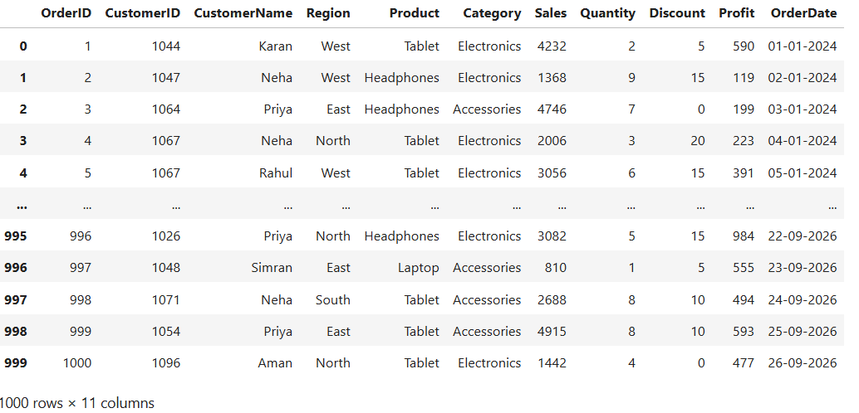
06📈 Seborn Visualizations data

Slide 9
07 Pandas & Data Visualization
Life Expectancy Dataset Analysis + Seaborn Charts
pandas
numpy
matplotlib
seaborn
📊 Dataset Analysis Tasks
Head (5 rows)
Shape
df.head(5)
df.shape
Missing values
Unique countries
df.isnull().sum()
df['Country'].nunique()
Column names
Life Expectancy > 75
df.columns
len(df[df['Life expectancy']>75])
Max Life Expectancy
Min GDP
df['Life expectancy '].max()
df['GDP'].min()
Avg Alcohol
Top 5 by Schooling
[df'Alcohol'].mean()
df.sort_values('Schooling',ascending=False)[['Country','Schooling']].head(5)

Slide 10
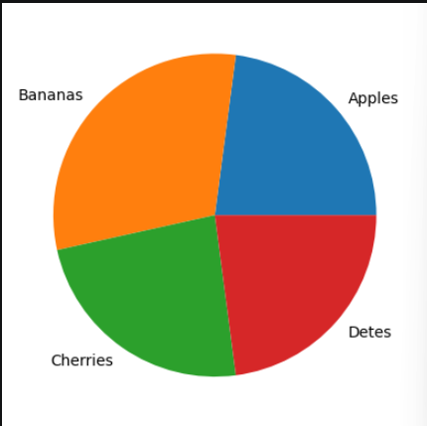
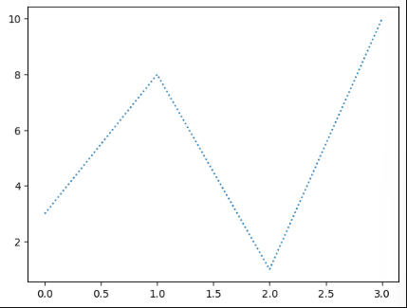
08📈 Matplot Visualizations Created
◔
Pie Chart
〜
Line Plot
plt.pie(df, df_name=df)
Plt.show()
plt.plot(ypoints, linestyle='dotted’)
Plt.show()
y=np.array([33,44,34,33])
mylables=['Apples','Bananas','Cherries','Detes']
ypoints = np.array([3, 8, 1, 10])

Slide 11
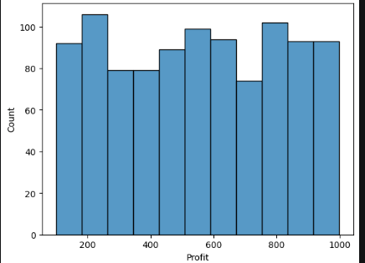
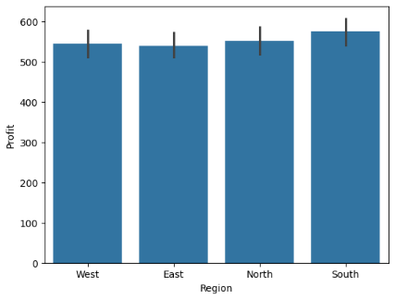
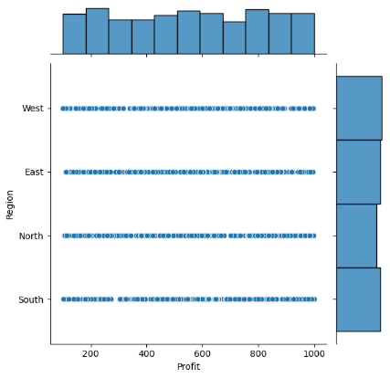
09📈 Seborn Visualizations Created
▬
Histogram
◔
Bar Chart
⊞
Joint Plot
sns.histplot(df['Profit'])
sns.barplot(x='Region', y='Profit', data=df)
sns.jointplot(x='Profit',y='Region', data=df)

Slide 12
Skills Acquired
What this notebook demonstrates
🔵 Core Python
🟣 Control Flow
🟦 While Loops
✓ Data types
✓ if/elif/else
✓ Counter loops
✓ Variables
✓ Nested conditions
✓ Password guard
✓ type() function
✓ Grade & Calculator
✓ Pyramid pattern
🟢 For Loops
🟠 Lists
🔴 Data Analysis
✓ range() iteration
✓ CRUD operations
✓ Pandas DataFrames
✓ continue & break
✓ Sorting
✓ EDA operations
✓ Dict traversal
✓ Aggregations
✓ Seaborn charts
🚀 Next Steps: Pandas Data Cleaning → EDA → Matplotlib → Seaborn → Plotly → Streamlit Dashboard

