Slide 1

H&M Customer Purchase Prediction
Prof. Kasun Samarasinghe
GROUP 6 PRESENTATION
Harkirat singh
Puneet madan
Harshit Gaur
Akash raj

Slide 2
Agenda
Introduction
Business Questions
Methodology
Predictive Modeling
Model Selection
About the Dataset
Exploratory Data Analysis
Conclusion & Recommendation

Slide 3
Introduction
H&M is a large fast-fashion apparel retailer
The objective of the project is to design an analytical framework to predict whether a customer is likely to purchase in the next 3 months
The historical purchase behavior of the customer is used train the ML models
ML predictive methods like Decision Tree, Random Forest, Gradient Boosting, Neural Network, and H20 AutoML algorithms are used
Using feature importance and SHAP to identify the important factors affecting the customer purchase
Marketing team of H&M would be the audience of the project, as they can target their customers to sent customized marketing campaigns

Slide 4
Business Question
Which customers are likely to make a purchase in the next 90 days?
What are the important factors that impact the purchase behavior of the customers?
How can the marketing team optimize their marketing strategy based on the recommendation?

Slide 5
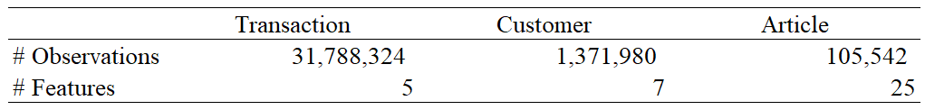
About the Dataset
H&M Data Source: Kaggle H&M Personalized Fashion Recommendations (Link)
Data Size: 34.56 GB of tabular and image data
Data Used: Transactions, Customers, and Articles tables
Transaction Data - Consists of the purchases each customer for each date
Customer Data – Metadata of each customer who made a purchase
Article Data – Metadata of each item available for purchase
Data was already pre-processed with no missing values

Slide 6
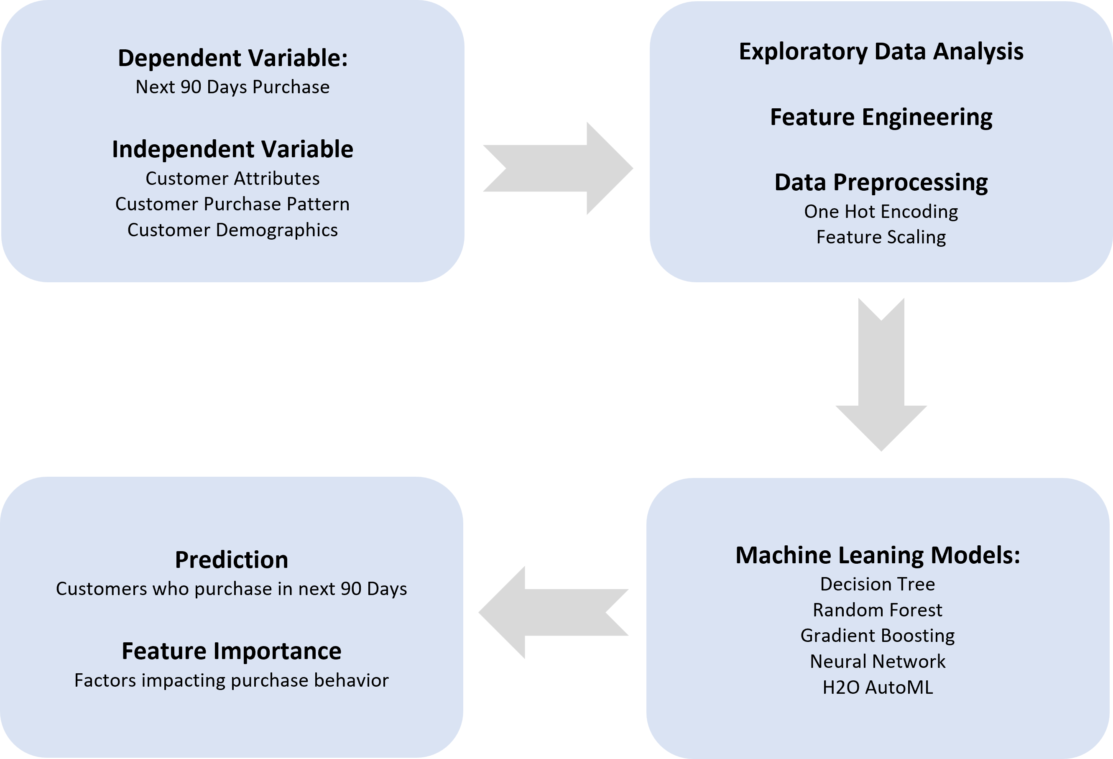
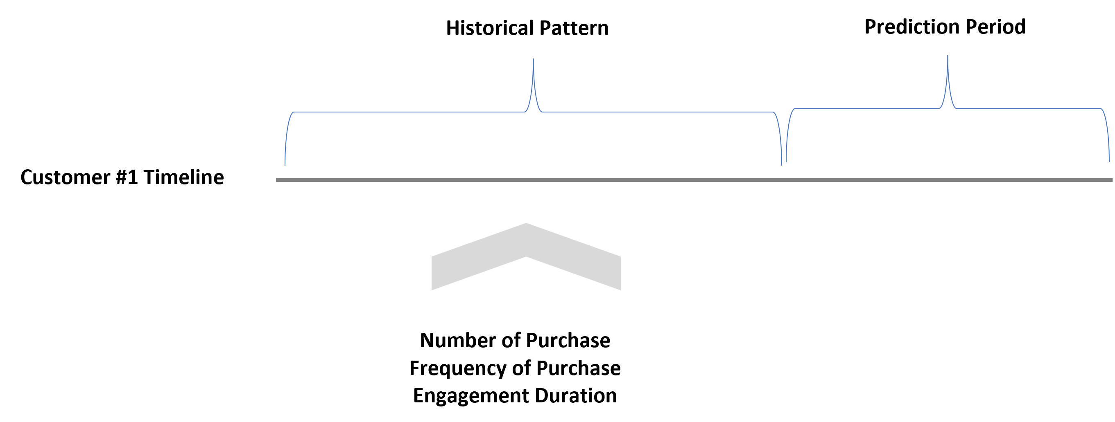
Methodology

Slide 7
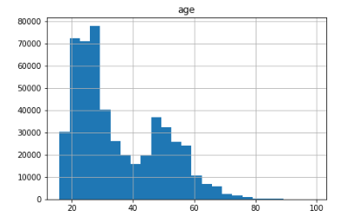
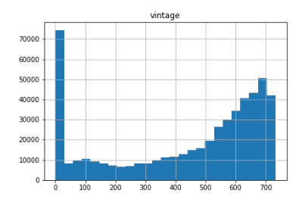
Exploratory Data Analysis
Observation 1 - Customers belonging to the age group of 20 - 30 have the highest % of population in H&M store data set following by the age group of 45 - 50.
Observation 2 - The 'vintage' variable is left-skewed suggesting that most of the customers have been in association with the organisation for a long time.
We can check a large portion of H&M's customers have been in association for the last 3 years.

Slide 8
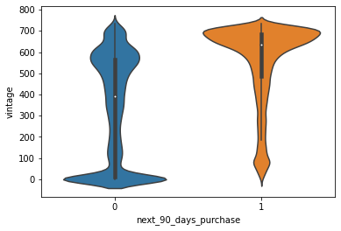
Exploratory Data Analysis
Observation – Higher proportion of old customers seem to purchase within the next 90 days as can be seen from the bulge in orange violinplot at the top. The opposite can be seen in the customers with less vintage.

Slide 9
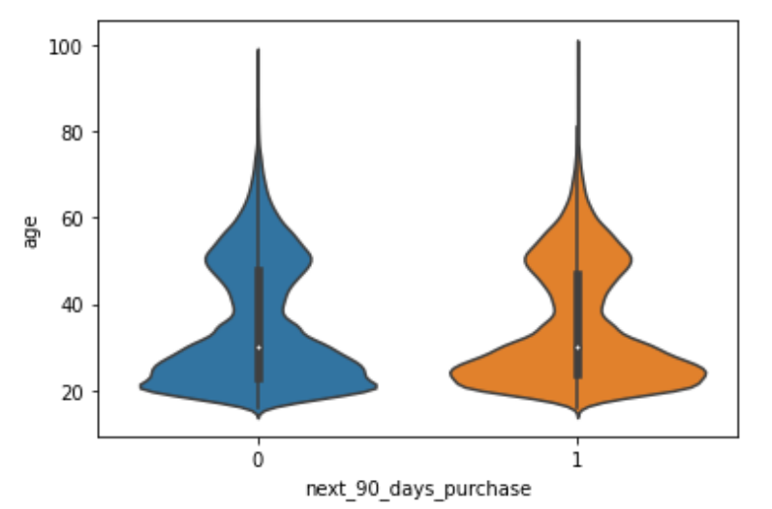
Exploratory Data Analysis
Observation – The density distributions of the plot are same amongst the customer bases, who will and who will not make purchases in the next 90 days, suggesting that the age distribution is almost same.
Age factor is NOT playing a role in deciding whether a customer will make a purchase in the next 90 days or not

Slide 10
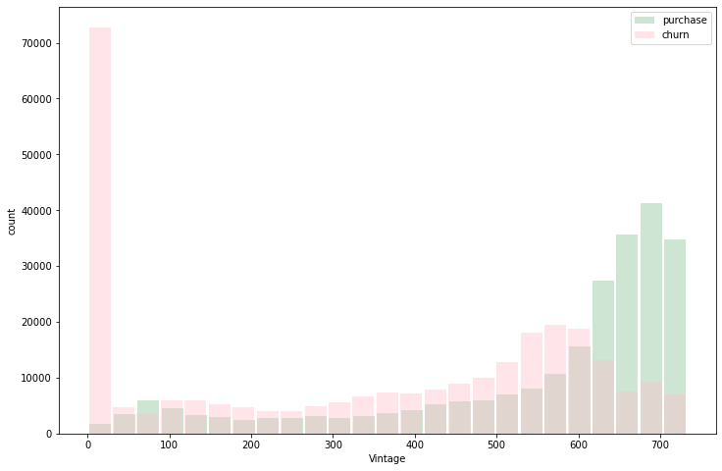
Exploratory Data Analysis
Observation – New customers are very likely to churn.
The number of customers are increasing with the vintage.
The customers with high vintage are likely to make a purchase.

Slide 11
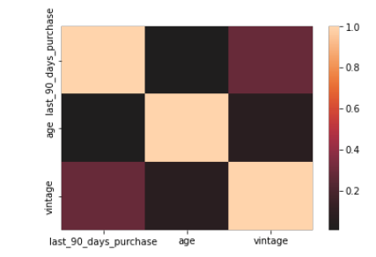
Exploratory Data Analysis
These 3 integer features do not have strong association with each other.
Feature 'last_90_days_purchase’ is associated at around 0.3 with 'vintage’ feature.

Slide 12




Predictive Modeling
Train and Test data split
One Hot Encoded the categorical variables
Scaled numeric variables using Standard Scalar
ML model used to predict next purchase:
Decision Tree
Random Forest
Gradient Boosting
Neural Network
H20 AutoML
Feature Importance, SHAP, and PDP used to explain the models
Decision Tree
Random Forest
Gradient Boosting
Neural Network
AutoML

Slide 13
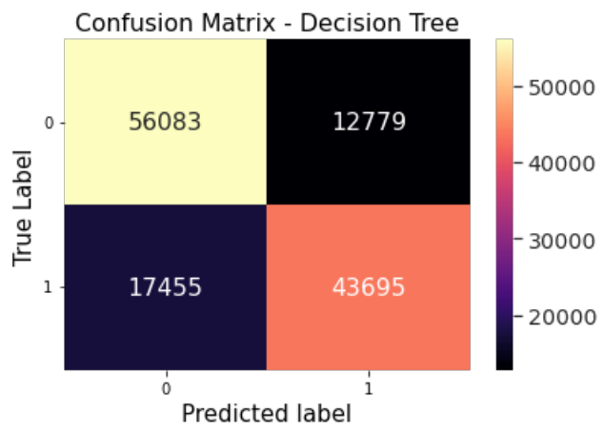
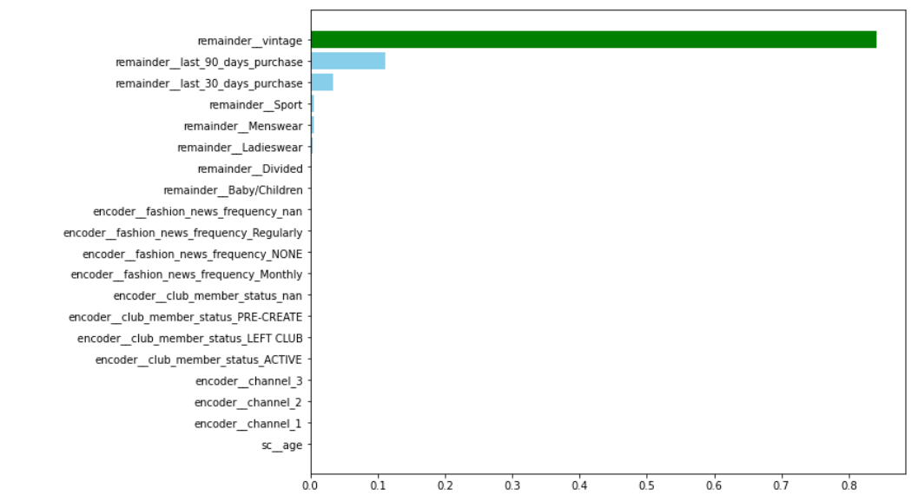
Decision Tree
‘remainder_vintage’ comes out to be very important feature (Using Feature Importance)
Accuracy: 76.70% Precision: 77.30% Recall: 71.40%
Used GridSearchCV for hyper-parameter tuning to find best parameters set

Slide 14
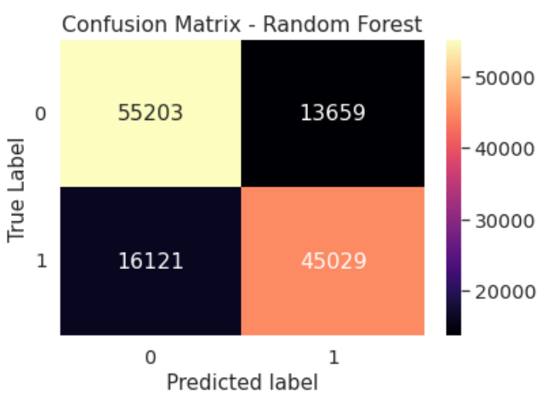
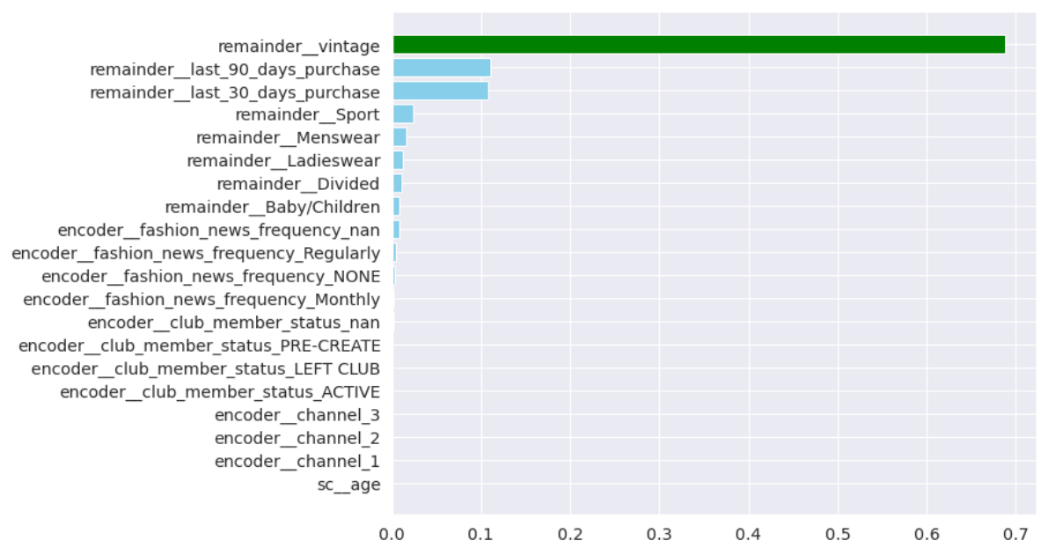
Random Forest
‘remainder_vintage’ again comes out to be very important feature (Using Feature Importance)
Accuracy: 77.40% Precision: 77.20% Recall: 74.15%
Used RandomizedSearchCV for hyper-parameter tuning to find best parameters set

Slide 15
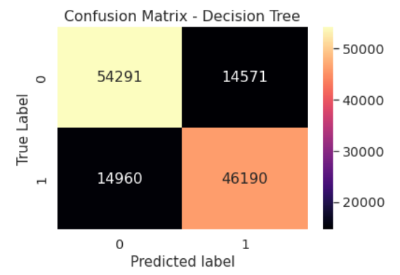
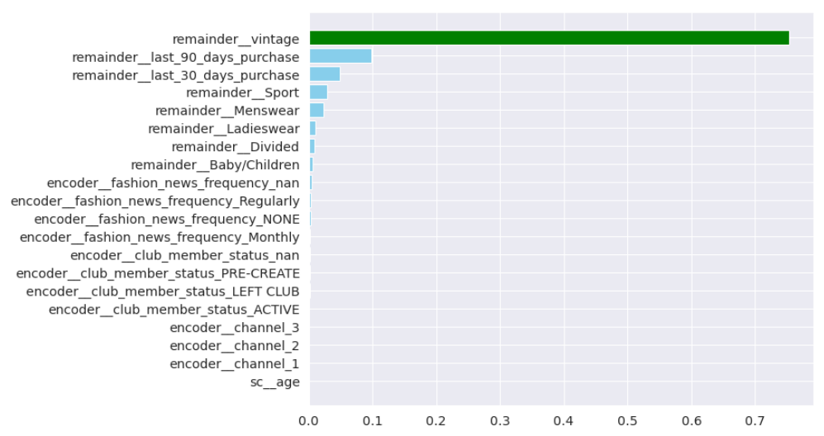
Gradient Boosting
‘remainder_vintage’ again comes out to be very important feature (Using Feature Importance)
Accuracy: 78.95% Precision: 76.00% Recall: 76.00%
Learning Rate was hyper-parameter tuned to find best parameters set

Slide 16
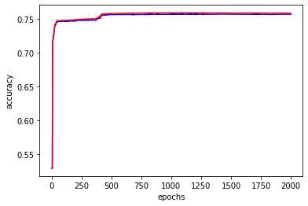
Neural Network
We used the model with 2 hidden layers and sigmoid activations with softmax at the output layer.
The loss function used was cross entropy and the learning algorithm was Adam with a learning rate of 0.1.
The accuracy starts to converge at 75.6% for both test and training data after 500 epochs.

Slide 17
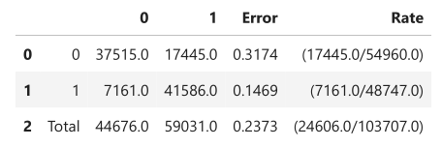
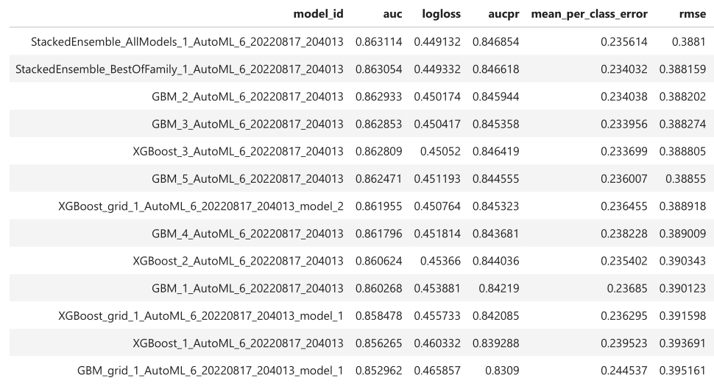
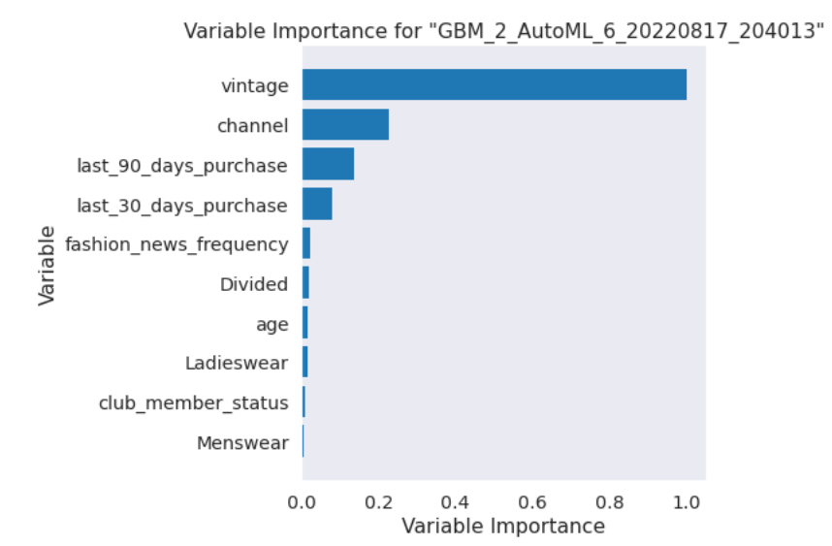
H2O AutoML
Explored 15 different model to check maximum accuracy
‘Vintage’ again comes out to be very important feature
H2OStackedEnsembleEstimator : The Best Model
Accuracy: 76.27% Precision: 70.45% Recall: 85.31%

Slide 18
Model Selection
Used ‘Accuracy’to compare the performance of the models
All models have similar performance
‘Gradient Boosting’ is found out as the best model to perform among all the models given the highest accuracy value

Slide 19
Conclusion & Recommendation
In
This
Project
We
Give
Recommendations

Slide 20
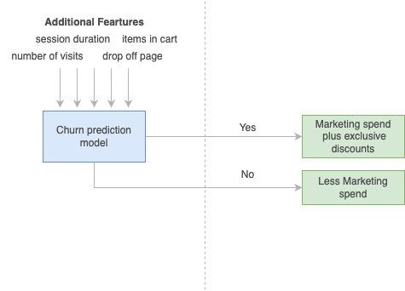
Proposed Future Work
Just with the transaction details of the customer, we were able to achieve 77% accuracy for our churn prediction model. For future analysis, we would want to incorporate variables such as session duration, number of visits, drop-off page, number of items in cart etc.
We would also suggest the company to optimize their marketing efforts leveraging the model. The customers who are less likely to make a purchase should be targeted more with promotional campaigns and exclusive discounts.

Slide 21

Thank you

