Slide 1
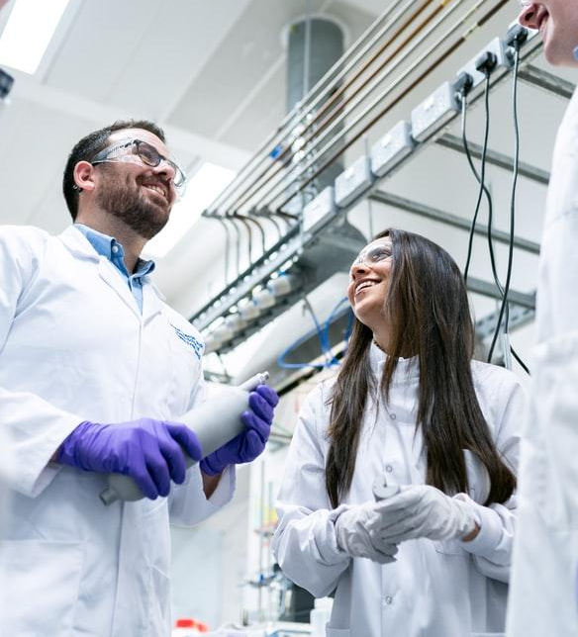
ALY6140 CAPSTONE PROJECT-4
By-
Supreeth Murugesh
Harshit Gaur &
Jeseeka Shah

Slide 2
Problem Statement
Exploratory Data Analysis of HbA1c value at the time of admission and readmittance rate of patients

Slide 3

What is HbA1c value? Relationship with Diabetes
Haemoglobin A1c levels between 7 and 8 percent mean you have prediabetes and a higher chance of getting diabetes. Levels of 8 % or higher mean you have diabetes.
Normal < 7
8 < Diabetes
7<Prediabetes<8
A1c Test Result

Slide 4
About Dataset
Obtained from Heath Fact database (UCI ML Repository) that stores the clinical records of various hospitals in United States.
Initially, data had 101,766 encounters with 55 features.
Removed encounters where HbA1c value was not recorded at the time of admission.
Dropped irrelevant features like payer code, identification numbers, medical specialty of doctors at the time of admission, and other unbalanced features from the dataset.

Slide 5
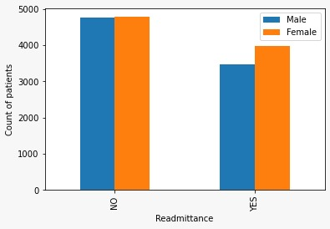
Exploratory Data Analysis
The readmission feature consisted of records with values <30, >30, and NO. We categorized <30 and >30 values as ‘YES’ since the readmission rate is our end goal.

Slide 6
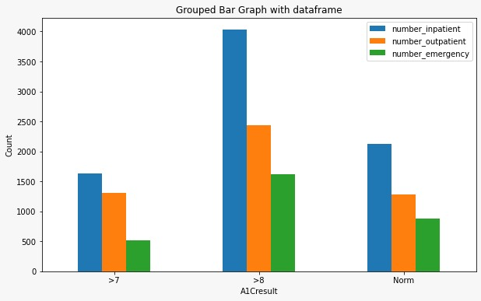
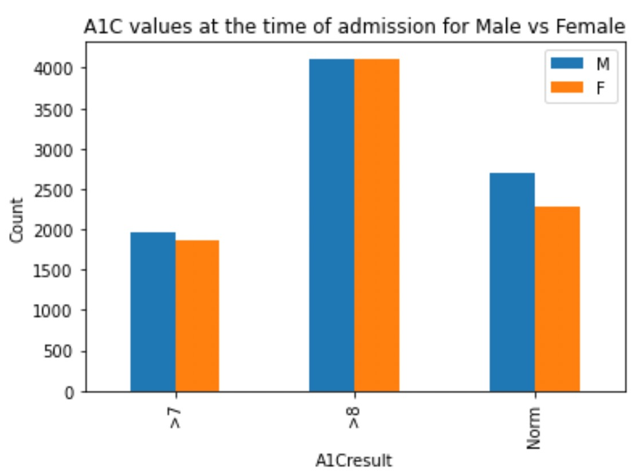
Exploratory Data Analysis
Above graph shows the plotting of A1c test values with respect to gender and other graph with number of inpatients ,outpatients and emergency.

Slide 7
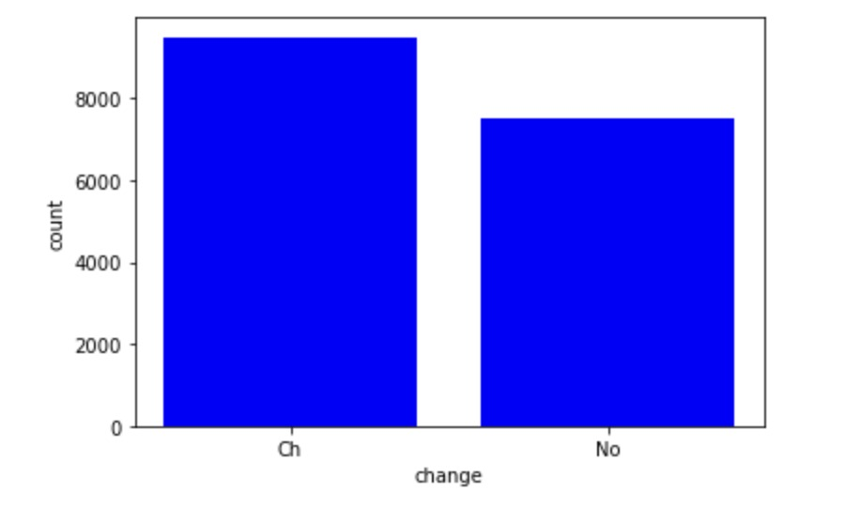
Exploratory Data Analysis
The change in the medication is taken place based on the result of the HbA1C test result and its frequency of retaking the test. The change in medication indicates the change can be increase or reduction in the medication as well as change in the generic name of the dosage.

Slide 8
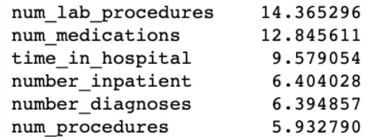
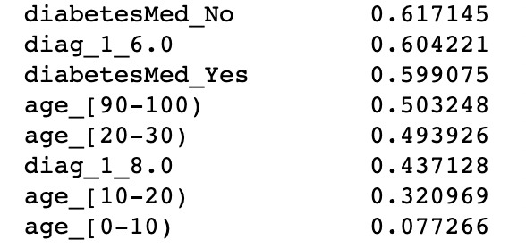
Feature Selection
To select the relevant features to be fed to the model we apply random forest classifier and calculated feature importance.
Elimination of features that had less importance compared to other features.
Probability of the feature importance using random forest.

Slide 9
Feature Transformations : One-Hot Encoding
A machine can only understand the numbers. It cannot understand the text. We need to convert categorical columns to numerical columns so that a machine learning algorithm understands it. This process is called categorical encoding.
One-Hot Encoding is a technique for treating categorical variables. It creates additional features based on the number of unique values in the categorical feature.

Slide 10
Models Applied
Random Forest
K Nearest Neighbour
Support Vector Machine
Logistic Regression

Slide 11
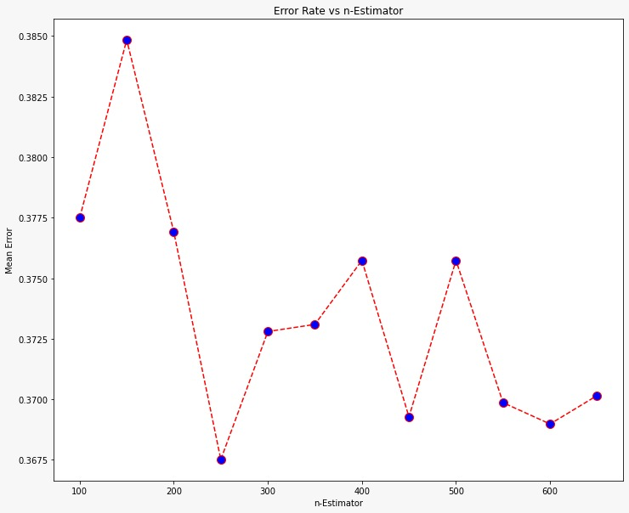
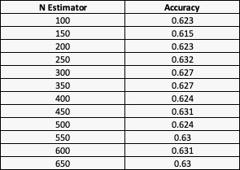
Models Applied : Random Forest Classifier
Builds multiple decision trees and takes the most popular decision tree as the output.

Slide 12
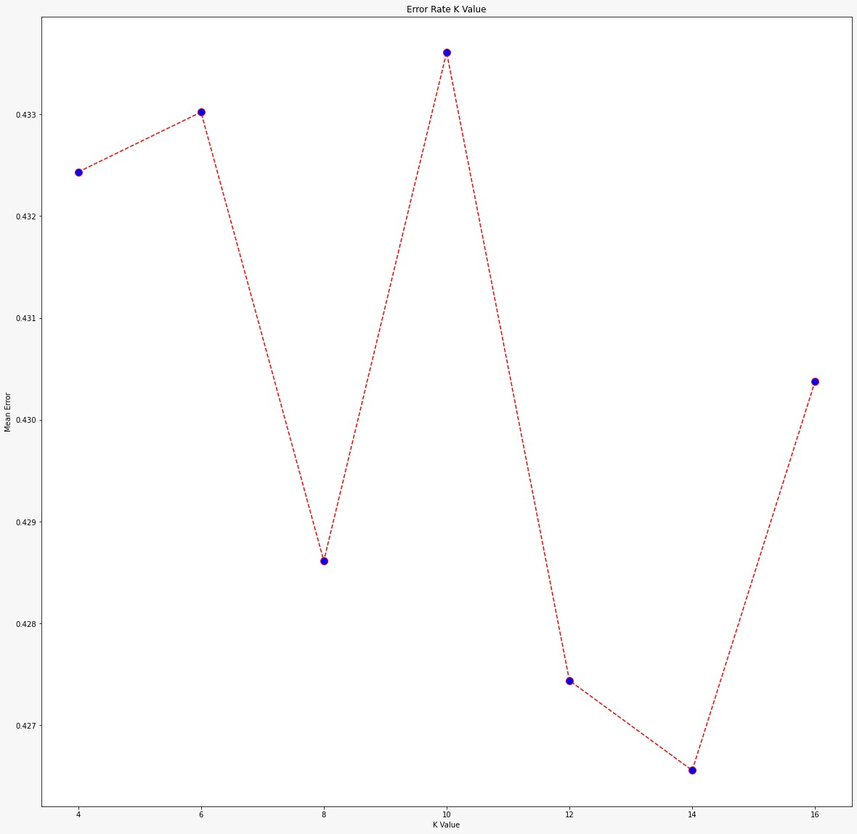
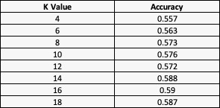
K Nearest Neighbour Classifier
K-Nearest Neighbor Classifier: Approach to data classification that estimates how likely a data point is to be a member of one group or the other depending the groups its nearest data point belongs to.

Slide 13
Logistic Regression
Logistic regression, despite its name, is a classification model rather than regression model used for binary problems; something that can take two values such as true/false, yes/no, and so on.
 | Predicted : Readmitted | Predicted : Not Readmitted
True : Readmitted | 1645 | 278
True : Not Readmitted | 900 | 581

Slide 14
Support Vector Machine
A support vector machine is a machine learning model that is able to generalise between two different classes if the set of labelled data is provided in the training set to the algorithm. The main function of the SVM is to check for that hyperplane that is able to distinguish between the two classes.
 | Predicted : Readmitted | Predicted : Not Readmitted
True : Readmitted | 1880 | 91
True : Not Readmitted | 1192 | 241

Slide 15
Conclusion
72.2% of the patients who had HbA1C result more than the normal value were readmitted.
27.8% of patients who had normal HbA1C value were readmitted.
Model Name | Accuracy obtained | Optimum parameter value
KNN | 59% | K-value=16
Random Forest | 63.2% | N-estimator =250
Logistic Regression | 62.4% | -
Support Vector Machine | 60.4% | Linear Kernel
Accuracy for the models was calculated using metrics of y-test and y-predicted.

Slide 16
Thank You

