Slide 1
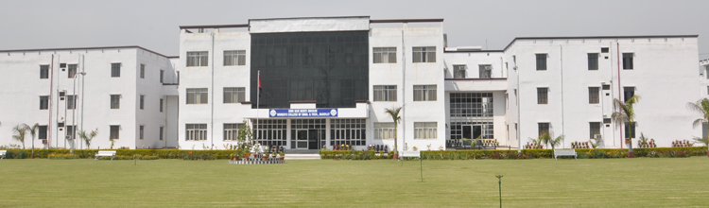

SHRI RAM MURTI SMARAK COLLEGE OF ENGINEERING TECHNOLOGY & RESEARCH
SEMINAR ON : Android Advanced Applications
SUBMITTED TO :
Mr. Jitendra Singh
Mr.Ankur kumar
SUBMITTED BY :
Shivangi Goel
(1445010029)
CS-14

Slide 2
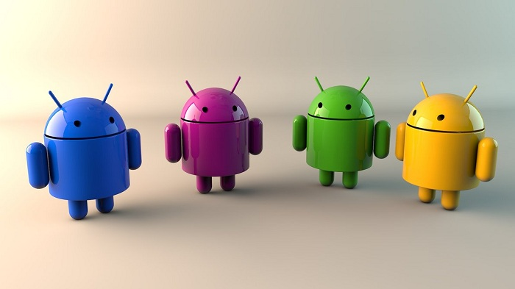

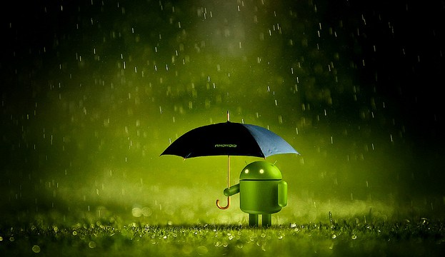
Content
What is Android
Foundation of an Android
Features of Android
Architecture of Android
Android Versions
Advanced Applications of Android
Pro’s & Con’s
Conclusions

Slide 3
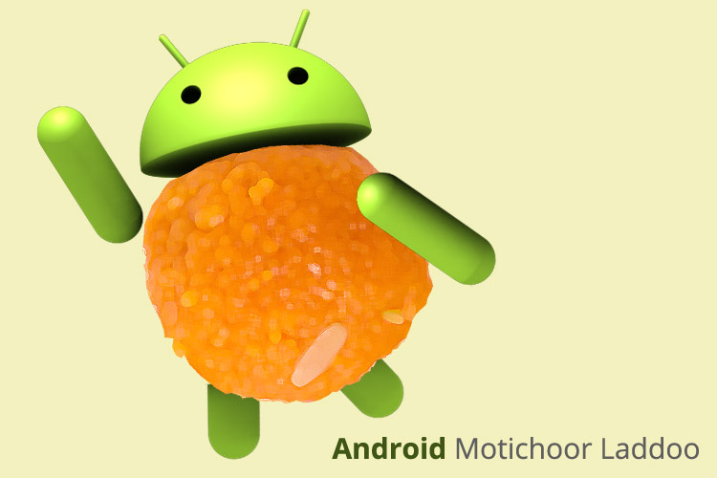
What is Android
A software for handheld devices(like mobile, tablet computers).
It includes an operating system, middle ware and a key applications based on the linux Kernel.
Developed by the OPEN HANDSET ALLIANCE(OHA) lead by Google in August17,2005.
Java Programming.
Android is specially developed for applications.
The Android is an open source.

Slide 4
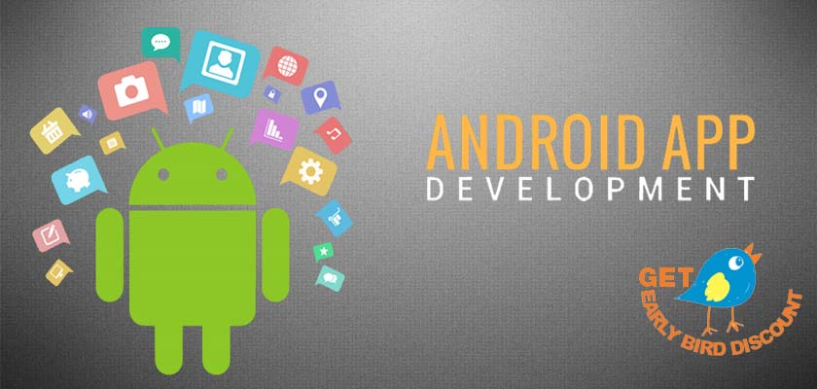
Foundation of an Android
Android, Inc. found in Palo alto in California united states by Andy Rubin. - October 2003
Google acquired Android, Inc. – August 2005
The open handset alliance, a group of several companies was formed - 5 November 2007
Android Beta SDK Released - 12 November 2007.

Slide 5
Features of Android
Android is not a single piece of hardware.
Android supports wireless communication includes :- 3G Network , 4G Network ,
Android has a better app market .
Android lets you change your settings faster.
It gives you more options to fit your budget.
Android keeps information visible on your home screen.
Android also support Java applications.

Slide 6

ARCHITECTURE
OF
ANDROID

Slide 7
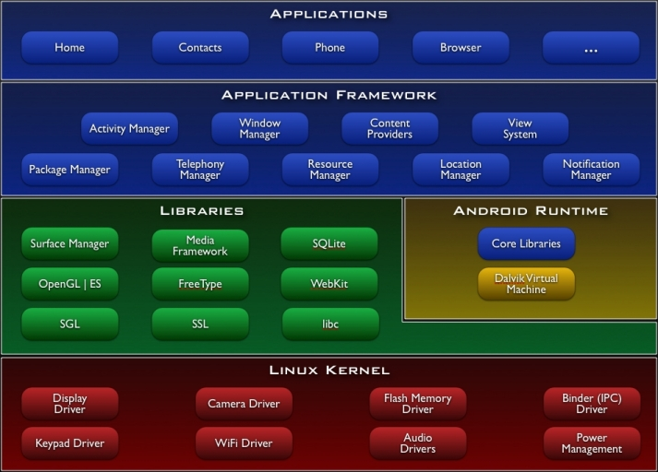
Architecture of Android

Slide 8
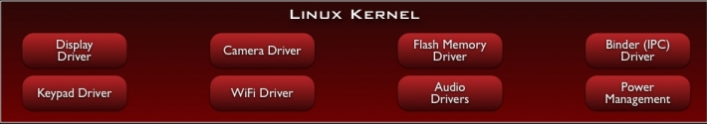
Linux Kernel
Android built on Linux 2.6 kernel.
Provides security, memory management, process management, network stack, and driver model.
Abstraction layer between hardware and the software stack .
Its handles security between the application and the system.

Slide 9
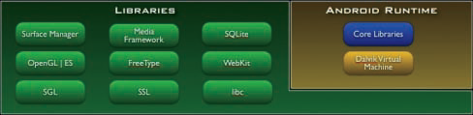
Android Libraries (in C & C++)
The Android run time: designed to meet the need of running in embedded environment (limited battery/memory/processor).
It is composed of Java core libraries( Collection classes, utilities, input/output etc) and DVM.
DVM is memory efficient, & multiple instances of it can run on the device at the same time.
Media frameworks: These libraries allow you to play and record audio and video.

Slide 10
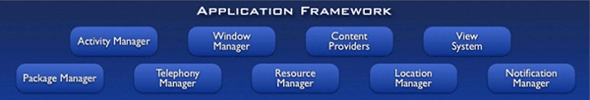
Application framework

Slide 11
Application framework (written in Java)
The application framework provides the classes used to create any Android applications.
Activity manager: Manages the activity life cycle.
Package Manager: keeps track of installed applications.
Content provider: Framework to allow the sharing of data among applications. Eg. Phone no.s, names etc are allowed to be used by sms application.
Window manager: manages window.
Telephony manager :contains API that we use to build the phone application that’s central to the phone experience.
Resource Manager: to store localized string, bitmaps, & external parts used to create applications . Ex. Images, audio/video etc.

Slide 12
ANDROID VERSIONS

Slide 13
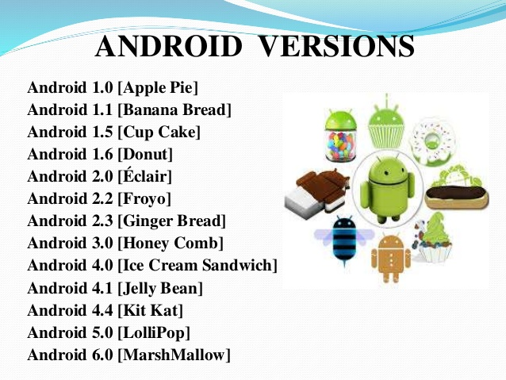

Slide 14
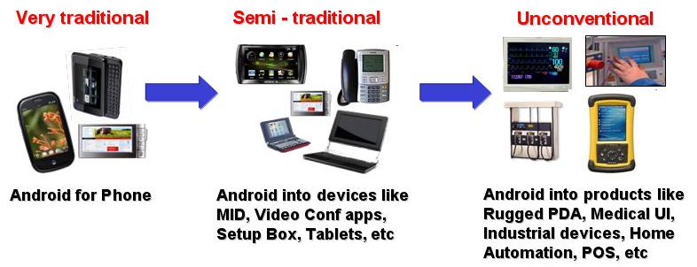
Advancement in Android

Slide 15
Advanced Applications of Android

Slide 16
Applications
Weather
Blue Mail
Google Maps
Google Play Music and Youtube
Nova Launcher
Pocket
Solid Explorer
Swift Key
Tasker
Zedge

Slide 17
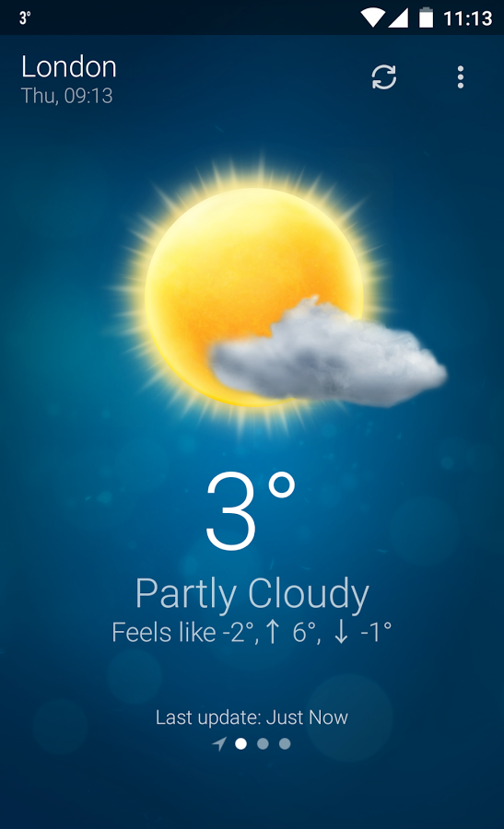
Weather
The best weather application.
It shows you the current weather also uses radar so you can see the storms approaching.
It will also provide you with
the weather notifications.

Slide 18
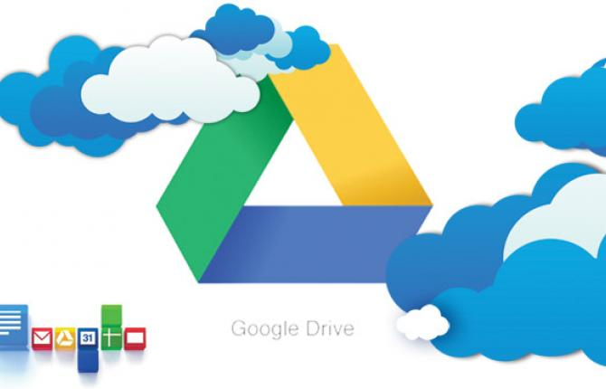
Google Drive Suite

Slide 19
Google Drive Suite
Google Drive is a cloud storage solution available on Android.
It includes Google Docs, Google Sheets, Google Slides, Google Photos, Gmail, Google Calendar, and Google Keep.
The features of these apps includes sharing features, and compatibility with Microsoft Office documents.

Slide 20
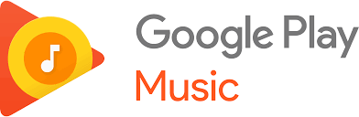
2. Google Play Music
The app can read both your local files and the music you like online.
You can upload tens of thousands of songs to the service for free.

Slide 21
Blue Mail
It features a simple interface, compatibility with virtually every email provider, and it just keeps things clean.
There are also a set of smart settings that can help you customize your experience.
It also has the ability to lock up private emails, widgets, color coding, and a lot more.
It's powerful, simple, and best of all it's completely free to download and use.

Slide 22
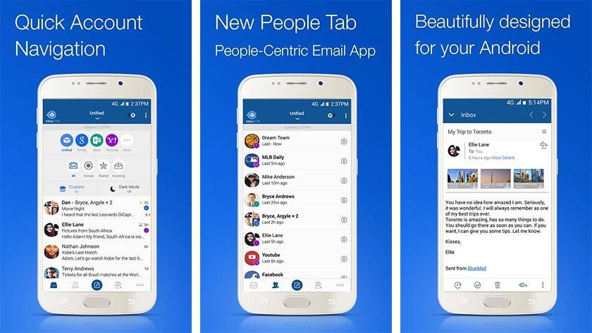
Blue Mail

Slide 23
Advantages & Disadvantages

Slide 24
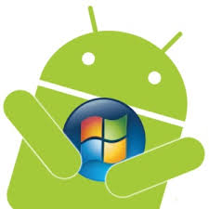

Pro’s
Multitasking.
Ease of notification.
Google Maniac.
Cost Effective.
Great Social Networking.
It lets you change your settings faster.
Video Calling.

Slide 25

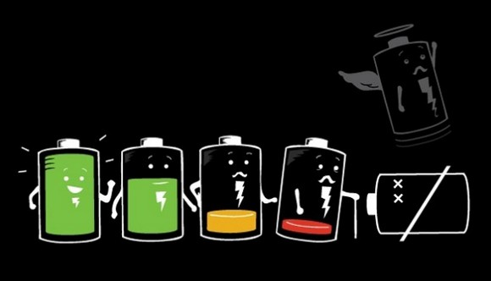
Con’s
Android Advertisements pop – ups.
Battery Drain.
Malware/Virus/Security.
Heat.

Slide 26
Conclusions
Android is open to all : industry , developers and users.
Participating in many of the successful open source projects.
Aims to be as easy to built for as the web.
Allow offline and online modes for apps.

Slide 27
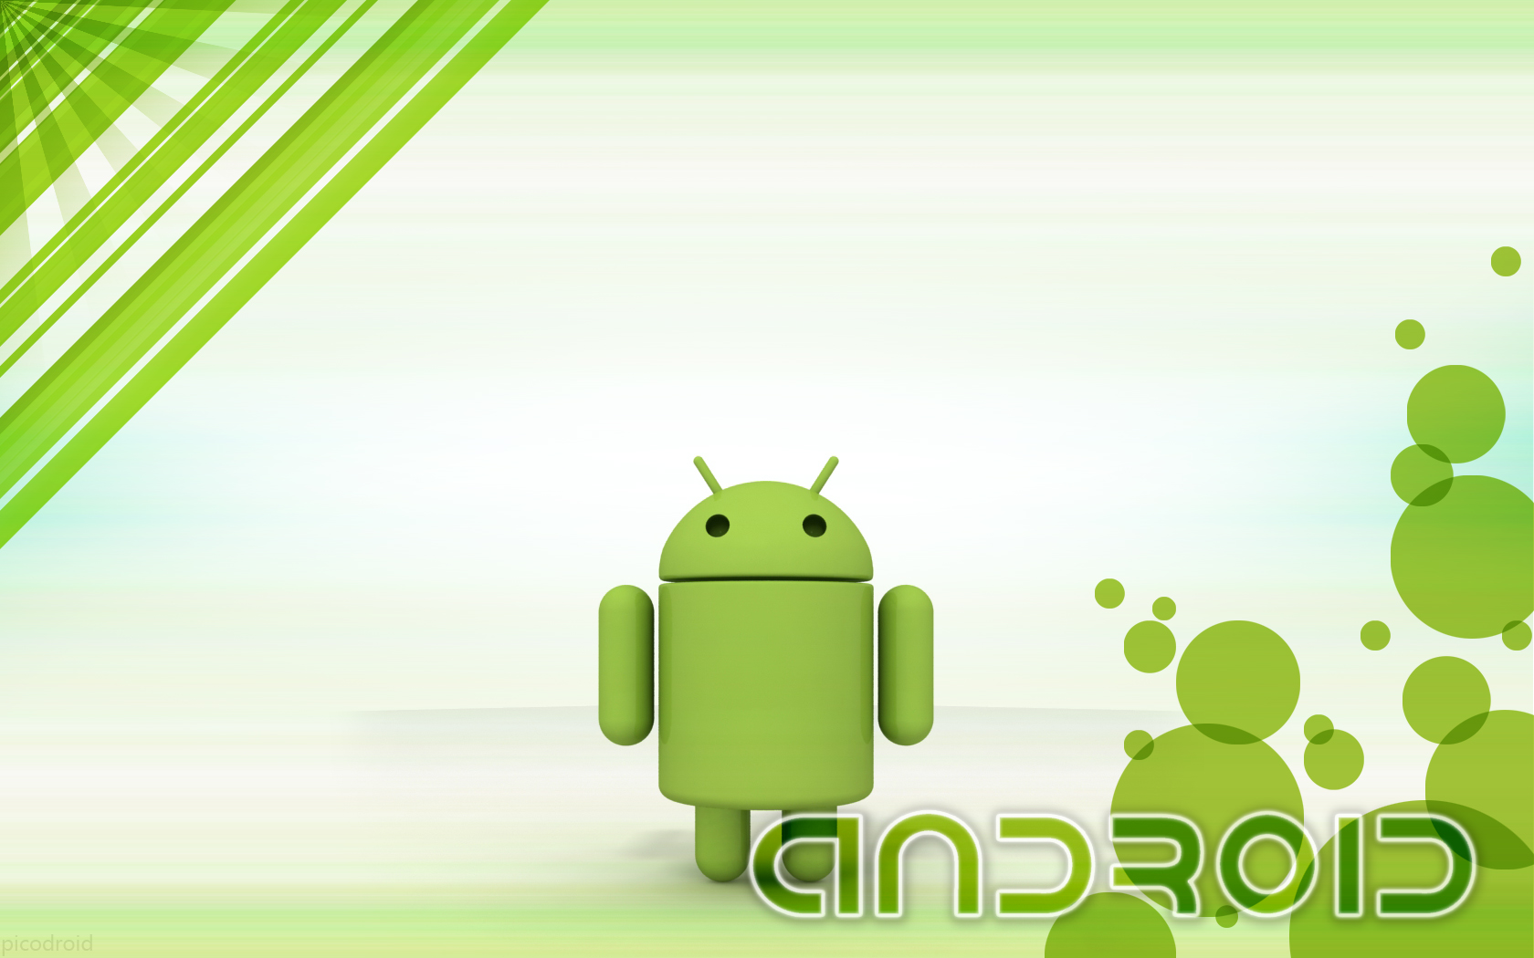
ANY
QUERIES ???

Slide 28

Thank You…

