Slide 1


How to Monitor your Employee’s Attendence? Here Comes Attendance Management System
Any company that has employees knows that it can be time consuming to keep track of everyone's attendance.

Slide 2

Product Description
Attendance Management System:
It is user-friendly, full feature and flexible employee attendance management tool which allows tracking of time and attendance.
Takes up data from time and attendance Terminals ,allows the entry in pc.

Slide 3

Main Functionality
Automatic calculates wages, working hours for any time period of the employee.
Enables us to perform some key HR functions such as vacations, Business trips, absences, e.t.c
Allows us to generate more then 30 types of information and reports, sending automatically via E-Mail.

Slide 4

Main Functionality
Enables to create shifts including our break hours and lunch breaks.
Enables to mange overtime payment rules and holiday payment rules.
Makes analysis of each employee to provide the information about their laziness.

Slide 5

Key Features
Can be used via internet also
Design is based on Client-Server
Fitted with user-friendly interface
Supports unlimited number of users, shifts, division, departments, policies and many others

Slide 6

What are the benefits?
Attendance Management System can improve company’s productivity by many ways:-
Removing mistakes made during calculation hours
Reducing time needed to verify attendance related data
Reducing time for calculated wages and working hours
Reducing time for making in reports and sending them to the required high officials

Slide 7

Why to buy attendance management system?
Have you thought about how much money you can lose just because of employees getting late?

Slide 8

Lets have a simple calculation
Suppose you have 50 employees in your office,
Working for 5 days a week for 8 hours,
Getting 150 000 AMD salary per month,
And being late for 15 min regularly.
Then..

Slide 9

You are Losing
exactly 2 800 00 AMD per year,
+
Money spent on doing calculation manually for employees, working hours,
+
Money spent on report making.

Slide 10

Do you want to save that money, reduce out costs and increase productivity by your employees.
If yes ? Then you are moving ahead on your right track!!

Slide 11

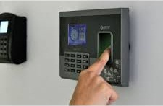
Attendance Management System helps to solve your company attendance related issues and to gain the benefits as following…
Better control over labor force
Support for decision making process
Enhanced worked productivity
Proper usage of financial and human resources

Slide 12
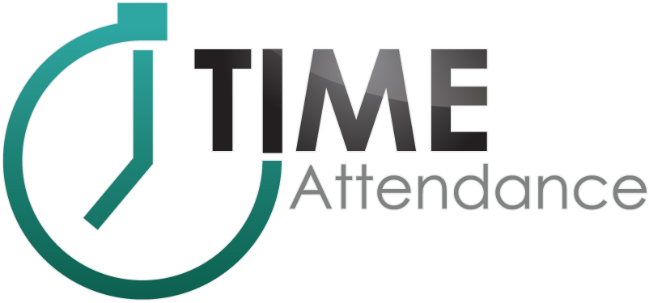
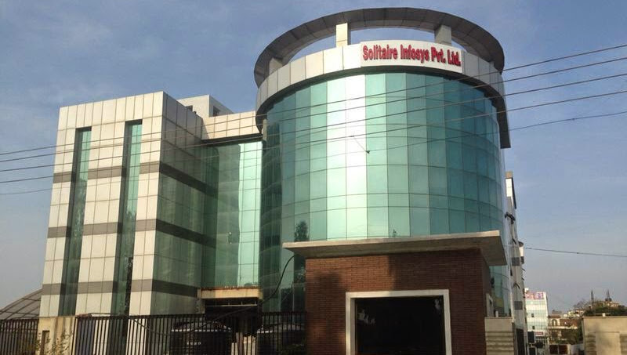
Thanking You
Click Here For More Inquiries Regarding Attendance Management System!
A Product By Solitaire Infosys Inc.
Our Offices-
Address (Canada): SUITE 208,3474-93 STREET NW DMONTON ALBERTA-T6E 6A4 CANADA
Address (India): C-110, Industrial Area Phase-VII, Mohali INDIA Phone: +91-9876656700, +91-9872220856, +91-9915715379

