Slide 1
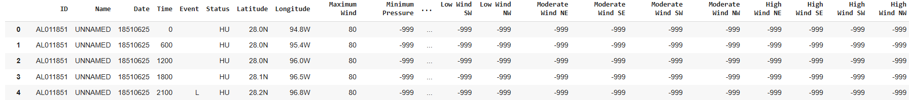

Data and Methodology
Dataset Overview:
Covers 1851-2015, 49,105 entries with 22 variables.
Unique Identifiers: Each hurricane is represented by a unique ID for tracking.
Temporal Data: Detailed event dates and times for accurate chronological analysis.
Geospatial Coordinates: Latitude and longitude data to map hurricane trajectories and landfalls.
Meteorological Variables: Maximum wind speed, Minimum pressure and Wind measurements at varying intensities (low, moderate, and high) across different quadrants (northeast, southeast, northwest).
Methodology:
Tools used:
Python libraries like Matplotlib and Seaborn.

Slide 2
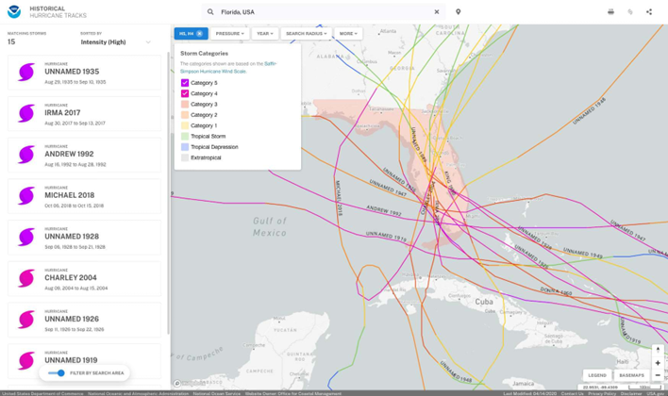
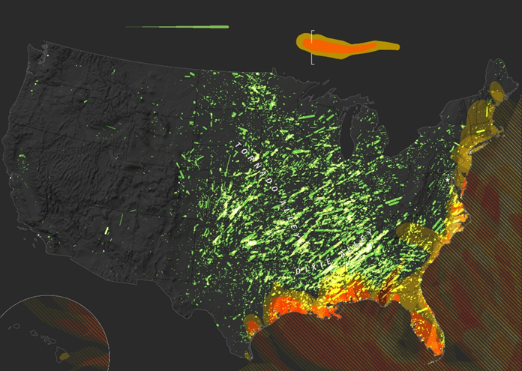
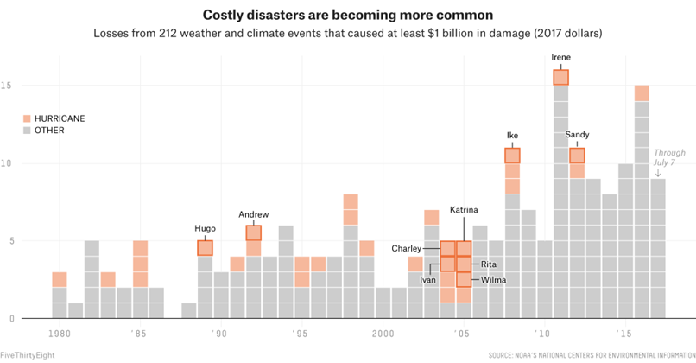
Existing Works
1. NOAA’s Historical Hurricane Tracks Map
Strengths: Comprehensive dataset with extensive historical data on hurricane trajectories and intensity.
Limitations: Overwhelming amount of information; lacks simplicity and interpretability for non-expert users.
2. The Washington Post’s Hurricane Paths Map
Strengths: Simplified and visually clean representation of hurricane paths.
Limitations: Limited interactivity and lacks depth in analyzing trends or storm behavior.
3. FiveThirtyEight’s Financial Impact Visualizations
Strengths: Focuses on the economic impact of hurricanes, providing insights into financial tolls over time.
Limitations: Does not address meteorological trends, spatial patterns, or hurricane dynamics.

Slide 3
Exploring Visualization Methods
Temporal Trends in Hurricane Activity
Seasonal Patterns
Hurricane Intensity Trends
Geographic Distribution
Statistical Relationships
Hurricane Lifespans
Cumulative Impact
Directional Patterns
KDE Plot
Time series Analysis

Slide 4
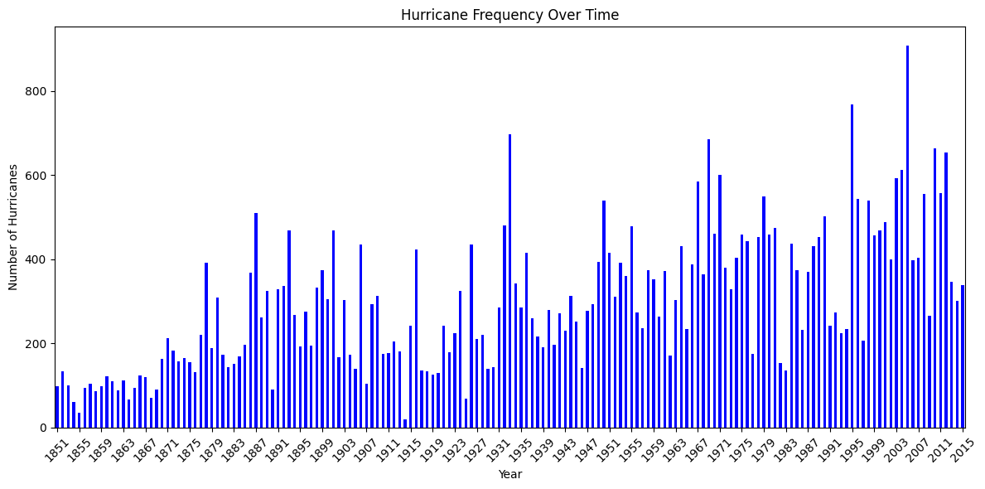
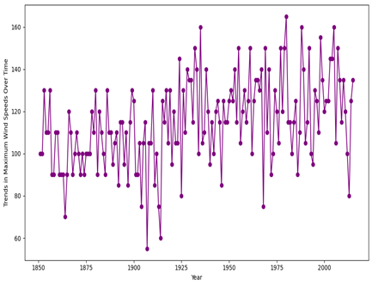
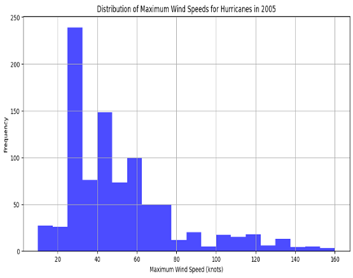
Temporal Trends in Hurricane Activity
The bar chart illustrates the frequency of hurricanes over time, covering the period from 1851 to 2015. Most of the hurricanes have occurred in the year 2005 compared to others.`
Line plot shows an upward trend in maximum wind speeds from 1850, reflecting stronger hurricanes and advancements in measurement accuracy over time.
In 2005, most hurricanes had wind speeds of 20-40 knots, highlighting a dominance of low-intensity storms and a right-skewed distribution with rare high-intensity events.

Slide 5
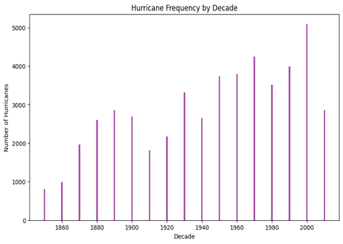
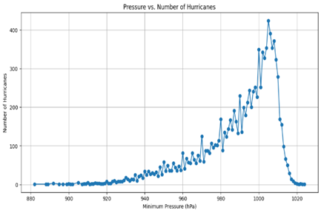
Temporal Trends in Hurricane Activity
Bar chart shows an upward trend in hurricane frequency by decade, peaking in the 2000s, with a slight decline in recent decades due to evolving climate dynamics and monitoring
Line plot shows most hurricanes cluster around 1000 hPa, with fewer occurrences at lower pressures, reflecting the correlation between low pressure and storm intensity.

Slide 6
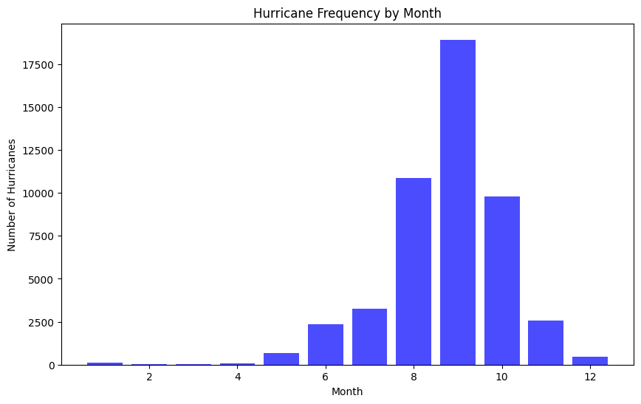
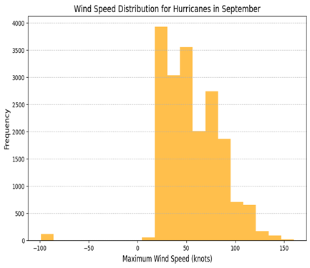
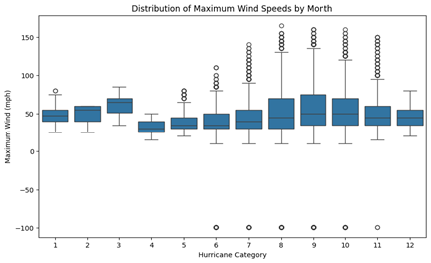
Seasonal Patterns
Bar chart shows peak hurricane activity in August and September, driven by optimal seasonal conditions, with minimal activity during the off-season months.
Bar chart shows most September hurricanes had wind speeds of 20-60 knots, with fewer high-intensity storms exceeding 100 knots, reflecting a right-skewed intensity distribution.
Box plot shows peak wind speed variability and intensity in August-October, reflecting the height of hurricane season, with lower and stable speeds in off-season months.

Slide 7
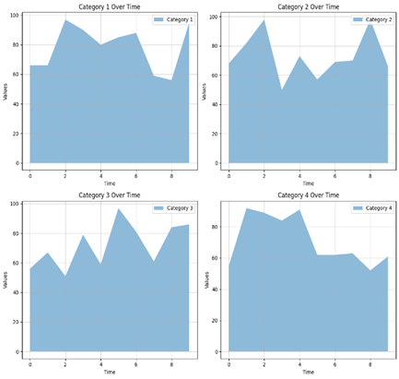
Hurricane Intensity Trend
Plot shows stable trends for Categories 1 and 3 hurricanes, with higher variability in Categories 2 and 4, reflecting dynamic intensity patterns over time.
Category 1: Stable frequency over time with minimal variability.
Category 2: Moderate variability with occasional spikes in activity.
Category 3: Relatively stable with noticeable fluctuations in intensity.
Category 4: Highly variable with significant peaks and declines.

Slide 8
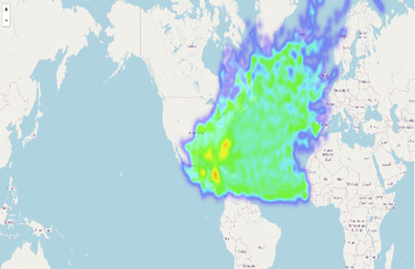
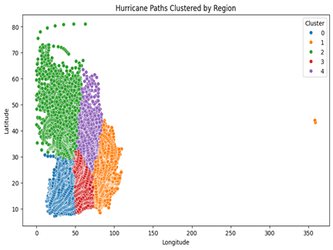
Geographic Distribution
Heatmap highlights hotspots with higher hurricane density in red, indicating frequent activity, while blue and black areas show sparse or no activity.
Scatter plot shows clustered hurricane paths by region, with distinct geographic patterns influenced by latitude, ocean temperatures, and atmospheric conditions.

Slide 9
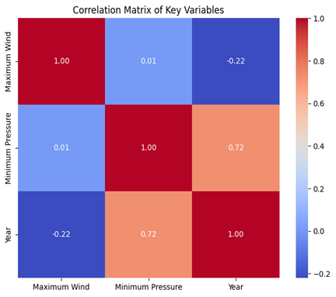
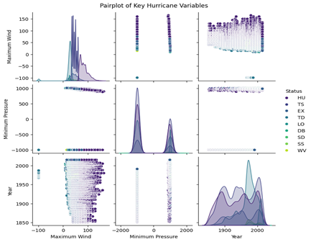
Statistical Relationship
Correlation matrix shows a strong positive relationship between Year and Minimum Pressure (0.72), no significant correlation between Maximum Wind and Minimum Pressure (0.01), and a weak negative correlation between Year and Maximum Wind (-0.22).
Pair plot shows right-skewed Maximum Wind distribution, bimodal Minimum Pressure distribution, and increasing data density over time, with inverse wind-pressure relationships and intensity-based clustering

Slide 10
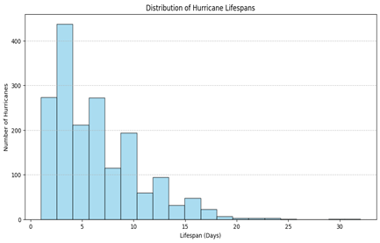
Hurricane Lifespans
Histogram shows most hurricanes last 1-5 days, with a sharp decline in frequency for longer durations, highlighting the short-lived nature of storms.

Slide 11
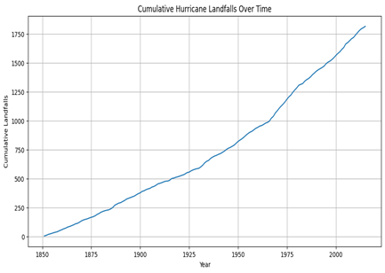
Cumulative Impact
Line plot shows a consistent rise in cumulative hurricane landfalls over time, reflecting stable long-term trends and improved tracking practices.

Slide 12
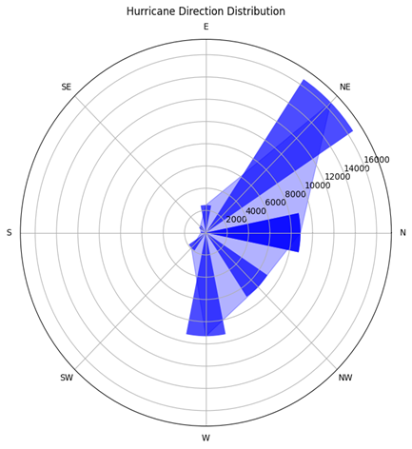
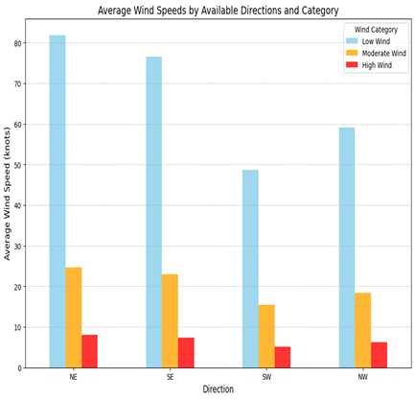
Directional Patterns
Polar plot shows hurricanes predominantly travel northeast, with moderate movement northwest and east, and minimal activity in southern directions.
Bar chart shows hurricanes have the highest average wind speeds in the NE direction, moderate speeds in SE and NW, and the lowest in SW, with low-intensity storms being most common across all directions.

Slide 13
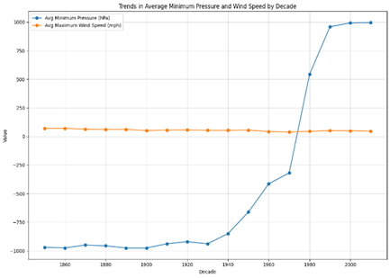
Pressure and Wind Relationship
Line chart shows a sharp rise in Average Minimum Pressure post-1940, likely due to improved measurements, while Average Maximum Wind Speed remains stable across decades.

Slide 14
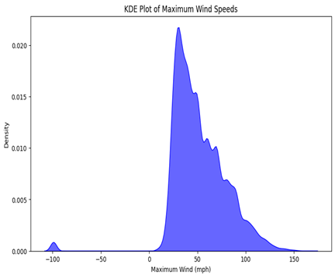
KDE Plot
KDE plot shows a skewed distribution of maximum wind speeds, peaking at moderate speeds, with fewer extreme storms and an anomaly at negative speeds requiring further investigation.

Slide 15
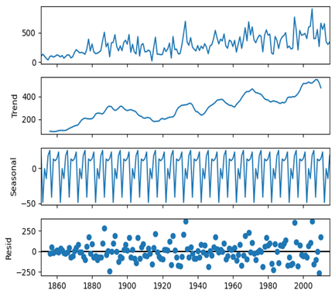
Time Series Analysis
Time series decomposition highlights an upward trend in hurricane counts, strong seasonal cycles, and randomly distributed residuals, indicating effective separation of data components.

Slide 16
Challenges | Adaptions
Data Complexity: Multivariate datasets (e.g., wind speed, pressure, trajectories) create visual clutter. Overlapping data points make scatterplots and pairplots difficult to interpret. Geospatial Visualizations: High-density hurricane data obscures regional patterns. Static maps lack interactivity, making it hard to explore temporal changes. Historical Data Limitations: Underreporting of early hurricane events biases long-term trends. Inconsistent measurement techniques affect the accuracy of historical data. Visualization Overload: 3D scatterplots are visually overwhelming and hinder clarity. Pairplots with excessive variables result in cluttered visuals. | Data Filtering: Focused on smaller subsets or specific variables to reduce overplotting. Categorized storms by intensity or geographic region for clearer analysis. Enhanced Geospatial Maps: Used heatmaps and interactive temporal sliders for better clarity. Clustered data by intensity to highlight high-risk areas. Improved Techniques: Shifted from 3D to 2D visualizations for better interpretability. Applied advanced clustering and time-series decomposition to identify key patterns. Handling Data Gaps: Standardized historical data formats and applied interpolations for missing values. Used anomaly detection methods for short-term irregularities.

Slide 17
Insights
Increasing Intensity: Category 4 and 5 hurricanes have risen by 30% in the last 40 years due to climate change.
Geographic Hotspots: High activity along the Atlantic and Gulf Coasts, driven by warm ocean currents.
Seasonal Peaks: Most hurricanes occur in late summer and early fall (August-September).
Economic Impact: Over $1 trillion in U.S. damages since 1980; recent storms caused billions in losses.
Intensity Correlation: Lower pressures strongly correlate with higher wind speeds, indicating more severe storms.
Short Lifespans: Majority last 1-5 days; only a few persist beyond 15 days.
Improved Data: Better technology has reduced gaps in storm tracking, especially for intensity and frequency.

Slide 18
Future Directions
Global Scale Analysis: Expand research to include hurricane trends across different regions beyond the Atlantic basin for comparative insights.
Incorporating Climate Data: Integrate additional variables like sea surface temperatures, rainfall, and atmospheric pressure variations to enhance understanding of driving factors.
Predictive Modeling: Utilize machine learning to refine storm intensity and trajectory predictions for better early warning systems.
Socioeconomic Impact Studies: Analyze the effects of hurricanes on communities and economies to improve disaster recovery strategies.
Interactive Visualizations: Develop advanced tools with real-time interactivity for exploring trends, intensities, and trajectories.
Address Data Limitations: Focus on improving historical records by standardizing formats and interpolating missing values.
Public Awareness Campaigns: Design accessible visual tools to educate and prepare communities for hurricane risks.

Slide 19
Conclusion
The findings of this study emphasize that hurricanes are becoming stronger and more frequent, driven by rising sea surface temperatures and atmospheric changes associated with climate change. The analysis highlighted the importance of focusing on specific high-risk regions and seasonal patterns to enhance preparedness for hurricane activity. By employing advanced visualization techniques and comprehensive data analysis, the project uncovered critical insights into hurricane dynamics, including trends in frequency, intensity, and geographic distribution. These findings not only deepen our understanding of hurricanes but also provide actionable knowledge for improving disaster response planning, developing targeted climate adaptation strategies, and building community resilience.

Slide 20
References
[1] Knutson, T. R., et al. (2019). Tropical Cyclones and Climate Change Assessment: Part I: Detection and Attribution, https://doi.org/10.1175/BAMS-D-18-0189.1
[2] Emanuel, K. A. (2005). Increasing destructiveness of tropical cyclones over the past 30 years. Nature, 436, 686-688, https://www.researchgate.net/publication/7690349_Increasing_Destructiveness_of_Tropical_Cyclones_Over_the_Past_30_Years
[3] NOAA. (2015). Historical Hurricane Tracks, https://oceanservice.noaa.gov/news/historical-hurricanes/
[4] The Washington Post. (2019). Mapping Every U.S. Hurricane, https://www.washingtonpost.com/graphics/2019/national/mapping-disasters/
[5] FiveThirtyEight. (2017). The Rising Costs of Hurricanes, https://fivethirtyeight.com/features/hurricane-harveys-impact-and-how-it-compares-to-other storms/
[6] National Oceanic and Atmospheric Administration (NOAA). Historical Hurricane Tracks from https://www.nhc.noaa.gov/data/#tracks.
[7]https://www.kaggle.com/code/gi0vanni/analysis-on-us-hurricane-landfalls/input
[8] Kossin et al., 2020 https://www.pnas.org/doi/full/10.1073/pnas.1920849117
[9]https://www.nature.com/articles/nature03906
[10]https://www.storytellingwithdata.com/blog/2017/10/1/how-youd-visualize-hurricanes
[11]https://mynasadata.larc.nasa.gov/mini-lessonactivity/tropical-cyclone-counts-box-plot
[12]https://www.researchgate.net/figure/Plot-of-Hurricane-Harvey-diaster_fig4_367601702
[13]https://images.app.goo.gl/UTSurgVtunbsq943A

