Slide 1
Sacred Heart Degree College Naipalapur Sitapur
BCA Department
Major Project Presentation
On
“Online Mobile Shopping”
Group Name:- A10
Presented By:- Hamza Khan
Harshit Gupta
Mohd. Faiz
BCA 3rd Year
Supervised By :- Mr. Ali Niazi Sir

Slide 2


Slide 3
Contents
Introduction
Objective
Requirements & Specification
Frontend
Backend
Modules
Data Flow Diagram
ER Diagram
Conclusion
Bibliography

Slide 4
Introduction
“Online MoBILE SHOPping” project is aimed at developing a Web application that depicts online Shopping of mobiles and purchasing using Payment Gateway.
Using this software, companies can improve the efficiency of their services. Online Shopping is one of the applications to improve the marketing of the company’s products. This web application involves all the features of the online shopping.

Slide 5
Objective
This web based software helps customer to find different mobiles, their features, and new updates easily.
Designed in such a way that one can view all the updates of the mobiles.
Easy maintaining and updating products.
Quick and easy comparison of different products.
This system will reduce the manual operation.
Main concept of the project is to enter transaction reports and to maintain customer records.
This web based software can be used in any mobile showroom to maintain their record easily.

Slide 6



Software Specification
Frontend
HTML
CSS
Javascript
JQuery
Backend
MySQL
Technology
PHP
Notepad++
Chrome
XAMPP

Slide 7



H/W and S/W Requirements
Processor
450 MHz Pentium II-class processor and above.
OS
Any standard Edition
Memory
512MB and above
Hard disk
Minimum space required 1GB
Intel P II
Windows
RAM

Slide 8
Modules
Login- Admin & User
New user
Manage Account- Admin & User
Product Categories/Series
Product
Cart
Payment
Stocks
Manage Order- Admin & User

Slide 9
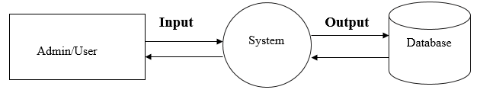
Data Flow Diagram
LEVEL 0

Slide 10
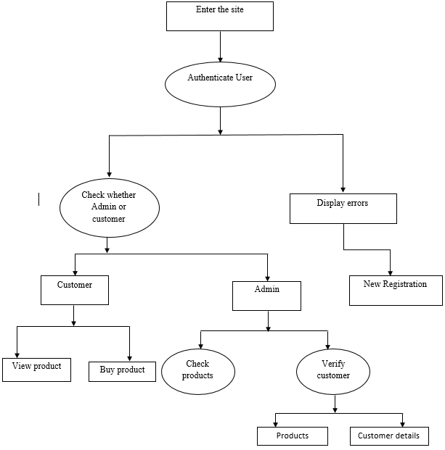
LEVEL 1

Slide 11
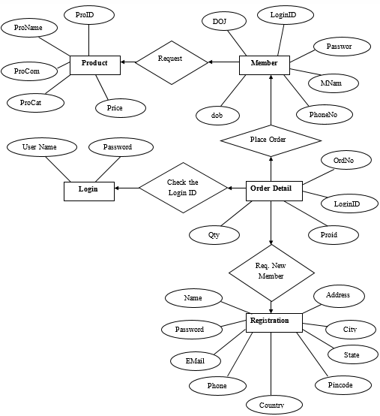
ER Diagram

Slide 12
Conclusion
Simple or Easy Understandable
Secure
Robust
User-friendly
Form Validation
Time Saving

Slide 13
Bibliography
www.google.com
www.w3school.com
www.tutorialspoint.com
www.bootstrap.com
www.youtube.com

Slide 14



