Slide 1
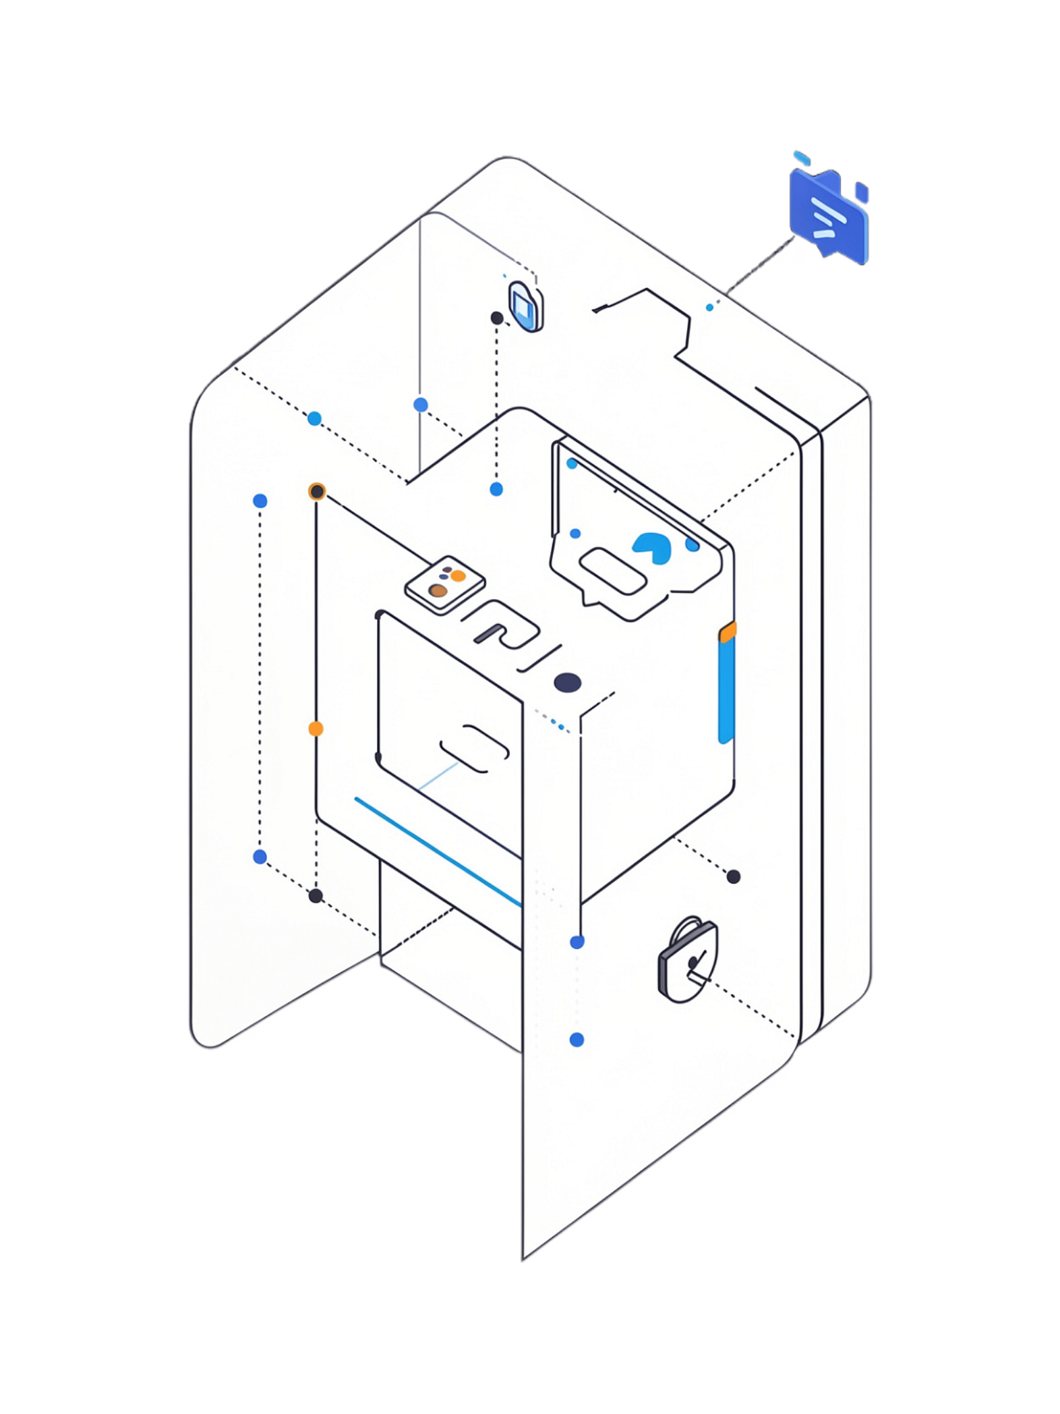
Design and Simulation of a Digital Access Card Verification System Using XOR/XNOR Logic
A 4-bit hardware authentication system for academic study in digital logic design.

Slide 2

Project Overview
4-Bit System
XOR / XNOR Logic
Develops a digital access card verification system using 4-bit binary codes
Uses XOR and XNOR gates for precise, secure bit-level authentication
Real-Time Comparison
Compares stored card code with entered code instantly at every bit position

Slide 3
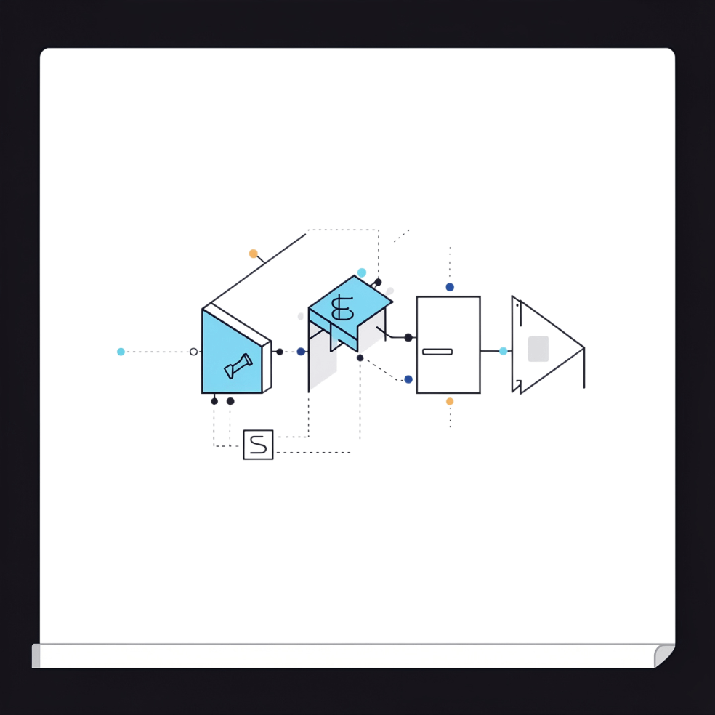

Why XOR/XNOR Logic?
XOR Gate
XNOR Gate
Ideal for Verification
Outputs 1 when inputs differ (A ≠ B) — flags a mismatch
Outputs 1 when inputs match (A = B) — confirms equality
Perfect for equality checking and bit-level authentication tasks

Slide 4
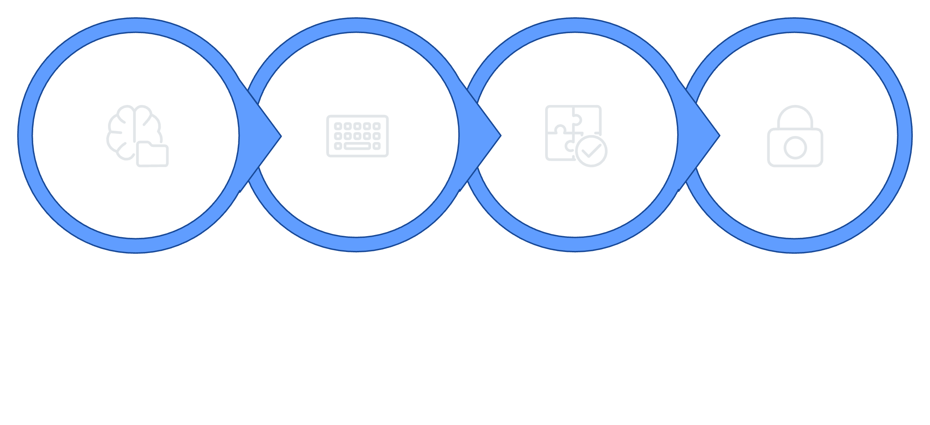
4-Bit System Architecture
XNOR Verification
Stored Code
Input Code
Output
Each stage processes one 4-bit word — the system performs a parallel, bit-by-bit comparison in a single clock cycle.

Slide 5
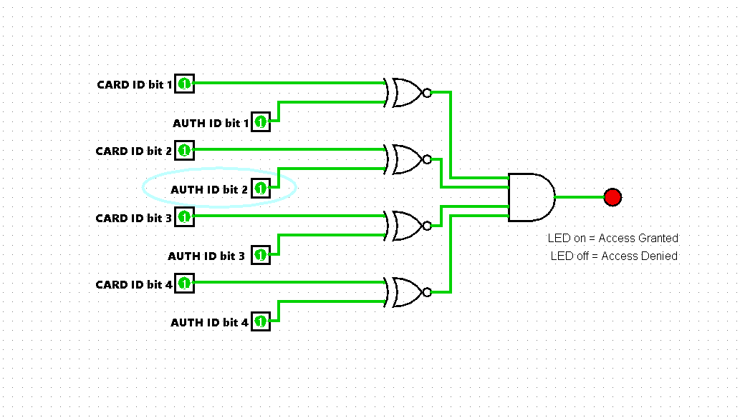

Slide 6
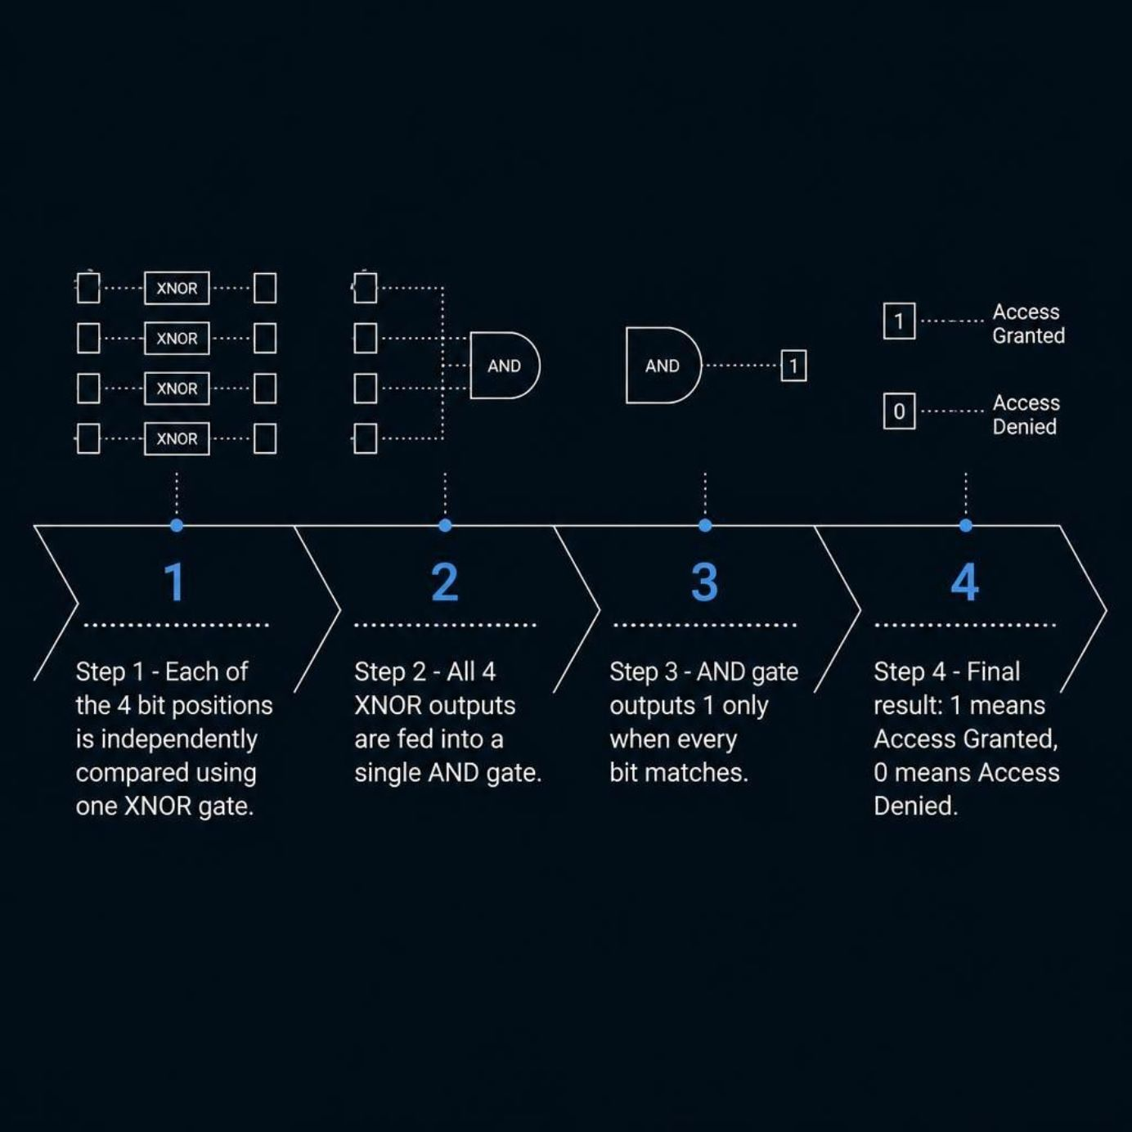

How the Verification Works
The Logic Chain
The verification pipeline is elegant in its simplicity:
Each bit position gets its own dedicated XNOR gate
All 4 XNOR outputs converge at a single AND gate
The AND gate enforces a strict all-or-nothing rule
Output 1 = Access Granted | Output 0 = Access Denied
Even a single mismatched bit drives the final output to 0.

Slide 7
Truth Table Example
Stored Code | Input Code | XNOR Bits | AND Output | Result
1 0 1 0 | 1 0 1 0 | 1 1 1 1 | 1 | Granted
1 0 1 0 | 1 0 1 1 | 1 1 1 0 | 0 | Denied
1 0 1 0 | 0 0 1 0 | 0 1 1 1 | 0 | Denied
Key Insight
The system rejects any code with even a single-bit mismatch. The XNOR gate at that position outputs 0, which forces the AND gate — and the entire verification — to fail.
This zero-tolerance behavior is what makes XOR/XNOR logic ideal for security applications.

Slide 8
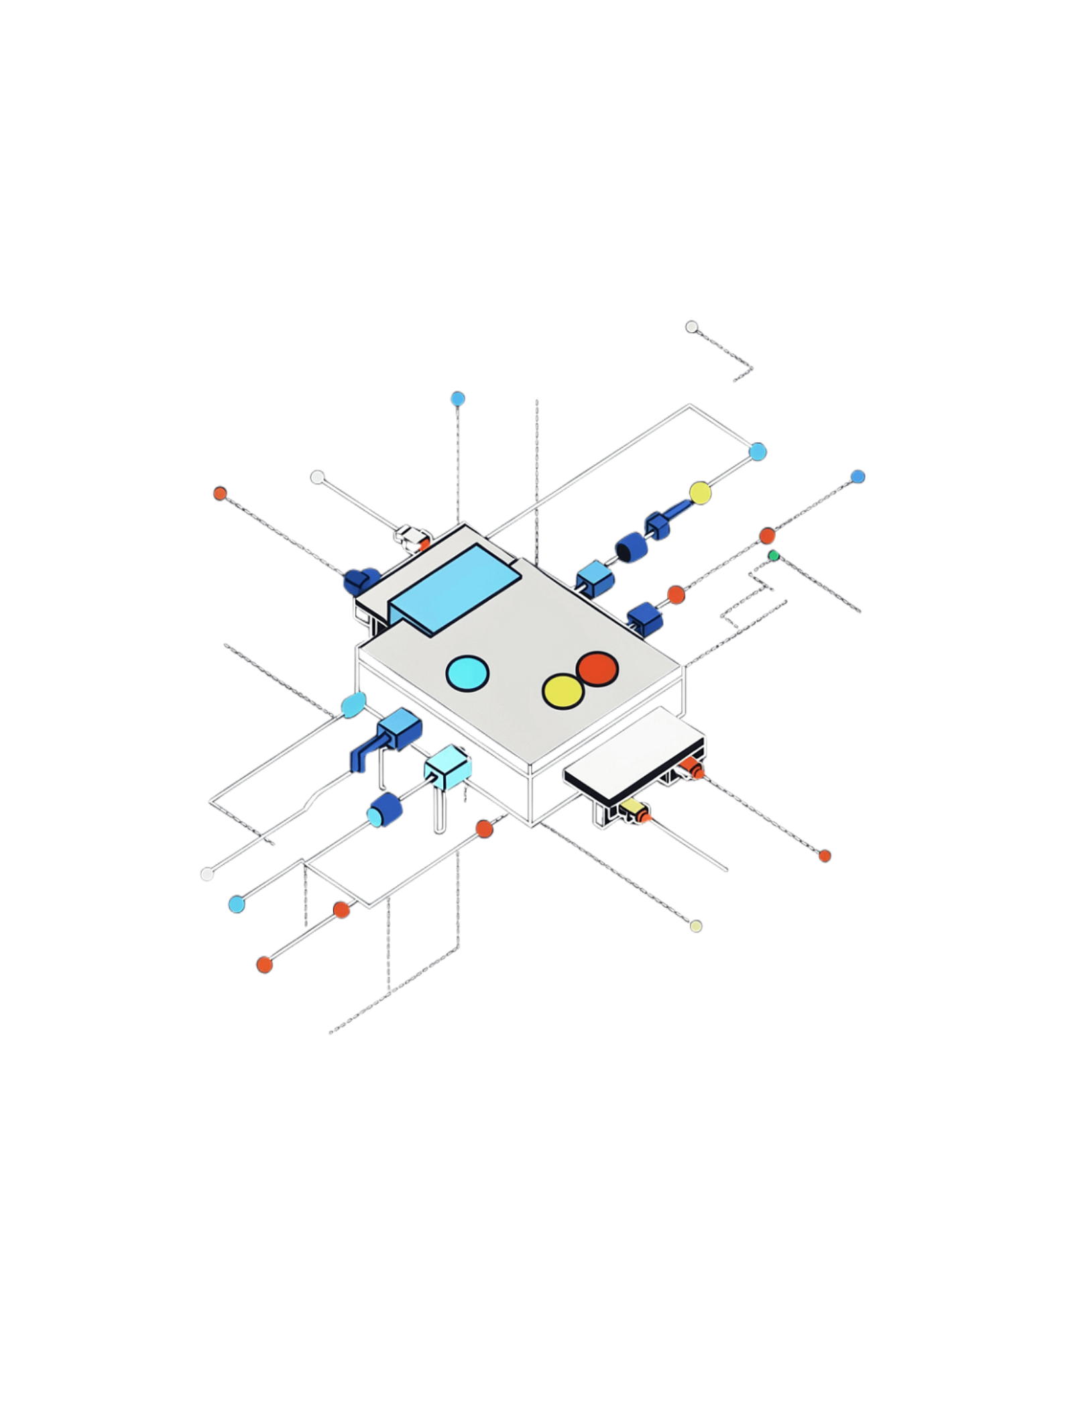




Circuit Implementation
4 × XNOR Gates
One gate per bit position — each performs a single equality comparison
1 × AND Gate
Combines all four XNOR outputs into a single pass/fail decision
LED Indicator
Visual output — lights up green for access granted, red for denied
Scalable Design
Simple, efficient architecture that scales cleanly to wider bit widths

Slide 9
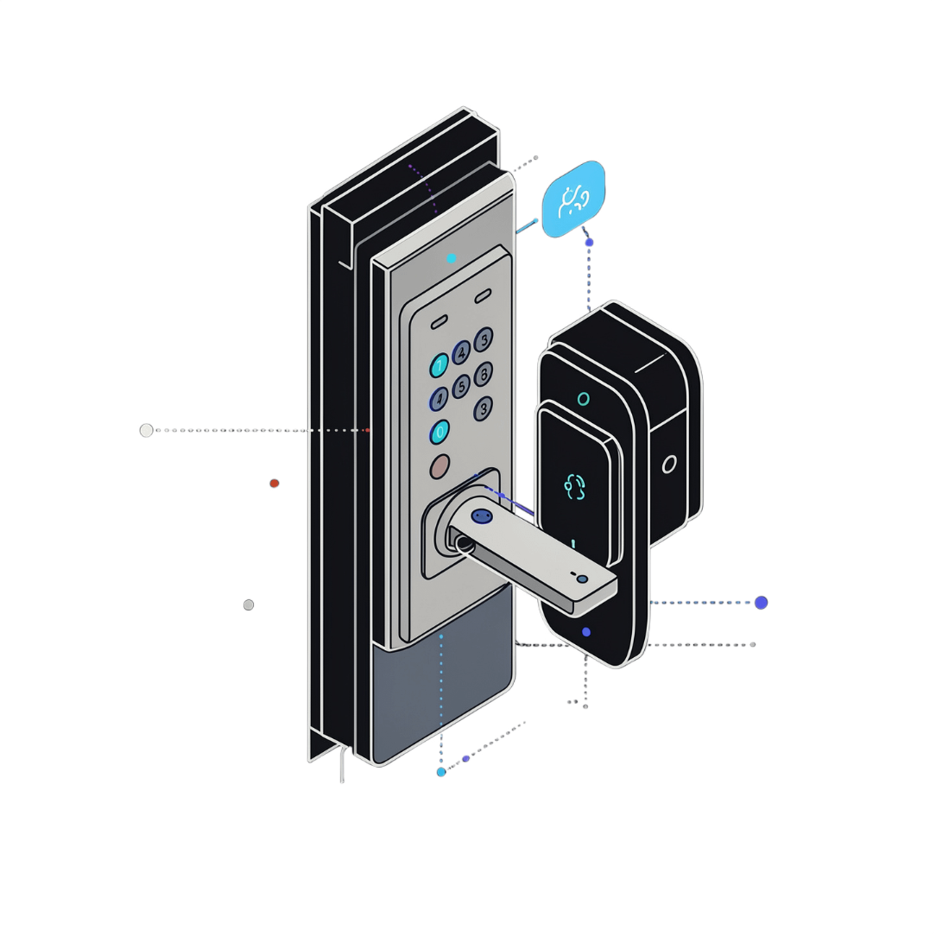
Applications & Future Scope
Real-World Security
Scalable to Higher Security
Security systems, door locks, and ATM card verification
Extend to 8-bit or 16-bit systems for exponentially more combinations
Foundation for Cryptography
Core building block for modern cryptographic and encryption systems

