Slide 1
VIVA-VOCE ADVANCED TRAFFIC NAVIGATION SYSTEM
PIP104 University Project-II
Batch Number: CSE-G155
Roll Number | Student Name
20201CSE0803 | Harshith Kumar R
20201CSE0804 | Piyanshu Gupta
20201CSE0806 | Shreyas S
Under the Supervision of,
Dr. MANISH M GOSWAMI
Associate Professor
School of Computer Science & Engineering
Presidency University

Slide 2
Introduction
Enhancing Navigation System for Rainy Days in Bangalore:
In tackling the issues brought on by heavy rain and traffic congestion, our proposal to improve Bangalore's rainy-day navigation system is a major step forward. Our method offers a useful way to help commuters navigate the city in bad weather by combining reliable traffic data with real-time rainfall accumulation statistics.
A flawless and secure travel experience is ensured by the user-friendly UI, turn-by-turn navigation, and timely weather notifications. On wet days, commuters can make their travels more effective and pleasurable by saving time, using less gasoline, and reducing stress associated with traveling. In a world where urbanization and weather patterns are always changing, our initiative provides a window into what may be achieved when technology is used to improve commuters' everyday experiences. We're excited to see this idea come to pass and improve people's ability to deal with rainy days in Bangalore and beyond.

Slide 3
Literature Review
Serial No. | Reference Models | Abstract
1 | https://developers.google.com/maps/documentation/javascript/overview#maps_map_simple-javascript | The Maps JavaScript API lets you customize maps with your own content and imagery for display on web pages and mobile devices.
2 | Vulnerability assessment of flood-affected locations of Bangalore by using multi-criteria evaluation-N.N Rama Prasad,Priya Narayan | Results from this investigation intuit in building a self-sufficient eco-friendly sustainable smart city that conserves the rainwater and avoid flooding in low-lying regions.

Slide 4
Literature Review
Serial No. | Reference Models | Abstract
3 | https://www.thehindu.com/news/cities/Kochi/gps-signal-effective-in-forecasting-extreme-rainfall-say-researchers/article66470881.ece | The study, using continuous GPS and rainfall data from Thiruvananthapuram, showed that any heavy rainfall event could be detected in advance using the delay in GPS signals.
4 | Traffic Status Evolution Trend Prediction Based on Congestion Propagation Effects under Rainy Weather -Yongjie Xue,Rui Feng, Shaohua Cui | The accurate prediction of traffic status not only helps road traffic managers to formulate traffic management methods but also helps travelers design travel routes and even adjust travel time.

Slide 5
Literature Review
Serial No. | Reference Models | Abstract
5 | Identification and Analysis of Weather-Sensitive Roads Based on Smartphone Sensor Data: A Case Study in Jakarta -Chao-Lung Yang | Experimental results show that the proposed method can cluster the roads according to the pattern changes in the traffic speed caused by weather change.
6 | Examining the effect of adverse weather on road transportation using weather and traffic sensors -Yichuan Peng, Yuming Jiang, Yajie Zou,Jian Lu | To develop effective intelligent transportation system (ITS) strategies to mitigate the negatives of these different types of adverse weather related to reduced visibility by studying the effect of rain and fog on traffic parameters.

Slide 6
Literature Review
Serial No. | Reference Models | Abstract
7 | Impact of Rainfall Condition on Traffic Flow and Speed: A Case Study in Johor and Terengganu -Nordiana Mashros, Johnnie Ben-Edigbe, Sitti Asmah Hassan. | Explores the impact of various rainfall conditions on traffic flow and speed using data collected on two-lane highway. The study aims to quantify the effect of rainfall on average volume, capacity, mean speed, free-flow speed and speed at capacity.
8 | Traffic Guidance for Inclement Weather using GPS Navigation System -G.Sandeep S.Shanmathi K.Sahiti Keerthana | GPS Navigation System is used where in, the user is guided to use an alternative path to their destination.

Slide 7
Literature Review
Serial No. | Reference Models | Abstract
9 | Assessing the impact of heavy rainfall on the Newcastle upon Tyne transport network using a geospatial data infrastructure. -Kristina Wolf a, Richard J. Dawson a b, Jon P. Mills a, | Historical and high-resolution temporal real-time data to identify districts and roads that are prone to different types of incidents during inclement weather and to better support emergency services in their decision-making.
10 | Joint Impact of Rain and Incidents on Traffic Stream Speeds -Mohammed Elhenawy,1Hesham A. Rakha | Investigates the effect of precipitation and incidents on the speed of traffic in the eastbound direction of I-64 in Virginia.

Slide 8
Some current solutions to the problem
Few solutions already implemented to the above stated problem are:
Advance Traffic Information and Management System (ATIMS) under implementation in parts of Bengaluru city comprises of two components:
B-TIC (Bengaluru Traffic Information Center)
2. ATCS (Advanced Traffic Control System)
The Advanced Traffic Management System(ATMs) is a revolution for highways.
Aimsun Live is a real-time predictive traffic management solution.
The following slides will dive deep into the different advantages of the above solutions and where it leaves something to be desired.

Slide 9
Advantages to the first solution-ATIMS
Improved Traffic Management: ATIMS aims to enhance traffic management through real-time data from various sources, such as BMTC Bus GPS Probe Data, ATCC, and QLMS.
Data-Driven Decision Making: The system facilitates transport planning agencies in making informed decisions by collating and analyzing mobility data.
Dynamic Traffic Information: B-TIC provides dynamic traffic information to various stakeholders, including Bengaluru Traffic Police and transport corporations, aiding in better response to traffic conditions.
Reduced Congestion: By analyzing congestion hotspots, authorities can take proactive measures to alleviate traffic congestion, potentially leading to smoother traffic flow.
Improved Traffic Management: ATIMS aims to enhance traffic management through real-time data from various sources, such as BMTC Bus GPS Probe Data, ATCC, and QLMS.
Data-Driven Decision Making: The system facilitates transport planning agencies in making informed decisions by collating and analyzing mobility data.
Dynamic Traffic Information: B-TIC provides dynamic traffic information to various stakeholders, including Bengaluru Traffic Police and transport corporations, aiding in better response to traffic conditions.
Reduced Congestion: By analyzing congestion hotspots, authorities can take proactive measures to alleviate traffic congestion, potentially leading to smoother traffic flow.

Slide 10
Disadvantages to the first solution-ATIMS
Initial Implementation Costs: Setting up the ATIMS infrastructure, including sensors and control systems, may involve high initial implementation costs.
Maintenance Challenges: Ongoing maintenance of the technology, including ATCC and QLMS sensors, might pose challenges and require significant resources.
Privacy Concerns: Collecting real-time data from sources like BMTC Bus GPS Probe Data raises potential privacy concerns for individuals using public transportation.
Dependency on Technology: The effectiveness of ATIMS relies heavily on the proper functioning of technology, and any technical glitches or failures could impact its performance.
Limited Coverage: The system's benefits may be confined to specific areas where sensors are installed, potentially leaving out suburban or less-developed areas.
Traffic Diversion: Drivers may alter their routes based on the dynamic traffic information, leading to potential traffic diversion issues in other areas.
Data Security Risks: Handling sensitive traffic data requires robust cybersecurity measures to prevent unauthorized access or potential data breaches.
Community Acceptance: The introduction of new traffic management systems may face resistance or skepticism from the community, requiring effective communication and public awareness efforts.

Slide 11
Advantages to the second solution-ATMs
Real-time Information: ATMS provides real-time information on weather conditions, road congestions, and maintenance activities, allowing road users to make informed decisions.
Emergency Assistance: The system offers round-the-clock emergency and traffic assistance, ensuring a prompt response to incidents and accidents on highways.
Monitoring and Mitigation: ATMS monitors and mitigates driving violations, contributing to improved road safety and reduced accidents.
Data-Driven Decision Making: The use of high-tech equipment, such as PTZ cameras, ATCC, and VMS, allows for data-driven decision-making in traffic management.
Fast Project Implementation: The article highlights a record-breaking completion time for an ATMS project, demonstrating efficiency and effectiveness in project implementation.
Zero Harm Policy: The commitment to a "Zero Harm" policy emphasizes a focus on health, safety, security, and environmental performance, promoting best practices in these areas.
Global Benchmarks: Setting industry standards and completing projects in record time positions the ATMS as a benchmark for similar projects globally.
Comprehensive Dashboard: The ATMS Dashboard provides a holistic view of equipment status and data, enhancing the overall monitoring and management capabilities.

Slide 12
Disadvantages to the second solution-ATMs
High Initial Costs: Implementing and maintaining a sophisticated ATMS infrastructure, including advanced equipment, may involve substantial initial costs.
Technological Dependency: The effectiveness of ATMS relies on advanced technology, and any technical failures or glitches could impact its performance.
Privacy Concerns: The use of surveillance cameras and data collection systems raises privacy concerns, requiring careful management of collected information.
Limited Coverage: The benefits of ATMS may be limited to specific areas covered by the installed equipment, potentially leaving out less-developed or remote regions.
Traffic Diversion: Real-time updates on road conditions may lead to traffic diversion, causing congestion or safety issues in alternative routes.
Maintenance Challenges: Ongoing maintenance of high-tech equipment, such as PTZ cameras and VMS, may pose challenges and require skilled technicians.
Community Acceptance: Introduction of surveillance and control systems may face resistance from the community, necessitating effective communication and awareness programs.
Environmental Impact: The production and maintenance of advanced equipment may have environmental implications, requiring consideration of sustainable practices.

Slide 13
Advantages to the third solution-AIMSUN Live
Real-time Predictive Traffic Management: Aimsun Live provides a real-time predictive traffic management solution, allowing traffic management centers to preemptively address potential congestion issues.
Full Digital Twin: The system offers a detailed representation of individual lanes, traffic control devices, vehicles, and traffic management actions, creating a comprehensive digital twin for effective decision-making.
AI-driven Predictions: Aimsun Live utilizes AI to fill in information gaps, enabling predictions across the network even where detectors are not present.
Adaptability to New Situations: The system can estimate the impact of events that haven't been experienced in the past, enhancing its adaptability to changing traffic conditions.
System Automation: Aimsun Live can run continuously 24/7 and deploy traffic management decisions without human intervention in authorized scenarios, ensuring constant monitoring and response.
Ultra Large Scale Simulation: The capability to simulate at a city or even regional scale allows for a comprehensive assessment of traffic conditions over extensive areas.
Integration with Existing Infrastructure: The system seamlessly integrates with existing traffic management infrastructure, providing flexibility and compatibility.
Continuous Improvement with Machine Learning: Aimsun Live continuously improves the accuracy of its forecasts through machine learning, comparing forecast performances against real field measurements.

Slide 14
Disadvantages to the third solution-AIMSUN Live
High Initial Costs: Implementing and maintaining a real-time predictive traffic management solution, especially one with AI capabilities, may involve significant initial costs.
Technological Dependency: The system's effectiveness relies on advanced technology, and any technical failures or glitches could impact its performance.
Privacy Concerns: The use of real-time data and simulations raises potential privacy concerns, especially when emulating individual vehicles and traffic management actions.
Limited Coverage: The benefits of Aimsun Live may be limited to areas covered by the simulation, potentially excluding less-developed or remote regions.
Traffic Diversion: Real-time predictions may lead to traffic diversion, causing congestion or safety issues in alternative routes.
Maintenance Challenges: Ongoing maintenance of a system with complex components, such as emulation of signal control systems, may pose challenges and require specialized expertise.
Community Acceptance: Introducing simulation-based traffic management may face resistance from the community, necessitating effective communication and awareness efforts.
Environmental Impact: The production and maintenance of advanced simulation equipment may have environmental implications, requiring consideration of sustainable practices.

Slide 15
Objectives
The research gaps present in the solutions for the problem are:
Privacy Concerns
Limited Coverage
Traffic Diversion
Maintenance Challenges
Community Acceptance
Now the objectives of our project learning from these research gaps and also the appropriate compensations to mitigate these research gaps are:
Privacy-Preserving Traffic Simulation Framework:
Objective: Develop a privacy-preserving traffic simulation framework that utilizes homomorphic encryption or federated learning to ensure the confidentiality of individual vehicle and user data.
Reasoning: Homomorphic encryption allows computations on encrypted data without decryption, ensuring privacy, while federated learning enables model training across decentralized devices, minimizing the need for centralized data storage.

Slide 16
Objectives
2.Distributed Traffic Management System:
Objective: Implement a distributed traffic management system that extends the coverage to less-developed or remote regions by leveraging edge computing and decentralized decision-making algorithms.
Reasoning: Edge computing brings computational power closer to the data source, enhancing coverage in areas with limited infrastructure. Decentralized decision-making reduces dependence on a central server and ensures adaptability to diverse traffic conditions.
3.Dynamic Traffic Diversion Optimization Algorithm:
Objective: Develop an algorithm for dynamic traffic diversion optimization that considers real-time predictions and adapts diversion strategies to minimize congestion and enhance safety in alternative routes.
Reasoning: Dynamic optimization algorithms, such as reinforcement learning or genetic algorithms, can continuously adapt diversion strategies based on changing traffic conditions, providing a more responsive and adaptive approach.

Slide 17
Objectives
4.Predictive Community Engagement Platform:
Objective: Create a predictive community engagement platform that uses data-driven insights to proactively communicate with the public about the benefits and implications of simulation-based traffic management.
Reasoning: Leveraging data analytics and predictive modeling can help anticipate community concerns and tailor communication strategies, fostering transparency and building trust.
5.Self-Healing Traffic Management System:
Objective: Develop a self-healing traffic management system that employs autonomous diagnostics and maintenance algorithms to address operational disruptions and minimize downtime.
Reasoning: Self-healing systems, utilizing machine learning-based fault detection and resolution, can autonomously identify and address maintenance challenges, ensuring continuous and reliable operation.

Slide 18
Methodology
Some of the softwares which could be used to bring to life the solutions mentioned in the previous slide:
Privacy-Preserving Traffic Simulation Framework:
omomorphic Encryption Libraries:
Example: Microsoft SEAL, TenSEAL.
Purpose: To perform computations on encrypted data without decryption.
Federated Learning Framework:
Example: TensorFlow Federated.
Purpose: To train machine learning models across decentralized devices.
Distributed Traffic Management System:
Decentralized Decision-Making Algorithms:
Example: Blockchain-based algorithms, Distributed Machine Learning.
Purpose: To enable autonomous decision-making without relying on a central server.

Slide 19
Methodology
Dynamic Traffic Diversion Optimization Algorithm:
Reinforcement Learning Libraries:
Example: TensorFlow, PyTorch.
Purpose: To implement dynamic optimization algorithms for traffic diversion.
Genetic Algorithm Frameworks:
Example: DEAP (Distributed Evolutionary Algorithms in Python).
Purpose: To optimize diversion strategies based on changing traffic conditions.
Predictive Community Engagement Platform:
Data Analytics and Predictive Modeling Tools:
Example: Python with libraries like pandas, scikit-learn.
Purpose: To analyze data and create predictive models for community engagement.
Communication Platforms:
Example: Custom-developed platforms or integration with existing communication tools.
Purpose: To engage with the community based on predictive insights.

Slide 20
Methodology
Self-Healing Traffic Management System:
Machine Learning-Based Fault Detection:
Example: Apache Kafka for real-time data processing.
Purpose: To detect faults and anomalies in the system using machine learning.
Autonomous Maintenance Algorithms:
Example: Proactive maintenance scripts.
Purpose: To autonomously address identified faults and maintain system health.

Slide 21
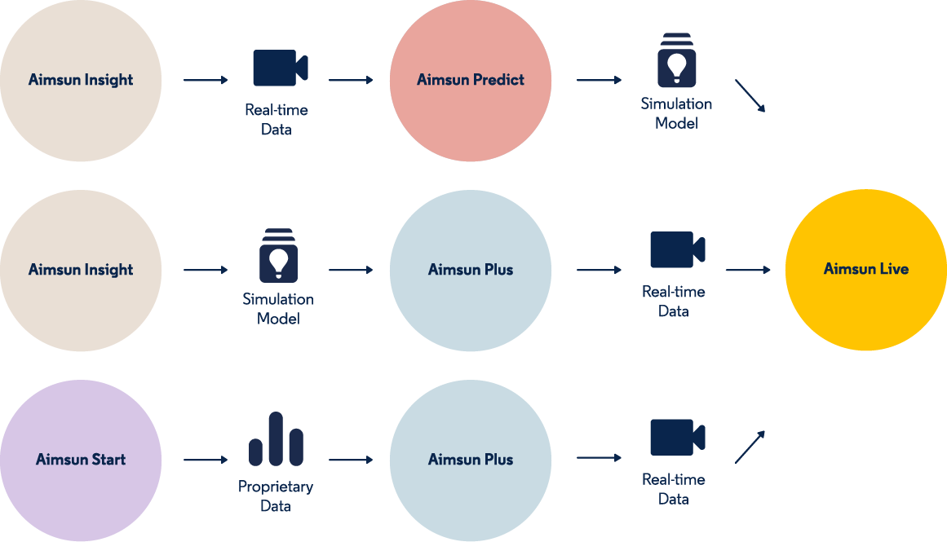
System Design/Implementation
Some of the design procedures involving such technologies are:

Slide 22
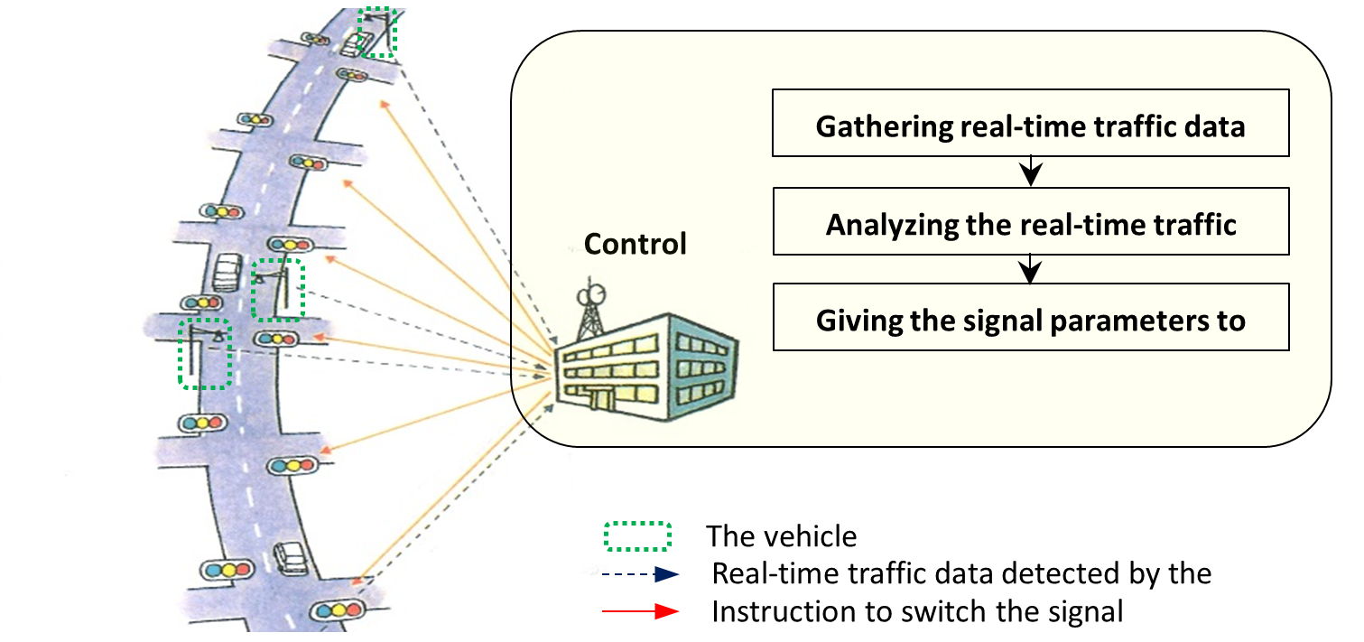

Slide 23
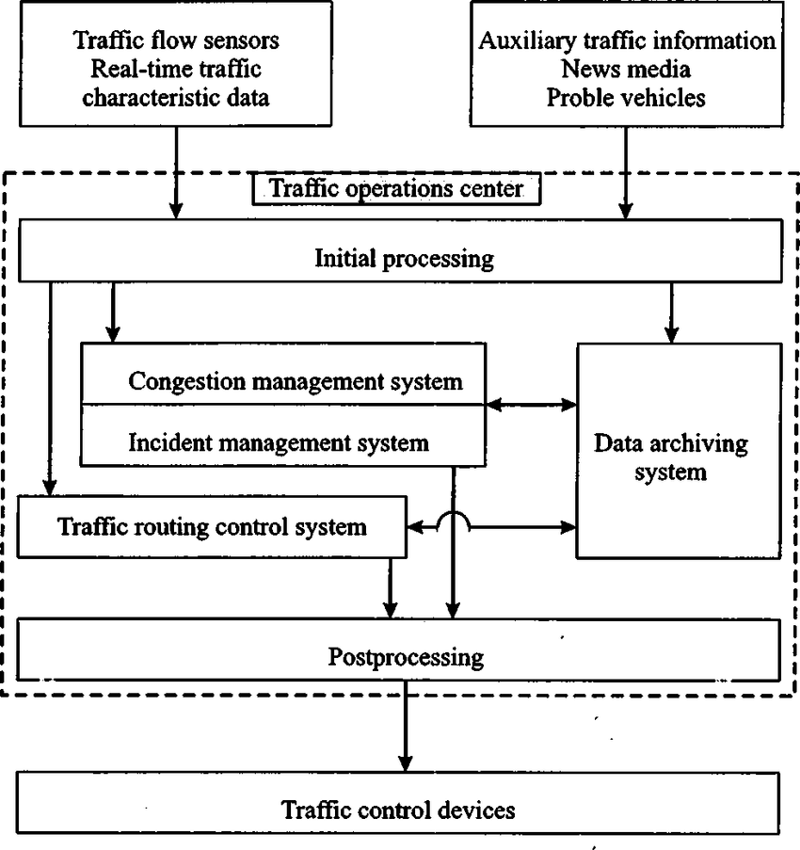

Slide 24
Timeline of Project
Serial No. | Task Undertaken | Duration
1. | Project Initiation and Data Collection- Define project scope and objectives. Form the project team and assign roles. Set up the project infrastructure and communication channels. Identify data sources and establish data collection mechanisms. Secure access to real-time weather and traffic data. | 3rd oct-13th oct 2023
2. | Data Processing and Backend Development- Develop the data processing pipeline for real-time data integration. Create the backend system for data collection and analysis. Begin implementing machine learning algorithms for rainwater accumulation prediction. | 20th oct-10th nov 2023

Slide 25
Timeline of Project
Serial No. | Task Undertaken | Duration
3. | Navigation and Route Planning Integration, Testing, and Deployment- Integrate mapping services, such as Google Maps API. Begin developing custom algorithms for alternative route suggestions. Test the navigation and route planning features for accuracy and reliability. Conduct rigorous testing of the entire system using simulated and real data. | 20th nov-30th nov 2023
4. | Final Refinements and Presentation- Address user feedback and make system refinements. Test the system's responsiveness and adaptability to changing conditions. Deploy the navigation system in Bangalore, focusing on areas prone to heavy rainfall. Prepare for a project presentation to showcase the system's features and user benefits. | 10th dec-30th dec 2023

Slide 26
Outcomes/Results
The proposed initiatives modernizes traffic management with cutting-edge technologies, optimizing traffic flow, engaging communities, and ensuring system resilience:
Privacy-Preserving Traffic Simulation Framework: Increased public trust through a secure traffic simulation framework using homomorphic encryption or federated learning, ensuring data confidentiality.
Distributed Traffic Management System: Improved efficiency and adaptability in less-developed regions by leveraging edge computing and decentralized decision-making.
Dynamic Traffic Diversion Optimization Algorithm:Enhanced traffic flow, reduced congestion, and increased safety through a dynamic diversion algorithm based on real-time predictions.
Predictive Community Engagement Platform:Improved transparency and community trust with a predictive platform addressing concerns through data-driven insights and tailored communication.

Slide 27
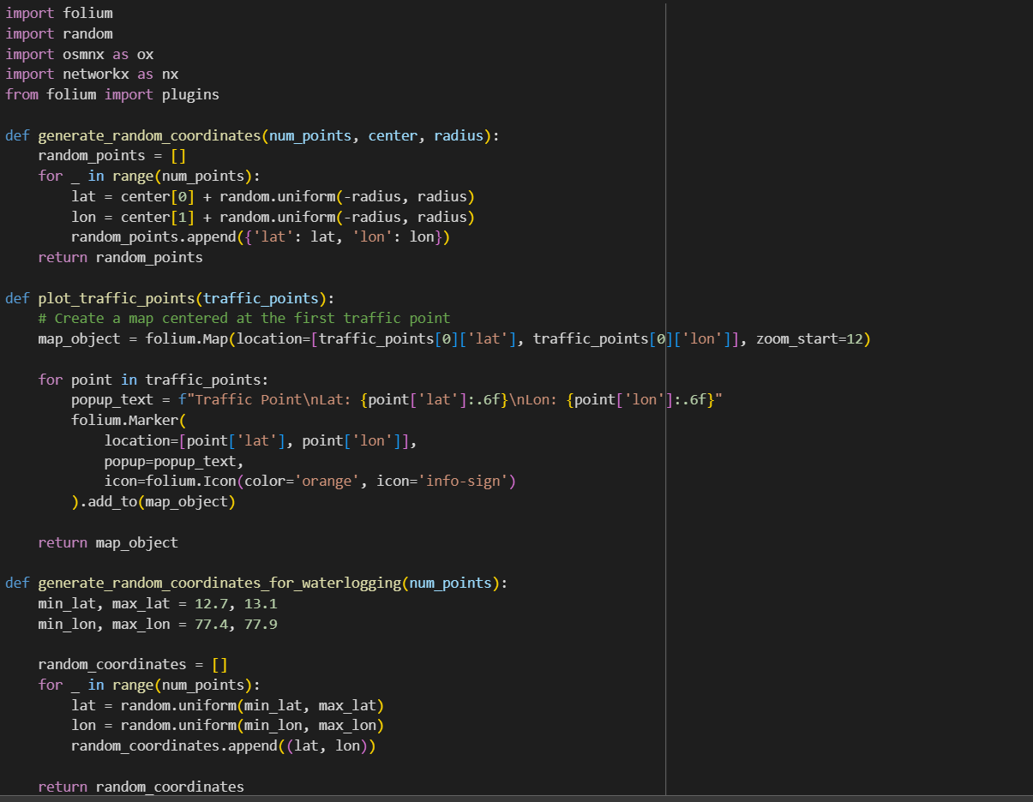
Outcomes

Slide 28
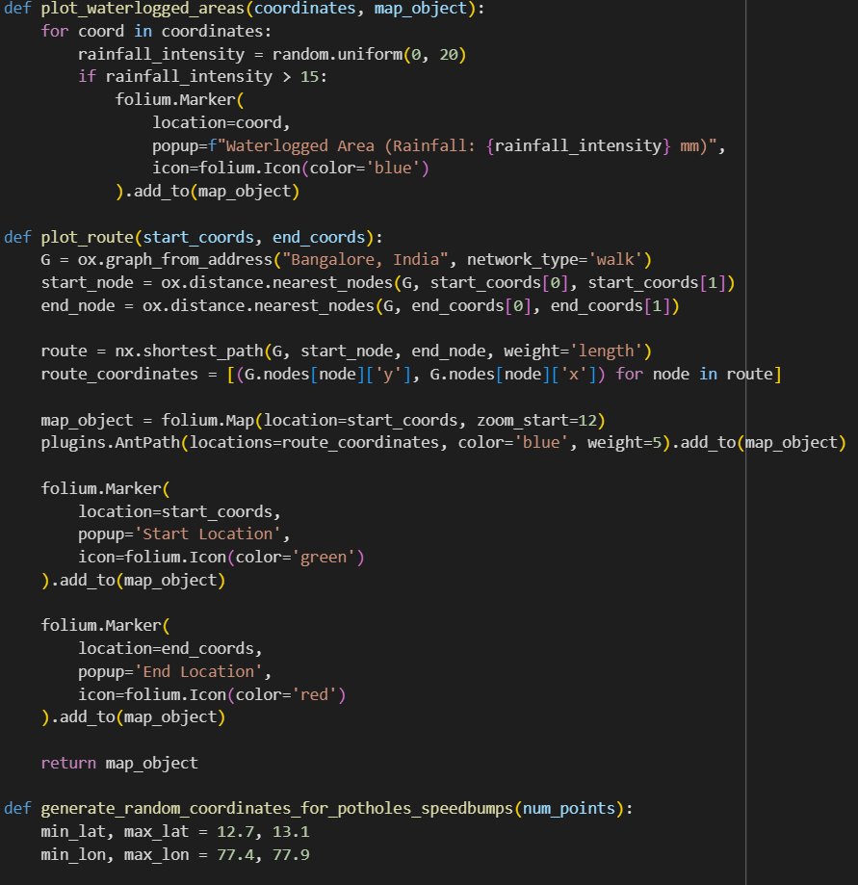
Outcomes

Slide 29
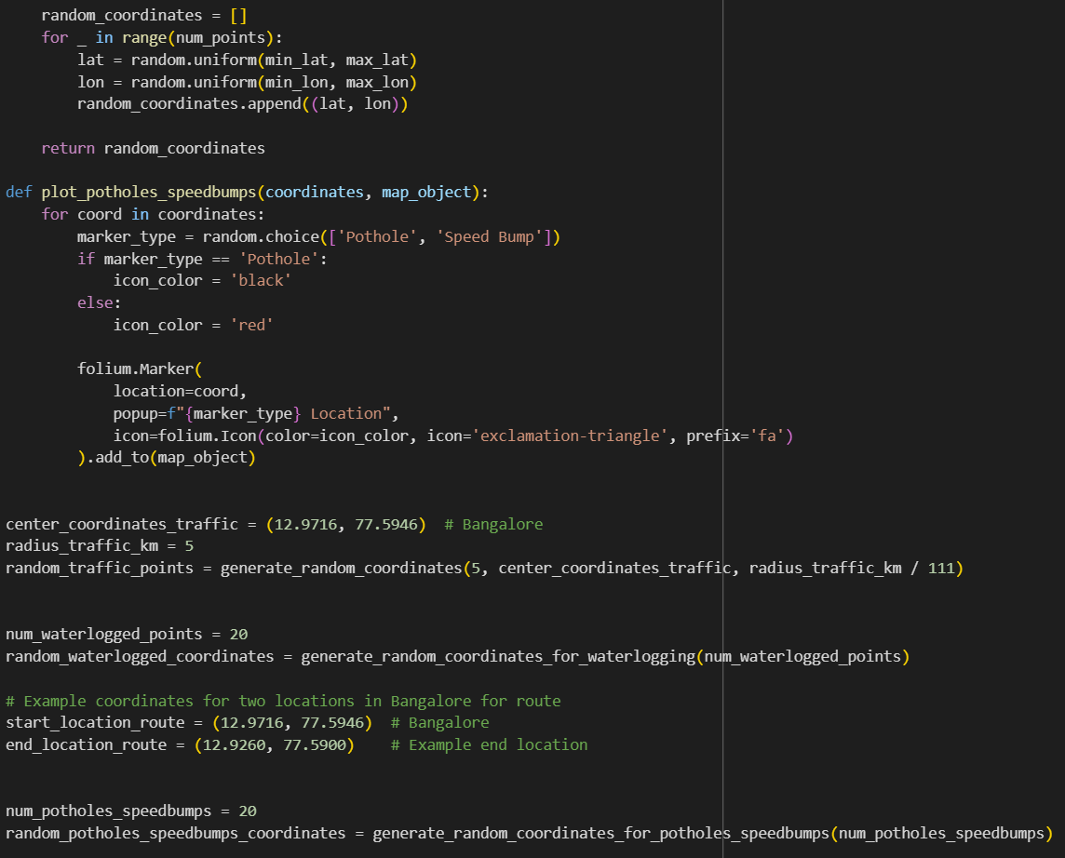
Outcomes

Slide 30
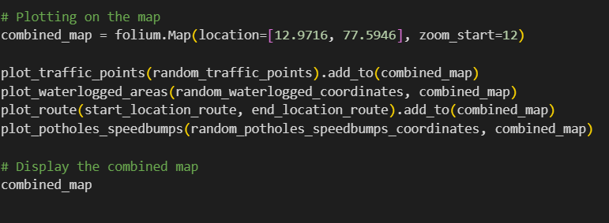
Outcomes

Slide 31
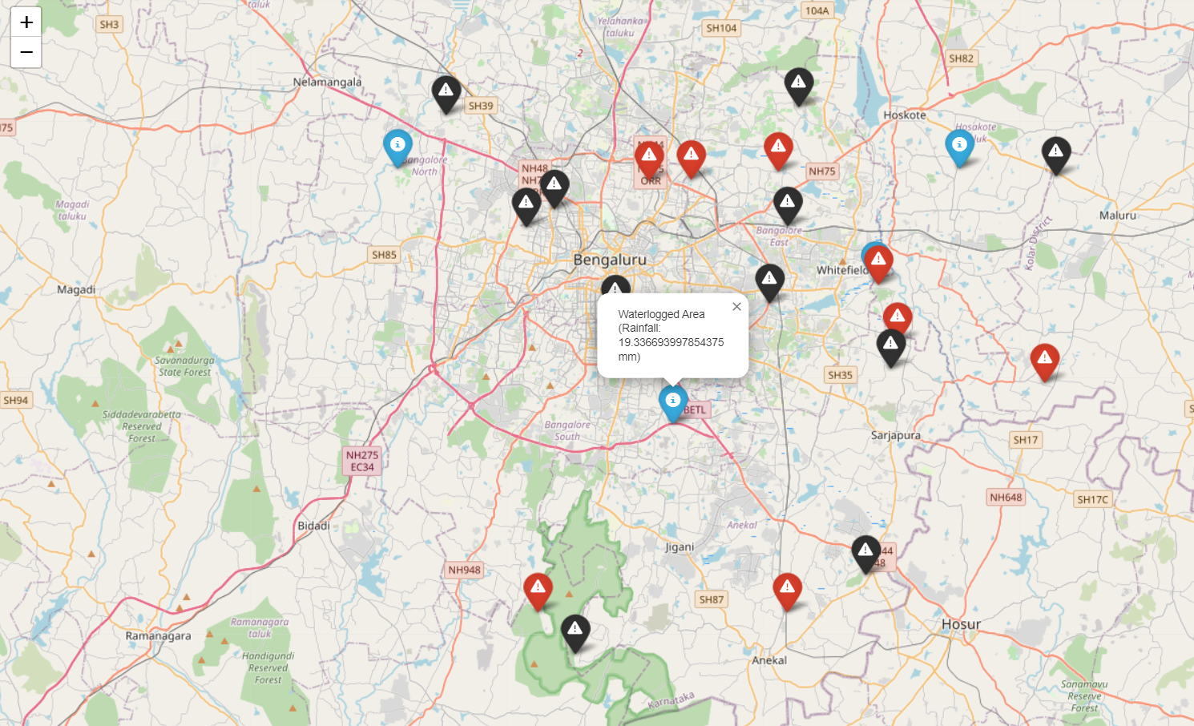
Outcomes

Slide 32
Results and Discussions
Urban areas face unprecedented challenges in managing traffic congestion, waterlogging, and road hazards. This project introduces an innovative solution that integrates advanced algorithms and real-time data simulation to address these issues. The comprehensive system includes modules for simulating heavy traffic points, identifying waterlogged areas during rainfall, optimizing routes using Dijkstra's algorithm, and randomly placing potholes and speed bumps on roadways.
Introduction:
The dynamic and ever-expanding urban landscape necessitates innovative solutions to alleviate congestion and enhance overall mobility.This project combines various modules to provide a holistic approach to urban planning.
Traffic Analysis:
A critical aspect of this project involves simulating potential heavy traffic points. Through the random generation of coordinates, we emulate the unpredictable nature of traffic congestion in Bangalore. This feature serves as a dynamic tool to understand traffic dynamics, aiding in the identification of areas susceptible to vehicular delays. Understanding traffic patterns enables city planners to implement targeted interventions to mitigate congestion.

Slide 33
Results and Discussions
Hazard Detection:
The project extends its capabilities to hazard detection, focusing on waterlogging during heavy rainfall. Real-time simulation, driven by random coordinates and rainfall intensity parameters, identifies and marks potential waterlogged areas. This module provides valuable insights into drainage and infrastructure vulnerabilities, facilitating preemptive measures to address these issues.
Efficient Route Planning:
Route planning is a critical component of urban mobility. This project employs Dijkstra's algorithm to optimize route planning, ensuring efficient navigation between source and destination points. By considering factors such as road length and congestion, this module provides users with optimal routes, contributing to reduced travel times and enhanced mobility.
Hazardous Road Conditions:
To further enhance the project's realism, we introduce the random placement of potholes and speed bumps on roadways. This feature reflects the diverse road conditions encountered in urban environments and reinforces the importance of proactive road maintenance.

Slide 34
Results and Discussions
In conclusion, this project offers a comprehensive solution to urban mobility challenges, incorporating traffic analysis, hazard detection, and efficient route planning. The use of advanced algorithms, coupled with real-time simulations and randomization, adds a dynamic dimension to the project, making it a valuable tool for urban planners and policymakers. The integration of Dijkstra's algorithm ensures optimal route planning, further contributing to the project's efficacy. As cities continue to evolve, such innovative approaches become imperative for creating sustainable and efficient urban mobility systems.

Slide 35
Conclusion
Our project to enhance the navigation system for rainy days in Bangalore represents a significant advancement in addressing challenges posed by heavy rainfall and traffic congestion. With a user-friendly interface, turn-by-turn navigation, and real-time weather notifications, our system promises to make commuting during inclement weather more efficient and enjoyable. As we look forward to bringing this innovative solution to reality, we aim to positively impact how individuals navigate rainy days not only in Bangalore but also in cities beyond, showcasing the potential of technology to improve daily lives and enhance urban mobility.
Note: This project uses Dijkstra’s algorithm to find the shortest path between two points using nodal points.

Slide 36
References
1.The Maps JavaScript API lets you customize maps with your own content and imagery for display on web pages and mobile devices
https://developers.google.com/maps/documentation/javascript/overview#maps_map_simple-javascript
2. Results from this investigation intuit in building a self-sufficient eco-friendly sustainable smart city that conserves the rainwater and avoid flooding in low-lying regions.
Vulnerability assessment of flood-affected locations of Bangalore by using multi-criteria evaluation-N.N Rama Prasad,Priya Narayan
3. The study, using continuous GPS and rainfall data from Thiruvananthapuram, showed that any heavy rainfall event could be detected in advance using the delay in GPS signals.
https://www.thehindu.com/news/cities/Kochi/gps-signal-effective-in-forecasting-extreme-rainfall-say-researchers/article66470881.ece
4. The accurate prediction of traffic status not only helps road traffic managers to formulate traffic management methods but also helps travelers design travel routes and even adjust travel time.
-Traffic Status Evolution Trend Prediction Based on Congestion Propagation Effects under Rainy Weather -Yongjie Xue,Rui Feng, Shaohua Cui

Slide 37
References
5.Experimental results show that the proposed method can cluster the roads according to the pattern changes in the traffic speed caused by weather change.
-Identification and Analysis of Weather-Sensitive Roads Based on Smartphone Sensor Data: A Case Study in Jakarta-Chao-Lung Yang
6.To develop effective intelligent transportation system (ITS) strategies to mitigate the negatives of these different types of adverse weather related to reduced visibility by studying the effect of rain and fog on traffic parameters.
-Examining the effect of adverse weather on road transportation using weather and traffic sensors-Yichuan Peng, Yuming Jiang,
Yajie Zou,Jian Lu
7.Impact of Rainfall Condition on Traffic Flow and Speed: A Case Study in Johor and Terengganu-Nordiana Mashros, Johnnie Ben-Edigbe, Sitti Asmah Hassan, Hassan Norhidayah.
https://www.researchgate.net/publication/266675964_Impact_of_Rainfall_Condition_on_Traffic_Flow_and_Speed_A_Case_Study_in_Johor_and_Terengganu

Slide 38
References
8. Traffic Guidance for Inclement Weather using GPS Navigation System -G.Sandeep, S.Shanmathi, K.Sahiti Keerthana, Ms.S.Suchithra M.E Assistant Professor(SI.Gr)
https://www.ijrdo.org/index.php/cse/article/download/487/449/
9. Assessing the impact of heavy rainfall on the Newcastle upon Tyne transport network using a geospatial data infrastructure- Kristina Wolf , Richard J. Dawson, Jon P. Mills , Phil Blythe , Craig Robson , Jeremy Morley
https://www.sciencedirect.com/science/article/pii/S2772741623000364
10. Joint Impact of Rain and Incidents on Traffic Stream Speeds- Mohammed Elhenawy,Hesham A.Rakha,and Huthaifa I. Ashqar

Slide 39

Thank You

