Slide 1
Which bits can we drop?
Component-wise quantization of a learned image codec
PULSE-MSE | 14.18M parameters | 8 quality settings | one weight file
We keep 39 times more quality than uniform INT8 at the same size.
21.677 MB
60.4 percent smaller. Loss is 0.94 percent.
18.664 MB
65.9 percent smaller. Loss is 1.60 percent.
39x
better than uniform INT8 at the same size
Notes:
One sentence: we measured which parts of a codec tolerate low precision, solved the choice as an integer program, and used fine-tuning where the choice was aggressive. Three numbers: two operating points and the ratio against the naive baseline.

Slide 2
One precision for all parts is the wrong tool
the parts are not equal
Group | Parameters | Share | What it means
Encoder E0-E5 | 12.13M | 85.6% | four blocks alone hold 11.6 MB
Entropy H0-H3 | 1.34M | 9.4% | takes 73 percent of a decode
Decoder D0-D8 | 708k | 5.0% | small, but one 4.7k block loses 8 percent
Sensitivity does not follow size.
A 2.89M encoder block loses 0.5 percent at 8 bits.
A 4.7k renderer block loses 8 percent at the same precision.
One weight file serves all eight settings. A choice per setting is not deployable.
So the task is an allocation problem: one precision per part, decided once.
artifacts/component_inventory.json
Notes:
The imbalance is the whole motivation. Uniform precision over-spends on robust parts and under-protects fragile ones. Note the inversion: the largest parts are the cheapest.

Slide 3
How we measured it
69,233 measurements. One part at a time.
7 formats
FP16, BF16, FP8-E4M3, FP8-E5M2, INT8, INT4, FP4-E2M1
19 parts x 8 settings
weights only. All other parts stay in FP32.
Kodak and CLIC
24 and 41 images. All eight quality settings.
Penalty = 100 x [(1 + dbpp/100) x 2^(-dPSNR/slope) - 1]
One number holds a quality change and a bitrate change. Zero means equal to FP32.
Additive: 0.96-1.05
Single-part costs add up, so the solver can sum them.
FP32 gate passes
The reference bitstream matches at all eight settings.
scripts/pipeline.py (metric) | analyze_additivity.py (check)
Notes:
Two safeguards make the numbers usable. The FP32 gate proves the baseline is the baseline. The additivity test proves single-part costs can be added. Without both, the optimizer input is invalid.

Slide 4
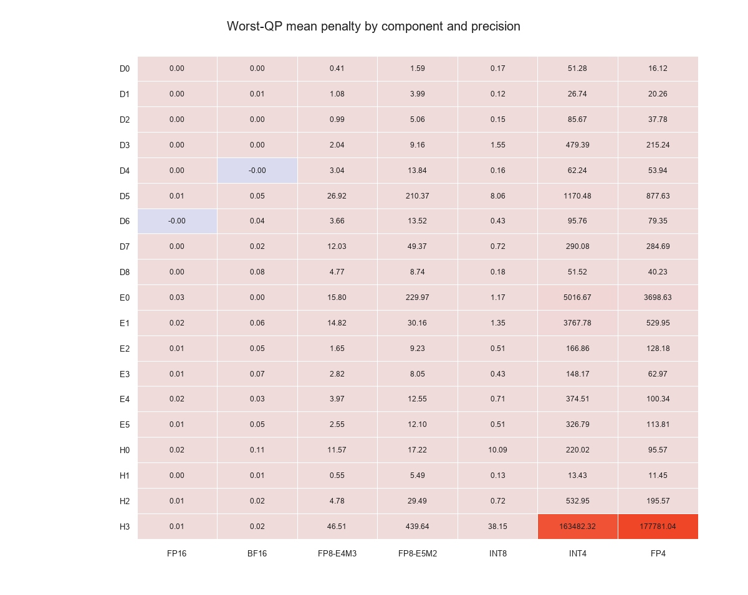
Three parts refuse 8 bits
13 of 19 are safe. The three that are not are small.
Intolerant at INT8
H3 entropy step: 38.15%
H0 hyper encoder: 10.09%
D5 renderer: 8.06%
Together 3.8 percent of parameters.
Cheap at INT8
E2 / E3: 0.51 / 0.43%
E1 / E4: 1.35 / 0.71%
D1: 0.12%
results/analysis/component_precision_penalty_heatmap.png
Notes:
Read a cell as the percentage penalty to quantize that part alone. The four large encoder blocks are the cheapest rows in the table, which is why every tier targets them.

Slide 5
We solved the choice as an integer program
one variable per part. Shared across all eight settings.
Why shared variables
One weight file serves all eight settings. A different assignment per setting would need eight files.
Constraints
One quality limit for each setting. Eight limits in total.
Objective
Minimise bytes. Not latency: we have no measured latency table per format, so an objective using one would optimize invented data.
Point | Size | Kodak | CLIC
1% champion | 21.677 MB | 0.67% | 0.85%
1.8% variant | 18.664 MB | 1.27% | 1.60%
INT8 tier + QAT | 14.401 MB | 1.85% | 2.87%
The knee is between 1.6 and 1.8 percent: 2.5 MB falls away in one step.
The 1.8 percent assignment beats the 2 percent one we first chose. It is 0.275 MB larger and better on all three sets.
Solved with HiGHS. A greedy baseline matches it within a few percent.
results/final/SUBMISSION_POINTS.md | results/night/ilp_fine_sweep.json
Notes:
The shared-variable constraint is deployability, not convenience. The knee matters: an earlier choice at 2 percent looked good until a finer sweep found 1.8 percent, which is both smaller and better.

Slide 6
The comparison that decides it
uniform INT8 is smaller and 39 times worse
26.18%
uniform INT8 at 13.9 MB
0.67%
our champion at 21.7 MB
Uniform INT8 also varies 2.9 times across datasets. The mixed model varies 1.4 times. A limit on the total gives quality and stability.
results/mixed/ | 7 configurations, 3 datasets
Notes:
This is the slide that justifies the project. Uniform quantization produces a smaller file and loses 39 times more quality on Kodak, 67 times on CLIC. The problem is granularity, not quantization.

Slide 7
4-bit failed. That is why we fine-tuned.
Group scaling helped by 5 to 22 times. Not enough.
Part | INT8 cost/MB | INT4 cost/MB
E3 | 0.14 | 31.4
E2 | 0.17 | 26.1
E4 | 0.24 | 31.2
E1 | 0.46 | 157.5
D5 | 1712 | not viable
Constrained, not penalised
Hold bitrate at its old value. Minimise distortion. A fixed penalty drifts in both directions.
Entropy stays frozen
The bundle holds integer CDF tables. Move the weights and encoder and decoder disagree.
Cost per MB is the decision number: penalty points paid for one megabyte saved.
Group-32 scaling cut INT4 weight error by 40 percent. The cost stays about 100 times that of the 8-bit step.
So 4-bit is not worth shipping alone. Can fine-tuning pay for it?
12,000 steps
2.2 percent of the pretraining steps. A repair, not a new training.
results/qat/WHY_THESE_COMPONENTS.md | scripts/qat_run.py
Notes:
Two ideas on one slide. Left: 4-bit is expensive per byte, so it needs help. Right: the three design choices that let fine-tuning help without breaking the bitstream.

Slide 8
QAT repairs what the choice leaves
61 to 98 percent. And zero where nothing was left.
Tier | Size | Before | 2k | 12k | Removed
INT8 tier | 14.401 MB | 8.61% | 8.61% | 3.36% | 61.0%
INT4, 2 blocks | 13.572 MB | 119.18% | 25.27% | 20.53% | 82.8%
INT4, 4 blocks | 11.369 MB | 1771.71% | 84.22% | 41.84% | 97.6%
ILP 2% assignment | 18.389 MB | 1.936% | not run | 1.936% | 0.0%
0.0%
gain on the assignment the solver optimized
61-98%
of damage removed on hand-chosen tiers
Fine-tuning replaces a good allocation. It does not extend it.
At 2,000 steps the INT8 tier gained nothing. We first concluded that QAT only helps severe damage. At 12,000 steps it removed 61 percent. The first result was a step-budget effect.
This is our most useful finding, not a failure: the repair is as large as the damage that the choice left behind.
results/final/qat_attempt/summary.csv | results/night/qat_int8_12k/summary.csv
Notes:
Two-sided result. QAT is a repair mechanism, and the size of the repair is set by how badly the assignment was chosen. On our optimized model it did nothing, which is the correct answer. State the correction honestly: our first reading was wrong.

Slide 9
We did not get a speedup. Here is why.
Quantization accelerates the part that is not the bottleneck.
A decode takes 88 ms.
Entropy coding takes 80 ms. The network takes 8 ms.
Convolutions are 9 percent of a decode and 27 percent of a round trip.
Quantization cannot fix the part that dominates.
+4.79%
latency for the mixed model. 95 percent CI +1.27 to +9.80.
-0.39%
energy change. The interval includes zero.
We make no speed claim for FP8, INT4 or FP4. These formats run as simulated quantization.
Only FP16 and BF16 have real kernels on this GPU. They save energy, not time.
A real integer speedup needs integer kernels. That is an engineering task, not a policy choice.
results/metrics/ | paired interleaved benchmark, 50 pairs per cell
Notes:
The honest negative. Quantization makes convolutions cheaper, and convolutions are 9 percent of a decode. Reporting a speedup here would have been wrong.

Slide 10
What we would ship, and what would change it
21.677 MB
champion. 60.4 percent smaller, 0.94 percent loss.
Limits we state first
Checkpoint selection under-reports the QAT gain. The probe said no change; the full test said 8.61 to 3.36 percent.
Weights only. No activation quantization, so W8A8 is not tested.
4-bit is simulated, so its speed is not measured.
One entropy lane. The largest unused latency lever.
QAT uses one seed and 100 images. The direction holds. The exact numbers are single-run.
18.664 MB
size-first variant. 65.9 percent smaller, 1.60 percent loss.
Do not use uniform INT8 at 13.9 MB. It is smaller and 39 times worse.
Do not use 4-bit without fine-tuning.
Granularity is the lever. Fine-tuning repairs what a choice leaves. An optimal choice leaves nothing.
Notes:
Close on the trade-off and the limits. If asked what we would do next: fix checkpoint selection, then test real integer kernels, then multi-lane entropy coding.

