Slide 1
CHATBOT
INTEGRATED WITH CHATGPT

Slide 2
INTRODUCTION
I am excited to discuss the integration of a powerful chatbot into a website and Android app, powered by ChatGPT. The objective of this presentation is to explore the benefits and capabilities that come with integrating a chatbot using ChatGPT into both website and Android app platforms. By leveraging ChatGPT's advanced language model, we can create an intelligent chatbot that adapts to user queries and provides relevant responses. This integration enhances user experience, streamlines communication, and offers personalized assistance. Users can access the chatbot from different platforms, ensuring widespread availability and convenience. Throughout this presentation, we will explore the advantages and demonstrate successful implementations, showcasing how this innovative technology can revolutionize user interactions and drive success. Thank you for your attention, and let's get started!

Slide 3
OVERVIEW OF CHATGPT
ChatGPT is a powerful language model developed by OpenAI, offering two engine variants for integration:
1)gpt-3.5-turbo
2)Davinci
The gpt-3.5-turbo variant provides excellent performance across various chat-based applications, making it ideal for tasks like customer support and recommendations. On the other hand, the davinci variant, with its larger model size and advanced capabilities, enables more customized and sophisticated chatbot experiences. Both variants allow developers to train chatbots with specific instructions, enhancing conversation flow and user engagement. By integrating ChatGPT into websites and Android apps, businesses can leverage its advanced language capabilities to provide accurate responses and create interactive and personalized user experiences.

Slide 4
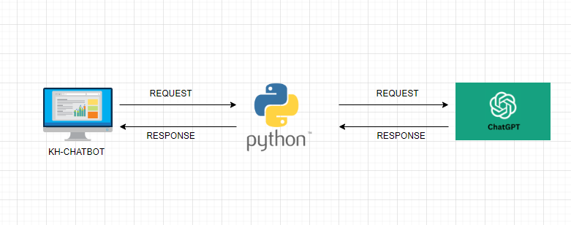
WORKFLOW

Slide 5
INTEGRATION
The integration of ChatGPT into the chatbot occurs through two distinct channels:
1) website
2) Android app.
In the website integration, users engage with the chatbot directly on the website interface, where they input text or voice commands, initiating a dynamic conversation with ChatGPT. Similarly, within the Android app integration, users access the chatbot through the app's interface, benefiting from features like voice input and push notifications. Both platforms leverage ChatGPT's capabilities to provide real-time, context-aware responses, resulting in a seamless and unified user experience across web and mobile interactions.

Slide 6
WEBSITE INTEGRATION
The website integration harnesses OpenAI's capabilities and the Streamlit Python module, seamlessly incorporating ChatGPT to deliver a dynamic conversational experience on the website interface.
Utilizing OpenAI's technology in tandem with the Streamlit Python module, the website integration seamlessly merges ChatGPT's conversational prowess into the website interface, offering users a fluid and interactive experience.
By ingeniously integrating OpenAI's cutting-edge technology and the versatile Streamlit Python module, the website integration effortlessly infuses ChatGPT's conversational abilities into the website interface. This harmonious fusion empowers users with an engaging and interactive chatbot experience, enhancing user engagement and satisfaction.

Slide 7
ANDROID INTEGRATION
The Android integration employs Java, along with Groovy and org.gradle, to seamlessly incorporate ChatGPT's capabilities into the Android app. This dynamic integration allows users to interact with the chatbot through the app's interface, enabling voice input, real-time responses, and offline capabilities, all while leveraging ChatGPT's language generation to deliver a seamless and intuitive conversational experience.
Leveraging the power of Java, Groovy, and org.gradle, the Android integration seamlessly weaves ChatGPT's capabilities into the fabric of the Android app. This integration empowers users to engage with the chatbot directly from the app's interface, accessing features like voice input and real-time responses. By merging these technologies, the Android integration ensures a smooth and efficient user experience, enhancing the app's functionality and user engagement.

Slide 8
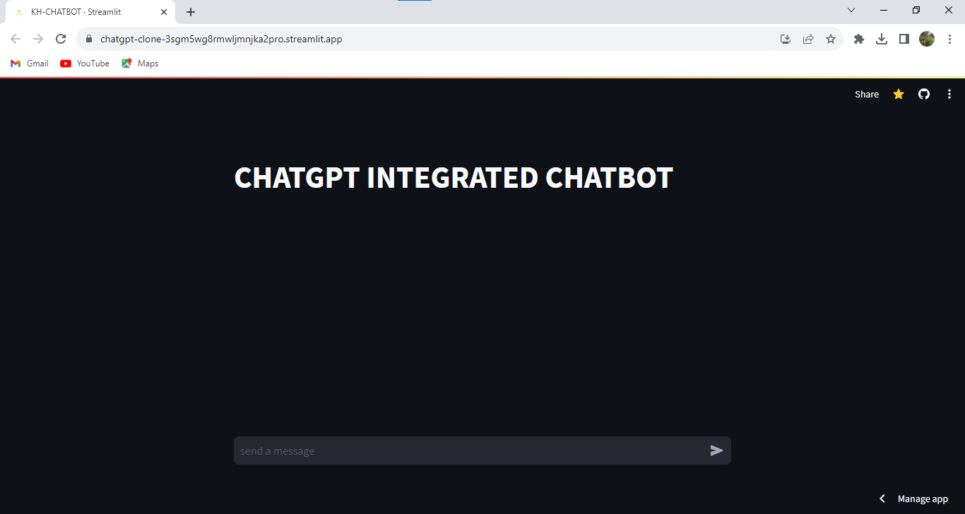
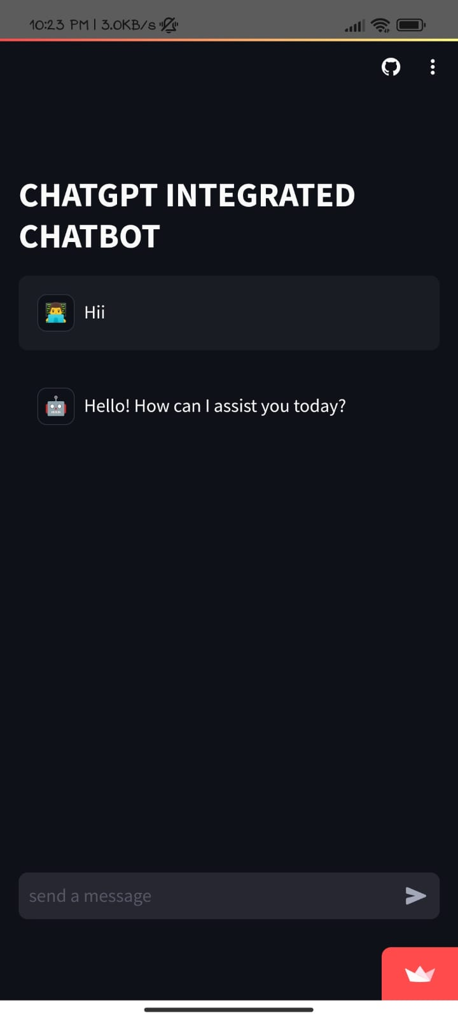
OVERVIEW OF WEBSITE AND ANDRIOD APP
WEBSITE
ANDRIOD APP

Slide 9
USE CASES OF THE CHATBOT
Customer Support: Chatbots can offer immediate assistance to customers, addressing common queries and providing troubleshooting steps. They enhance customer satisfaction by providing 24/7 support and reducing response times.
E-commerce Assistance: Chatbots can help customers navigate through product catalogs, provide recommendations, assist with the purchase process, and answer questions about shipping, returns, and availability.
Appointment Scheduling: Chatbots can streamline the appointment booking process by offering available time slots, confirming appointments, and sending reminders, reducing the administrative burden.
Information Retrieval: Chatbots can quickly retrieve information from databases or knowledge bases, delivering accurate answers to user inquiries, which can be especially useful for FAQs.

Slide 10
ADVANTAGES OF CHATBOT
Natural and Engaging Conversations: With ChatGPT's language generation capabilities, the chatbot can engage users in natural and meaningful conversations, providing a human-like experience that keeps users engaged and satisfied.
24/7 Availability: The chatbot, being AI-powered, is available round-the-clock on both the website and the Android app, ensuring users can access assistance whenever they need it, regardless of time zones.
Seamless Omni-Channel Experience: Users can seamlessly transition between the website and the Android app, continuing conversations without disruption. This unified experience enhances user satisfaction and convenience.
Multi-Platform Accessibility: Users can interact with the chatbot using their preferred platform, whether it's the website on a desktop or the Android app on a mobile device, providing flexibility and accessibility

Slide 11
DEMO
KH-CHATBOT
KH-CHATBOT(APK)

Slide 12
FUTURE POSSIBILITIES
Cross-Platform Integration: Expanding the integration beyond Android to include an iOS app could extend the chatbot's reach to a broader user base, ensuring a consistent experience across major mobile platforms.
AI-Assisted Content Generation: The chatbot could be developed to assist users in creating content, such as writing articles, emails, or social media posts, based on their input and style preferences.
Offline Mode Enhancement: Strengthening the chatbot's offline capabilities would ensure that users can still access basic information and features even when connectivity is limited.
Multilingual Support: Enabling the chatbot to converse fluently in multiple languages would open doors to a global audience. Users from diverse linguistic backgrounds would be able to interact with the chatbot in their native language, enhancing inclusivity and engagement.

