Slide 1
MACHINE LEARNING MINI-PROJECT
ATP Tennis Match
Winner Prediction
Historical evaluation on the 2024 ATP season
Pre-match features • chronological validation • model comparison
Results include accuracy, precision, recall, F1, and ROC-AUC

Slide 2
Problem and dataset
Prediction question
Dataset overview
Can information available before a match predict which ATP singles player wins?
1991–2024
season coverage
108,375
cleaned match rows
98,530
prediction rows after Davis Cup exclusion
One row represents one match. Player A is the lower numeric player ID. The target is 1 when Player A wins and 0 when Player B wins.
Source: Jeff Sackmann / Tennis Abstract ATP match data mirror. License: CC BY-NC-SA 4.0.
ATP MATCH PREDICTION
02

Slide 3
Pre-match features and preprocessing
Player strength
Match context
Prior matchup history
•
Rank and ranking points
•
Surface and event level
•
Surface-specific win rates
•
Career win-rate difference
•
Round, best-of, and draw size
•
Head-to-head record
•
Recent form: last 5, 10, and 25 matches
•
Age, height, and handedness differences
•
Recent match activity
Cleaning and safeguards
•
Combine and standardize annual files; remove unusable or duplicate rows.
•
Impute missing values and encode categories inside each model pipeline.
•
Use only past information; apply a 14-day gap because exact match dates are unavailable.
Current-match outcome, score, duration, and serve statistics are excluded from the inputs.
ATP MATCH PREDICTION
03

Slide 4
Algorithms and hyperparameter tuning
Chronological workflow
Fit 1991–2021 → choose settings on 2022 → refit through 2023 → evaluate once on 2024
Algorithm
Settings searched
Selected setting
2022 validation
Logistic regression
C: 0.01, 0.1, 1, 10
C = 0.01
66.04%
Linear SVM
C: 0.01, 0.1, 1, 10
C = 0.01
65.89%
Random forest
Depth: None/20; leaf: 1/3
Depth 20; leaf 3
66.37%
Random forest: 200 trees, sqrt feature sampling. Preprocessing is fitted on training data only.
The 2024 test season was not used to select hyperparameters.
ATP MATCH PREDICTION
04

Slide 5
2024 held-out test results
All three models use the same 2,816-match test season. Player A win is the positive class.
Algorithm
Selected parameters
Accuracy
Precision
Recall
F1
ROC-AUC
Logistic regression
C = 0.01
65.34%
65.40%
63.04%
0.642
0.715
Linear SVM
C = 0.01
65.23%
65.27%
62.97%
0.641
0.715
Random forest
depth 20; leaf 3
64.45%
64.56%
61.82%
0.632
0.711
Accuracy by model (%)
70
65.34%
65.23%
64.45%
63.77%
60
40
20
0
Logistic regression
Linear SVM
Random forest
Rank baseline*
*Rank baseline: 63.77% on 2,810 matches with both rankings available; model table metrics use all 2,816 test matches.
ATP MATCH PREDICTION
05

Slide 6
What the results show
Key findings
•
Logistic regression had the highest 2024 accuracy (65.34%) and ROC-AUC (0.715).
•
Its precision was 65.40%, recall 63.04%, and F1 0.642 for Player A wins.
•
The best 2022 validation accuracy belonged to Random Forest (66.37%).
•
The 2024 results are a held-out historical test, not future match forecasts.
Demo
Open tennis_match_prediction.ipynb, select the project Python environment, and run the cells in order. The final results cell displays the metrics table and plots.
Limits
ATP main-tour data only; no exact match dates, injuries, or betting odds. The 14-day history gap can make recent-form features less current.
ATP MATCH PREDICTION
06

Slide 7
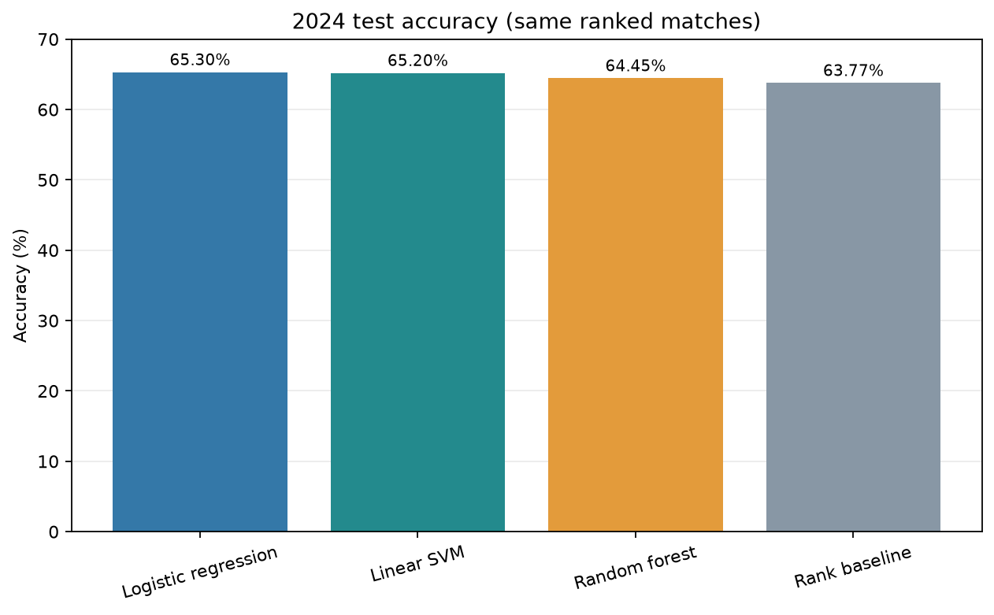
2024 test accuracy comparison
The rank baseline is evaluated on matches where both player rankings are available.
ATP MATCH PREDICTION
07

Slide 8
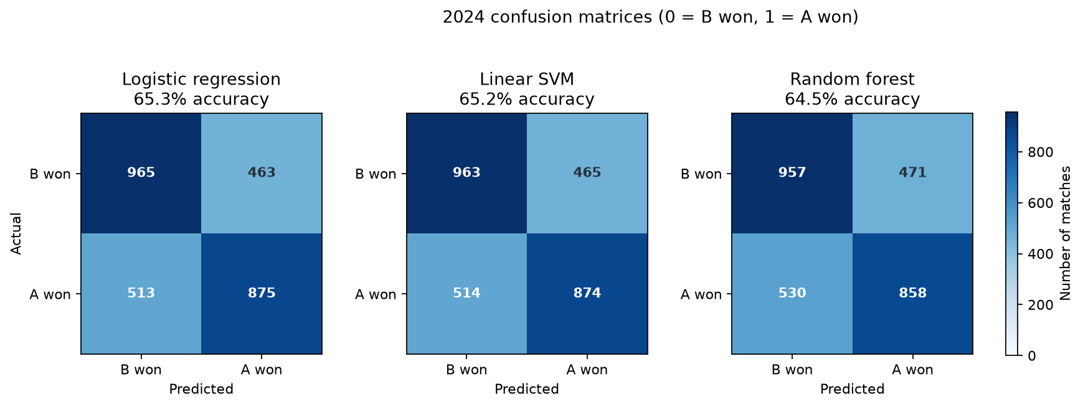
2024 test confusion matrices
Rows show actual outcomes and columns show predictions; 0 = Player B won and 1 = Player A won.
ATP MATCH PREDICTION
08

Slide 9
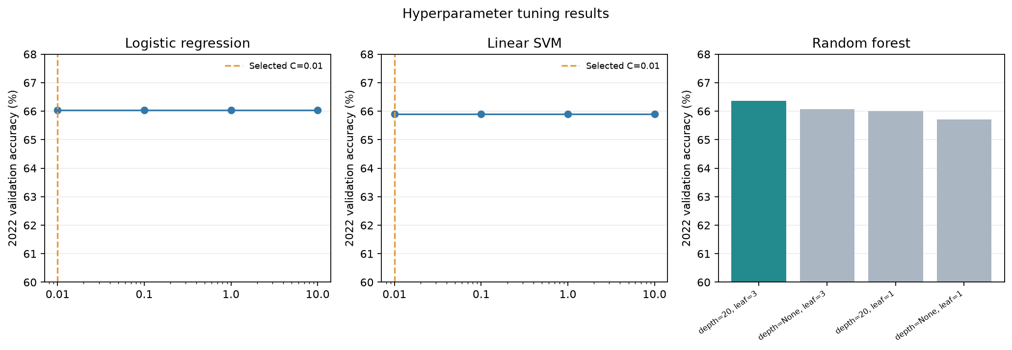
Hyperparameter tuning on 2022 validation data
Settings were selected using 2022 validation accuracy; 2024 remained held out for final evaluation.
ATP MATCH PREDICTION
09

Slide 10
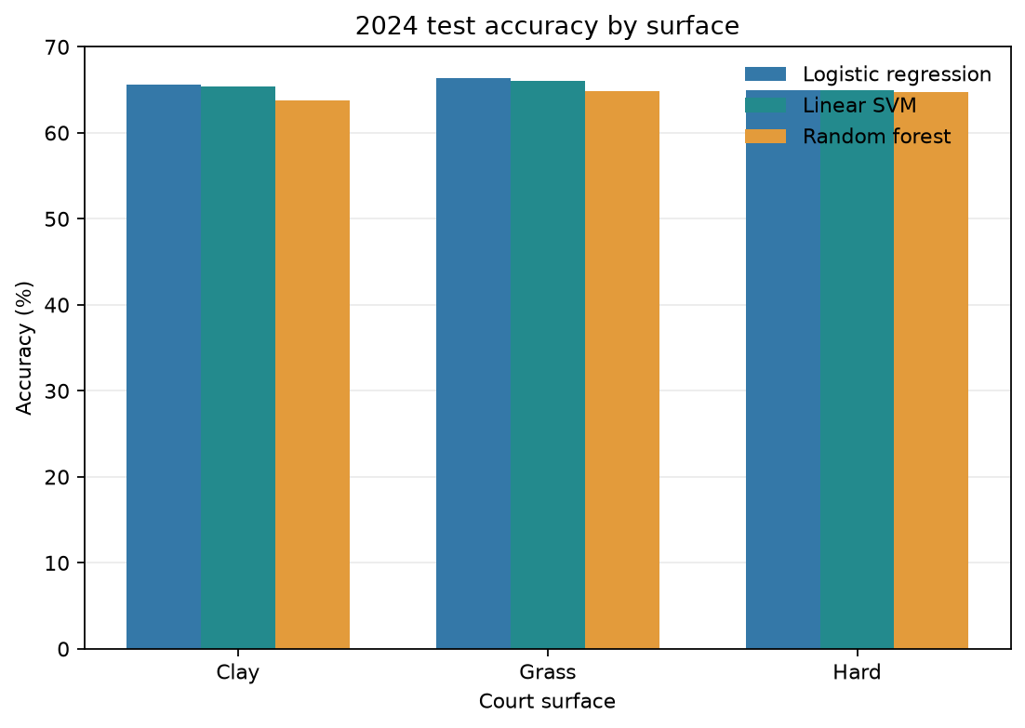
2024 test accuracy by court surface
These are per-surface results from the same 2024 held-out test season.
ATP MATCH PREDICTION
10

