Slide 1

Hospital Appointment Management & Patient Attendance Analysis Using R
Harshit Srinivasa Prasad
Roll Number: 160124771033
Department of Artificial Intelligence & Data Science (AI & DS)
Chaitanya Bharathi Institute of Technology (CBIT)
Completed Project Presentation
Notes:
Completed project: attendance analysis of hospital appointment records in R, with Random Forest and XGBoost models and a new-patient probability example.

Slide 2



Problem Statement and Objectives
Objectives
Why it matters
Hospital staff plan appointments without knowing whether each patient will attend.
A missed appointment leaves capacity unused and makes scheduling less reliable.
Historical records can show patterns linked to missed appointments.
Attendance analysis
Describe attended and missed appointments across age, waiting period, gender and SMS status.
Model comparison
Research question
Train Random Forest and XGBoost, select follow-up thresholds on validation data, and compare test results.
How can historical patient and appointment information help identify appointments at higher risk of being missed, while reporting the probability of attendance?
New-patient probability
Estimate attending and missing probabilities for a new appointment record.
Hospital Appointment Management & Patient Attendance Analysis Using R
2
Notes:
Frame the problem and the research question. Stress that the outputs are probabilities and follow-up flags, not guarantees of attendance.

Slide 3
Dataset and Attendance Summary
110,527
Original source dataset: records, 14 columns
Attendance outcome (n = 53,976)
53,978
Imported working CSV (KaggleV2-May-2016.csv): records
53,976
Cleaned working dataset: records used in analysis
The working file may be a subset of the original dataset.
Each row is one appointment; a patient can appear more than once.
The No-show column was renamed verification: No = Attended, Yes = Missed.
Attended 42,599 (78.92%) · Missed 11,377 (21.08%)
Hospital Appointment Management & Patient Attendance Analysis Using R
3
Notes:
Original source: 110,527 records and 14 columns. Working CSV: 53,978 imported, 53,976 after cleaning. Missed rate 21.08%. The working file may be a subset of the original; its coverage should be documented.

Slide 4
Data Preparation and Selected Features
Implemented preparation steps
Nine predictors
1
Inspected data types, missing values, duplicates and invalid records.
Age
Gender
Scholarship
2
Removed negative ages and invalid waiting periods; age 0 is kept.
Hipertension
Diabetes
Alcoholism
3
Converted booking and appointment dates.
Handcap
SMS_received
WaitingDays
4
Calculated WaitingDays as calendar days between the two dates.
Identifiers (PatientId, AppointmentID) are excluded from predictors.
Target: verification (Attended or Missed). Teal = top XGBoost gain features.
5
Encoded gender and attendance labels; no missing values remained.
Hospital Appointment Management & Patient Attendance Analysis Using R
4
Notes:
Only the implemented cleaning steps are shown. Identifiers and the target are not used as predictors. Gender becomes indicator columns for XGBoost.

Slide 5
Workflow and Patient-Separated Data Splitting
Import and cleaning
Patient-based splitting
Random Forest and XGBoost training
Validation and threshold selection
Test evaluation
New-patient prediction
Appointments in each partition
34,719
8,597
10,660
Training
Validation
Testing
Fits Random Forest and XGBoost
Selects settings and follow-up thresholds
Evaluates the fixed models once
Patients are separated across partitions: no patient appears in more than one.
Validation picks model settings and thresholds (search from 0.01 to 0.99 maximising validation F1).
Testing evaluates the fixed models; it did not choose thresholds.
Hospital Appointment Management & Patient Attendance Analysis Using R
5
Notes:
Patient-based splitting guarantees zero shared patients between training, validation and testing (checked for all three pairs). Validation decides thresholds; the test set is used for final reporting only.

Slide 6
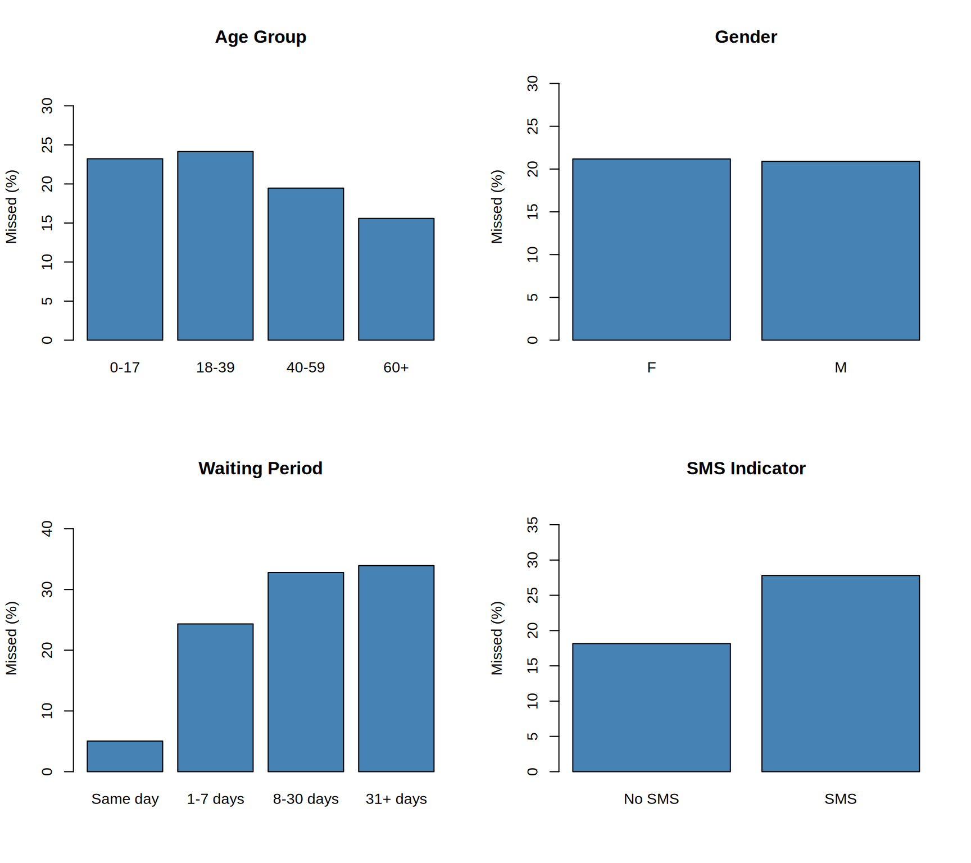
Attendance Patterns by Group
What the graphs show
Waiting period shows the clearest pattern: the missed share rises from same-day appointments to 31+ days.
Patients aged 60+ have the lowest missed share; ages 0–17 and 18–39 are highest.
Gender groups are similar.
Patients with an SMS indicator have a higher missed share than those without. These are descriptive associations; SMS groups also differ in waiting periods, so this does not show that SMS causes better or worse attendance.
Hospital Appointment Management & Patient Attendance Analysis Using R
6
Notes:
Figure from the final report: missed (%) by age group, gender, waiting period and SMS indicator. Values are shown as drawn in the report; the interpretation is qualitative and reads only the bar order and relative heights.

Slide 7

Random Forest and XGBoost Implementation
Random Forest
XGBoost
Probability forest (ranger 0.18.0)
Gradient-boosted trees (xgboost 3.2.1.1)
Probability forest from the ranger package
300 trees
mtry = 3
Minimum node size = 20
Binary logistic objective
Learning rate (eta) = 0.05
Maximum depth = 4; minimum child weight = 10
Row and column sampling = 0.8
Up to 500 rounds; early stopping after 30 rounds without validation log-loss improvement
Both models use seed 33 and are trained on the 34,719-appointment training partition. Thresholds are selected on validation data only.
Hospital Appointment Management & Patient Attendance Analysis Using R
7
Notes:
Only the two implemented models are shown. Configuration values are taken from the final report.

Slide 8
Test Performance Comparison
Model | Follow-up threshold | Accuracy | Precision | Recall | F1 | Brier score
Random Forest | 0.22 | 60.29% | 31.60% | 75.22% | 0.4450 | 0.1516
XGBoost | 0.24 | 62.60% | 32.52% | 71.37% | 0.4468 | 0.1505
Test set: 10,660 appointments. Precision, recall and F1 refer to missed appointments. Thresholds were selected on validation F1 (RF 0.4446; XGBoost 0.4465).
Always-attend baseline accuracy: 78.84%.
Constant-risk baseline Brier score: 0.1668 (lower is better).
Lower thresholds detect more missed appointments but flag more patients who attend, so accuracy falls below the always-attend baseline. This is the trade-off.
Brier score is in the table only: it is not on the chart scale.
Hospital Appointment Management & Patient Attendance Analysis Using R
8
Notes:
Chart values are the test metrics from the report (4 d.p.). Accuracy and precision are not the right headline measures for an imbalanced outcome; recall and F1 for missed appointments show the detection trade-off.

Slide 9
Confusion Matrices and Interpretation
Random Forest (threshold 0.22)
XGBoost (threshold 0.24)
Actual \ Predicted | Predicted attended | Predicted missed
Actual attended | 4,730 | 3,674
Actual missed | 559 | 1,697
Actual \ Predicted | Predicted attended | Predicted missed
Actual attended | 5,063 | 3,341
Actual missed | 646 | 1,610
Rows are actual outcomes; columns are threshold-based predictions. Shaded diagonal cells are correct predictions.
Random Forest identifies more missed appointments: 1,697 of 2,256 (recall 75.22%), but flags 5,371 appointments, of which 3,674 attend.
XGBoost flags 4,951 appointments, of which 3,341 attend, with slightly higher F1 (0.4468 vs 0.4450) and lower Brier score (0.1505 vs 0.1516).
Neither difference establishes a decisive winner.
Many flagged patients actually attend, so flags are best used to prioritise reminders and confirmation calls.
Hospital Appointment Management & Patient Attendance Analysis Using R
9
Notes:
Confusion matrices from the report. Flags = predicted missed at the validation threshold. Test set: 8,404 attended and 2,256 missed appointments.

Slide 10
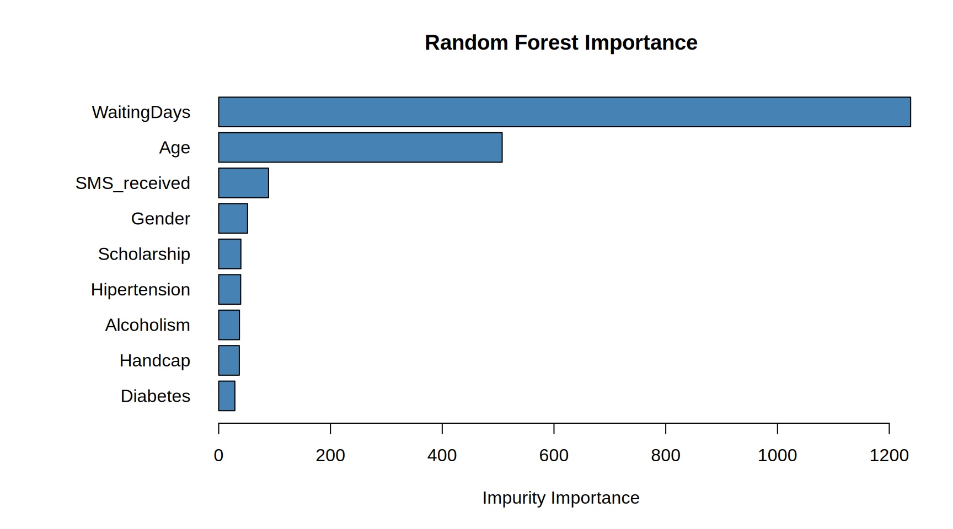
Feature Importance and New-Patient Output
Random Forest importance (impurity)
XGBoost importance (gain)
WaitingDays and Age have the highest XGBoost gain. Importance shows model use, not causation; the two scales differ.
Fictional patient: Age 28, Gender M, Scholarship 0, Hipertension 0, Diabetes 1, Alcoholism 0, Handcap 4, SMS_received 0, WaitingDays 20.
More probable outcome (50% rule): Attended for both models.
Follow-up flag (validation threshold): flagged by both (RF: 27.64% missing ≥ 22%; XGBoost: 39.40% missing ≥ 24%). A flag does not mean missing is more likely.
Hospital Appointment Management & Patient Attendance Analysis Using R
10
Notes:
Probabilities come from the report (new appointment, fictional patient). The 50% rule gives the more probable outcome; the follow-up flag uses the validation thresholds (0.22 RF, 0.24 XGBoost). The demonstration does not validate the model. Diabetes is coded 0 or 1.

Slide 11
R Markdown, Saved Outputs and Limitations
Tools and outputs
Limitations
The working data may be a subset of the original dataset, so coverage is incomplete.
Personal and operational factors that affect attendance are missing (for example transport and urgency).
Historical patterns may not transfer to other hospitals or later dates.
The SMS indicator does not establish reading or causation, and must be known when a prediction is made.
Moderate precision creates unnecessary follow-up flags.
Predictions are uncertain; calibration, subgroup performance and external validation remain to be assessed.
Analysis ran in R (4.6.1) in Google Colab, with ranger and xgboost.
R Markdown combines narrative, code, tables, graphs and saved results into one HTML report.
The report renders saved results without retraining; saved models, comparison results and prediction outputs are kept with it.
Git version control: pending. The report notes that version history must be maintained separately; no repository evidence was supplied.
Hospital Appointment Management & Patient Attendance Analysis Using R
11
Notes:
Git is marked pending because the report states version control is maintained separately and no repository evidence was supplied. Do not describe Git as completed unless a repository is shown.

Slide 12
Conclusion and References
Conclusion
References
Medical Appointment No Shows dataset (Kaggle); working file KaggleV2-May-2016.csv.
Wright, M. N., & Ziegler, A. (2017). ranger: A fast implementation of random forests for high dimensional data in C++ and R. Journal of Statistical Software, 77(1), 1–17. https://doi.org/10.18637/jss.v077.i01
Chen, T., & Guestrin, C. (2016). XGBoost: A scalable tree boosting system. Proceedings of the 22nd ACM SIGKDD International Conference on Knowledge Discovery and Data Mining. https://doi.org/10.1145/2939672.2939785
R Core Team (2026). R: A Language and Environment for Statistical Computing, version 4.6.1. R Foundation for Statistical Computing, Vienna, Austria.
R packages used for the report: rmarkdown 2.32 and knitr 1.52 (documentation).
Both models estimate attending and missing probabilities and provide follow-up flags.
Validation selects follow-up thresholds; test results report probability quality and missed-appointment detection.
The project is a research prototype. It does not show improved hospital efficiency or reduced no-shows.
Practical use needs external validation and an assessment of follow-up costs and benefits.
Hospital Appointment Management & Patient Attendance Analysis Using R
12
Notes:
Conclusion is limited to a research prototype. References are taken from the final report.

