Slide 1
Perishable Food Monitoring throughout the Supply Chain
Team Challengers

Slide 2
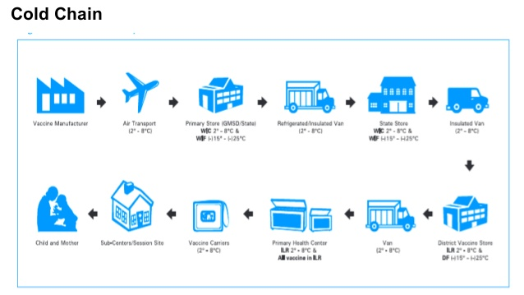
WHAT IS COLD CHAIN?
Cold Chain is a system of storing and transporting food or vaccine at the recommended temperature range from point of manufacture to point of use

Slide 3
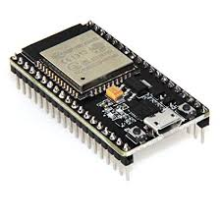
HARDWARES
ESP 32
DHT 11
RTC MODULE
GPS MODULE
MQ135

Slide 4


SOFTWARES
IBM CLOUD
NODE RED
MIT APP INVENTOR
ARDUINO IDE

Slide 5
ESP 32 FEATURES
Two independently-controlled CPU cores with adjustable clock frequency, ranging from 80 MHz to 240 MHz
+19.5 dBm output at the antenna ensures a good physical range
Classic Bluetooth for legacy connections, also supporting L2CAP, SDP, GAP, SMP, AVDTP, AVCTP, A2DP (SNK) and AVRCP (CT)
Support for Bluetooth Low Energy (BLE) profiles including L2CAP, GAP, GATT, SMP, and GATT-based profiles like BluFi, SPP-like, etc
Bluetooth Low Energy (BLE) connects to smart phones, broadcasting low-energy beacons for easy detection
Sleep current is less than 5 μA, making it suitable for battery-powered and wearable-electronics applications
Integrates 4 MB flash
Peripherals include capacitive touch sensors, Hall sensor, low-noise sense amplifiers, SD card interface, Ethernet, high-speed SPI, UART, I2S and I2C
Fully certified with integrated antenna and software stacks

Slide 6
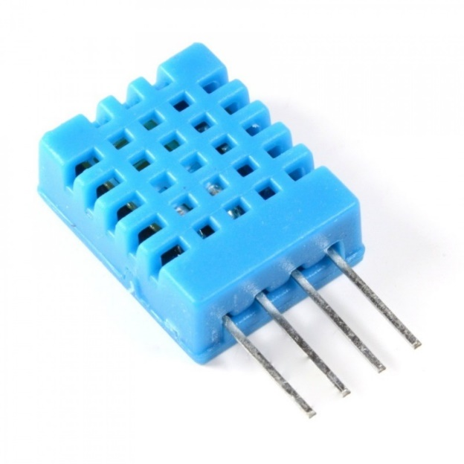
DHT 11
The DHT11 is a basic, ultra low-cost digital temperature and humidity sensor. It uses a capacitive humidity sensor and a thermistor to measure the surrounding air, and spits out a digital signal on the data pin (no analog input pins needed).

Slide 7
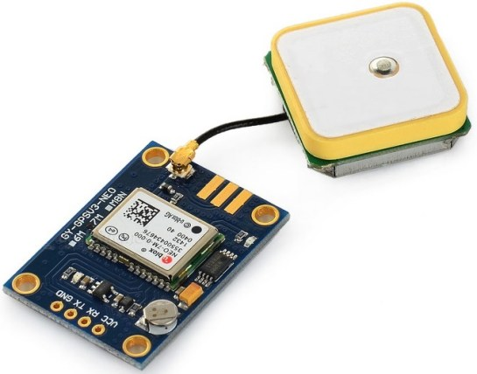
GPS MODULE
Global Positioning System (GPS) is a satellite-based system that uses satellites and ground stations to measure and compute its position on Earth.
GPS is also known as Navigation System with Time and Ranging (NAVSTAR) GPS.
GPS receiver needs to receive data from at least 4 satellites for accuracy purpose. GPS receiver does not transmit any information to the satellites.

Slide 8
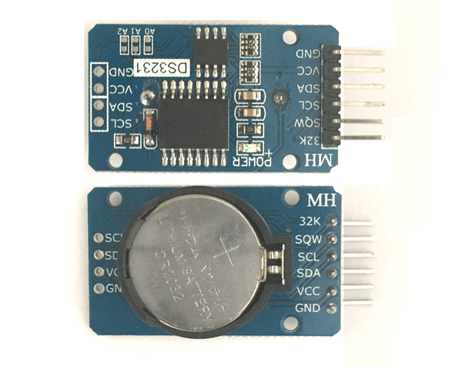
RTC MODULE
RTC means Real Time Clock. RTC modules are simply TIME and DATE remembering systems which have battery setup which in the absence of external power keeps the module running. This keeps the TIME and DATE up to date. So we can have accurate TIME and DATE from RTC module whenever we want.

Slide 9
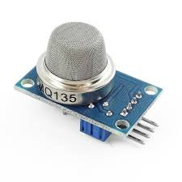
MQ135
Air Quality Sensor (MQ135) Description: Air quality sensor for detecting a wide range of gases, including NH3, NOx, alcohol, benzene, smoke and CO2. Ideal for use in office or factory.MQ135 gas sensor has high sensitivity to Ammonia, Sulfide and Benzene steam, also sensitive to smoke and other harmful gases.

Slide 10
DESCRIPTION
Initially the values of all the sensors are sent to the IBM cloud
Let us assume that there are 10 boxes to be monitored in a container
So there will be a product for each box working as a slave
There will be the master so it will gather all the data from the slaves
If there is any disturbance in one of the box i.e. change of temperature then there will be a immediate precaution that there is some problem with the box

Slide 11
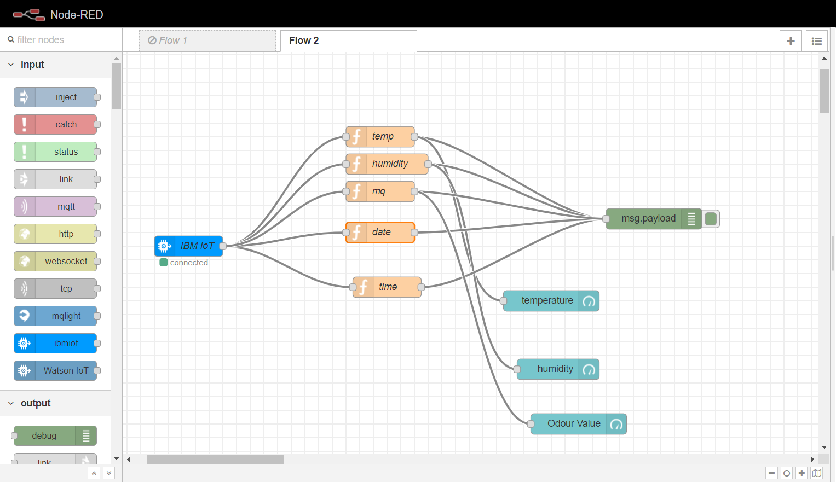
NODE RED FLOW

Slide 12
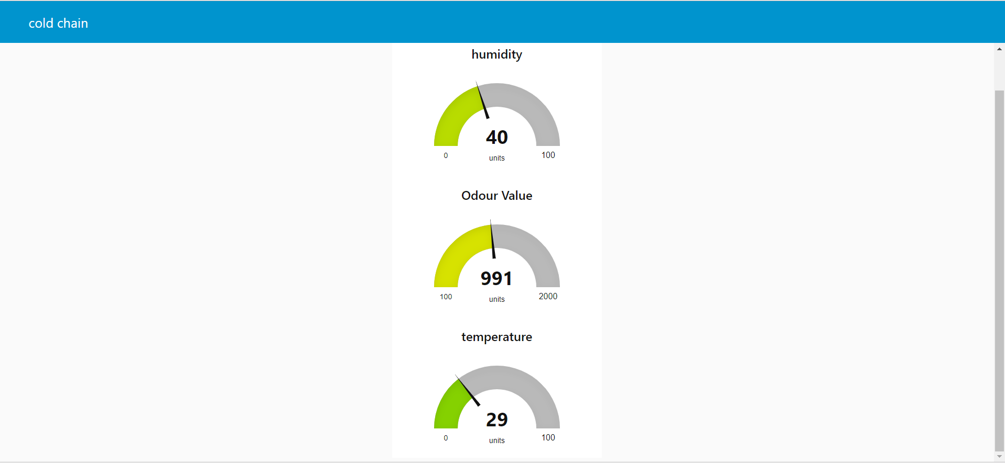
OUTPUT

Slide 13
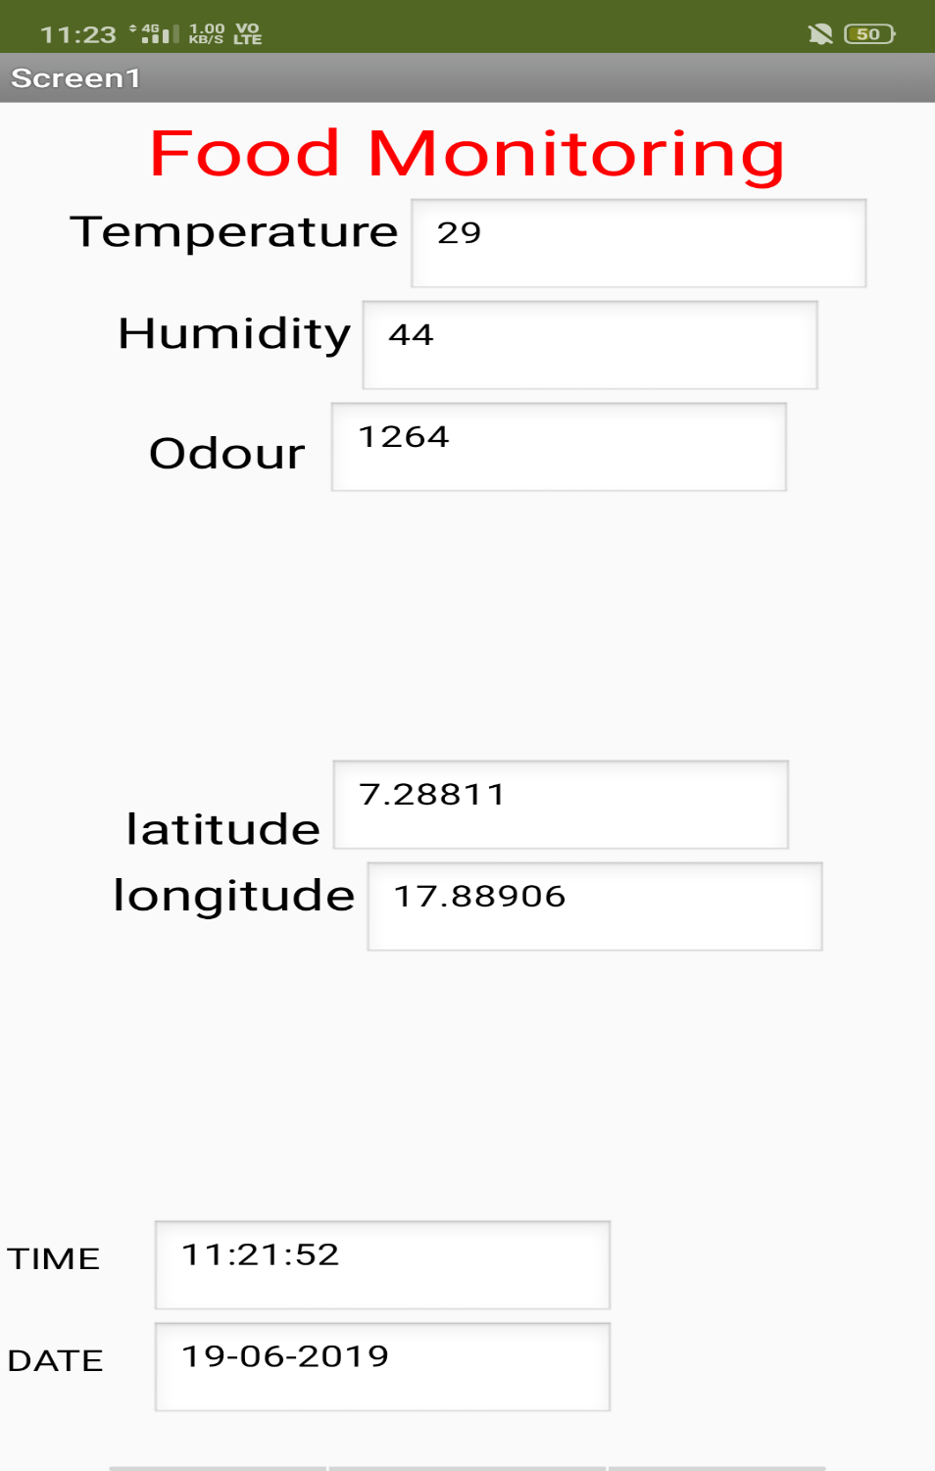

Slide 14
ADVANTAGES
As the perishable foods tends to more economic loss so we can easily reduce the economic loss
Perishable food safety is increased and the loss of food is reduced

Slide 15
FUTURE SCOPE
As this project is only for monitoring in future we can use coolants to automatically maintain the temperature or humidity whenever there is disturbance in the particular box so by this we can maintain a reqired temperature everytime and this would reduce the economic loss

Slide 16


