Slide 1
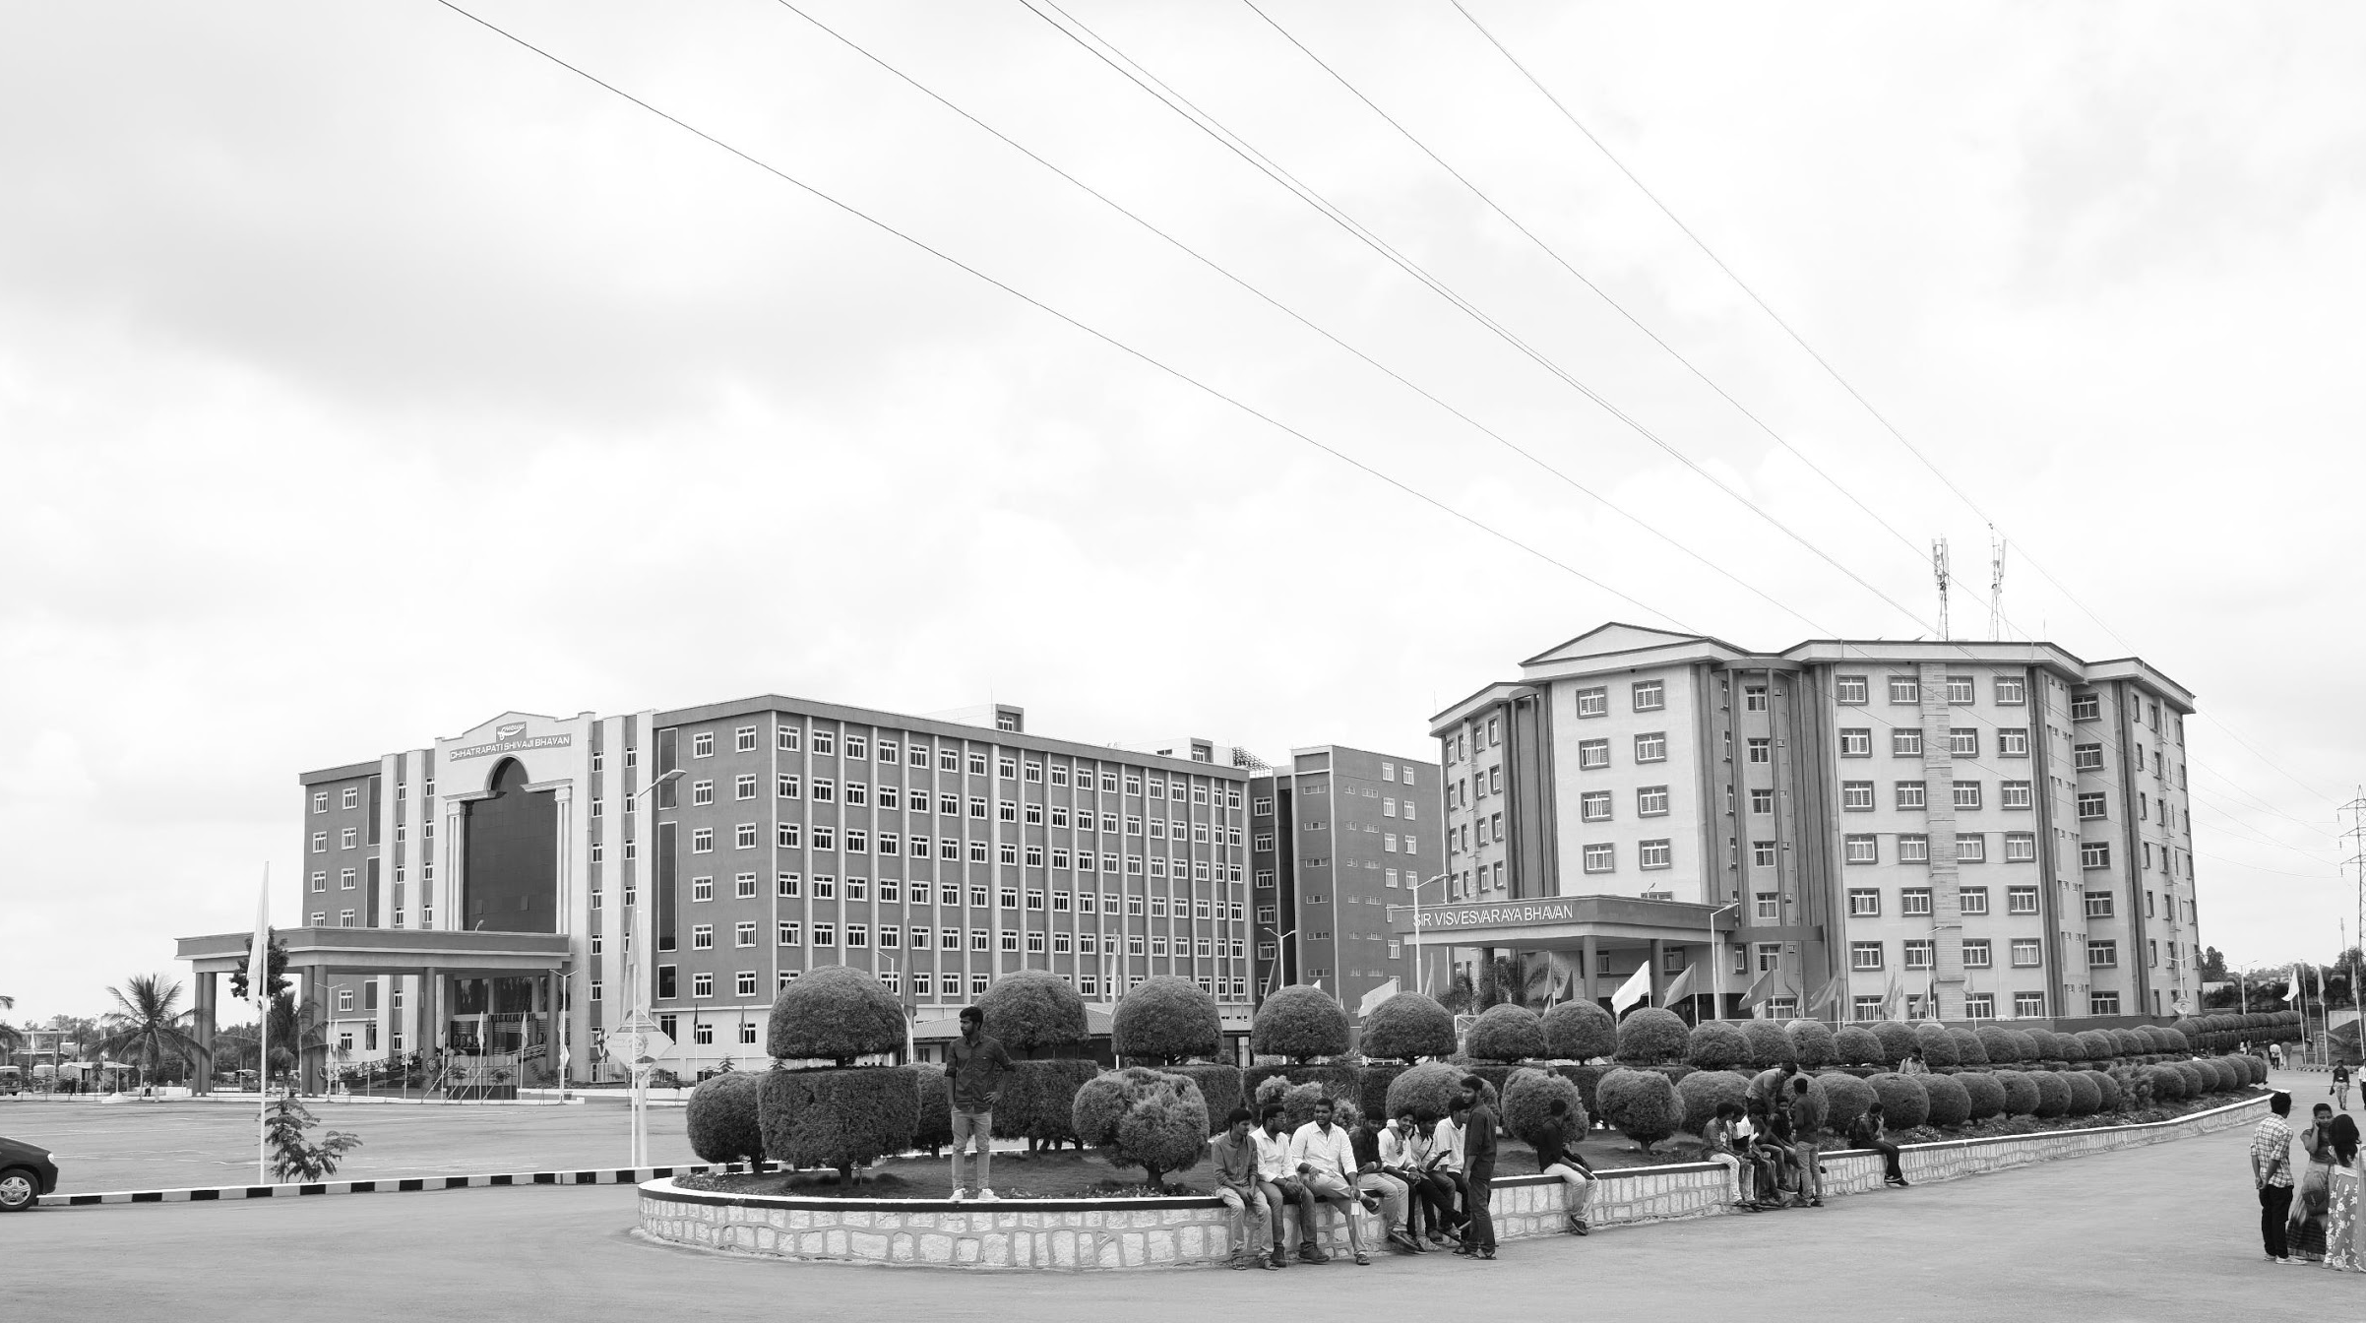

Development of Finger PPG Sensor to address Heart Rate Anomalies
Review-I
AY 2025-26
Capstone Project – Introduction (PROJ2999)
GITAM (Deemed-to-be) University
Department of Electrical Electronics and Communication Engineering
Project Team:
HARSHITHA:BU22EECE0100300
MEGHANA:BU22EECE0100339
SINCHANA:BU22EECE0100441
Project Mentor: Dr Kshitij Shakya
Project In-charge: : Dr Kshitij Shakya
www.gitam.edu

Slide 2
Objective and Goals
Objective
Brief Description
The Finger PPG sensor uses a simple, non-invasive optical technique that employs LEDs and photodetectors to track volumetric changes in blood flow in the finger. The sensor signals are processed using KiCad-designed electronics and software algorithms to detect irregular heartbeats and potential cardiovascular anomalies. The sensor is designed for ease of use, portability, and real-time monitoring, catering to diverse environments and users needing continuous health surveillance.
Goals
Main Goals
Compact hardware design
Real-time signal processing
User-friendly for field use
Continuous heart rate tracking
Early cardiovascular anomaly detection
Additional Goals
Low power consumption
Scalable and cost-effective
Enhanced motion performance
Wireless data connectivity
Easy maintenance and calibration.

Slide 3
Project Plan (Clearly mention milestone for objectives under each reviews)
Objective | Milestone Description
Hardware Design | Schematic design and component selection
Signal Processing | Develop /test signal algorithms
Prototype Assembly | Build and test first prototype
User Testing | Usability testing and feedback
Final Deployment | Integrate, review, and deploy

Slide 4
Literature Survey
Key Publications
Google scholar research best 6-8 papers
https://iopscience.iop.org/article/10.1088/1361-6579/ada246/meta
https://onlinelibrary.wiley.com/doi/abs/10.1002/9781394275588.ch8
https://www.sciencedirect.com/science/article/pii/S0263224124013319
https://link.springer.com/article/10.1007/s11277-017-4777-z
https://onlinelibrary.wiley.com/doi/abs/10.1002/lpor.202401992
https://pmc.ncbi.nlm.nih.gov/articles/PMC6426305/
Key Resources – Whitepaper| Application Notes | Datasheet| Others
Photoplethysmography (PPG) Sensor Datasheet
https://support.pluxbiosignals.com/wp-content/uploads/2022/10/Photoplethysmography-PPG-Sensor_Datasheet.
pdf �PPG Sensor System Architecture Whitepaper: https://www.cs.tau.ac.il/~nin/Courses/Workshop12a/PPG%20Sensor%20System.pdf
�Development of a PPG Sensor Array as a Wearable Device (Master's Thesis
https://scholarworks.wmich.edu/cgi/viewcontent.cgi?article=6349&context=masters_theses
Existing Implementations – Products| Opensource| GitHub etc
Pulse-PPG: Open-source field-trained PPG model:
https://arxiv.org/html/2502.01108v2
Seeing Red: PPG biometrics using smartphone cameras (GitHub open source):
https://github.com/ssloxford/seeing-red
Awesome PPG – Curated list of PPG libraries, datasets, and resources:
https://github.com/mintisan/awesome-ppg

Slide 5
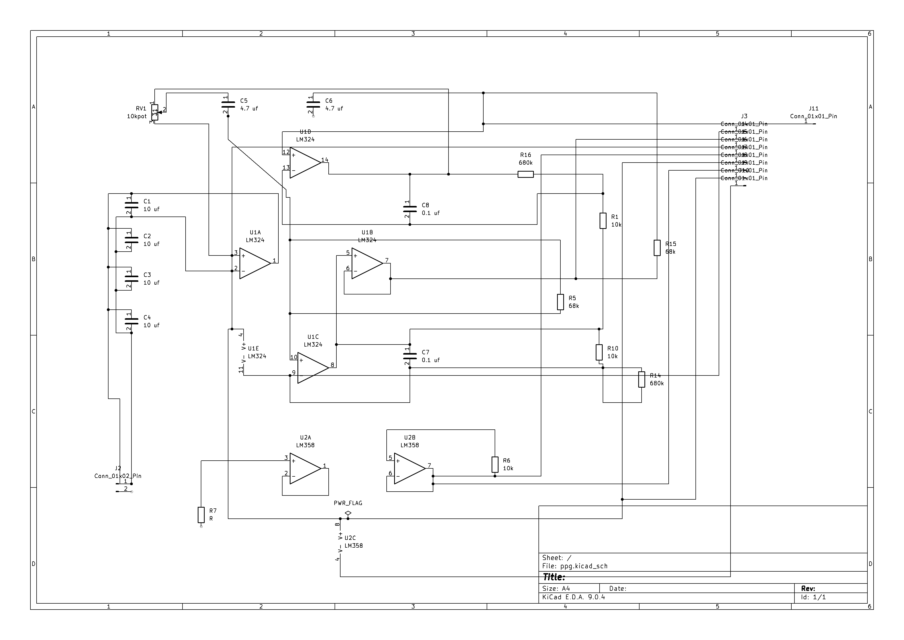
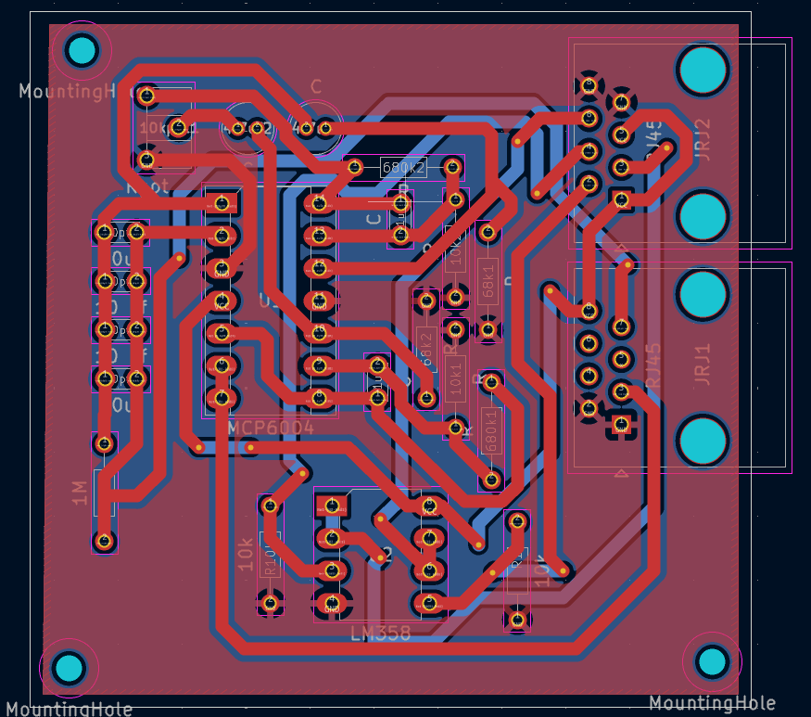
Architecture
Structural Diagram
Block Diagram/Pin Diagram
Resource -
Behaviour Diagram
Flow chart/ State machine
Resource -

Slide 6
Use Cases & Testing
USES CASES | TEST CASES
Daily heart monitoring | Rest/activity accuracy
Field health monitoring | Noise immunity
Remote patient care | Placement testing
Fitness tracking | Data output validation
Research experiments | Temperature/humidity test

Slide 7
Implementation and Results – Iteration 1
Iteration 1 : Results
*Schematic design in KiCad
*PCB layout from schematic
*Systematic component organization
*Initial circuit large size
*Goal: miniaturization
*Wearable, compact device aim
*Non-intrusive data collection
*Focus: efficiency, accuracy, wearability

Slide 8
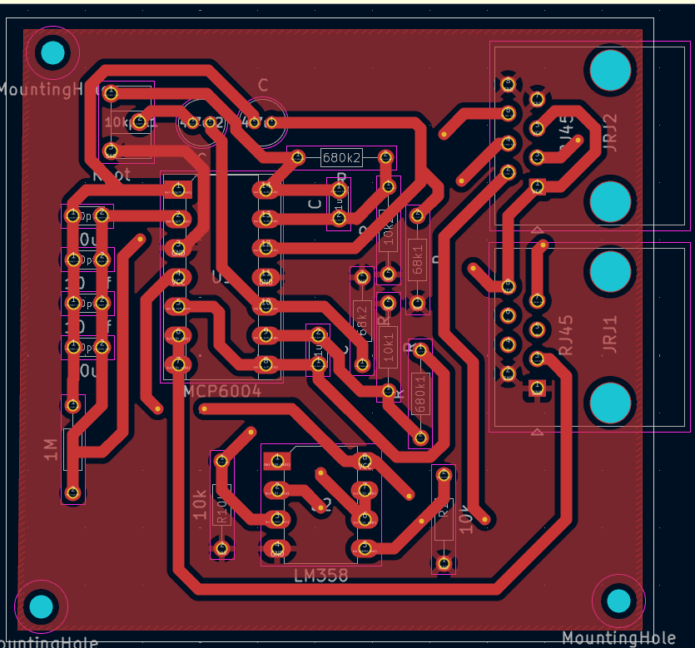
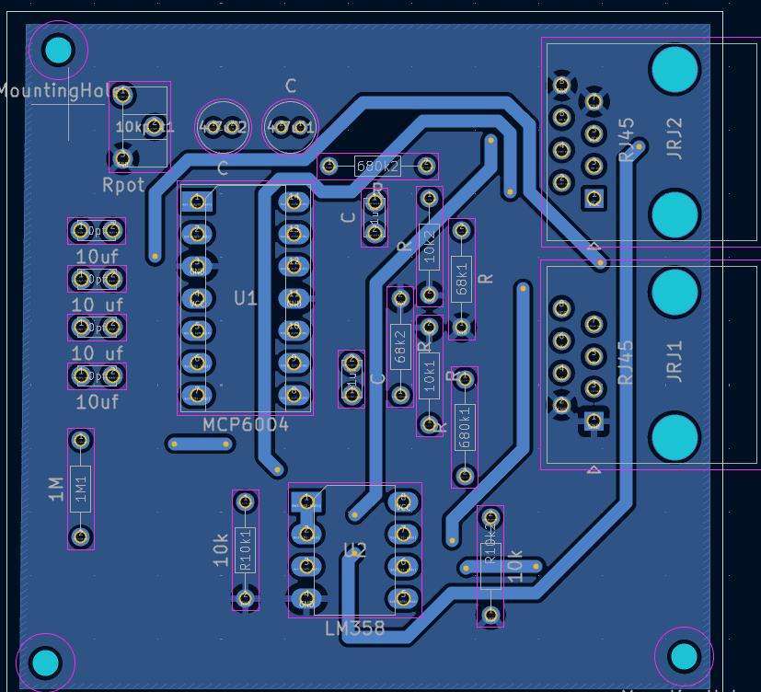
Implementation and Results – Iteration 2
Iteration : Results + Validation against the use cases and test cases
*Miniaturized circuit fabricated
*Usability tested (finger/neck)Use case-based validation
*Real-time data, multi-condition testing
*Reliable heart signals, consistent performance
*Feedback guided optimization

Slide 9
Conclusion & Future Work
Summary and Conclusion
*Completed the initial design and prototyping of the finger PPG sensor circuit using KiCad workflow, moving from schematic to PCB layout and real hardware.
*Achieved reliable heart rate detection validated with multiple test conditions and real-user scenarios.
*Demonstrated that continuous monitoring is feasible with the current design, offering valuable support for both regular users and demanding use cases like soldiers and field workers.
*Identified challenges such as the need for size reduction and improved integration with wearable formats
Future Work
*Further miniaturization
*Enhanced wearability
*Advanced validation
*Broader field testing
*Performance optimization
*Multi-parameter monitoring
*User feedback integration

Slide 10
THANK YOU
Have a Great Day !

