Slide 1


NPC Dialogue Chatbot
Guide: Dr. Graceline Jasmine
Sree Harshitha | 21BAI1029

Slide 2
Project Overview
Designed to create interactive AI-driven NPC conversations. The system enables NPCs to engage in dynamic dialogue with players and other NPCs
Problem Statement
Use Case
Requirements
To build an AI-powered chatbot that allows NPCs in Unity to have realistic and dynamic conversations with players. This will make NPC interactions feel more natural and engaging, creating a more immersive gaming experience where players can talk to NPCs in a meaningful way.
Virtual AI powered Sales Agent Using Google Dialogflow CX, Text-to-Speech (TTS) API, and Speech-to-Text (STT) API, the NPC chatbot processes player input, generates dynamic responses, and delivers them with realistic voice output while enabling seamless two-way conversations.
NPCs generate context-aware responses
Two-way conversations.
NPC to NPC interactions
NPC actions and facial animations.

Slide 3
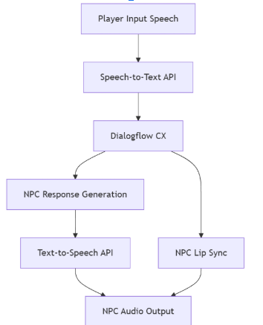
Tech Stack and Integration
Tech Stack
Google Dialogflow CX – For natural language understanding (NLU) and generating intelligent NPC responses.
Google Text-to-Speech (TTS) & Speech-to-Text (STT) APIs – To enable realistic voice output and player voice input processing.
Meta Occulus– lip-sync animations
Rationale
I initially tried using different local LLM models, but the latency was low, and I couldn't train them on specific data. The models also struggled with context and accuracy. These problems were resolved by using Google Dialog Flow CX, which offers faster response times and can easily be trained on specific data, providing more accurate and dynamic conversations.
Scalability: Dialog Flow CX handles multiple NPCs and interactions efficiently.
Flexibility: Easy to update and adapt dialogue for various inputs.
Trade-offs: Requires internet and may have slight latency, but offers faster, more accurate responses than local models.

Slide 4
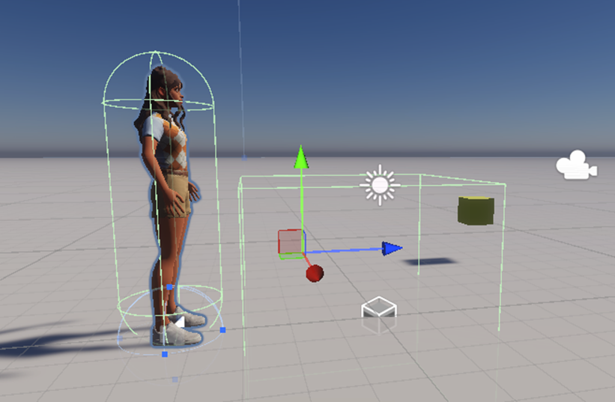

Slide 5
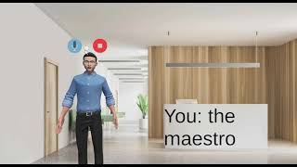
Questionnaire

Slide 6
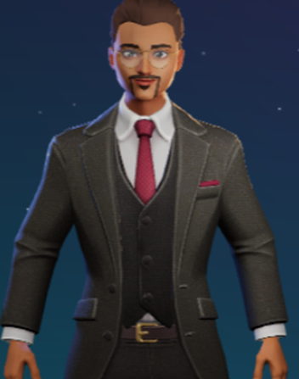
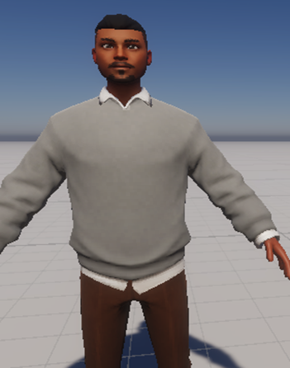
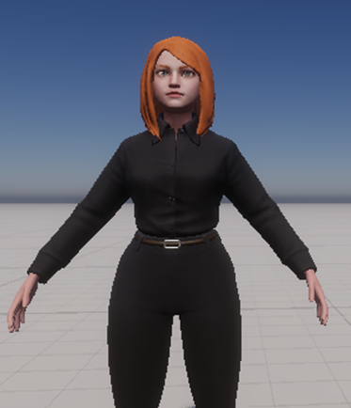
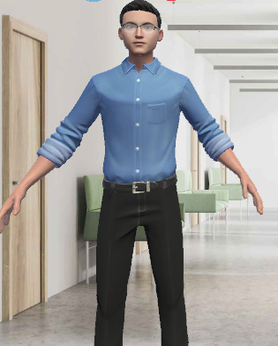
Personalities
Name: Sam
Profession: Sales Manager
fluent in English, Hindi, Telugu, and Tamil, and always answer diligently with a calm and composed demeanor.
subtle sales agent who occasionally shares opinion on vehicles.
Name: Revi
Profession: Researcher works on developing electric scooter
Characteristics:
Rude and Savage to everyone else except Lia
Friend of Lia
Lazy
Always chilling at cafeteria
Name: Lia
Profession: Team leader
Characteristics:
Sweet, kind, gentle
Best friend Revi
Likes Novels
Diligent
Name: John
Profession: Receptionist
Can show you path in the office

Slide 7
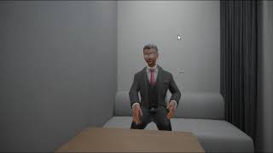
Multilingual

Slide 8

NPC to NPC

Slide 9
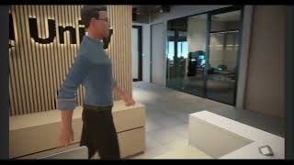
Asking NPC to show me path

Slide 10
Planned
Accomplished
Goal 1
Brainstorm, Working with local LLMs
Outcome 1
Goal 2
Tested with different Local LLMs result was low accuracy, low latency, could not train with specialized dataset
To use any cloud based model
Outcome 2
Goal 3
used Google dialogflow - responses were fast, accurate. Added TTS and STT API
Add Multiple NPCs, Add Triggers, Add Personalities to NPCs, Add Actions relevant to each npc
Outcome 3
Goal 4
NPC when they encounter each other they start conversation, perform any action, respond
Add Facial Animations, Add memory, backstory, Multilingual support

Slide 11
Future Scope
Market Integration: The system could expand into industries like e-commerce, education, and training simulations, offering dynamic NPC interactions for better customer engagement and learning experiences.
Expansion Opportunities: Integrating with voice assistants, virtual reality (VR), and AR platforms could enhance immersion
Additional Features: Future updates could include procedural dialogue generation, more emotion-driven interactions, and multilingual support for global reach.

Slide 12
Week 3
Week 2
Setup & Basic NPC Interactions
Milestone: Create multiple NPCs and basic interaction triggers.
Add 3-5 NPCs to the game world.
Set up interaction triggers for NPCs to detect each other and initiate conversations.
Test the basic functionality of NPCs interacting upon encountering each other.
NPC Personalities & Actions
Milestone: Implement NPC personalities and corresponding actions.
Add personality types (e.g., friendly, rude, neutral) to NPCs.
Define NPC actions (e.g., wave, talk, ignore).
Test the system to ensure NPCs interact based on personality and take appropriate actions when meeting another NPC.
Dialogue Integration & Actions
Milestone: Integrate dynamic dialogue responses and action triggers.
Program dynamic conversations between NPCs based on their personalities.
Ensure actions are triggered during conversations (e.g., one NPC might walk away, another might start a conversation).
Milestone: Final testing and refinement of the NPC interactions system.
Test multiple NPC encounters in various scenarios to ensure dialogue and actions work as expected.
Week 1
Monthly Roadmap
Week 4
Page #

Slide 13
Thank you

