Slide 1

Digital Assignment -2
Object detection using YOLO in Real-time
Kambala Sree Harshitha
21BAI1029

Slide 2
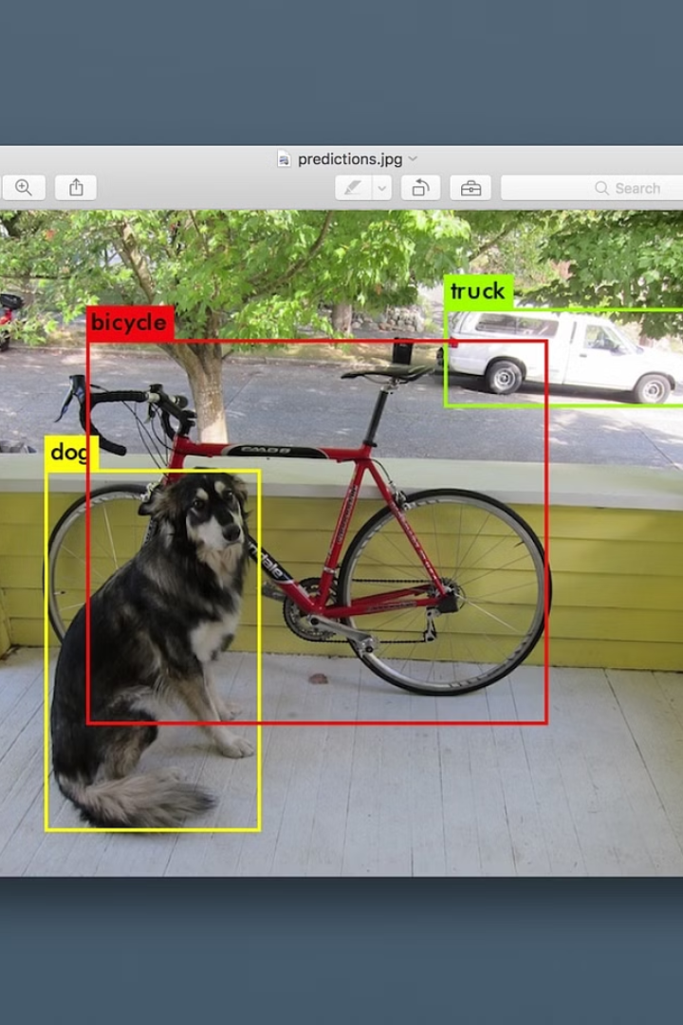
Introduction
In this project, we delve into the realm of enabling computers to perceive the world much like humans do – by detecting objects in real-time videos or images. Our focus lies on employing YOLO (You Only Look Once), a highly efficient object detection technique, to train a system adept at recognizing various objects swiftly. The noteworthy advantage of YOLO is its ability to keep pace with the rapid flow of video streams, making it an ideal candidate for real-time applications.

Slide 3
Objectives
Real-time Object Detection with YOLO in videos or images.
High Accuracy Object Recognition: Training the YOLO system to achieve high accuracy in recognizing various objects.
Efficiency in Object Detection: Ensuring the YOLO implementation is efficient enough to handle the processing demands of real-time video streams.
This work investigates how YOLO can be optimized for real-time object detection while considering potential trade-offs between speed and accuracy. By utilizing its efficient single-stage architecture, the project aims to develop a solution suitable for resource-constrained environments and applications demanding fast response times.

Slide 4
Related work and its limitations
https://www.ijisrt.com/assets/upload/files/IJISRT22AUG337_(1).pdf
https://www.ijeat.org/wpcontent/uploads/papers/v8i3S/C11240283S19.pdf
https://www.eurchembull.com/uploads/paper/b07a24c39913c1e8f1bec902731e7898.pdf
LIMITATIONS
While R-CNN delivers high accuracy, its slowness and complexity limit its real-world use.
SSD offers a speed boost but sacrifices some accuracy, especially for smaller objects.
Faster R-CNN improves on R-CNN's speed but remains slower than YOLO and can have accuracy issues based on proposal quality.
In essence, all three models have trade-offs between speed, accuracy, and complexity for real-world object detection.

Slide 5
Datasets and Attributes
Objects365: Focuses on associating images with descriptive captions.
GQA: Focuses on using images to answer open-ended or factual questions.
Flickr30K Entities: Focuses on recognizing and describing entities within images and their relationships.
These datasets all fall under the category of vision-language datasets, but they differ in the specific way they combine visual and textual information

Slide 6
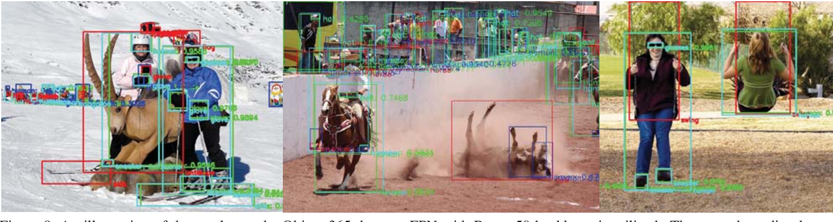
Objects365
Images: 30,000 images.
Visual: Image itself (likely in JPEG or PNG format).
Textual: 5 descriptive captions associated with the image. These captions could describe objects, actions, or the overall scene in the image.

Slide 7
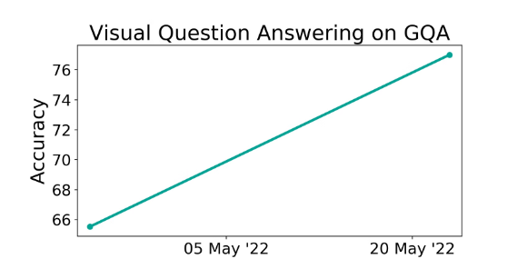
GQA (General Question Answering)
GQA (General Question Answering): Data: Not strictly images, but a combination of images and questions about those images. Attributes: Visual: Images (format likely JPEG or PNG). Textual: Questions: Questions posed about the content of the images. ("What is happening in this image?"), or more factual ("What color is the car?"). Answers: These answers could be single words, phrases, or even paragraphs depending on the complexity of the question.

Slide 8
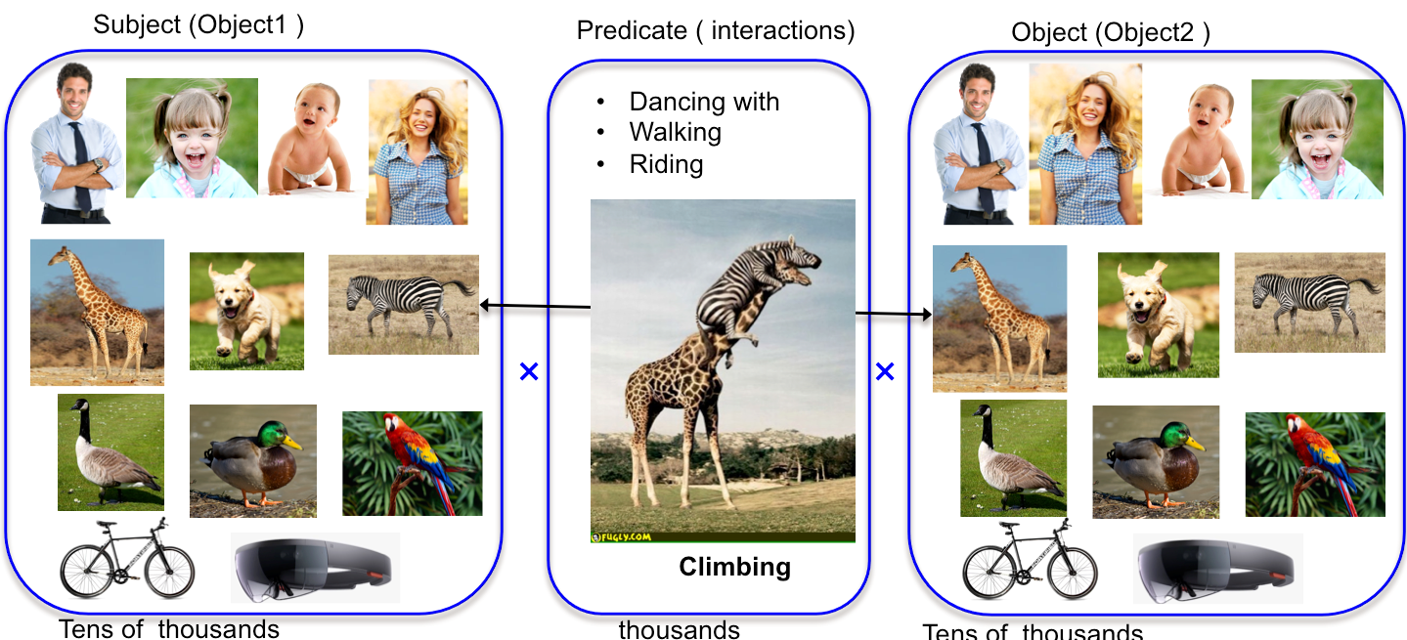
Flickr30K Entities:
Images: 30,000 images from Flickr.
Attributes per image:
Visual: Image itself (likely in JPEG or PNG format).
Textual:
Entities: A list of named entities (people, places, objects) identified within the image.
Relationships: Relationships between the entities (e.g., "person is riding a bike").
Attributes of entities: Some datasets might additionally include attributes of the entities, such as color, size, or material for objects.

Slide 9
Proposed Methodology (Modifications of the based model)
Fine-Tuning Tricks: Finding ways to adjust the model training process to make it better on a specific task (like focusing on a particular dataset)
Making Data More Varied: Trying different methods to create more variations of existing data, like flipping images or adding noise. This can help the model perform better on new data it hasn't seen before, especially for uncommon objects (rare categories).
Learning with Less Info: We can explore ways to train the model even if the data we have doesn't have super detailed labels (weakly supervised learning). This could be helpful for tasks like segmentation where creating precise labels for everything can be time-consuming.

Slide 10
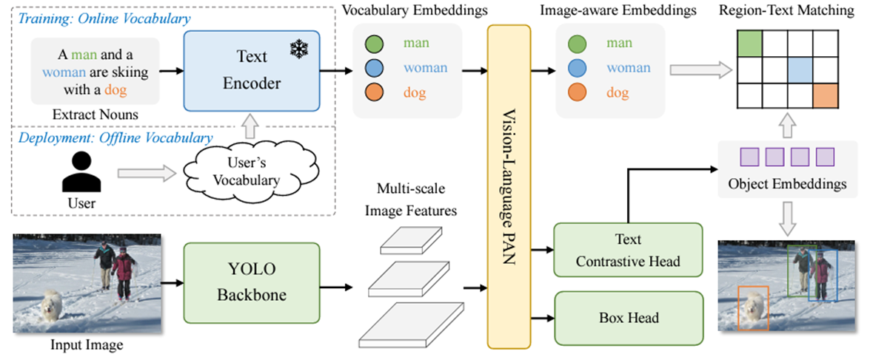
Architecture

Slide 11
Preliminary results
The model can find a wide variety of objects (even without specific training)
Identify specific parts of objects based on your descriptions
The model is capable of identifying a diverse range of objects, even without requiring specific training.
It can identify specific parts of objects based on provided descriptions, allowing for detailed object recognition.
Understand phrases like "the standing person" to locate objects in an image
Initial results suggest this could be useful for many real-world applications
It can understand phrases such as "the standing person" to accurately locate objects within an image.
These initial results indicate that the model could be highly beneficial for a wide range of real-world applications.

Slide 12
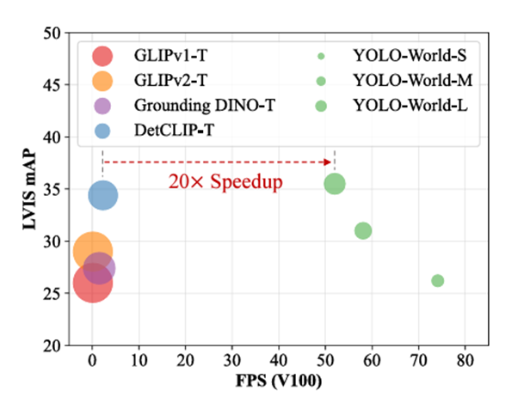
Preliminary results

